Slide 1
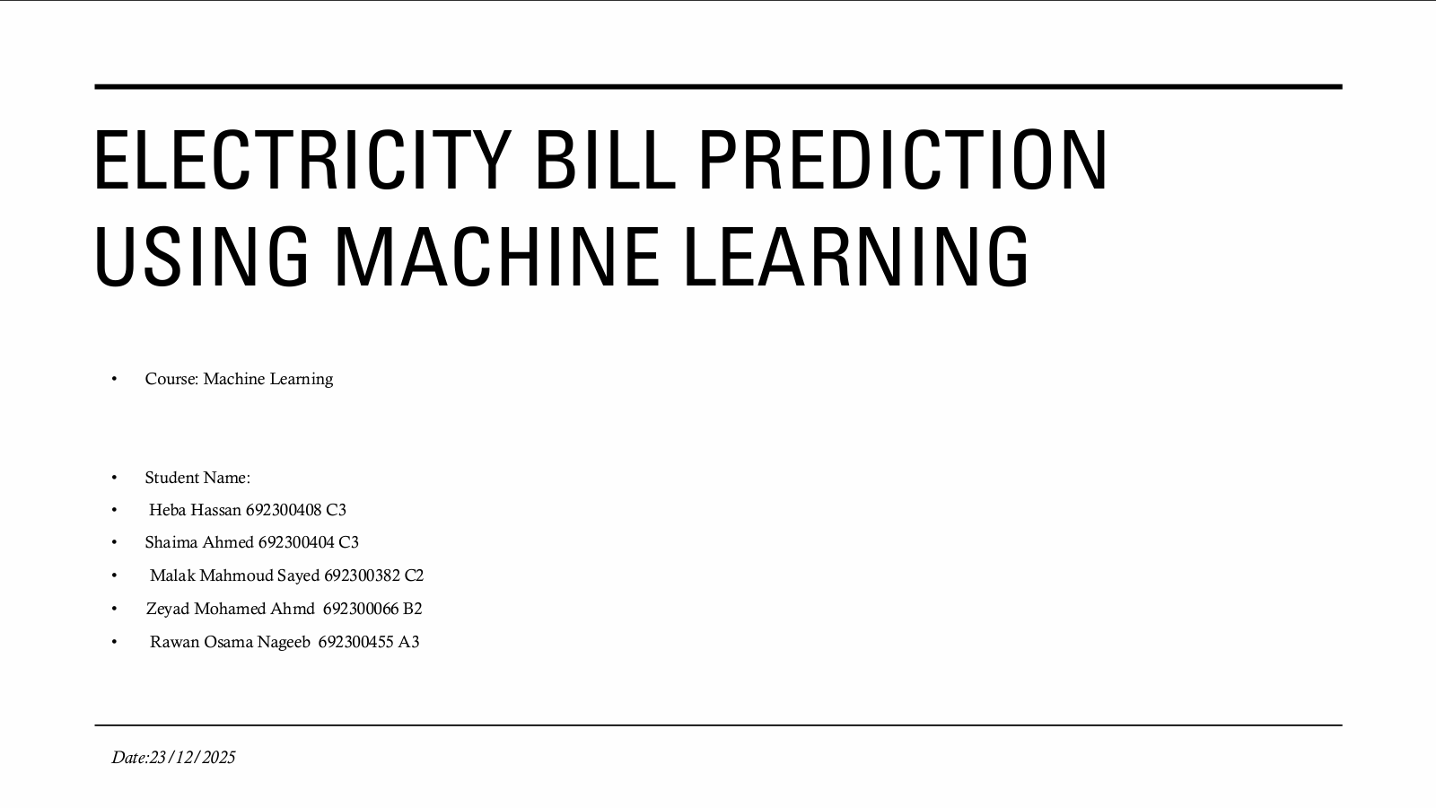
Bank Customer Financial Behavior Clustering
Data-Driven Customer Segmentation for Targeted Marketing Strategies
Zeyad Mohmed Ahmed Refaey
69230066
B2

Slide 2
Project Objectives
Goal: Group customers based on shared financial and behavioral characteristics.
Purpose: To move away from "one-size-fits-all" marketing and create personalized financial products.
Key Question: How can we identify high-value vs. high-potential customers using unsupervised learning?

Slide 3
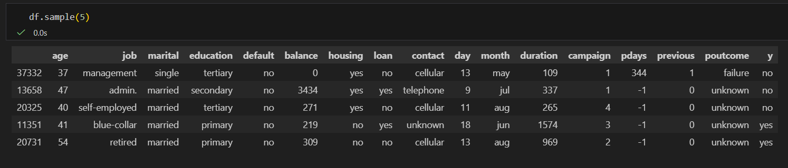
Data Overview
Dataset: Bank-full dataset (45,211 entries).
Key Features: * Demographics: Age, Job, Marital Status, Education.
Financials: Yearly balance, credit default, housing/personal loans.
Campaign: Contact duration, frequency, and previous outcomes.

Slide 4
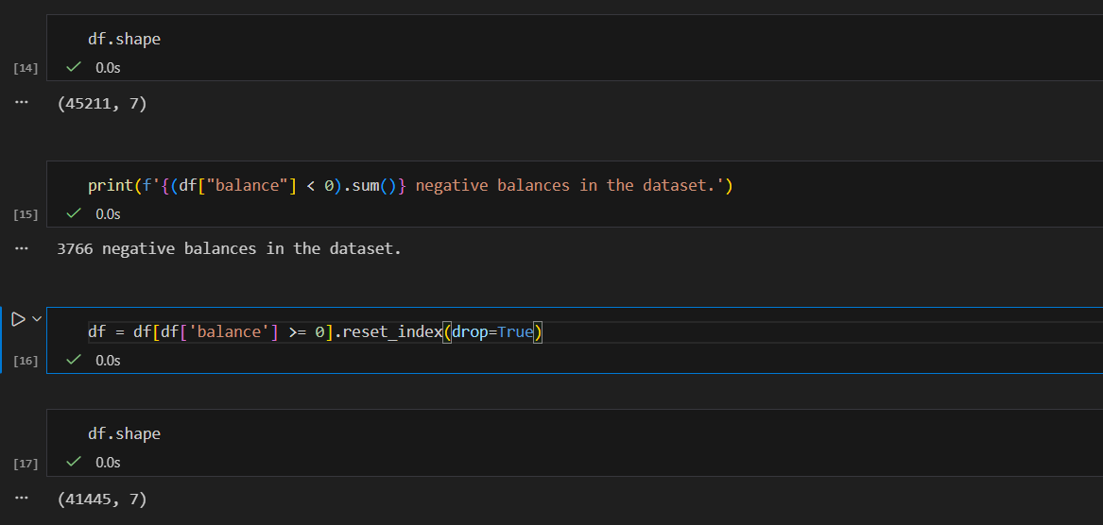
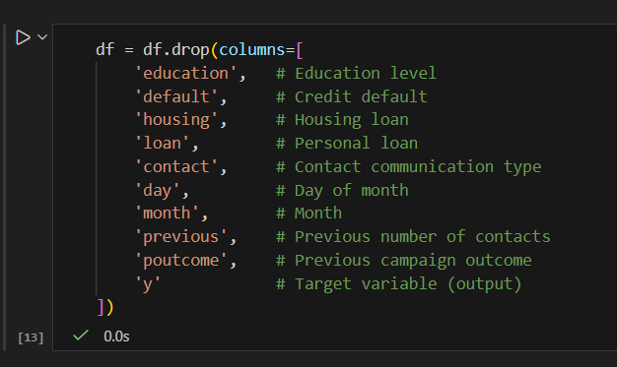
Data Preprocessing Pipeline
Cleaning: Handling missing values and noncorrect Data.

Slide 5
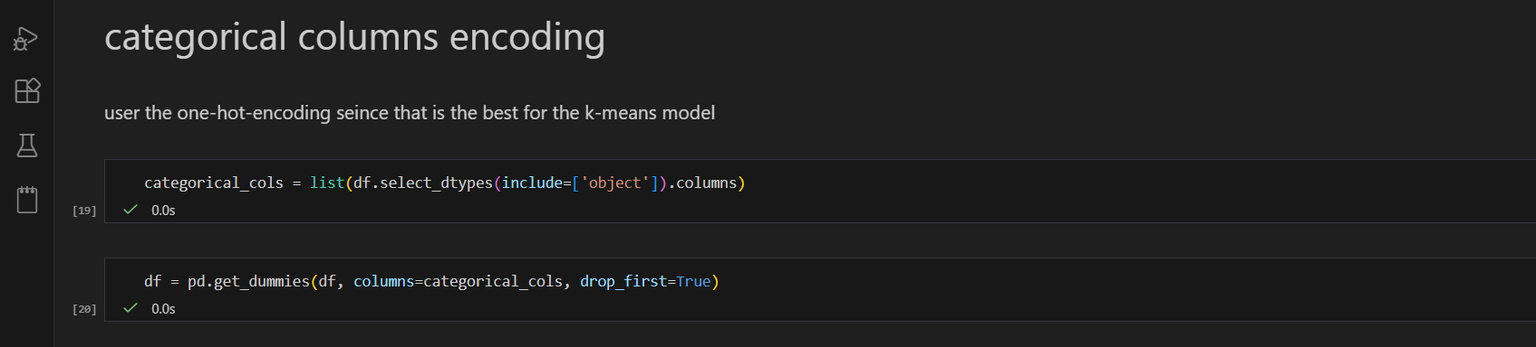
Data Preprocessing Pipeline
Encoding: One-Hot Encoding for categorical variables (Jobs, Marital status, etc.).

Slide 6
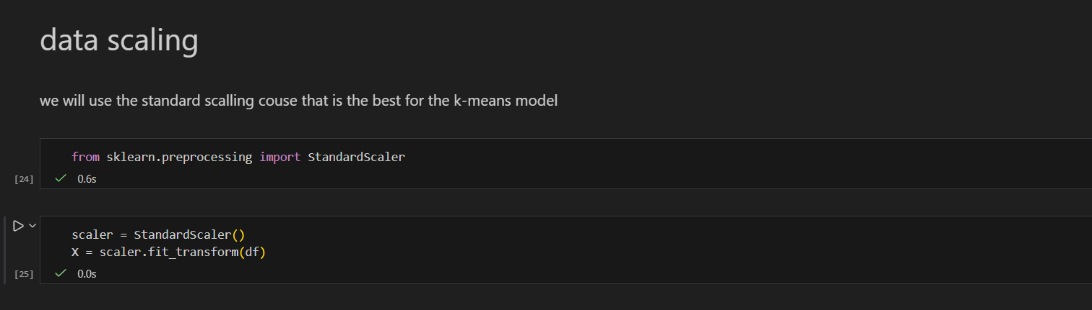
Data Preprocessing Pipeline
Scaling: Standardizing numerical data to ensure "Balance" doesn't overshadow "Age."

Slide 7
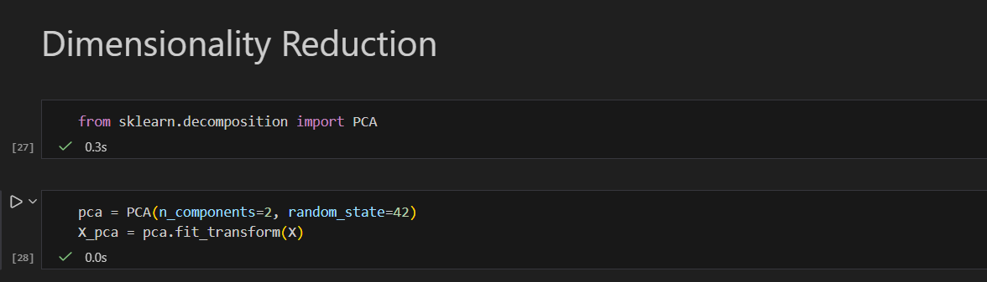
Data Preprocessing Pipeline
Dimensionality Reduction: Using PCA (Principal Component Analysis) to simplify the data while keeping the most important information.

Slide 8
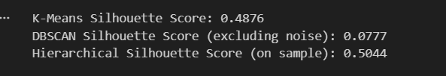
Choosing the Right Model
Algorithms Tested: K-Means, DBSCAN, and Hierarchical Clustering.
Selection Metric: Silhouette Score.
Outcome: Mention that while Hierarchical had a high score, K-Means was selected for its balance of interpretability and efficiency in deployment.

Slide 9
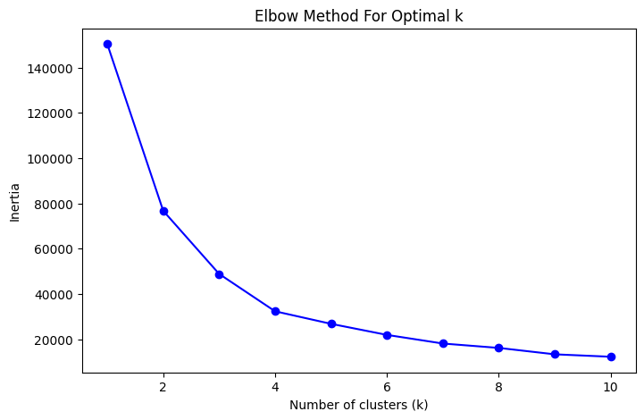
Optimal Clusters (The Elbow Method)

Slide 10
Cluster 2: High-Value Managers: Married, highest balances, tertiary education.
Segment Profiles (Clusters 0–2)
Cluster 0: Stable Working-Class: Married, consistent income, likely to have housing loans.
Cluster 1: Young Professionals: Single, high activity, potential for long-term growth.
Cluster 2: High-Value Managers: Married, highest balances, tertiary education.

Slide 11
Segment Profiles (Clusters 3–4)
Cluster 3: Early-Career Prospects: Students and junior roles, lower current balance but high future value.
Cluster 4: Affluent Retired: High stability, low loan usage, specific wealth management needs.

Slide 12
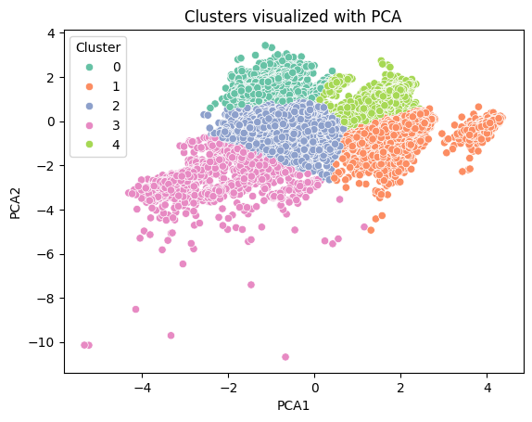
Segment Profiles (Clusters)

Slide 13
Marketing Recommendations
High-Value Managers: Offer investment portfolios and premium credit cards.
Young Professionals: Focus on digital banking, mobile apps, and personal loans for travel/tech.
Retired: Focus on fixed deposits and pension-related financial security.
Working Class: Focus on mortgage refinancing and insurance products.

Slide 14
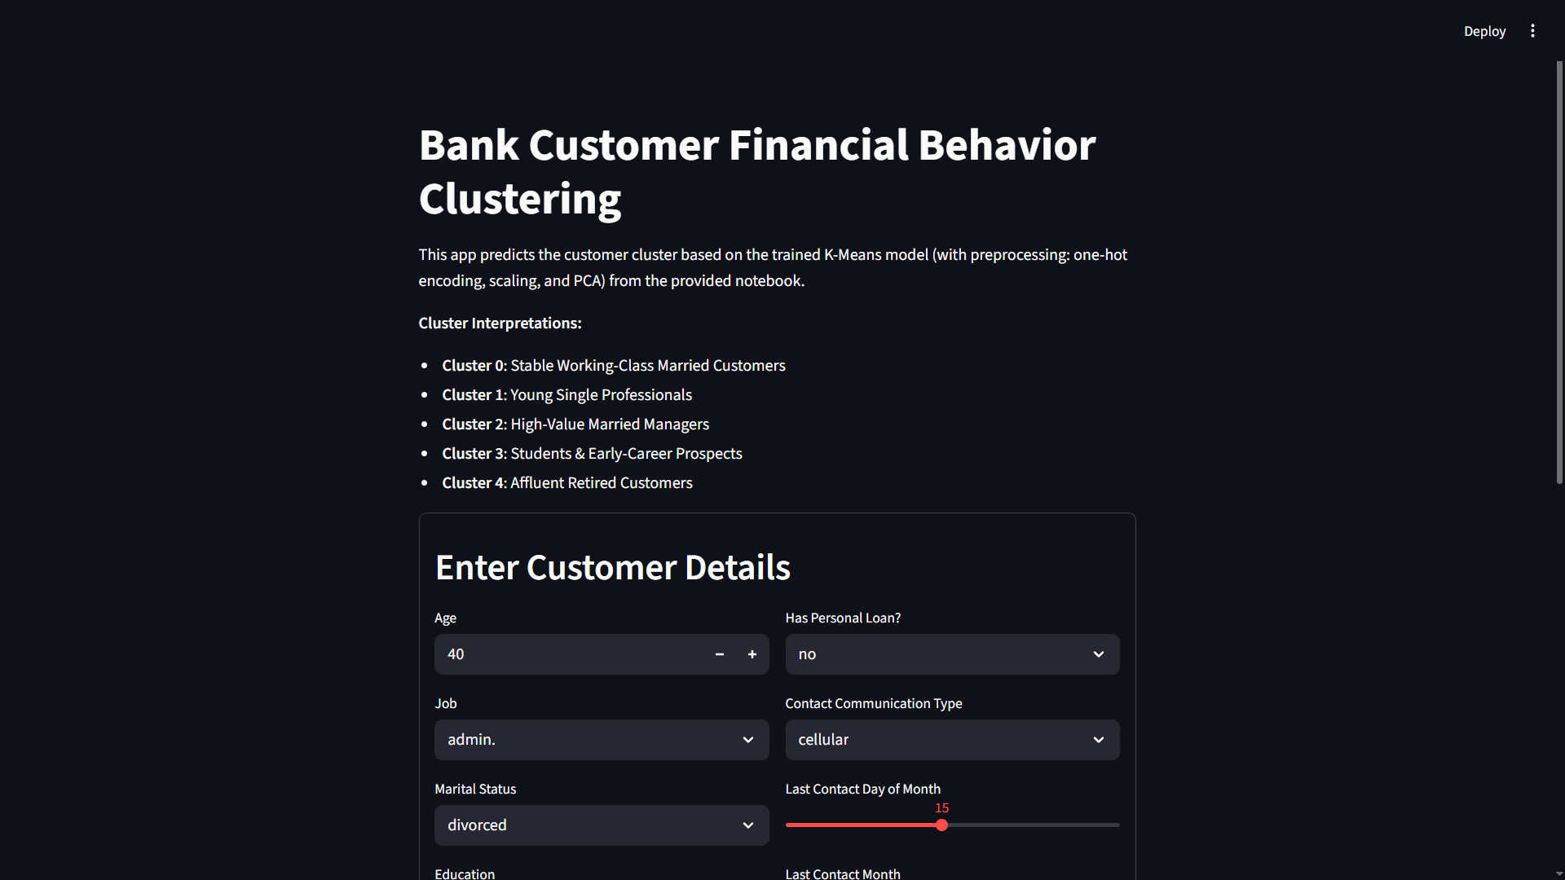
Conclusion & Deployment

Slide 15
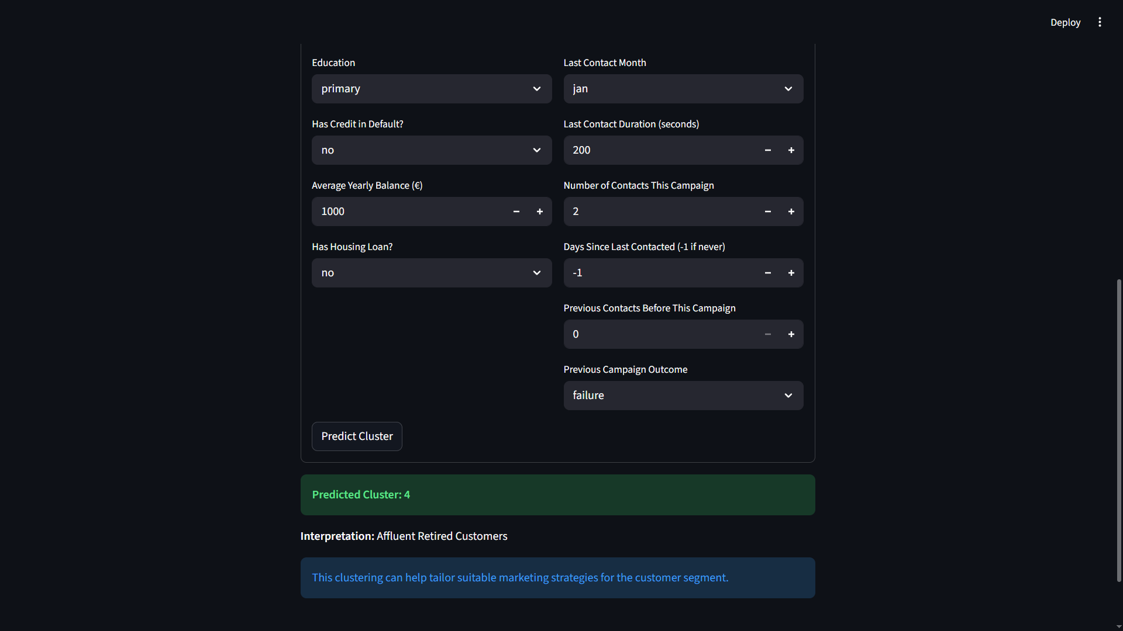
Conclusion & Deployment

