Slide 1
WEARABLE
MOTION/POSITIONING
MONITOR
Adwoa Asare, Tianyi He, Shao-Ju Wang
December 8, 2025
FINAL DEMO

Slide 2
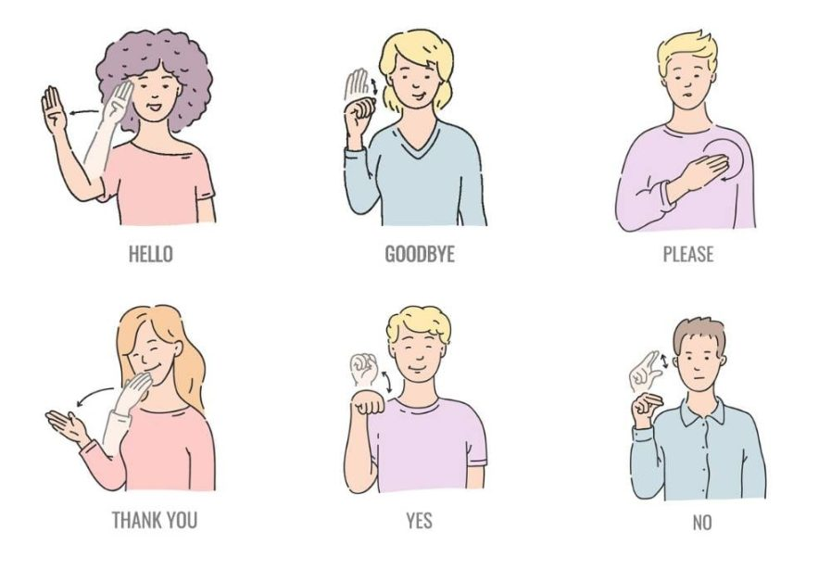
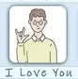
ABSTRACT: Sign Language Interpretation
Hand position/movement classification glove with applications in human-computer interaction
Useful for cases where hands need to be tracked without the use of a camera
Edge processing maintains user bio-data privacy and real-time responsiveness
Multi-sensor fusion improves resolution and classification accuracy
The glove classifies sign language gestures and allows the user to interact with a virtual agent through sign language. Real-world applications would allow the glove to translate American Sign Language (ASL) to English or other spoken languages.

Slide 3
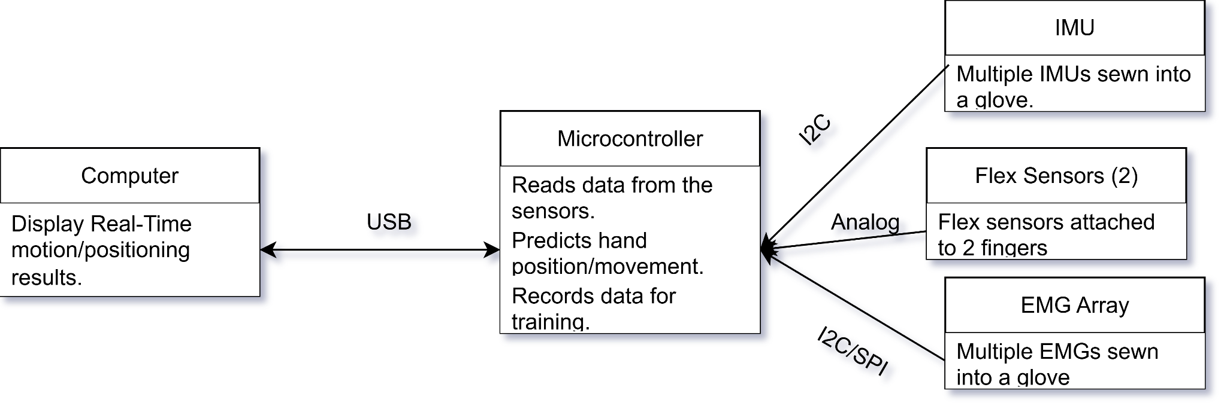
SYSTEM DESIGN: SENSOR FUSION

Slide 4
EDGE IMPULSE IMPLEMENTATION
1
Data Collection
2
Spectral Analysis
We attached the sensors to a physical glove and recorded >= 50 samples of each gesture and cropped them to 1 second windows.
Instead of analyzing the raw data, we do spectral analysis on all channels to convert to the frequency domain.
3
Classification
4
LLM Integration
The EI Classifier block analyzes the spectral features and assigns a label out of: I_love_you, goodbye, hello, idle, other, please, thank_you, yes
We used Ollama to run a local LLM that asks the user questions and responds to their sign language interactions.

Slide 5
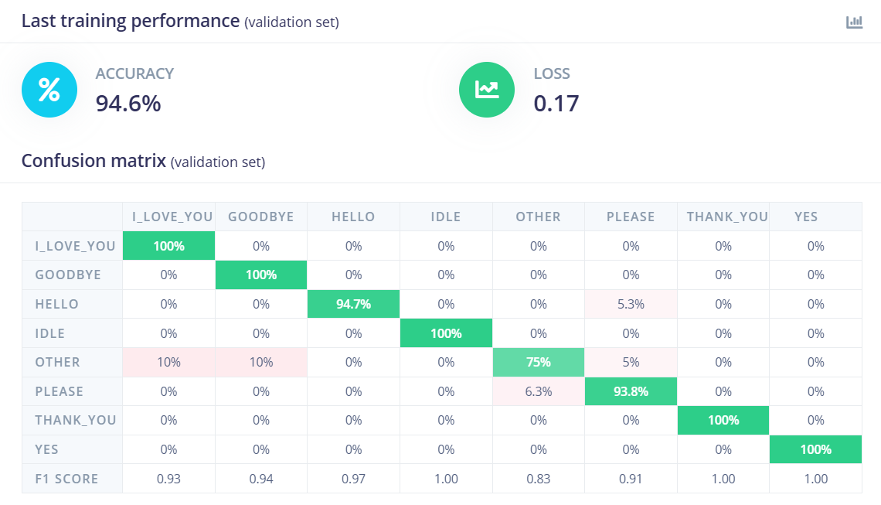
1
Training Accuracy

Slide 6
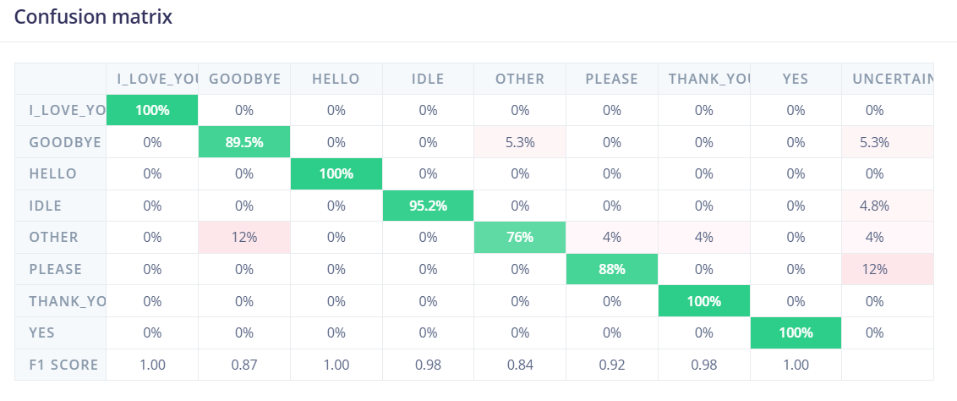
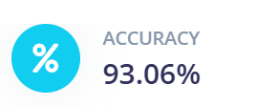
2
Testing Accuracy

Slide 7
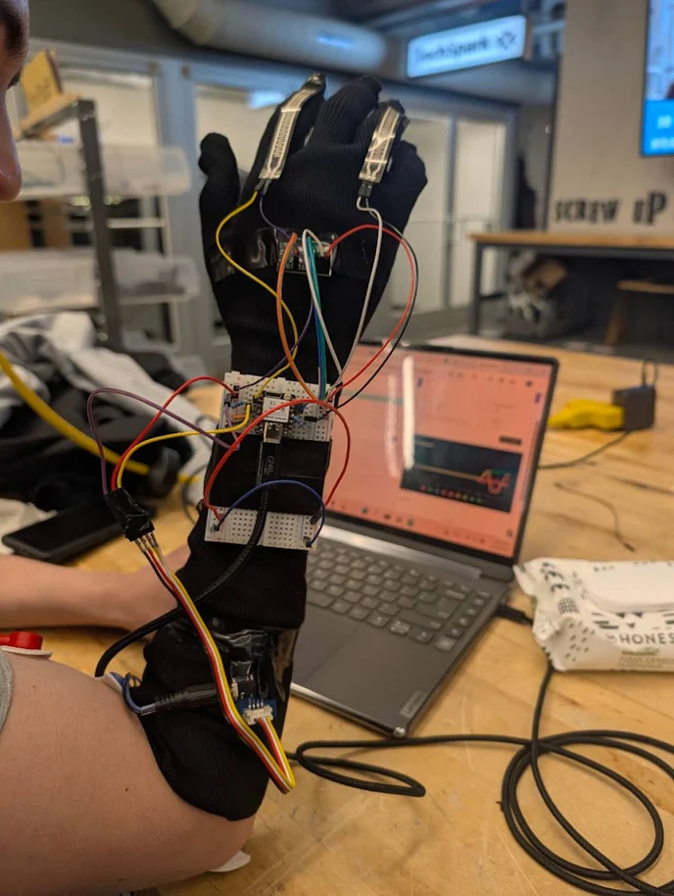
2
Deployment

Slide 8
CHALLENGES FROM
THE SEMESTER
1
Sensor Failure
2
Difficult to Distinguish Gestures
Our original EMG sensors had a lot of issues and were not producing good readings. Many of our sensors did not arrive and needed to be reordered.
Some gestures were difficult to distinguish from each other so we had to carefully select our gesture set after trial and error in the data collection phase.
3
LLM Integration
4
Glove Construction
We got creative with hoe the LLM responded and guided the conversation to adapt to the limited gesture set.
We sewed multiple glove prototypes to get it right as we iterated with our sensor designs.

Slide 9
GESTURES

