Slide 1
Offline Storytelling Companion
Shreesh Tripathi • Vignesh Natarajan

Slide 2
Quick Summary
What
An offline bedtime-story companion on Jetson Orin Nano that generates and narrates kid‑safe stories using a tiny LLM + STT/TTS.
New vs. Enhancement
New product built from open-source components (LLM, TTS) with a safety‑first pipeline.
Objective
Deliver safe, customizable, internet‑free storytelling with <5s start‑to‑speech latency via streaming.
For whom
Children (end users), parents/educators (buyers/custodians).

Slide 3
Technical details - Hardware
Compute platform:
NVIDIA Jetson Orin (e.g., Orin NX) running the L4T-ML GPU container with CUDA enabled.
Audio I/O:
USB microphone for speech input.
USB speakers / USB audio DAC for story playback.
Planned extensions:
GPIO push-button to trigger interactions and a status LED to indicate system state (recording, thinking, speaking).

Slide 4
Technical details - Software
Language & framework:
Python running on the Jetson with PyTorch using the GPU.
AI models:
Whisper Tiny for turning speech into text (speech‑to‑text).
TinyLLaMA 1.1B Chat for generating the story (language model).
Coqui TTS for turning the story text back into audio (text‑to‑speech).
Audio handling:
Uses simple Python audio libraries to record from the USB mic, save/load WAV files, and play back through the USB speakers.
App logic:
Python scripts that connects all steps: listen → transcribe → generate story → speak, plus a text-only mode for development without audio.

Slide 5
Technical Aspects
User experience:
Child speaks a short prompt (optionally starting with a wake word “storybot”), the system transcribes it, generates a 5–10 sentence wholesome story with a clear moral, and reads it aloud.
Latency-focused design:
Story is generated and spoken sentence-by-sentence (streaming), so audio output starts quickly instead of waiting for the full story.
Modes:
Audio mode for real interactions, text-only mode for development/debugging (no mic/speaker required).

Slide 6
Technical Aspects
Added an additional thread:
Generation thread: runs TinyLLaMA and pushes text chunks into the streamer.
Main thread: drains the streamer, finds sentence boundaries, enqueues sentences for TTS, and records stats.
TTS worker thread: pulls sentences from the queue and plays them, so audio no longer blocks streaming.

Slide 7
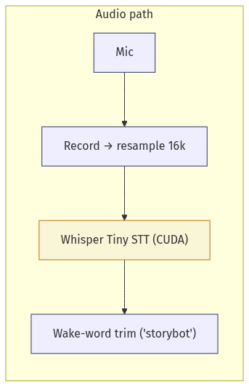
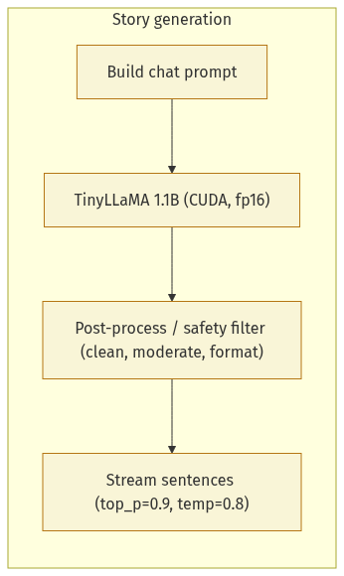
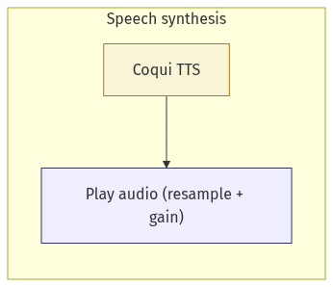
Architecture

Slide 8
Metrics
Captured run metrics for an example run:
Record audio: 10 s (fixed recording window)
First audio after start: 3.25 s
STT: 1.97 s
LLM stream: TTFT=0.52s, first sentence=0.86s, tokens=253 @ 10.5 tok/s)
TTS: 14 sentences, total 155.35 s (avg 11.10 s/sentence)

Slide 9
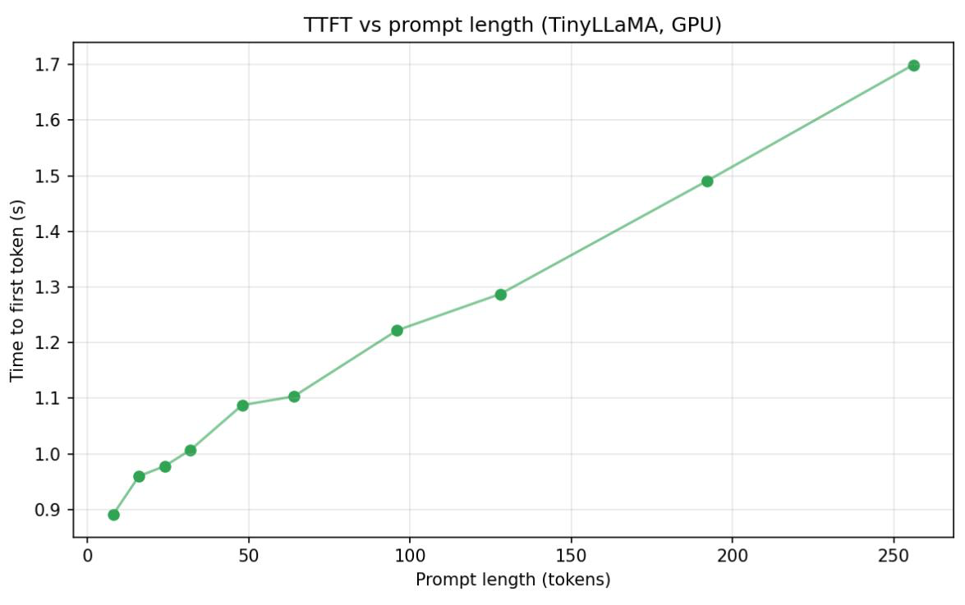
TTFT vs Prompt Length

Slide 10
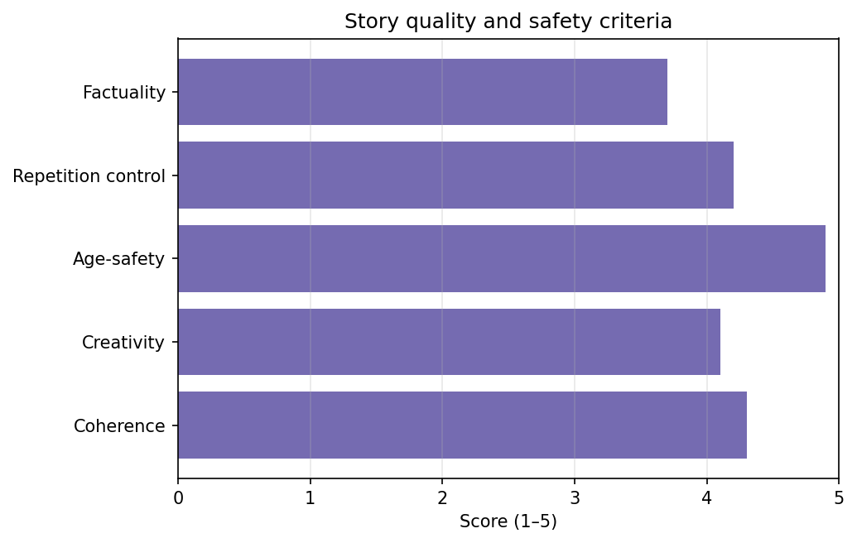
Accuracy Framework, n = 5000

Slide 11
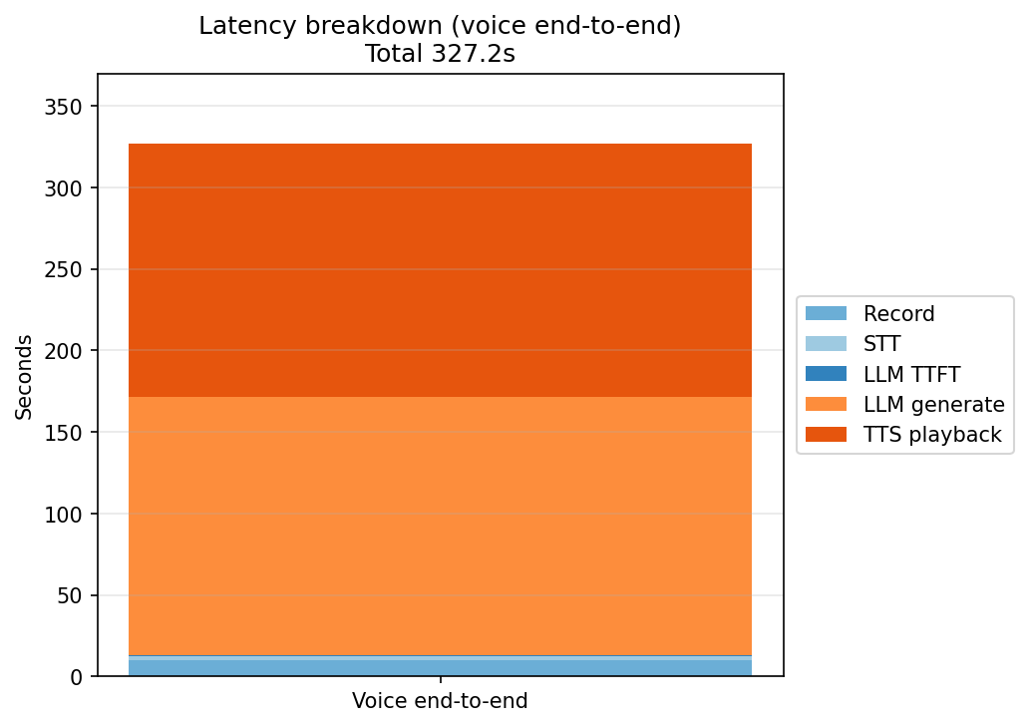
Distribution of Compute (Attempt 1)
Initial numbers. TTS was hogging resources and needed to be tweaked.

Slide 12
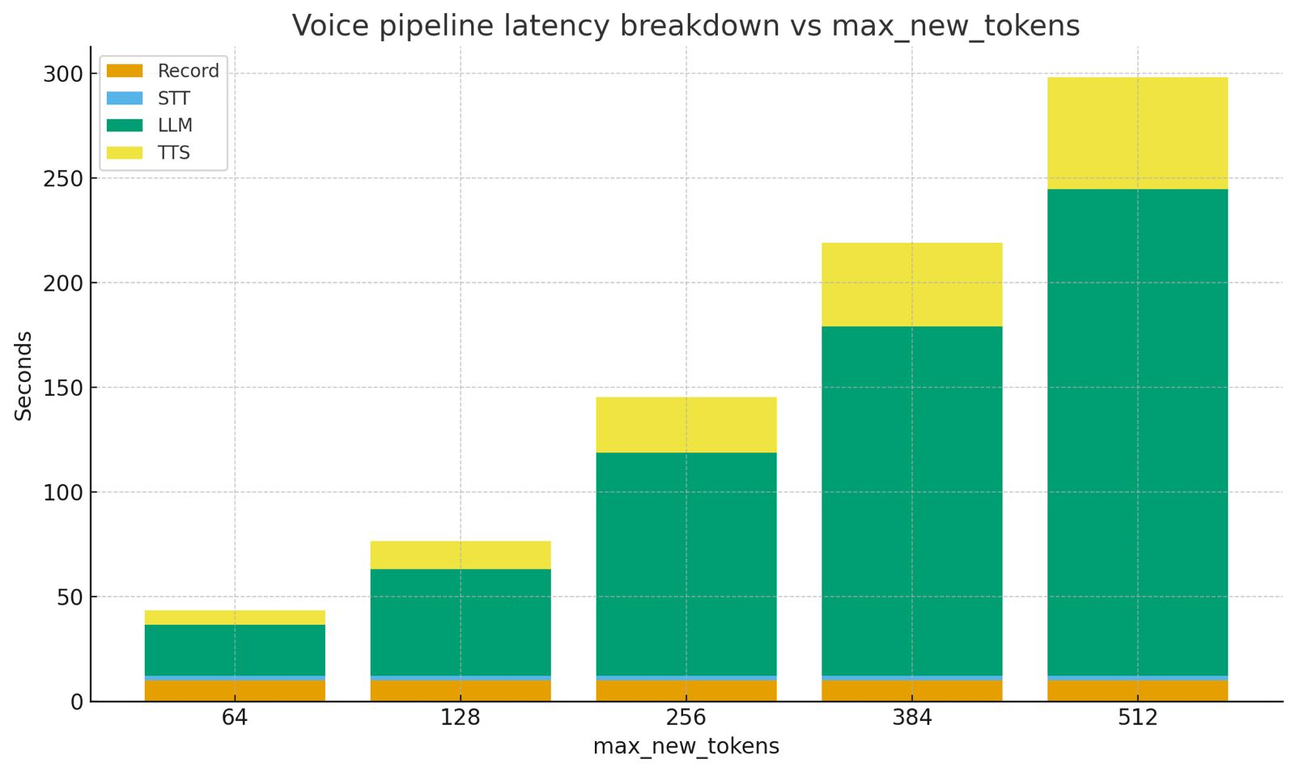
Distribution of Compute (Optimized)

Slide 13
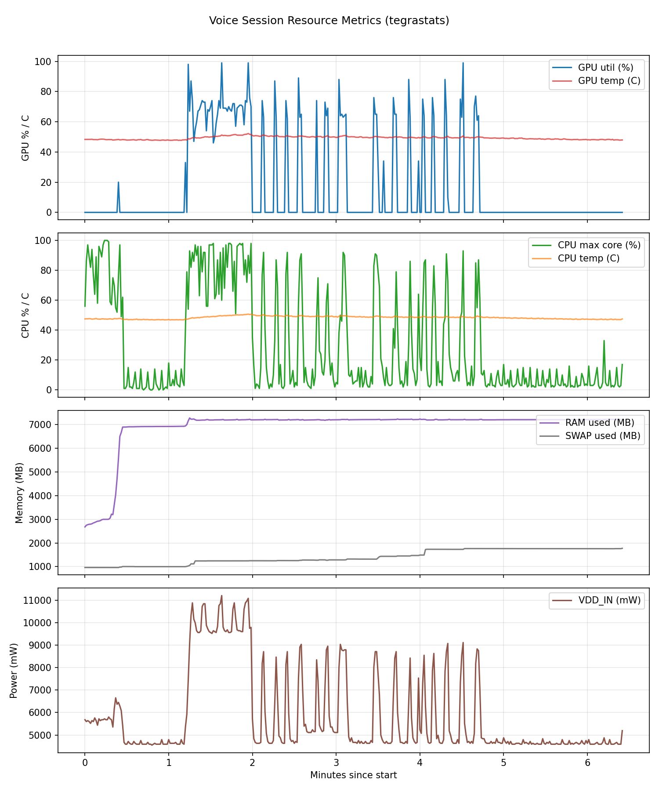
Resource Utilization

Slide 14
Demo

Slide 15
Questions?

