Slide 1
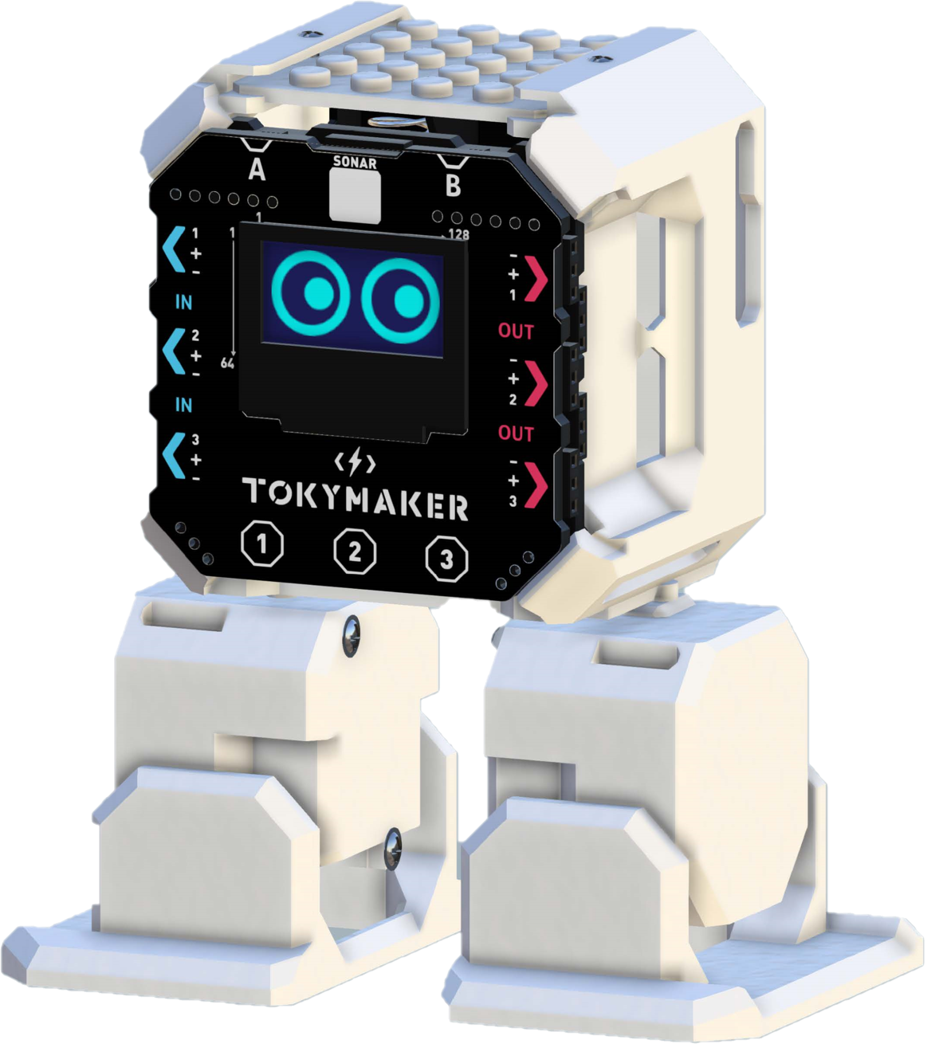
PetBot
Mahlet Mesfin

Slide 2
Objective
A responsive pet robot that provides light entertainment and interaction without increasing screen time.
Primarily for anyone seeking a fun, interactive desk gadget.
Bandwidth: Reduces network usage because all inference happens locally; only occasional model updates or telemetry need network transfer.
Latency: On-device processing → no cloud latency or dependency.
Economics: cheaper to scale and operate long-term.
Reliability: Fast response time between hearing a command and taking action.
Privacy: All audio processing happens on the device, keeping user data local

Slide 3
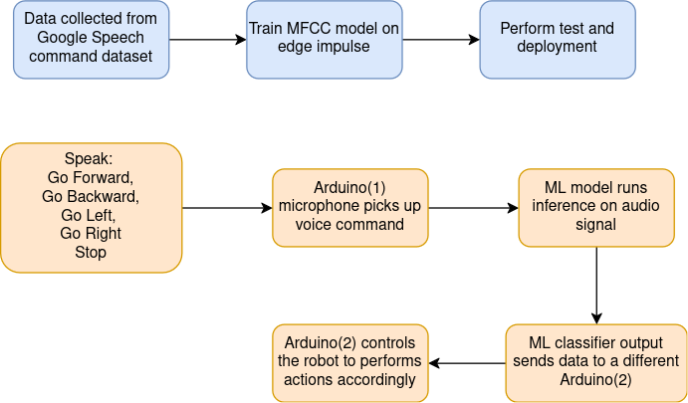
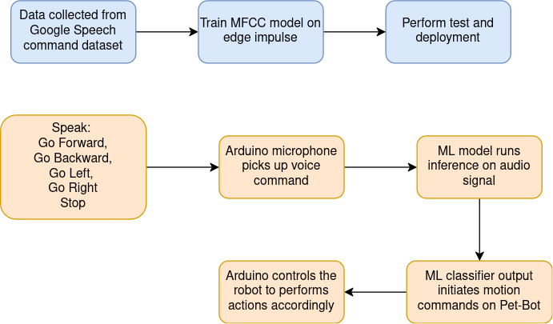
Block diagram

Slide 4
Data Collection
Words: go, stop, left, right, forward, backward, happy
  Go left
  Go right
  Go forward
  Go backward
  Stop
  Happy
Used google speech command-set
MFCC: keyword spotting
Feature extraction and preprocessing: on edge impulse
Used a Neural network

Slide 5
Embedded systems
Components:
Microcontroller: Arduino Nano BLE 33 Sense (for keyword spotting).
Robot Kit: TokyMaker kit (for movement and actuation).
Sensors: Built-in microphone - Arduino
Actuators: Motors for walking, servo for gestures.

Slide 6
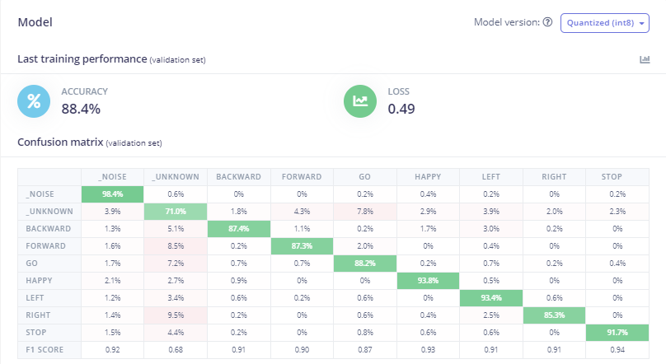
Training Result

Slide 7
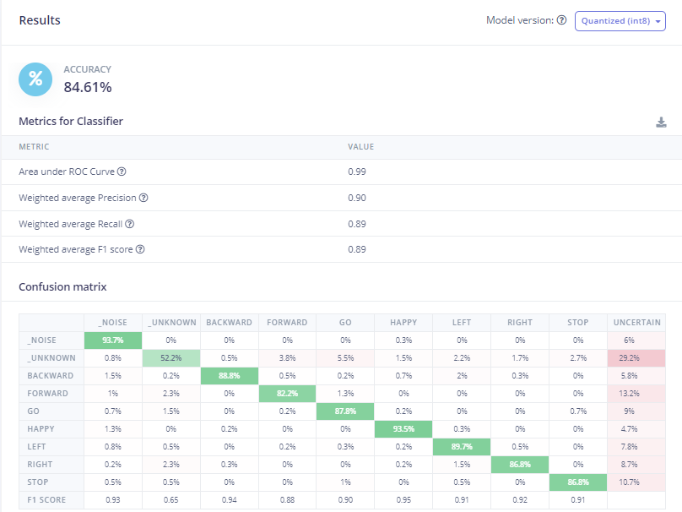
Test Result

Slide 8
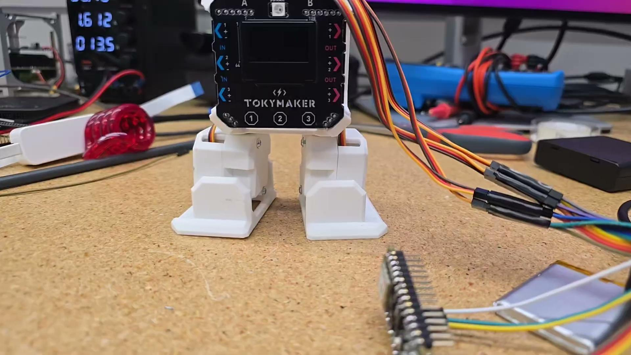
Video

Slide 9
Challenges
Live testing inference delay
Doing inference and motion tasks in one core: had to split to two arduinos to smoothly enable the movements
Testing accuracy skewed by _unknown_ sounds

