Slide 2
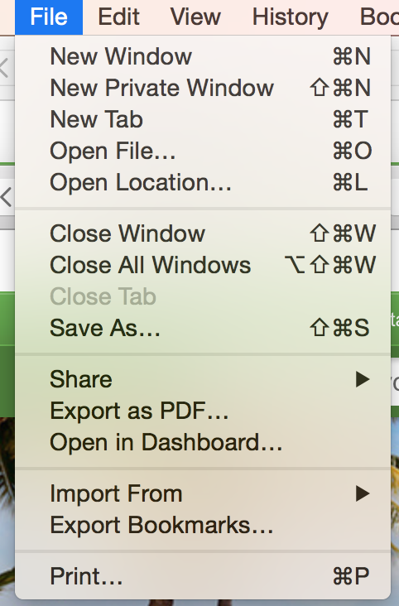
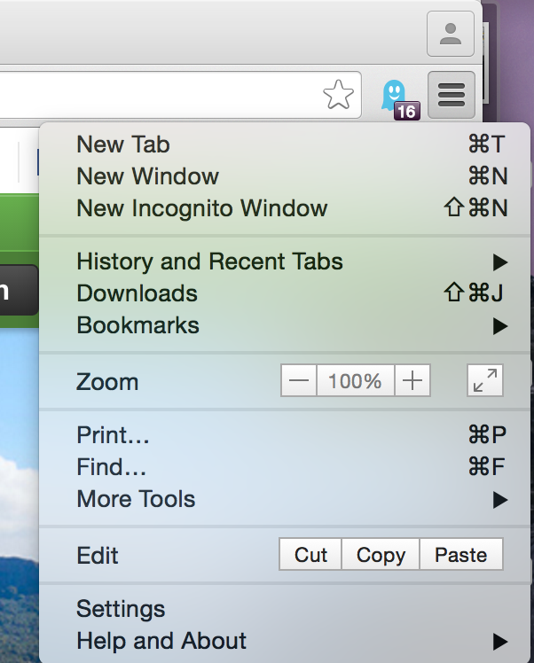
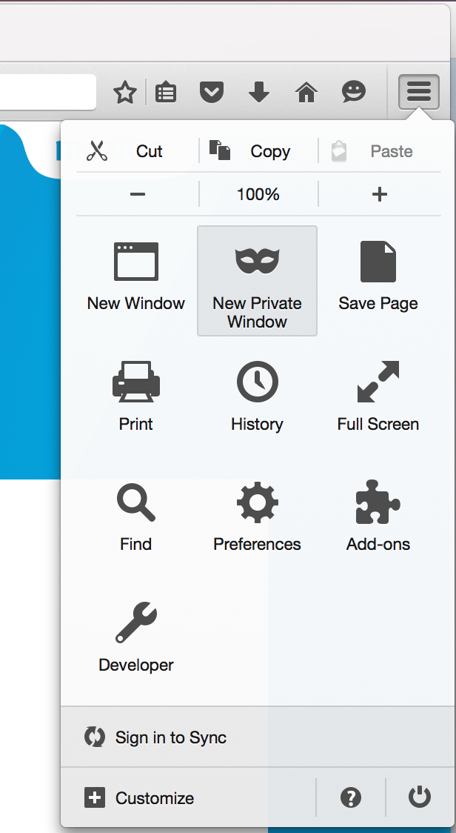
UI
Analysis
Easy to find
Easy to understanding

Slide 3
UI

Slide 4
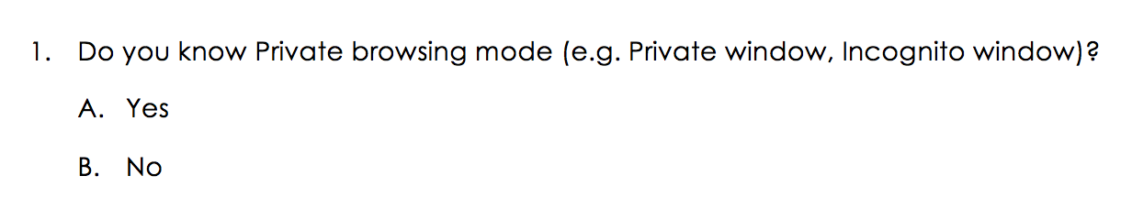
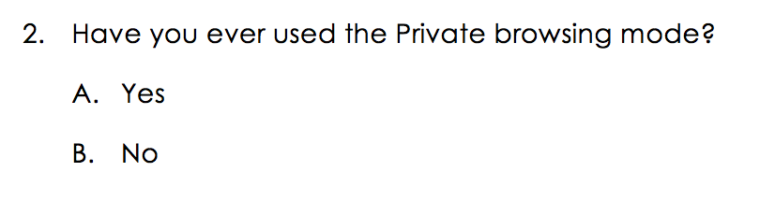
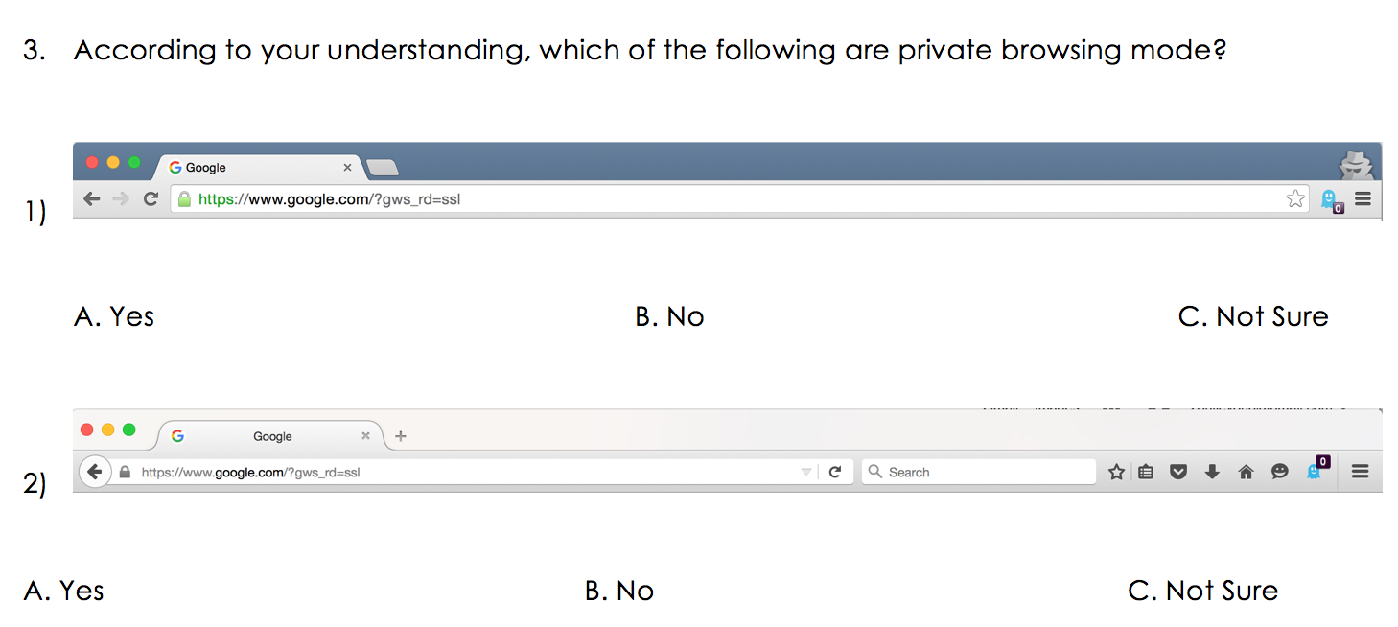
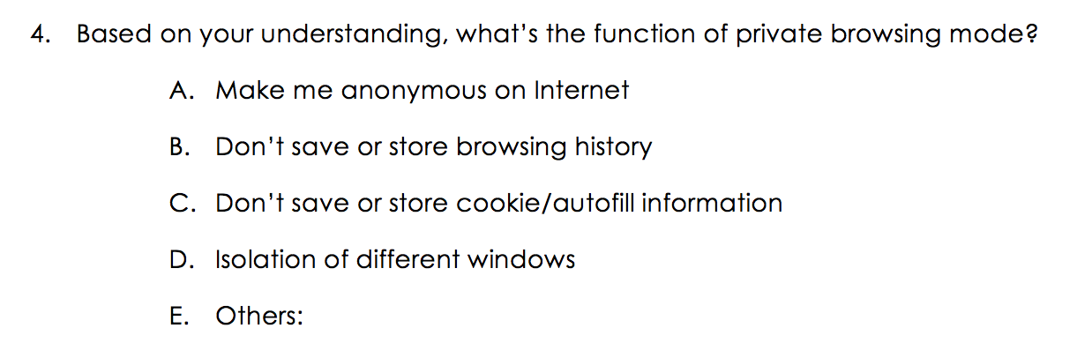


Survey
result

Slide 5
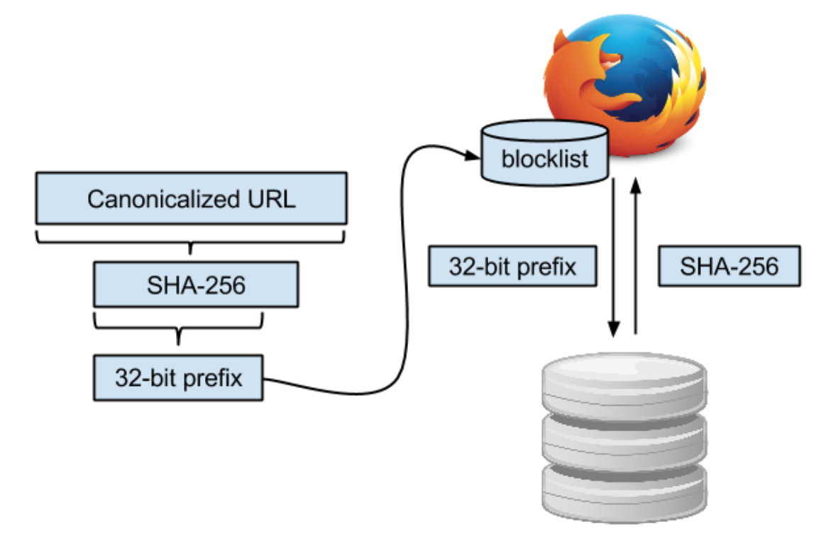
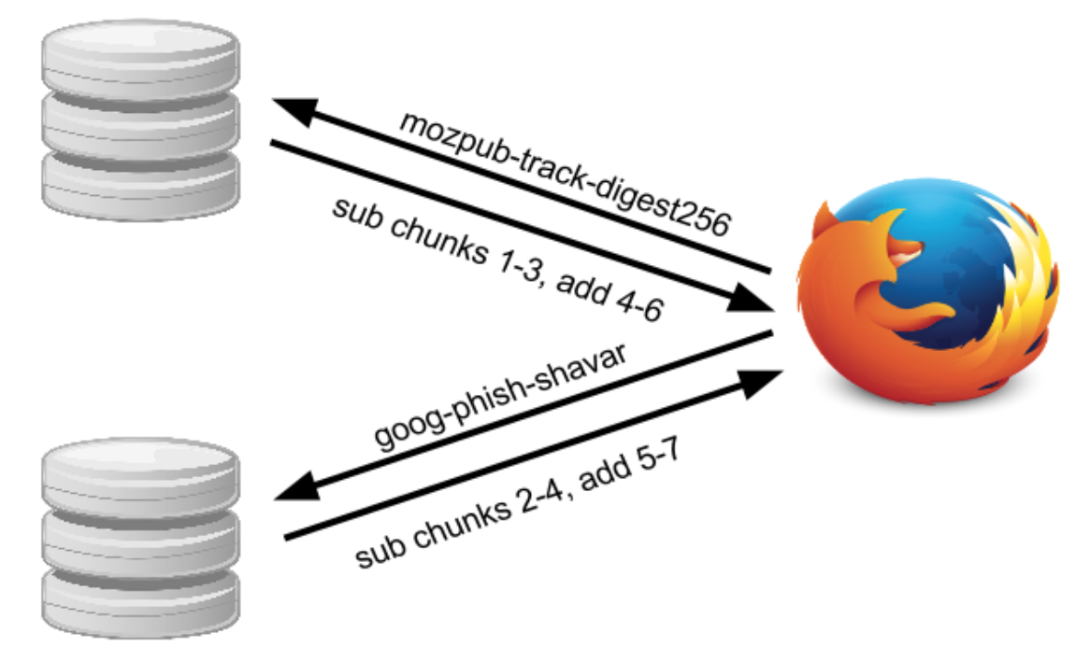
Private browsing mode Technology

Slide 6
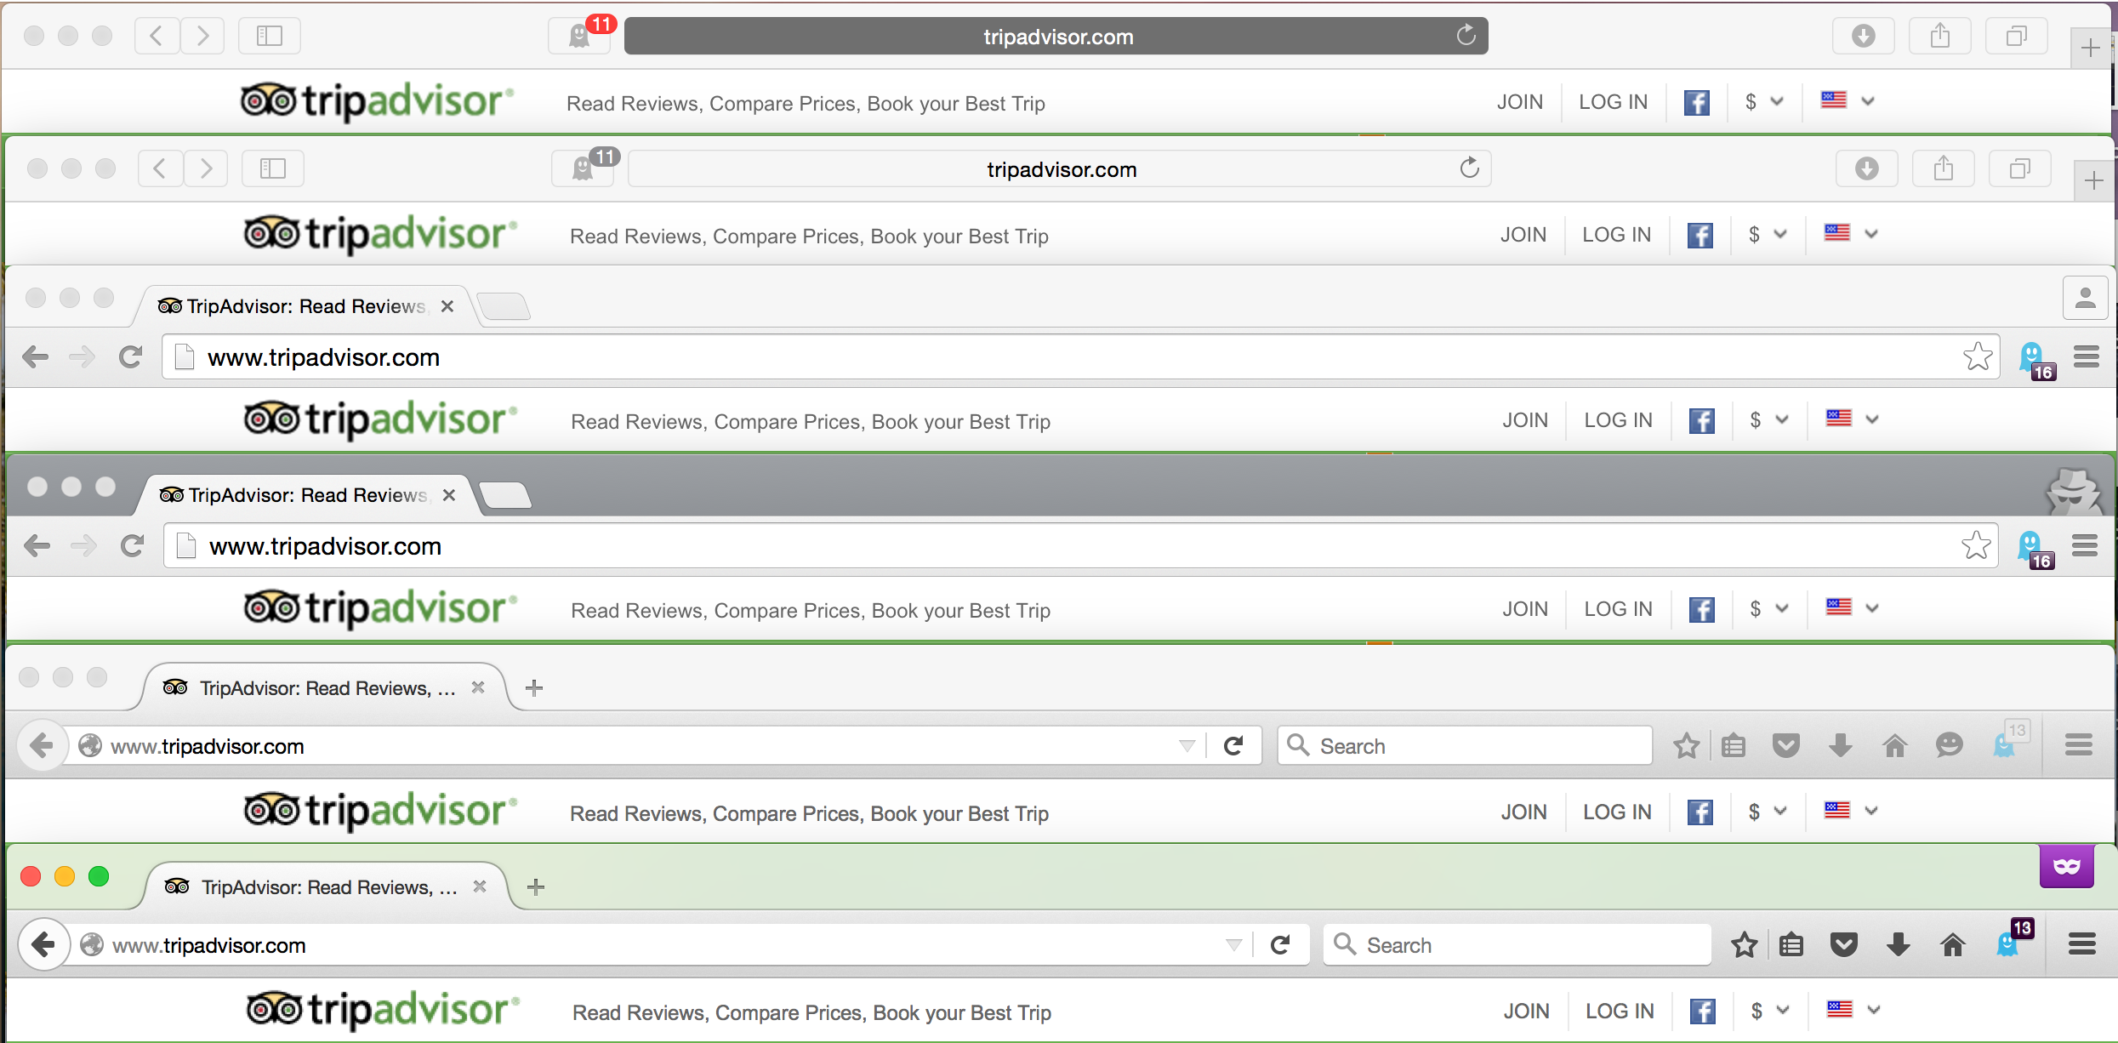
Tracker
Notes:
Firefox fetches the tracking protection list mozpub-track-digest256 from a Mozilla Safe Browsing server, and the existing phishing list from the Google Safe Browsing server.
Safe Browsing lists are based on URLs. To save space, Safe Browsing supports a format that stores only the truncated SHA-256 hash of the URL. When a match is found, Firefox requests the complete hash from the appropriate server.

Slide 7
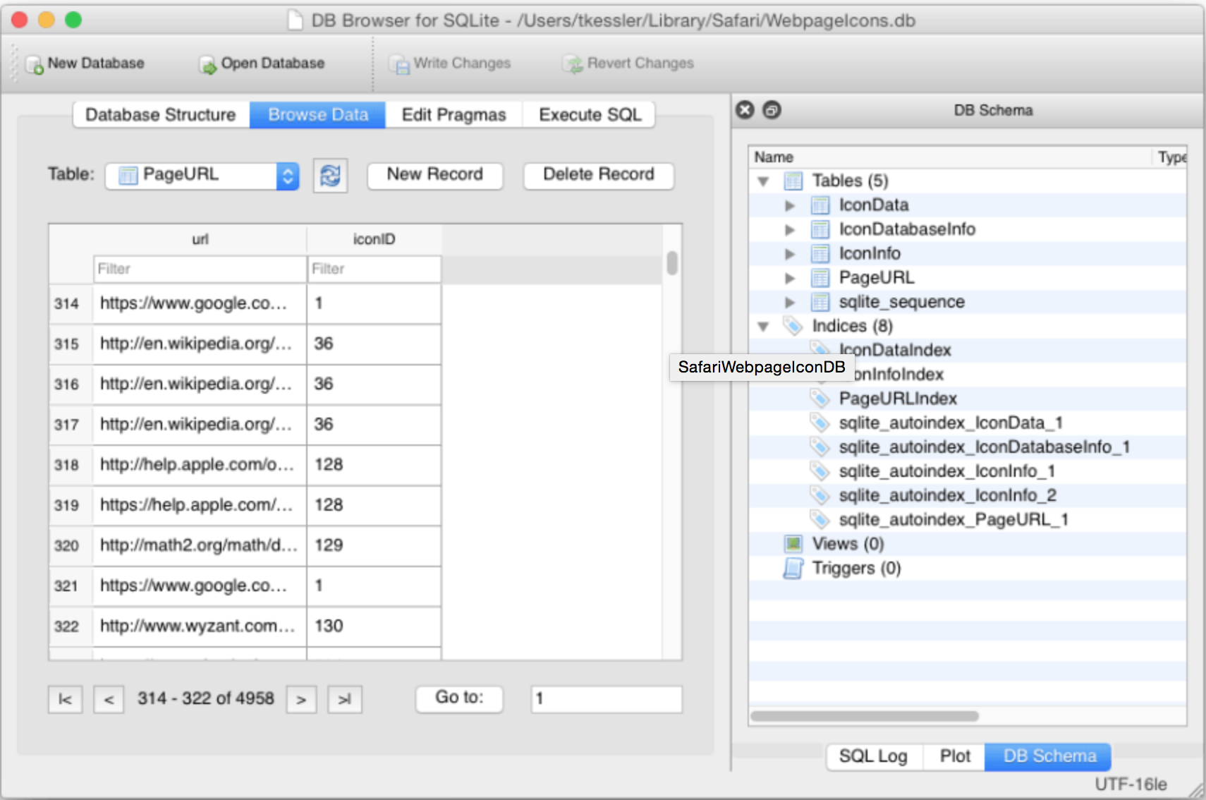
Analysis
Private browsing mode doesn’t change the number of tracker
Private browsing mode doesn’t hide online activities from
Website
Server provider
Employer
Private browsing mode saves URL in a easily accessible file

