Slide 1
ELEC 9782 Project
Zhengyue LIU
z5036602

Slide 2
Question.1
Feature selection for gender identification
Pitch vs MFCC

Slide 3
How to choose?
Ideally, features should:
have large inter-gender variability and small intra-gender variability (i.e. cluster are well-separated)
be robust against noise and distortion
not be affected by the speaker’s psychological factor or behavioural factor.

Slide 4
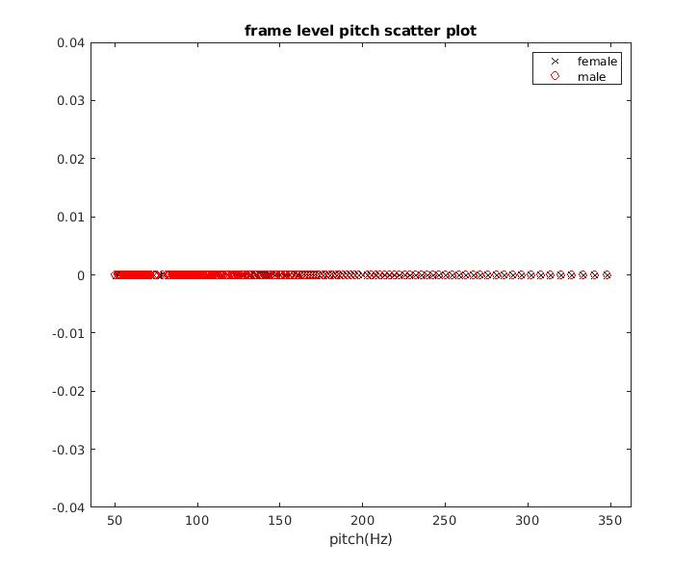
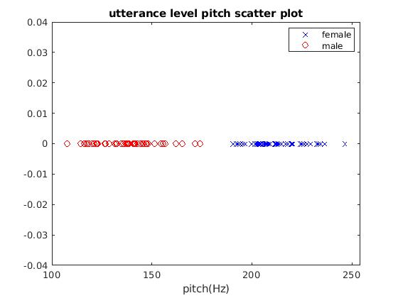
Pitch
Female pitch u =213.36hz
Male pitch u = 139.04hz
Female pitch sigma =33.30hz
Male pitch sigma =54.14hz
Female pitch u =212.90hz
Male pitch u = 138.26hz
Female pitch sigma =12.77hz
Male pitch sigma =15.36hz

Slide 5
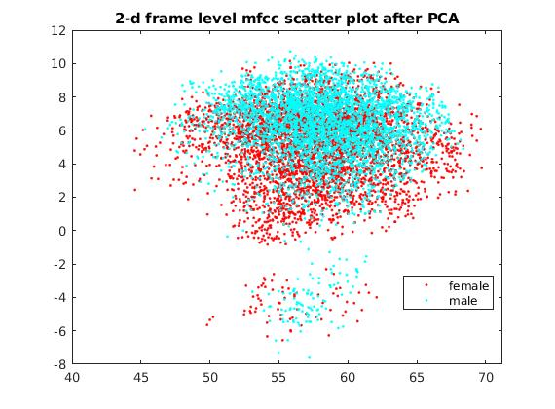
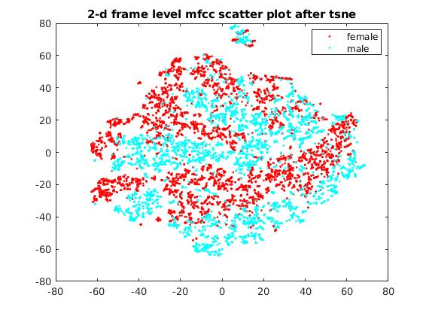
MFCC

Slide 6
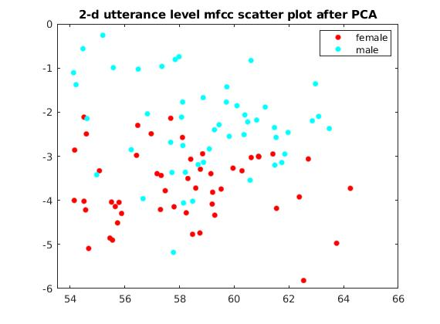
MFCC

Slide 7
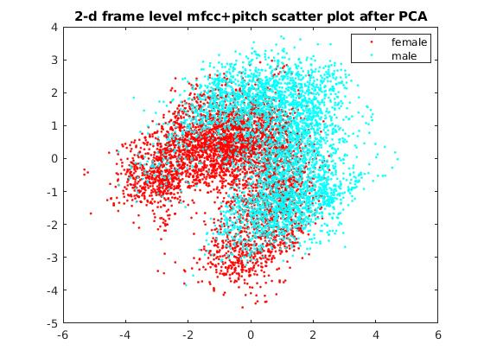
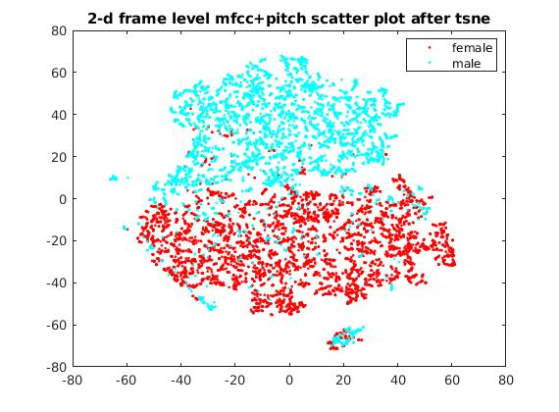
Pitch+MFCC

Slide 8
Reasoning
For accuracy, I will use pitch+mfcc. From the 2-d tsne visualisation, pitch+mfcc feature can be separated at frame-level which is really good!!!
For simplicity, I will use pitch only. Pitch feature has only one dimension, and pitch values at utterance-level i.e. mean pitch for each utterance are well-separated. Although pitch can be heavily affected by emotion, it might just be adequate for identifying just gender among 10 speakers in this project.
MFCC is not as good as two other features in terms of complexity and separation. MFCC captures the overall characteristics of individual speaker, and thus are not specific for capturing gender information.

Slide 9
Implementation steps
1. Compute the pitch and 13 MFCCs for each frame of the entire file.
2. Mark the voiced frames.
3. Keep the pitch and MFCC coefficients pertaining to the voiced frames only. Store them into a big feature matrix.
5. Use PCA and tsne matlab built-in function for analysis.

Slide 10
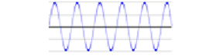
Audio signal
Pre-emphasizing
Log
Framing and windowing
DCT
FFT/DFT
MFCC
Mel filter bank and energy calculation

Slide 11
MFCC configuration
Window length: 25ms (400 frames)
increment size: 10ms (160 frames)
Mel-filter bank number: 23
Lowest cut-off = 20 hz
Highest cut-off = 7800 hz

Slide 12
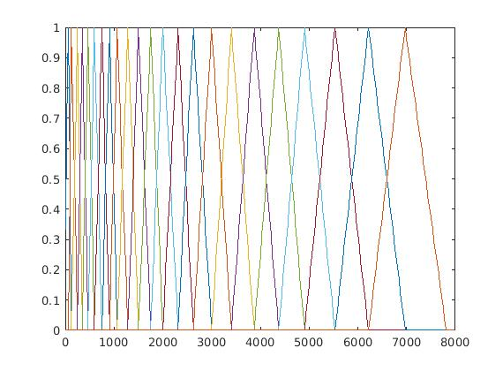
Mel filter bank

Slide 13

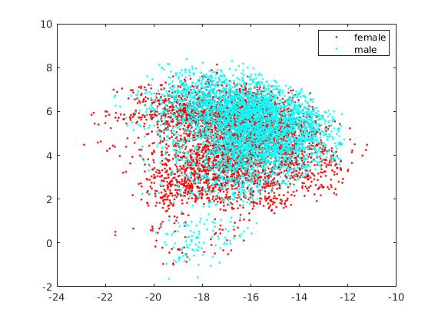
MFCC correctness check
PCA of my mfcc
PCA of built-in matlab mfcc

Slide 14
MFCC correctness check
Also checked my output with mfccs submitted by other people online.
https://au.mathworks.com/matlabcentral/fileexchange/23119-mfcc

Slide 15
Mark voiced frames
For each frame,I calculate the energy and use a energy threshold to decide whether the frame corresponds to a voiced frame or not.
E(voiced)>E(unvoiced)>E(silence)

Slide 16
Threshold tuning
I tuned the threshold by using the data description file, as it marks the frame position of different phonemes pronounced. My threshold should try it best to discard the frames for unvoiced phonemes (/s/ /t/) and silence.

Slide 17
Pitch
Matlab built-in function pitch();
auto-correlation function (fs/(first peak-second peak)).
f_0 = pitch(x,fs, ...
'WindowLength',400, ...
'OverlapLength',240, ...
'Range',[50 350], …%% minimum and maximum range
'Method','NCF'); for find first peak and second peak

Slide 18
Question2.a
EM algorithm
Formula deduction of MAP(Maximum a posterior) EM

Slide 19
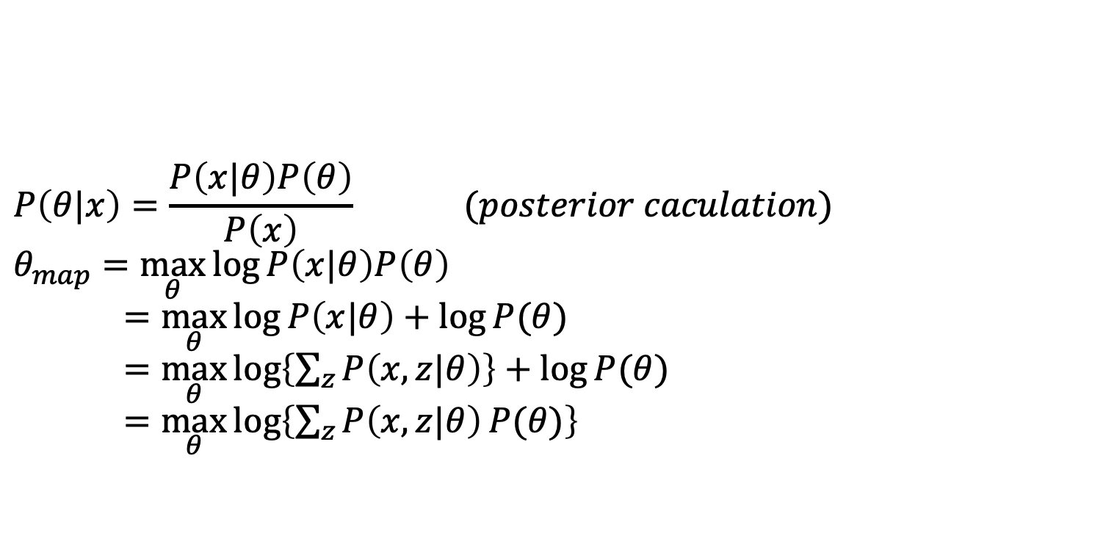
Maximum a posterior
$$P\left(θ|x\right)=\frac{P\left(x|θ\right)P\left(θ\right)}{P\left(x\right)} (posterior caculation)$$
$$θ_{map}=\max_{θ}{\log{P\left(x|θ\right)P\left(θ\right)}}$$
$=$ $\max_{θ}{\log{P\left(x|θ\right)+\log{P(θ)}}}$
$=\max_{θ}{\log\left\{\sum_{z}{P\left(x,z|θ\right)}\right\}+\log{P(θ)}}$
$=\max_{θ}{\log\left\{\sum_{z}{P\left(x,z|θ\right)}P(θ)\right\}}$

Slide 20
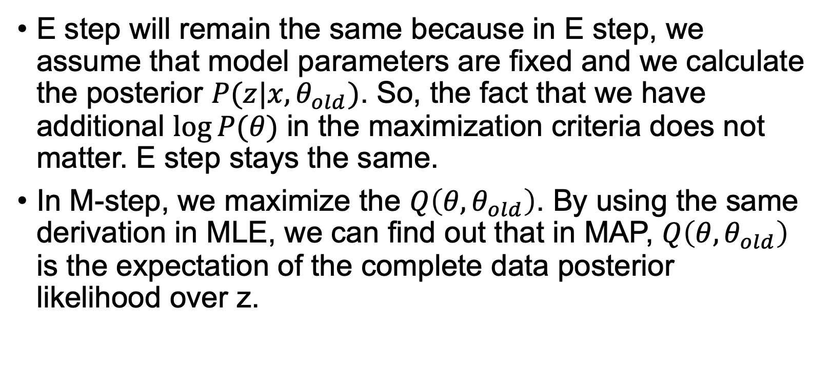
E step will remain the same because in E step, we assume that model parameters are fixed and we calculate the posterior $P(z|x,θ_{old})$. So, the fact that we have additional $\log{P(θ)}$ in the maximization criteria does not matter. E step stays the same.
In M-step, we maximize the $Q\left(θ,θ_{old}\right)$. By using the same derivation in MLE, we can find out that in MAP, $Q\left(θ,θ_{old}\right)$ is the expectation of the complete data posterior likelihood over z.

Slide 21
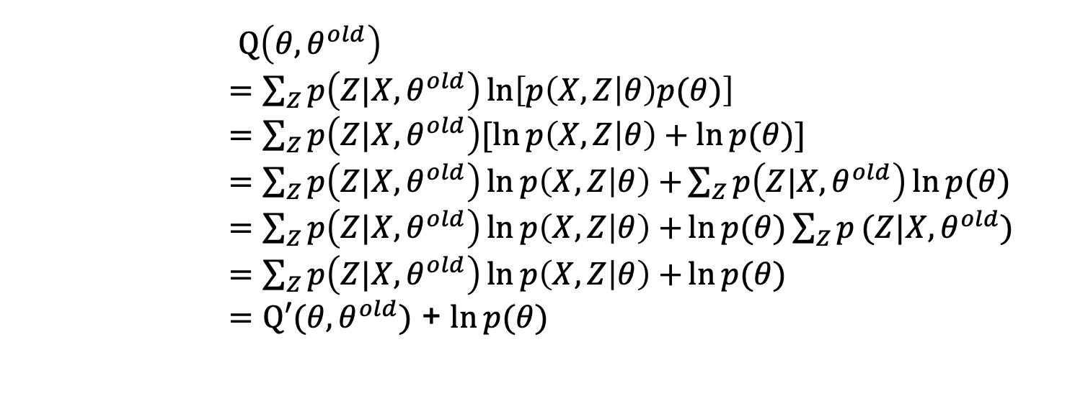
M-step
$Q\left(θ,θ^{old}\right)$
$=\sum_{Z}{p\left(Z|X,θ^{old}\right)\ln\left[p\left(X,Z | θ\right)p(θ)\right]}$
$=\sum_{Z}{p\left(Z|X,θ^{old}\right)[\ln{p\left(X,Z | θ\right)+\ln{p(θ)]}}}$
$=\sum_{Z}{p\left(Z|X,θ^{old}\right)\ln{p\left(X,Z | θ\right)+}}\sum_{Z}{p\left(Z|X,θ^{old}\right)\ln{p(θ)}}$
$=\sum_{Z}{p\left(Z|X,θ^{old}\right)\ln{p\left(X,Z | θ\right)+}}\ln{p(θ)\sum_{Z}{p}(Z|X,θ^{old})}$
$=\sum_{Z}{p\left(Z|X,θ^{old}\right)\ln{p\left(X,Z | θ\right)+}}\ln{p(θ)}$
$=Q′(θ,θ^{old})$ + $\ln{p(θ)}$

Slide 22
Question2.b
Speaker Identification
GMM-UBM (map) vs GMM (ml)

Slide 23
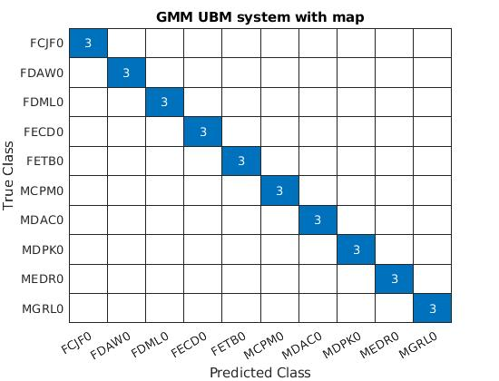
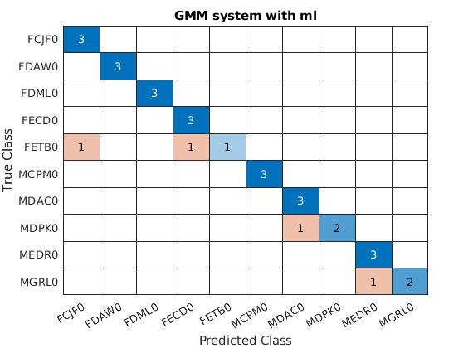
Question2.b Speaker Identification
Err = 0%
Err = 13%

Slide 24
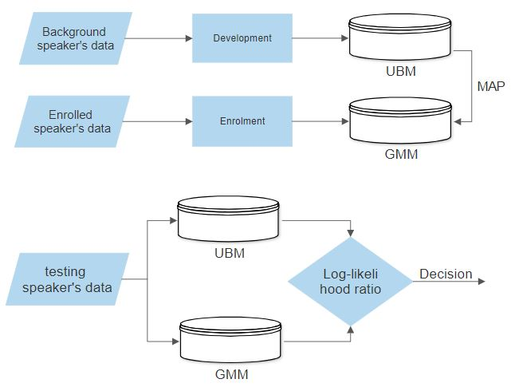
SV GMM-UBM overview
Λ(X)= log p(X|gmmspk)−log p(X|ubm)

Slide 25
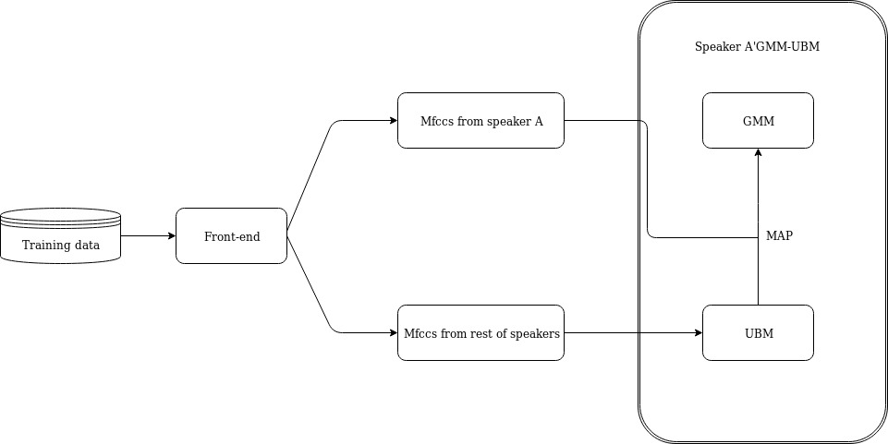
SID GMM-UBM overview

Slide 26
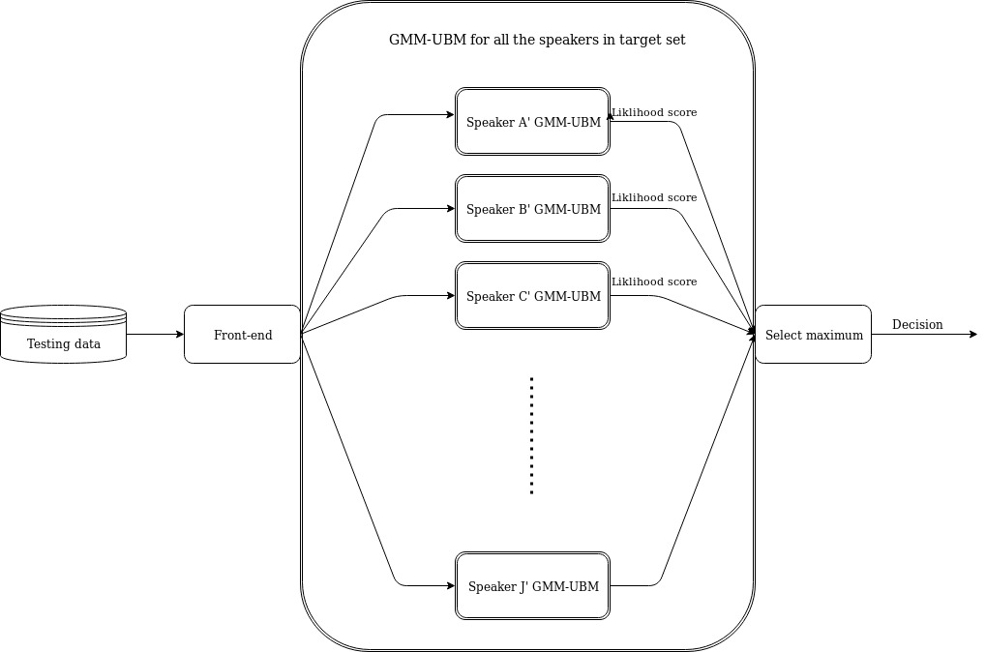
SID GMM-UBM overview

Slide 27
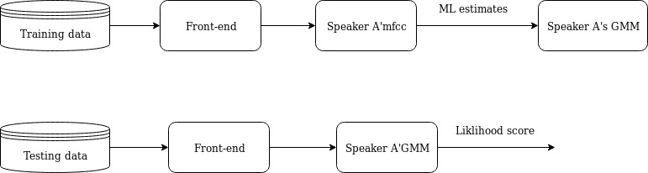
SID GMM overview
Λ(X)= log p(X|gmmspk)

Slide 28
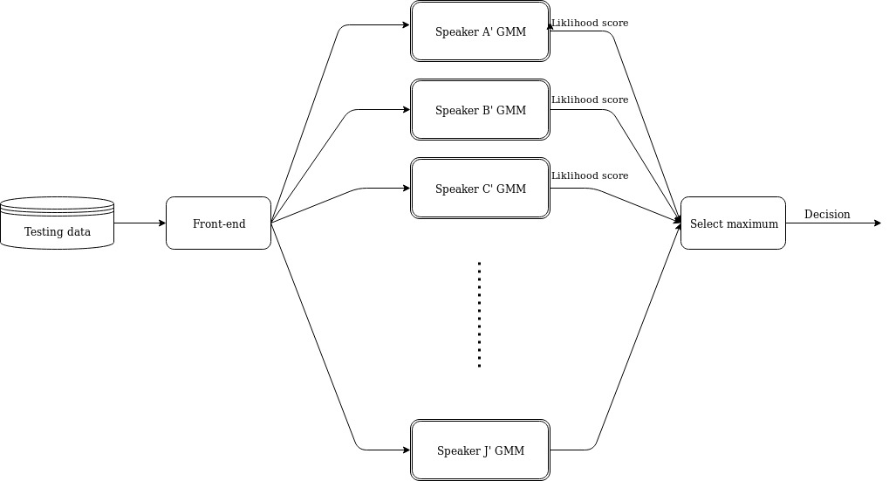
SID GMM overview

Slide 29
System front-end
Front-end is same as implementation in Q1, except that the pitch feature is not included.

Slide 30
System back-end configuration
Male and female speech data are split to create GMM, then combined to form UBM. So the problem that there is an imbalance of sub-population in training data can be overcome.
As previous research have suggested [1][2], I used relevance factor R = 16, and I only adapted means of the UBM to the speakers’ GMM.
The number of components for Gaussian mixture is 10, as for 10 speakers.

Slide 31
References
[1]Bhattacharjee, Utpal. “GMM-UBM Based Speaker Verification in Multilingual Environments.” (2012).
[2]Reynolds, Douglas A. et al. “Speaker Verification Using Adapted Gaussian Mixture Models.” Digital Signal Processing 10 (2000): 19-41.

