Slide 1
Welcome
Project Scope
Random Forest: Improving model, additional pre-processing, performance evaluation, recommendations.
Neural Network: Improving model, additional pre-processing, performance evaluation, recommendations.
Decision Tree: Improving model, additional pre-processing, performance evaluation, recommendations.
Linear Regression: Improving model, additional pre-processing, performance evaluation, recommendations.
Gradient Boosting: Improving model, additional pre-processing, performance evaluation, recommendations.
Exploratory Data Analysis, Final Conclusions & Recommendations & Summary.
Python code Link
Presented by: Hima Rohini Mallina

Slide 2

Business Objective & Presentation Summary
Dataset: 1, Insurance Company; predicting medical claim charges.
Objective: Develop and test the following models on Dataset 1 with the goal to understand and improve model performance, draw business insights, strategies and forecast insurance charges based on variables related to health and demographics.
Models Tested:
Gradient Boosting
Linear Regression
Random Forest
Artificial Neural Network
Decision Tree

Slide 3
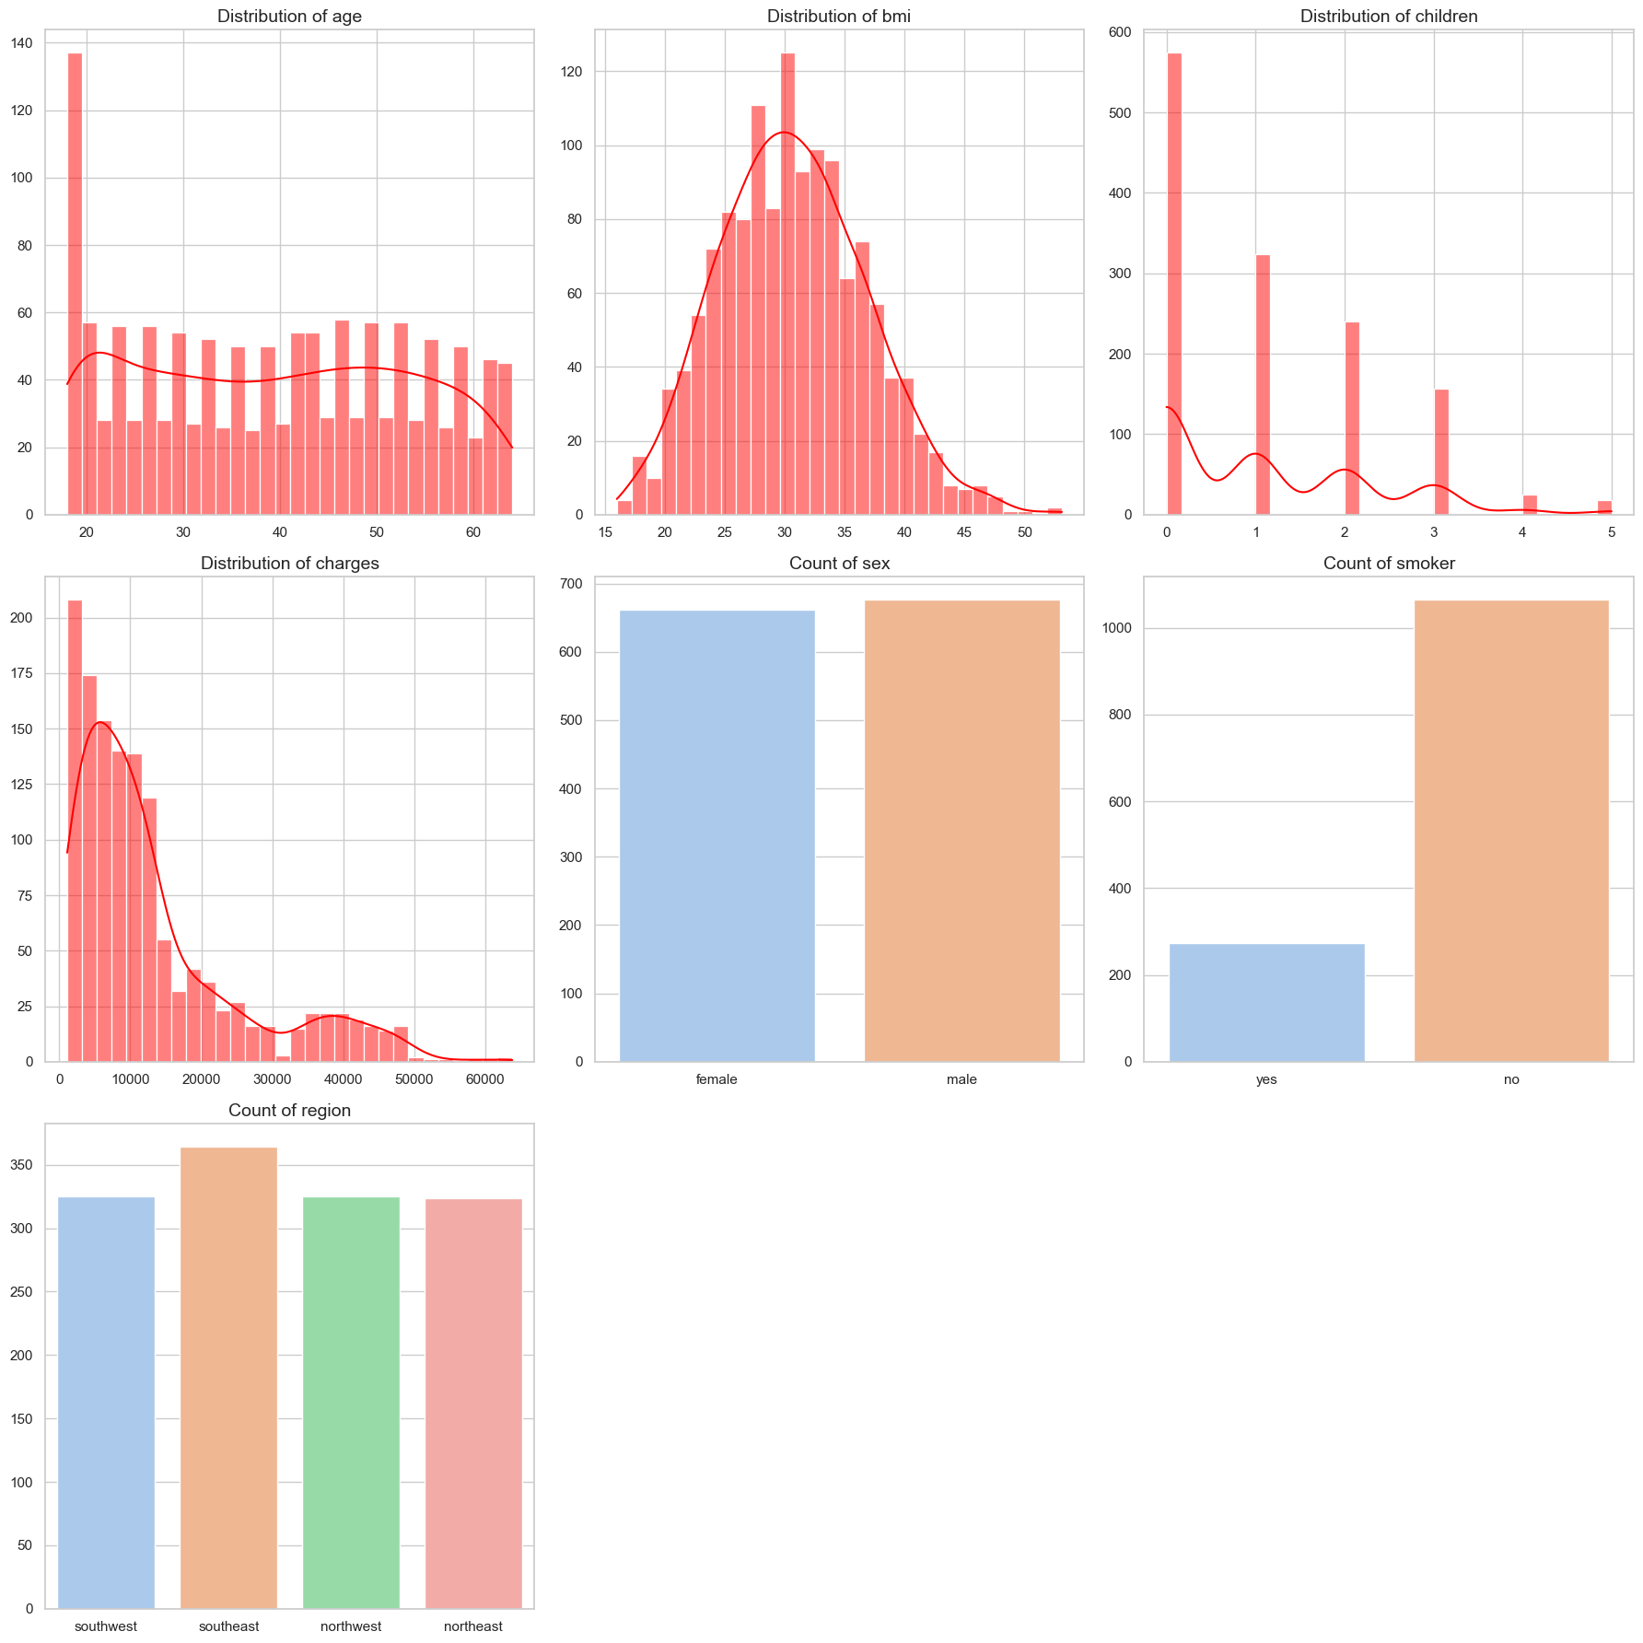
Exploratory Data Analysis
Age: 18 – 64, Distribution relatively uniform across most age groups.
BMI: Mix of healthy and overweight individuals.
Children: Most individuals have no children, avg 1.1.
Sex: Balanced distribution between M & F.
Smoking: Representative of population.
Region: Dataset is well-distributed across 4 regions.
Charges: Most charges are below 20,000 with some high-cost outliers.
Anomalies detection: 0.29%

Slide 4
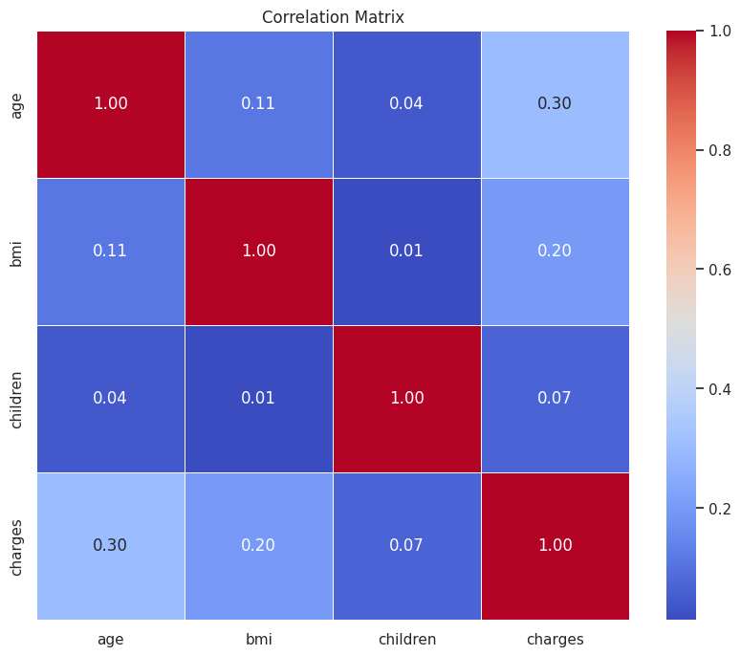
Correlation Analysis
Correlation Analysis Outcome of features on charges
Age and charges (0.30):Moderate positive correlation. As age increases, the insurance charges tend to increase.
BMI and charges (0.20):Weak positive correlation. Higher BMI values are slightly associated with higher insurance charges.
Children and charges (0.07):Very weak positive correlation. The number of children has little to no effect on the insurance charges.
Multi-collinearity: No multicollinearity detected within features.

Slide 5
Data Pre-processing
Encoding:
Standardization and One-hot encoding
Data Split & Preprocessing:
Training/Test : 80/20 Split.
Fit & transform data
Polynomial Features:
Introduces non-linear relationships
Model Training & Prediction:
Model trained on training data and predictions are made on test data
Model Initializing:
A dictionary of five models is created
Metrics Calculation & Results:
MSE, MAE, R-square & MedAE.
Scores stored in results dictionary.

Slide 6
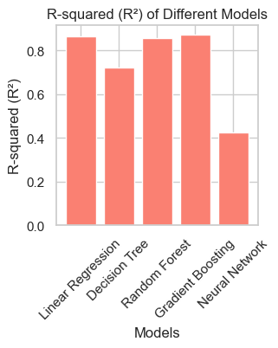
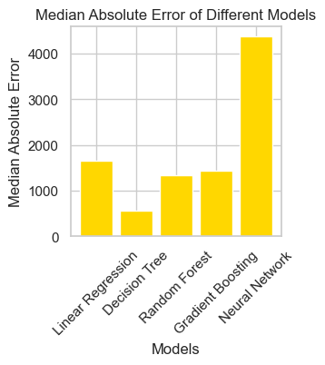
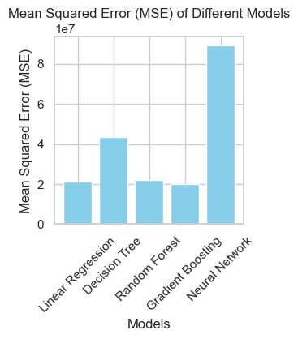
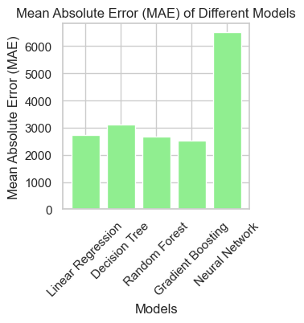
Initial Model Performance Analysis
Gradient Boosting: Best performance with lowest MSE (20,076,820.24), high R² (0.8707), and low MAE (2,514.39)..
Linear Regression: High R² (0.8637) and relatively low errors.
Random Forest: Good performance, slightly higher errors than Gradient Boosting and Linear Regression.
Decision Tree: Lower R² (0.6998) and higher errors.
Artificial Neural Network: Worst with highest errors and lowest R² (0.4268).

Slide 7
Improving Model Performances: Gradient Boosting
Model performance before and after hyperparameter tuning:
Model results :
•Lower Mean Squared Error (MSE) found in the improved model, indicates better prediction accuracy
•Lower Mean Absolute Error (MAE) found in the improved model, indicates model prediction results are closer to actual values
•Higher R-squared (R²) value found in the improved model, indicates the new model fits well in data fitting and generates better predictions
•Higher Median Absolute Error (Med AE) found in the improved model, indicates an increased number of errors are found
Scores | Initial Model | Improved Model
Mean Squared Error (MSE) | 20076820.238734633 | 18797741.252354514
Mean Absolute Error (MAE ) | 2514.392111633668 | 2445.1354848914148
R² Score | 0.8706796503532237 | 0.878918551721947
Median Absolute Error (Med AE) | 1438.7828769638427 | 1494.9642687136025
The improved model still perform better with higher accuracy. However, business need to aware of possible prediction consistent problem as Med AE increase slightly.

Slide 8
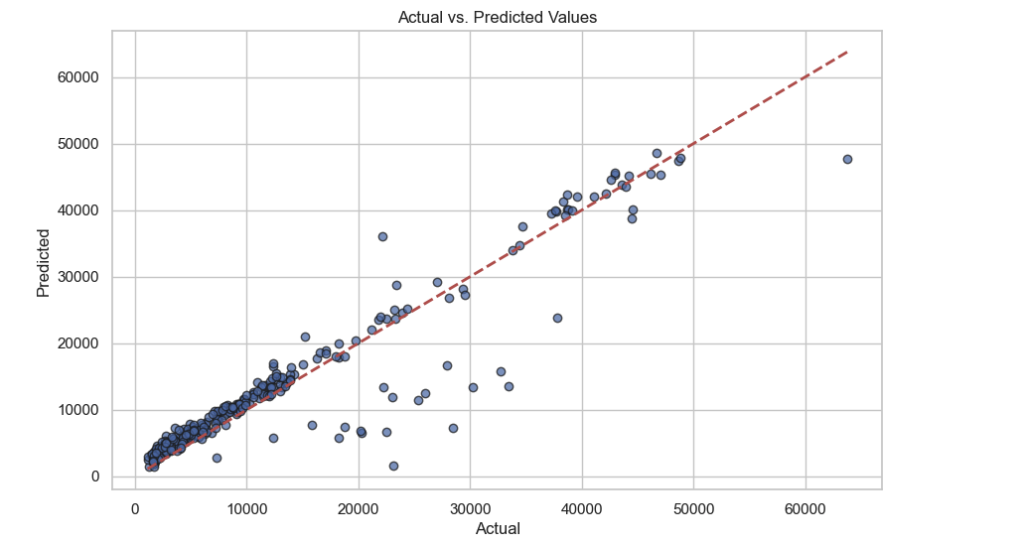
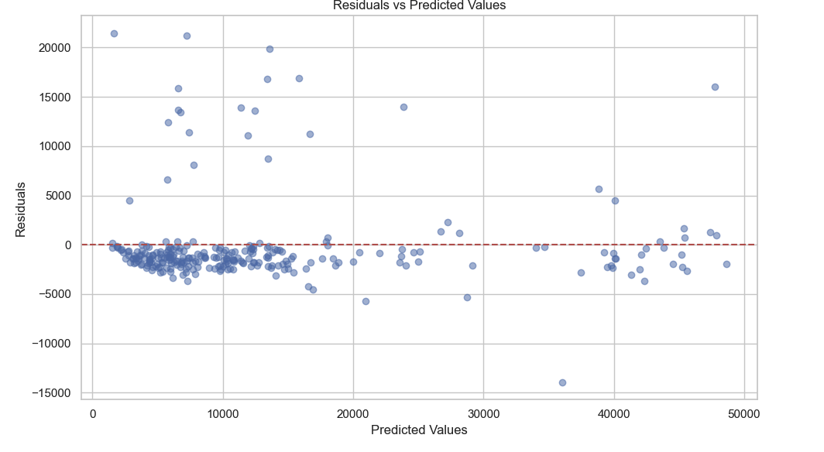
Improving Model Performances: Gradient Boosting
The actual values are mostly close to the absolute prediction line. The gradient boosting model predicts charges close to actual values
The residuals are randomly spread along the horizontal axis. However, the residual pattern changes and spread away when predicted value increases

Slide 9
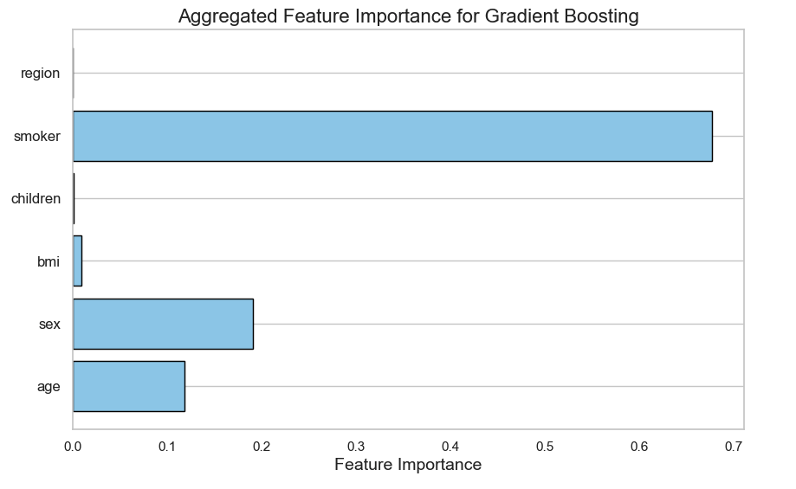
Improving Model Performances: Gradient Boosting
Model enhancement process:
Define Hyperparameter Grid with range of values
Adopt GridSearchCV
Use 5-fold cross validation for hyperparameter performance
Evaluate best model on test set
Calculate metrics to compare model results
Ensure optimal model performance and prevent
overfitting
Top significant factor: Smoking habits ; 2nd significant factor: Gender; 3rd significant factor: Age

Slide 10
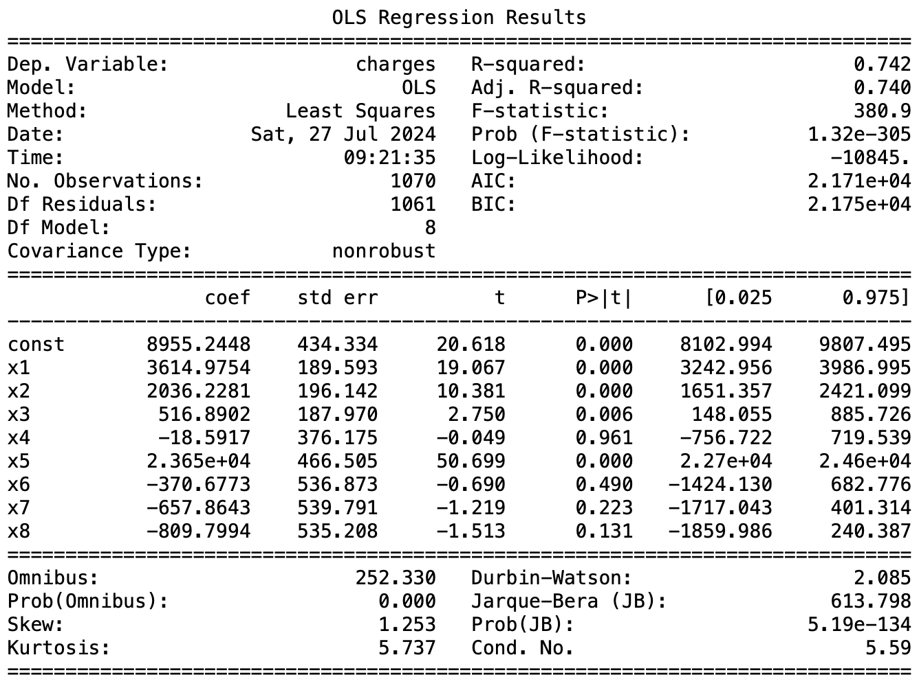
Improving Model Performances: Linear Regression
OLS Regression Model: (Baseline)
R-square = 0.742; model explains about 74% of the variance in 'charges'. It fits the data relatively well.
Significant Variables:
Variables with P-value < 0.05; ‘age’, ‘sex’, ‘bmi’, ‘smoker’.
Additional Pre-processing:
Feature Scaling
Polynomial Features
Cross-Validation
Ridge & LASSO Regression:
Ridge: Alpha 1.0 | MSE 33.65mil. | MAE 4193
LASSO: Alpha 10. | MSE 33.68mil. | MAE 4188

Slide 11
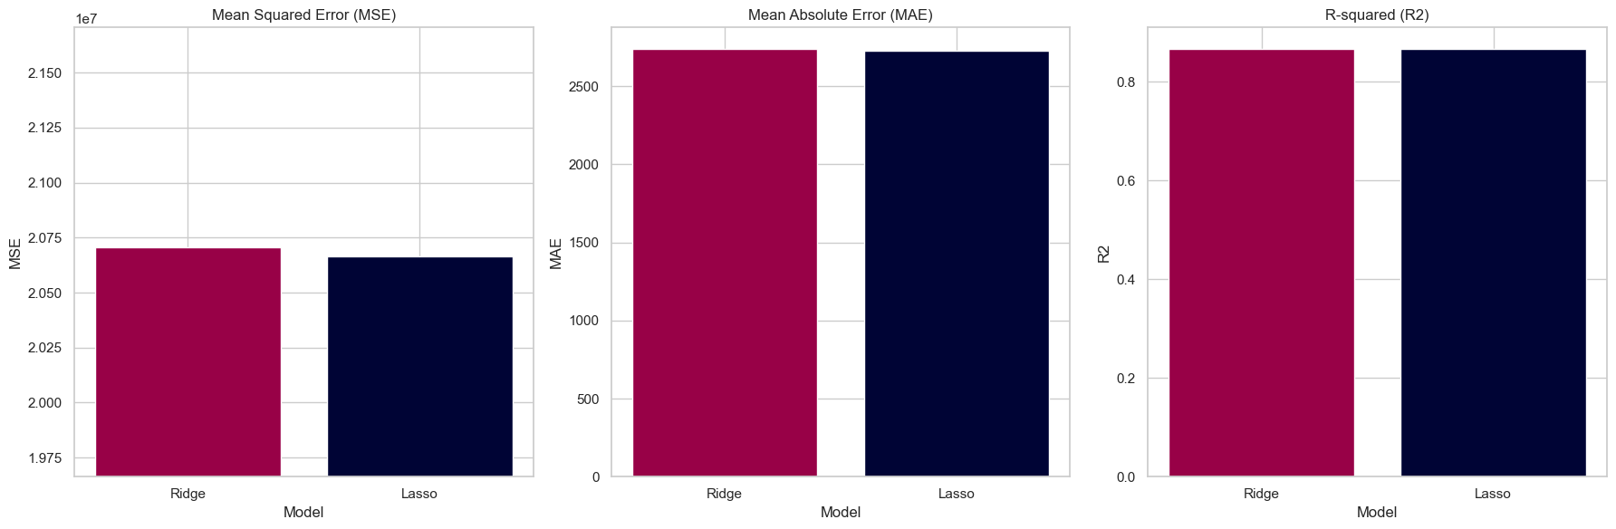
Improving Model Performances: Linear Regression
Best Model via GridSearchCV:
Ridge Regression with Polynomial Features:
Degree: 2 Regularization strength (Alpha): 1.0
Initial Model:
MSE: 21.16 mil
MAE: 2743
MedAE: 1656
R-square: 0.863
Improved Model:
MSE: 20.70 mil
MAE: 2738
MedAE: 1626
R-square: 0.867

Slide 12
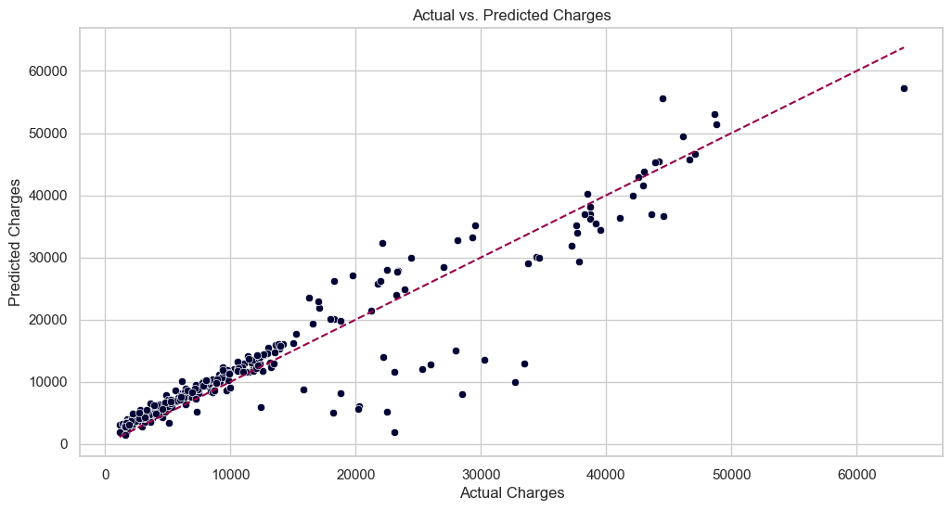
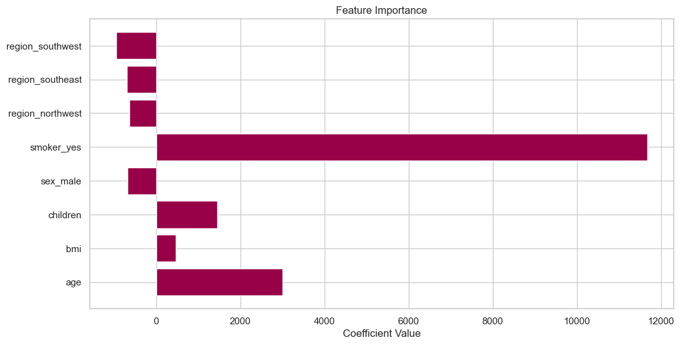
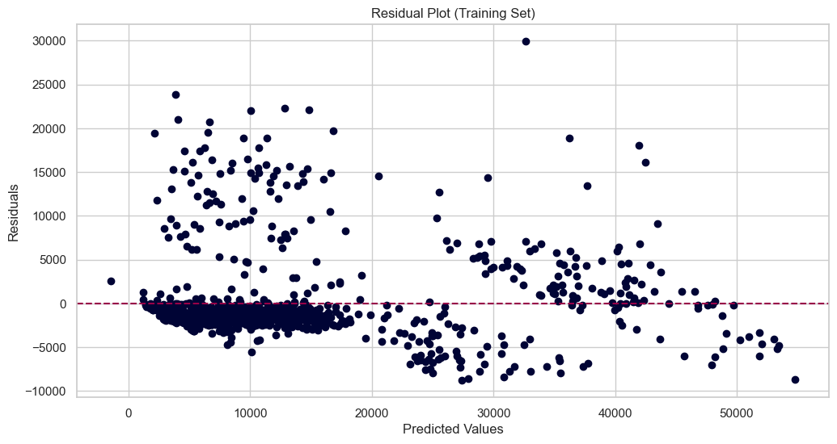
Improving Model Performances: Linear Regression
Actual v/s Predicted: Predicted Charges are close to Actual; Good model performance.
Feature Importance: Being a smoker significantly increases the expected charges.
Residual Plot: Scatter indicates a good model fit. Cluster in a specific range.
Suggestions:
Targeted Interventions.
Comprehensive family health plans.
Consider adding more detailed medical history data for even more precise predictions.

Slide 13
Improving Model Performances: Random Forest
PERFORMANCE MATRIX | INITIAL MODEL | IMPROVED MODEL
Mean Squared Error | 21818184.33195798 | 19302256.14735103
Mean Absolute Error | 2665.9223713023953 | 2601.3646345732936
R-squared | 0.8594630428068 | 0.8756688318037958
Median Absolute Error | 1345.286898949993 | 1684.6390502114086
The improved model has a lower MSE, indicating better performance.
The improved model has a slightly lower MAE indicating slightly better accuracy
The improved model has a higher R-squared value, suggesting it explains more of the variance
While the improved model shows better overall performance in terms of other metrics, the higher MedAE indicates that its typical error is larger compared to the initial model.
Business Consideration : Overall, the improved model seems to be better. However, businesses should remain cautious of the occasional larger errors and manage them accordingly.

Slide 14
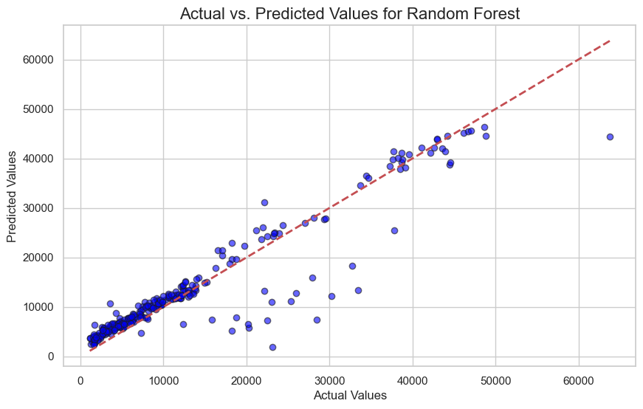
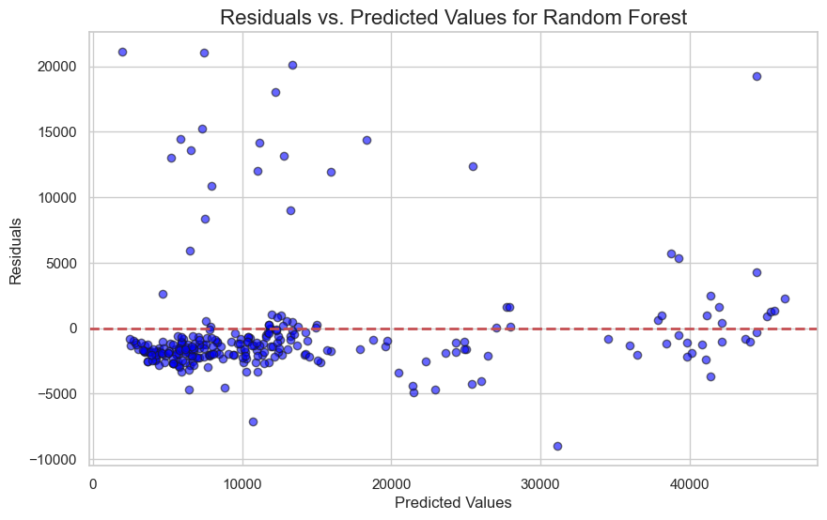
Improving Model Performances: Random Forest
Business Implication : This Model will be helpful in making reliable decision-making, risk management, cost-benefit analysis.
Majority of the data points are close to the red diagonal line, indicating that the predictions are generally accurate and align well with the actual values.
The residuals are mostly centred around the red horizontal line at y=0, showcasing that the Random Forest model does not have a significant bias in overpredicting or underpredicting insurance charges.

Slide 15
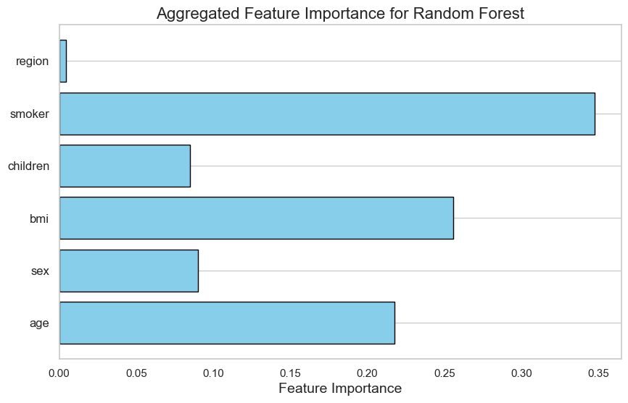
Improving Model Performances: Random Forest
Model Improvement Steps:
• GridSearchCV Hyperparameter Tuning hyperparameters.
• Utilized a comprehensive parameter grid.
• Applied 5-fold cross-validation.
• Ensured optimal model performance.
• Prevented overfitting through cross-validation.
• Utilized parallel processing for efficiency.
Top significant factors: Smoking and BMI

Slide 16
Improving Model Performances: Neural Network
Scores | Original | Improved
Mean Squared Error | 88993133 | 20757803
Mean Absolute Error | 6500.634 | 2662.478
Median Absolute Error | 4369.066 | 1472.948
R-squared Score | 0.42677 | 0.86629
Steps in hyperparameter tuning
Hidden layers
Regularization strength (alpha)
Learning rate
Feature selection
Cross-validation

Slide 17
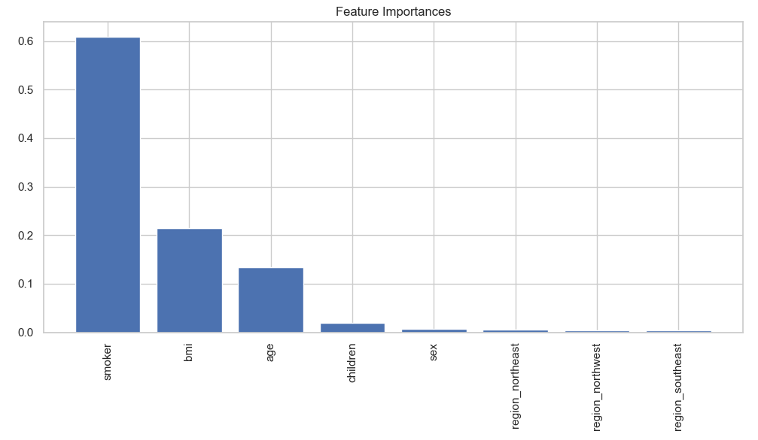
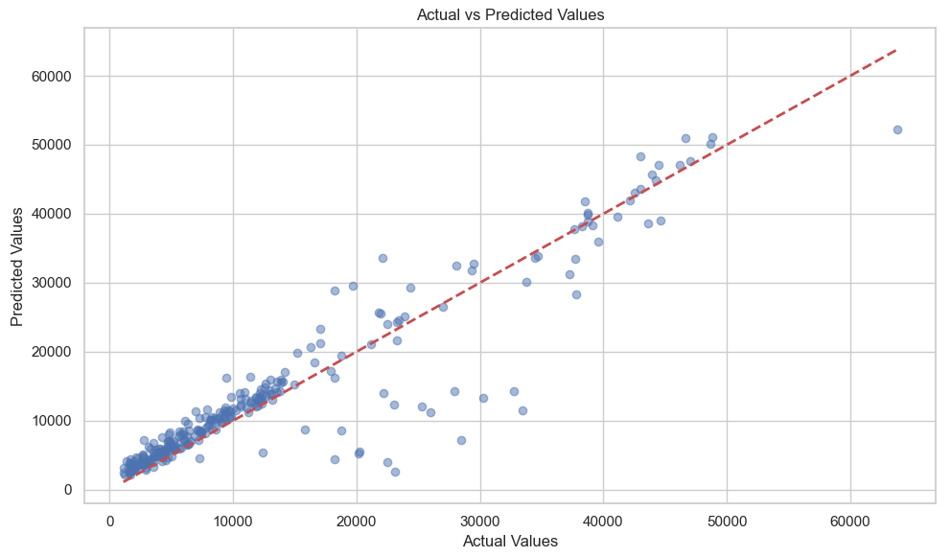
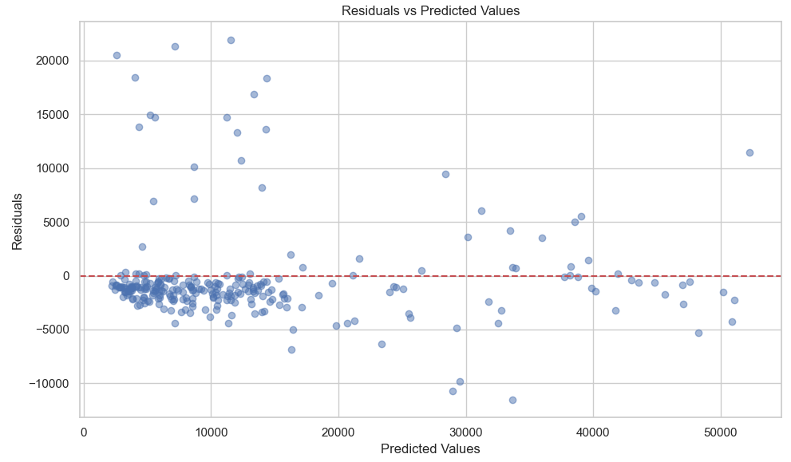
Improving Model Performances: Neural Network
Smoker
BMI & Age
Children
Sex & Region

Slide 18
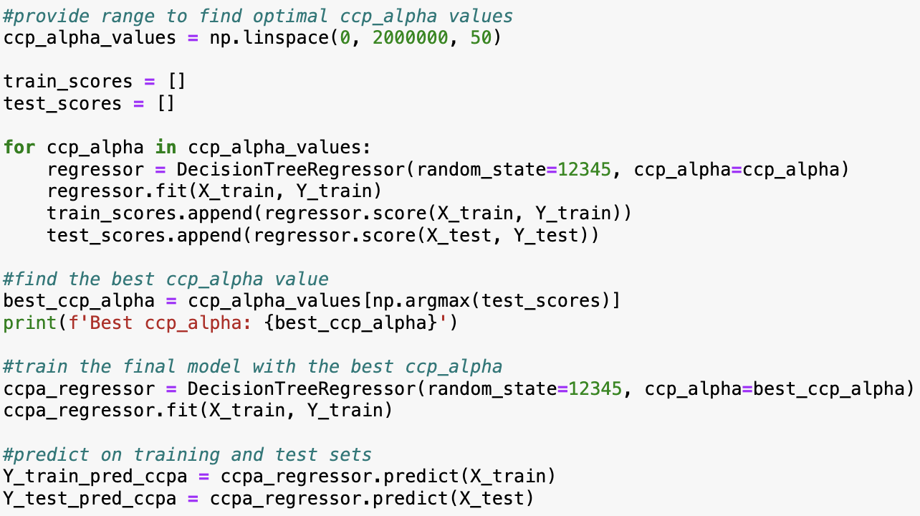
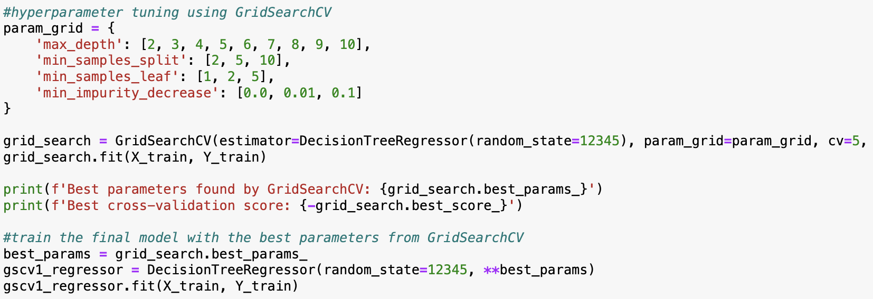
Improving Model Performances: Decision Tree
Optimal CCP Alpha Model = Uses optimal ccp_alpha (326530.612244898) to prune the Baseline Decision Tree.
GridSearchCV Model = Uses GridSearch to create Decision Tree with optimized hyperparameters.
For this presentation, focuses on Optimal CCP Alpha Model due to its readability.
It is still recommended to use the GridSearchCV model for practical applications.
METRICS | BASELINE | OPTIMAL CCP ALPHA | GRIDSEARCHCV
R² | 0.699847213287613 | 0.8696897310227775 | 0.8721354613425493
Mean Squared Error (MSE) | 42814772.39798076 | 18587881.753453627 | 18239014.804274816
Root MSE | 6543.299809574734 | 4311.366576093203 | 4270.715959212789
Mean Absolute Error (MAE) | 3085.531141847015 | 2438.820042497317 | 2401.277598044412
Median Absolute Error (MedAE) | 573.7182750000002 | 1487.3676458147875 | 1458.147168660025

Slide 19
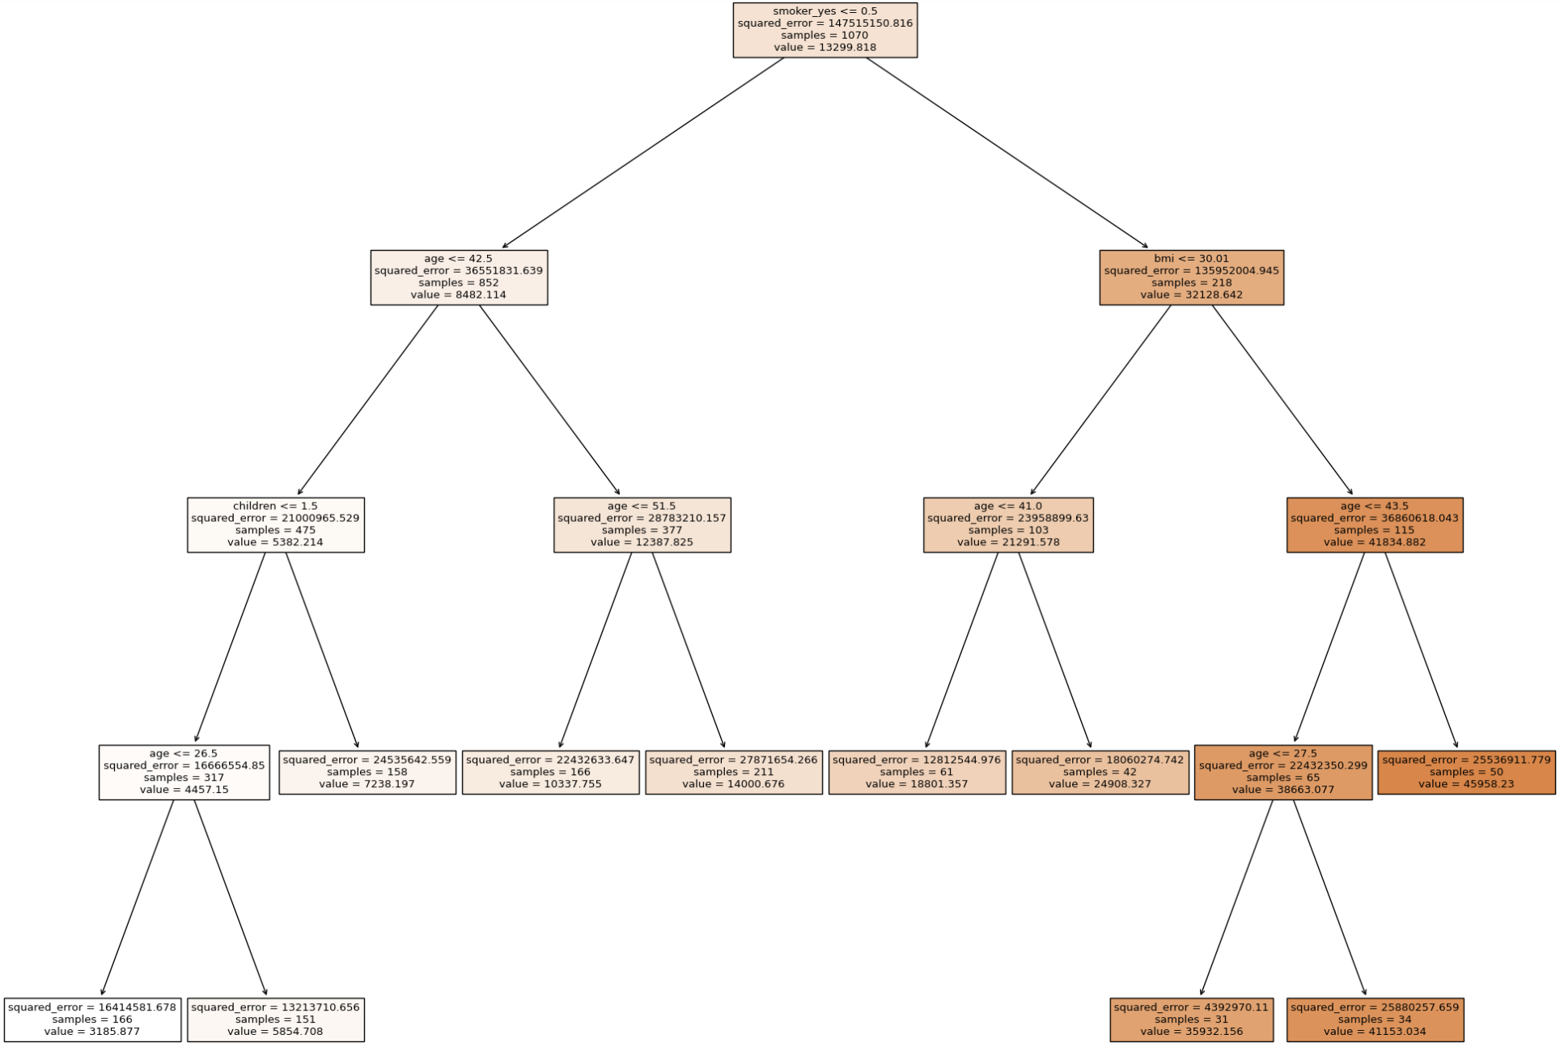
Improving Model Performances: Decision Tree
Specific Example:
Smoker + BMI > 30 + Age > 43.5 = Insurance Charges of $45,958.23.
Benefits of Decision Tree:
Highlights Key Variables.
Shows Decision-Making Process.
Manages Non-Linear Relationships Well.
Handles Categorical / Non-Categorical Data.

Slide 20
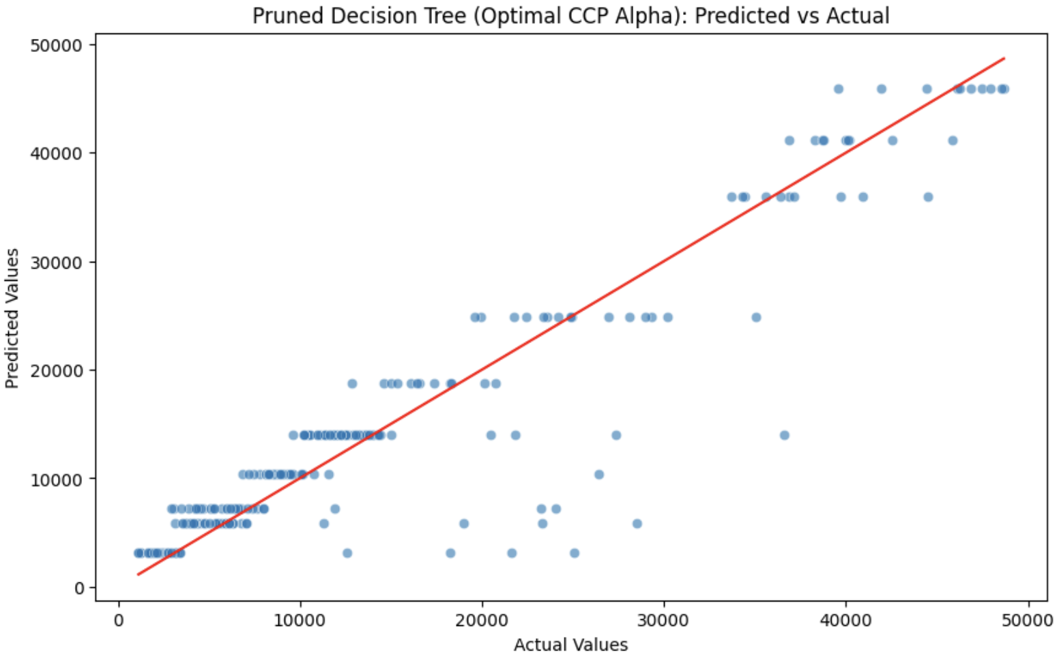
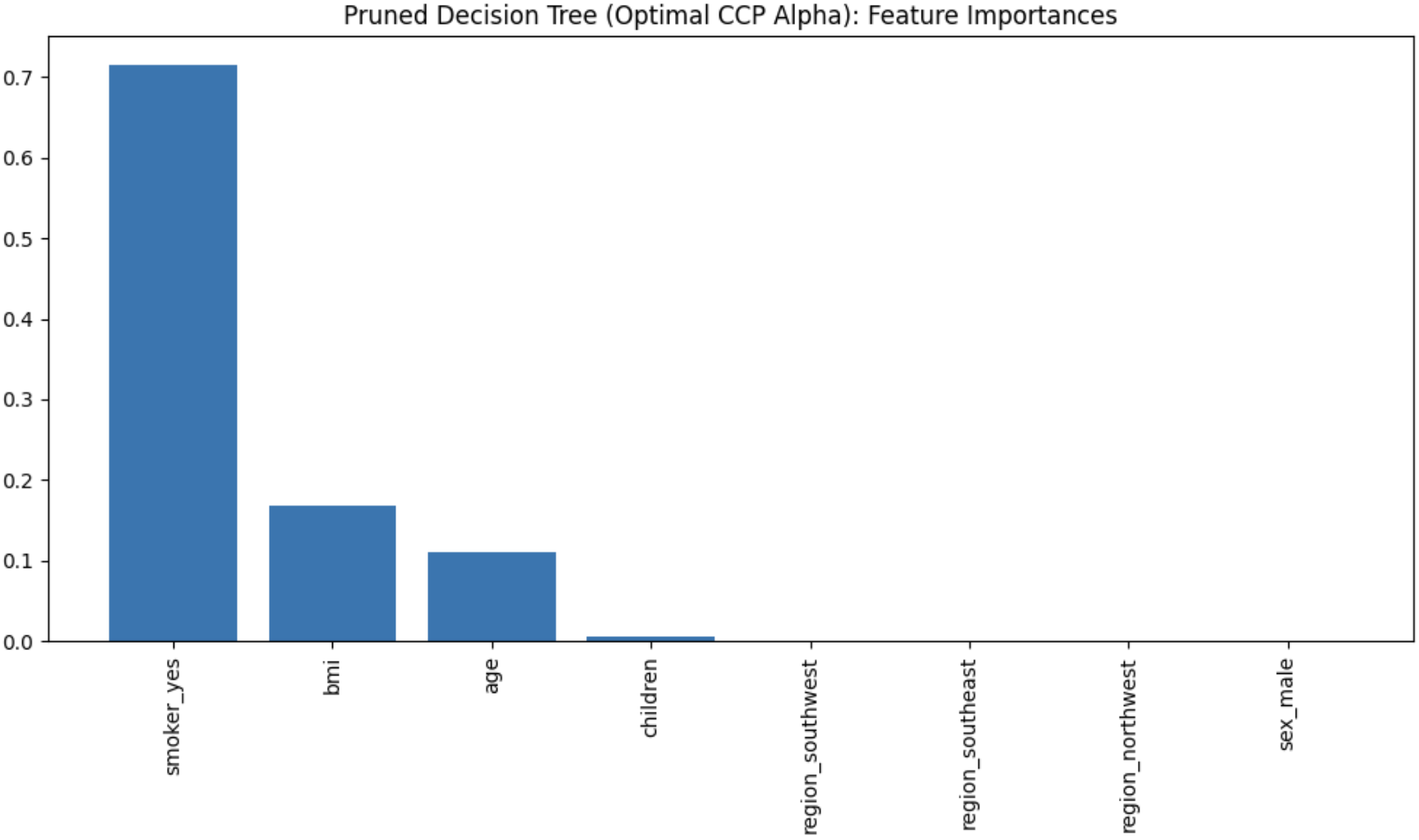
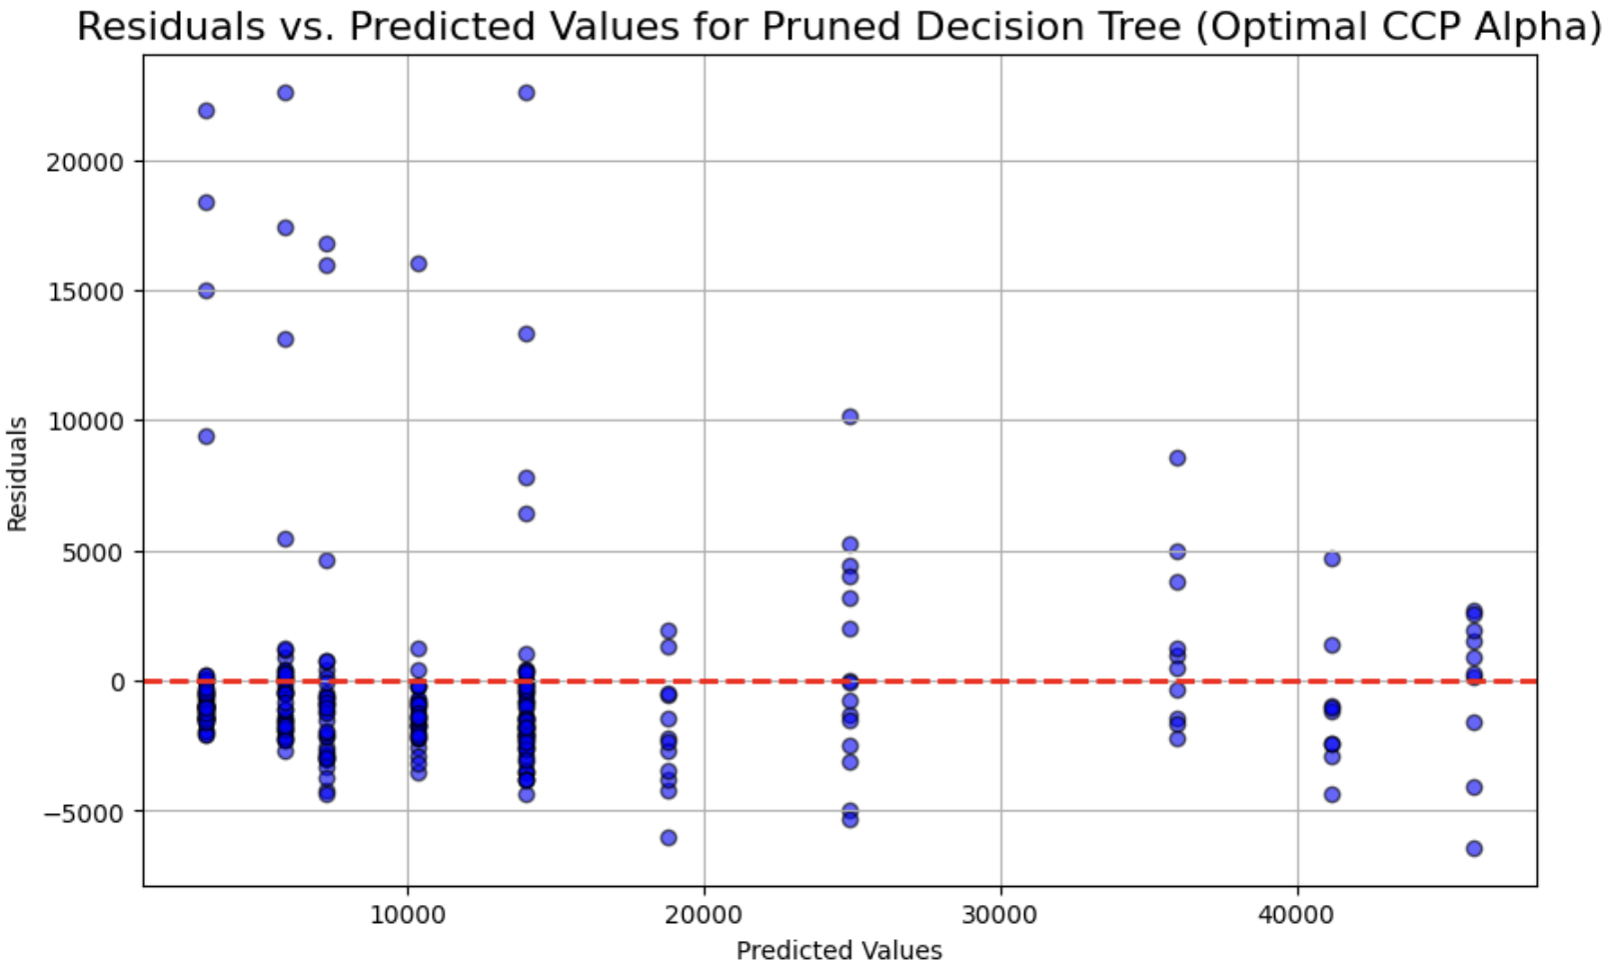
Improving Model Performances: Decision Tree
Overall Business Insights:
Prioritize data collection on key variables to enhance segmentation and create personalized insurance plans.
Use decision tree to justify different insurance charges to stakeholders.
Recognize the model's bias, as residual analysis shows it tends to overpredict charges.

Slide 21
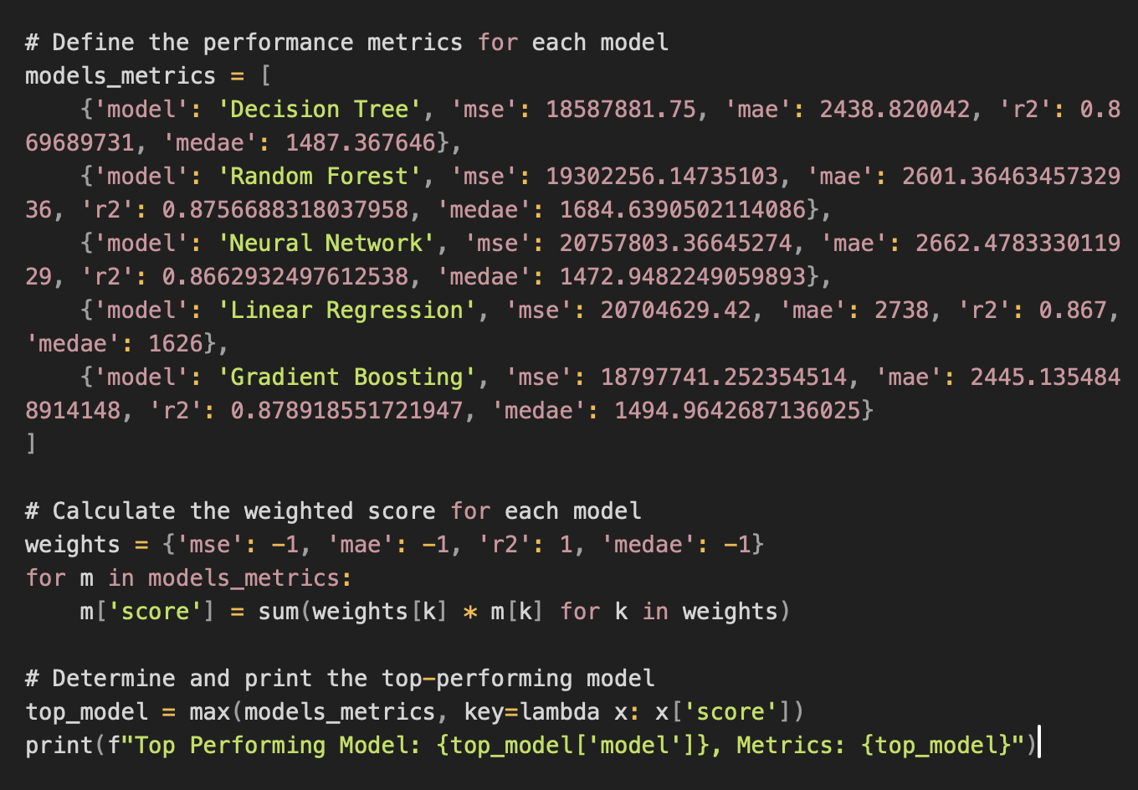
Final Summary & Recommendations
Summary:
Decision Tree is the top performing model based on weighed metrics, useful for day-to-day operations as the dataset is representative of the overall population.
Recommendations:
Personalized Health Plans
Targeted Market Campaigns
Family-Oriented Insurance Packages
Periodic model retraining and validation
Explore additional variables like detailed medical history or lifestyle.

Slide 22
Reference List
Australian Institute of Health and Welfare, Australia’s health 2018, BMI: where do you fit? Accessed 2024, online, Available at: https://www.aihw.gov.au/reports/australias-health/australias-health-2018/contents/bmi-where-do-you-fit.
Bergstra, J. and Bengio, Y., Random search for hyper-parameter optimization, The Journal of Machine Learning Research, 2012, Online, Available at: https://www.jmlr.org/papers/volume13/bergstra12a/bergstra12a.pdf
Prof. Le Pan, INFS5720 Tutorial Sessions 3 to 7, UNSW, Term 2, 2024
Scikit Learn, ColumnTransformer for heterogeneous data, Accessed 2024, Online, Available at: https://scikit-learn.org/stable/modules/compose.html#columntransformer-for-heterogeneous-data
Scikit Learn, Tuning the hyper-parameters of an estimator, Accessed 2024, Online, Available at: https://scikit-learn.org/stable/modules/grid_search.html#randomized-parameter-optimization
Scikit Learn, Gradient Boosting Regressor, Accessed 2024, Online, Available at: https://scikit-learn.org/stable/modules/generated/sklearn.ensemble.GradientBoostingRegressor
Statista, Average children per family U.S. 2023 | Statista. Accessed 2024, online, Available at: https://www.statista.com/statistics/718084/average-number-of-own-children-per-family/

