Slide 1

Sandbox Industry Project – Contoso Hotel Business Analysis
Presented By
Hima Rohini Mallina

Slide 2
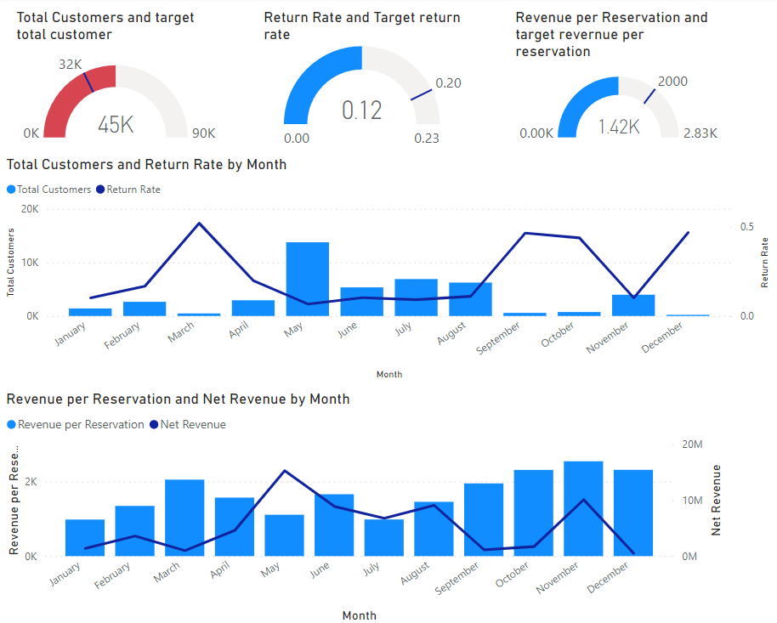
Contoso's Strategic Focus: An overview
Goal
Sustain high customer acquisition
Improve return rate and revenue per reservation
Strengthen profitability and customer satisfaction during peak season
Strategic Focus on the Holiday Period
Highest customer numbers in May-August
Opportunity to maximize revenue and build loyalty
Assumptions
The holiday period is May to August.

Slide 3
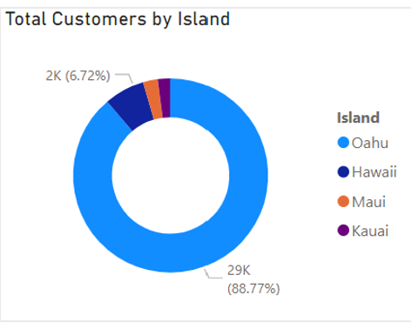
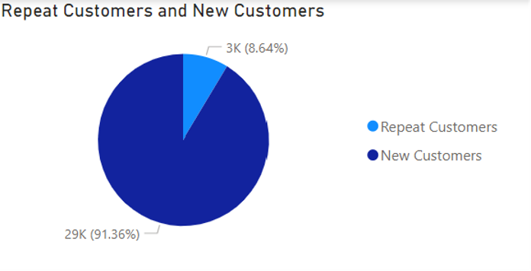
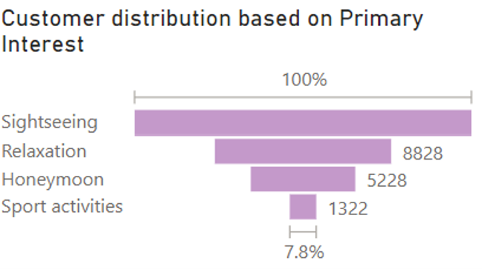
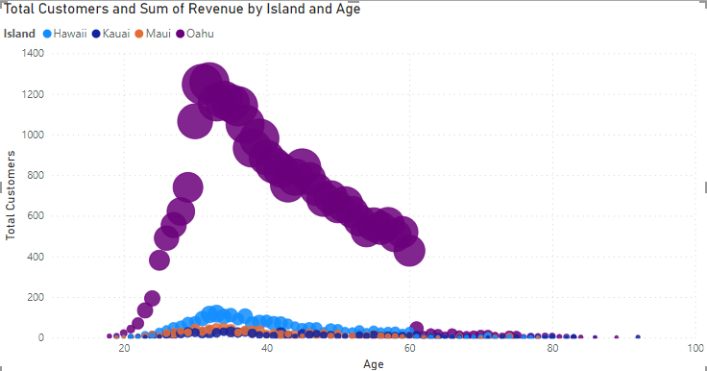
1st KPI - Customer Number Analysis 1. What is the empirical analysis of the distribution of customer preferences and demographic characteristics during the holiday?
New customer overweight repeat customer.
Sightseeing attracted most customers.
Expand the range of sights to attract new customer
Oahu received the majority of the customers.
Developing the similar facility on other islands.
Notes:
Focus on the customer visited KPI:
RQ1: What is the empirical analysis of the distribution of customer preferences and demographic characteristics during the holiday period?
The unequal distribution implies that attracting new customers might be more actionable than retaining existing ones. Moreover, exploring customers' primary interests reveals that expanding the range of attractions could help to attract customers.
The data shows that Oahu outperforms the other islands, indicating that implementing similar facilities on other islands could attract more customers by satisfying their preferences.

Slide 4
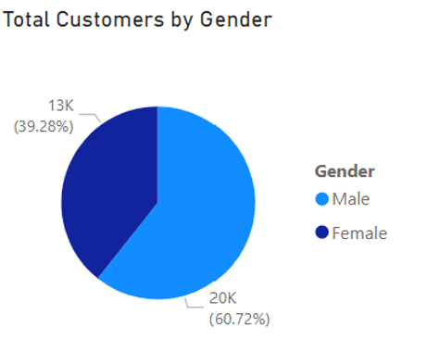
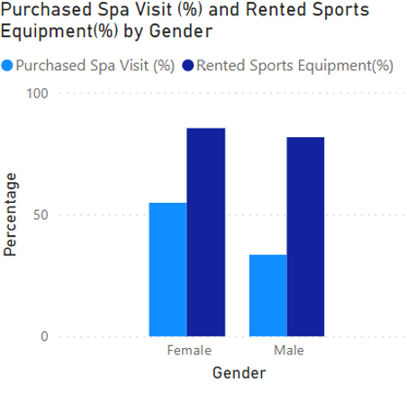
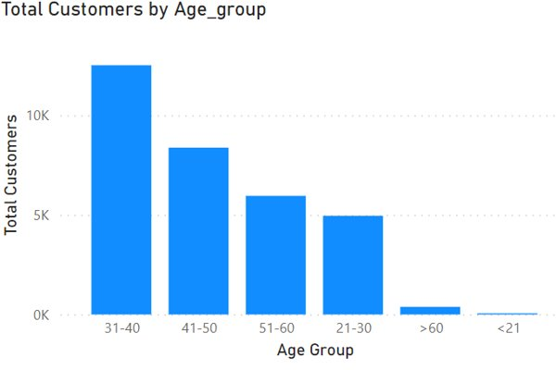
Continued
Compared to others, the representation of school-age teenagers (< 21) among the customer base was in the minority.
The hotels received less femal customers during holiday.
Spas and sports equipment are more preferable by female customers than male customers
Notes:
Continue with previous research question:
From the distribution of customer's gender, it can be seen that female customers are much less than male customers, Therefore, it is crucial to focus on attracting more female customers.
From the comparison between the male and female customer's preference, it can be summarized that female customers are more likely to purchase spa and rent sports equipment, Thus, by introducing different kinds of spa and sports equipment.
Compared to others, the representation of school-age teenagers (< 21) among the customer base was in the minority. However, considering the ample free time students have during holidays. It can be a good choice to tie-up with some universities and schools, offering tailored discounts and promotions, to effectively attract and engage younger customers.

Slide 5
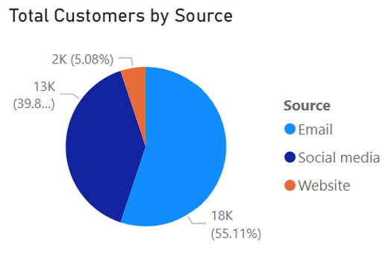

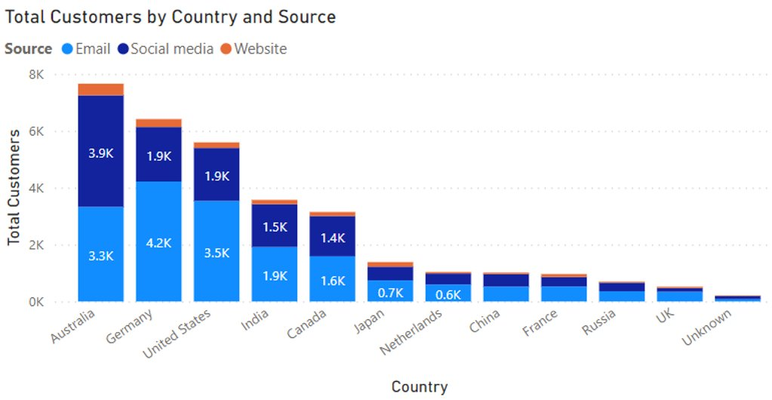
1st KPI - Customer Number Analysis 2.What would be the most effective source for attracting customers to our hotels during the holiday seasons?
Therefore, the perference of Australian customers can be focused. It can be observed that over half of them were attracted by social medias.
The emails would attract most customers from countries except Australia.
The majority of customers are from Australia.
Notes:
QR2: What would be the most effective source for attracting customers to our hotels during the holiday season?
By checking the distribution of resources it can be observed that overall the email would attract more customers, indicating more promotions could be sent through the email to increase the number of total customers.
However, the majority of customers came from Australia through social media, so we could definitely attract more customers in Australia though inviting some influencer to advertise.

Slide 6
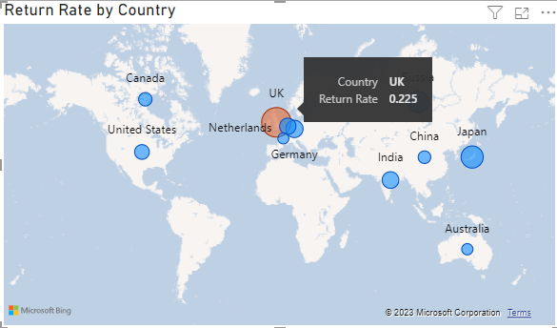
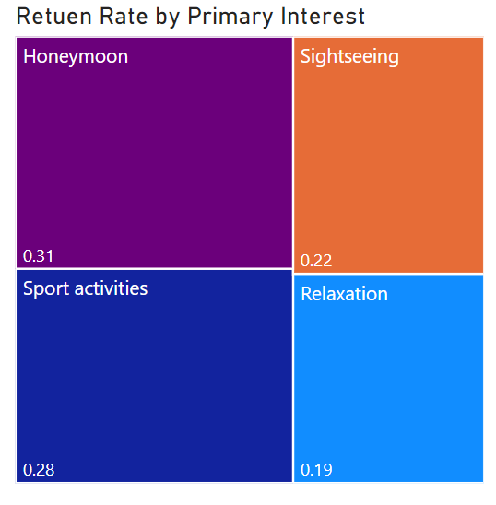
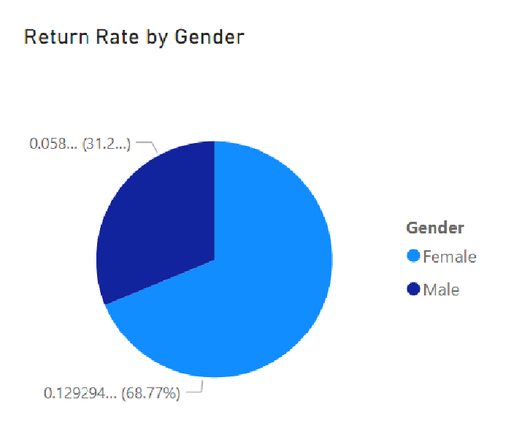
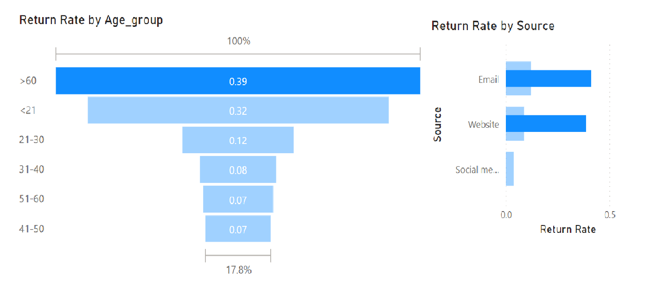
1. Which customer segments (age, gender, country, ) have the highest return rates , and how do these rates compare to the overall target of 0.2?
2nd KPI - Customer Return Rate Analysis
UK's return rate>0.2
No gender group's return rate>0.2
Age over 60 group's return rate>0.2
Notes:
Base on this graph, we can see that, the country which got the highest customer return rate is UK and its return rate reaches 0.23. The primary interest of Most of the customers from UK is honeymoon and sport activities, therefore our marketing campaign in UK can emphasis those interests more. According to the pie chart, female customers have a higher return rate than male customers, but either female or male didn’t reach 0.2. Looking through all the segments, the age over 60 group got the highest return rate which is 0.39. To attract more people from over 60, we can use the information from the graph that most of the customers over 60 were attracted by email and website. Therefore, we can improve the email and website campaign and building more elderly-friendly facilities.

Slide 7
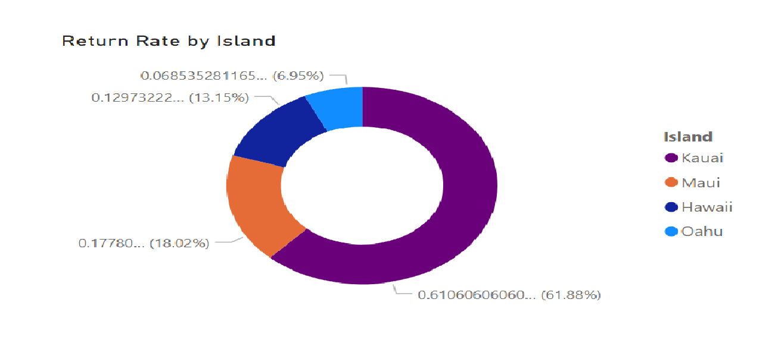
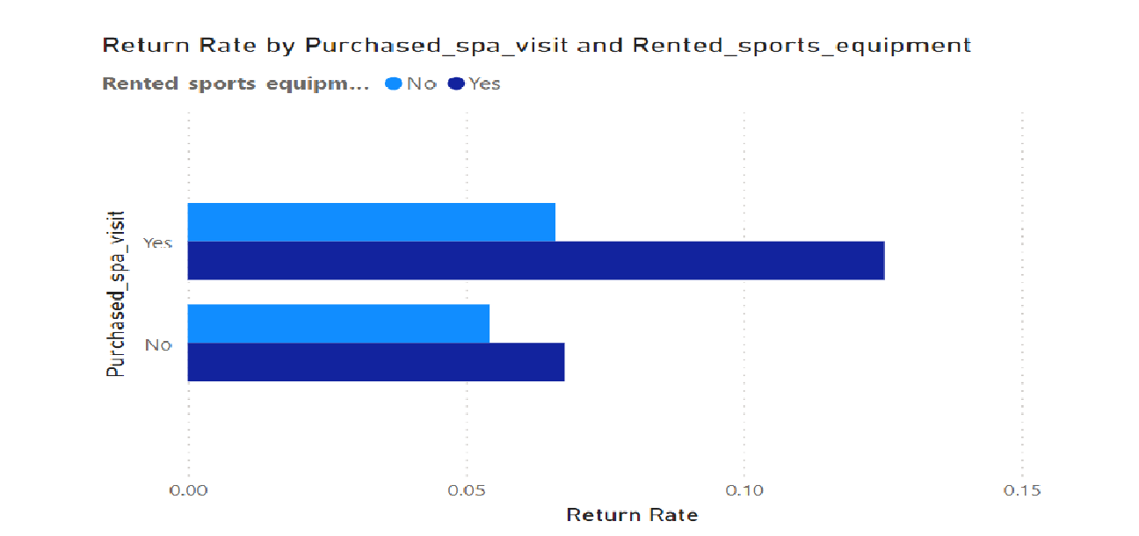
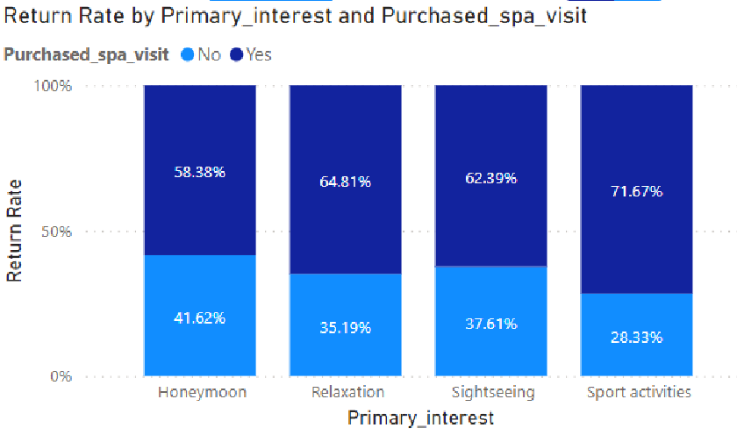
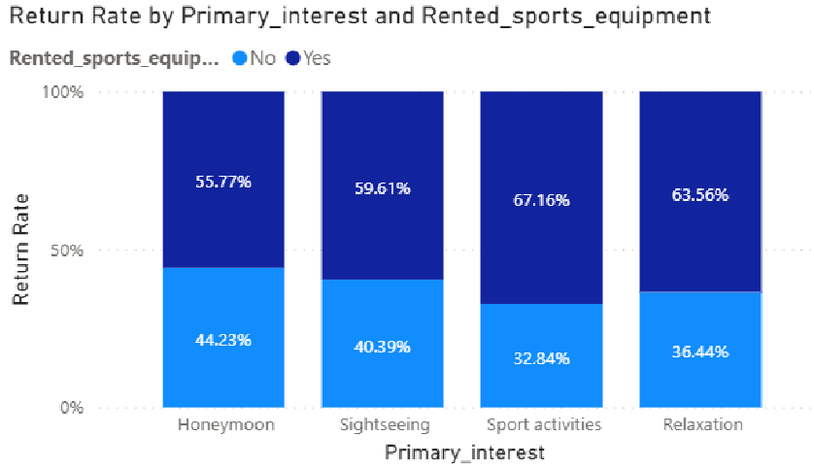
2. What is the impact of spa visits, sports equipment rentals and islands on customer return rates?
Customers who lived on Kauai island are more likely to return.
Customers who purchase services are more likely to return.
Most customers who rented sport equipment would likely return.
Notes:
For the islands, Kauai island has the highest customer return rate which reaches 0.61. We can analyze the differences between Kauai and other islands and utilize Kauai as a role model to modify the facilities and campaign of other islands.
And we can easily see that from the graphs, the purchasing of the spa visit and renting of sport equipment can both positively impact the customer return rate. It shows that the customers’ satisfaction of the services can be a very important reason of returning. Therefore, developing more services which can Make it more convenient for customers can increase the customer return rate. And we can find that if the primary interest of the customer is sport activities, then they are more likely to return if they purchased services. Therefore, we can promote those services and give voucher to the target customers to attract them to return.

Slide 8
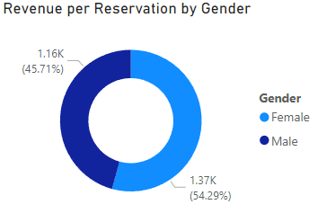
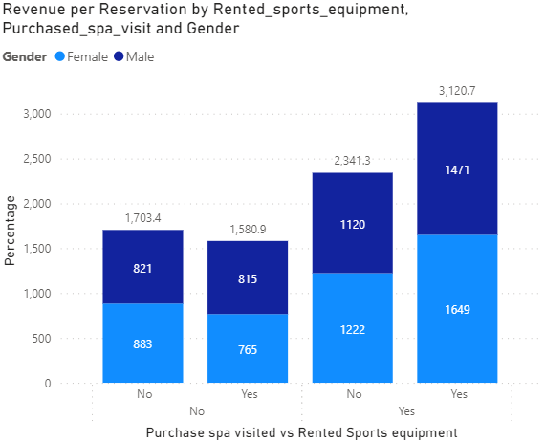
3rd KPI - Revenue Per Reservation Analysis 1. How would the choice of hotel amenities like spa visits and sports equipment rentals impact revenue per reservation during the holidays for each gender?
Female contribute more than male in revenue per reservation.
Customers who participated in both activity or only rented sports equipment has the highest revenue per reservation, with more females than males.

Slide 9
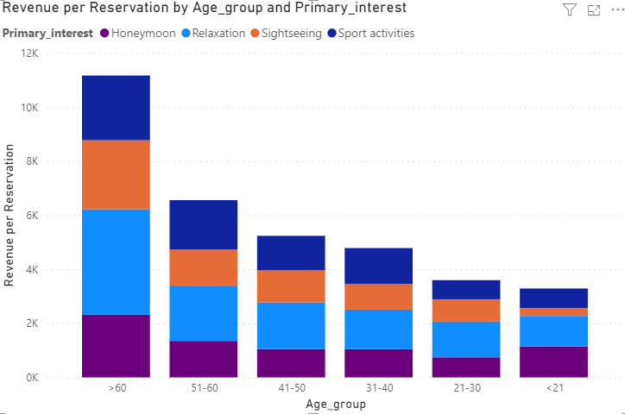
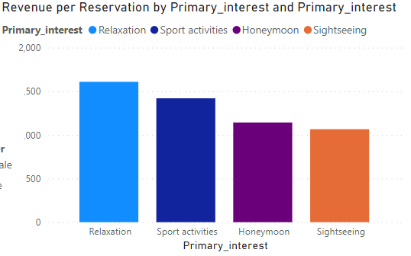
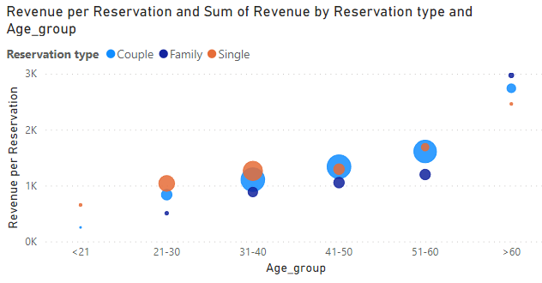
3rd KPI - Revenue Per Reservation Analysis 2. What strategy should be provided to customers in each age group to increase the revenue per reservation during holidays?
Most profitable area:
Revenue per reservation-Relaxation and sports
Elder age group tend to spend more than younger age group, with the most profits came from relaxation.
Targeting to increase number of customers for elder age group, increase spending for middle age group with promotion on single and couple room type.

Slide 10
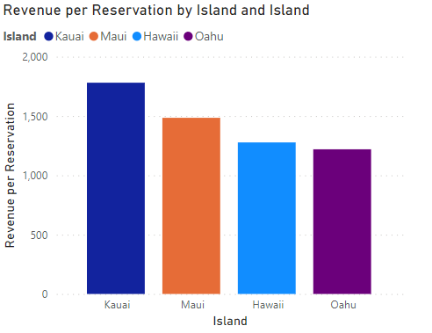
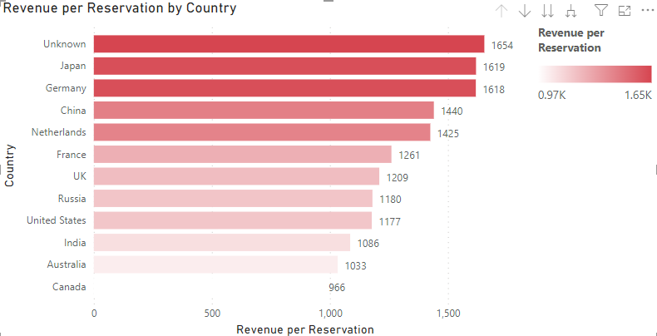
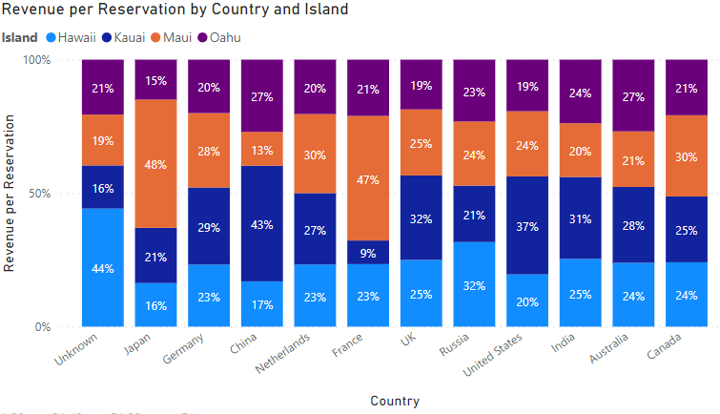
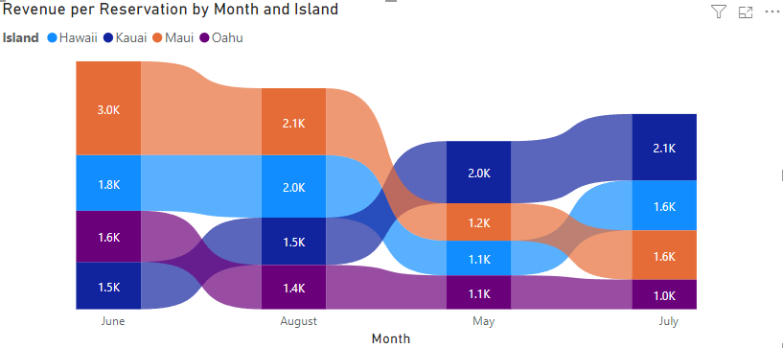
3rd KPI - Revenue Per Reservation Analysis 3. Which island branch is most profitable and what marketing campaign should be implemented for each country?
In general, Kauai is the most profitable island. Followed by Maui.
Japanese spent the most in Maui island, where people from other top spending countries prefer Kauai.

Slide 11
Conclusion: Business strategies for Contoso
How to attract more customers? | How to increase customer return rate? | How to increase sale per reservation?
University and School Partnerships Special promotions and discounts. Email & Social Media Campaigns Targeted promotions, focus on Australian social media. Enhanced Offerings for Female Customers Variety of spas and sports equipment Develop Attractive Natural Sights Increase appeal for nature enthusiasts Replicate Oahu Success Extend facilities and services to other islands | Loyalty Program Implementation Target newly acquired customers for off-peak returns Develop Convenient Services Offer new, customer-centric conveniences Promote Spa & Sports Equipment Vouchers for sports enthusiasts Highlight spa and sports services UK Market Focused Campaigns Emphasize honeymoon and sports activities Target the UK's high return rate demographics Replicate Kauai's Successful Facilities Implement similar amenities as in Kauai Enhance Email and Website Campaigns More targeted and engaging online marketing Elderly-Friendly Facility Upgrades Develop accommodations and services for over 60s | Gender-Specific Marketing Tailored campaigns for female customers Activities & Equipment Focus Promote activity and equipment rental Bundled accommodation packages Elder Age Group Targeting Packages for elder guests Focus on relaxation and wellness Middle-Aged Customer Promotions Discounts for single and couple rooms Activity and dining experience offers Maximize Profitable Areas Develop packages in relaxation and sports Leverage high revenue-generating potential Focus on Kauai and Maui Allocate resources to most profitable islands Tailor offerings to island-specific features

Slide 12

Thank you!

