Slide 1
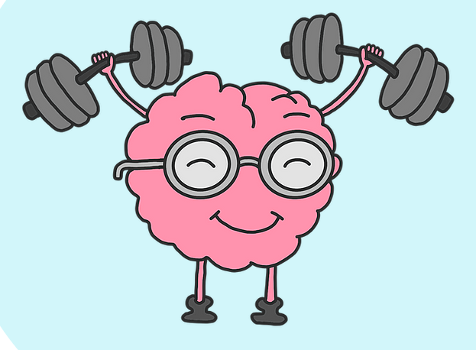
Brain Exercise Initiative

Slide 2
Our Purpose
We are a 501(c)(3) nonprofit organization that uses simple math, writing, and reading aloud exercises as an intervention to improve cognitive function.

Slide 3
About Us
BEI is an international organization established at Universities in 4 countries
Program is 100% free to participate in
Sessions led entirely by university student volunteers
We currently have 80 Chapters, over 1,000 incredible volunteers, and are continuing to rapidly grow!

Slide 4
The Research
Research conducted by Japanese Neuroscientist Dr. Ryuta Kawashima
Did simple math, reading, and writing
  30 minutes a day, 5 days a week
Showed improvements in cognitive functioning for Alzheimer’s
Exercises activate the prefrontal cortex
  part of brain responsible for memory, planning, and cognition
Individuals showed progress in communication skills
Reported feeling happier overall
https://www.tohoku.ac.jp/en/research/research_highlights/research_highlight_22.html and https://academic.oup.com/biomedgerontology/article/60/3/380/630607.

Slide 5
What We Do
Work with both Dementia and non-Dementia residents
Lead seniors in brain exercises consisting of writing, math, and reading
Work with participants for 30 minute - 45 minutes multiple times a week (virtually or in-person if possible)

Slide 6
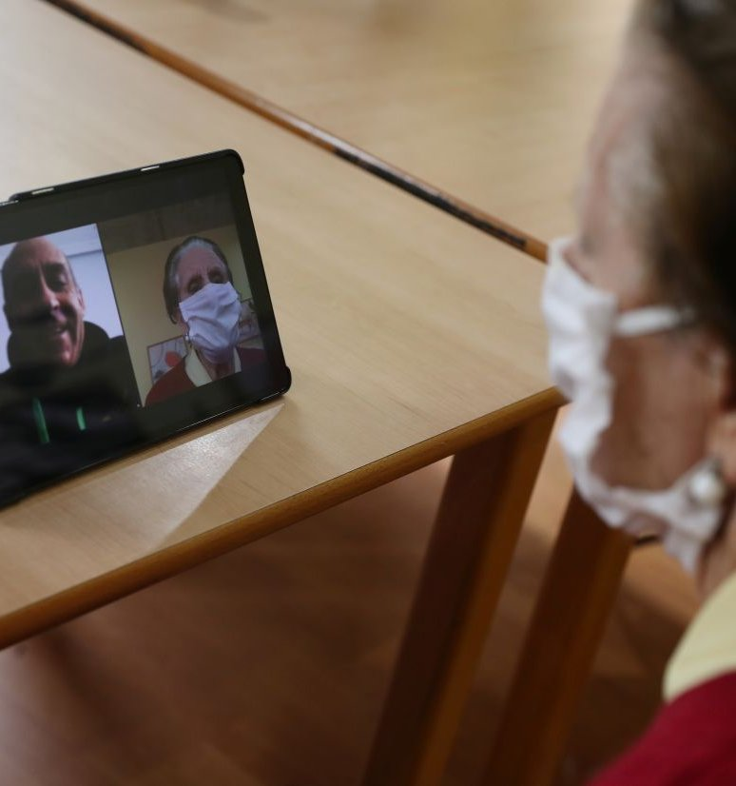
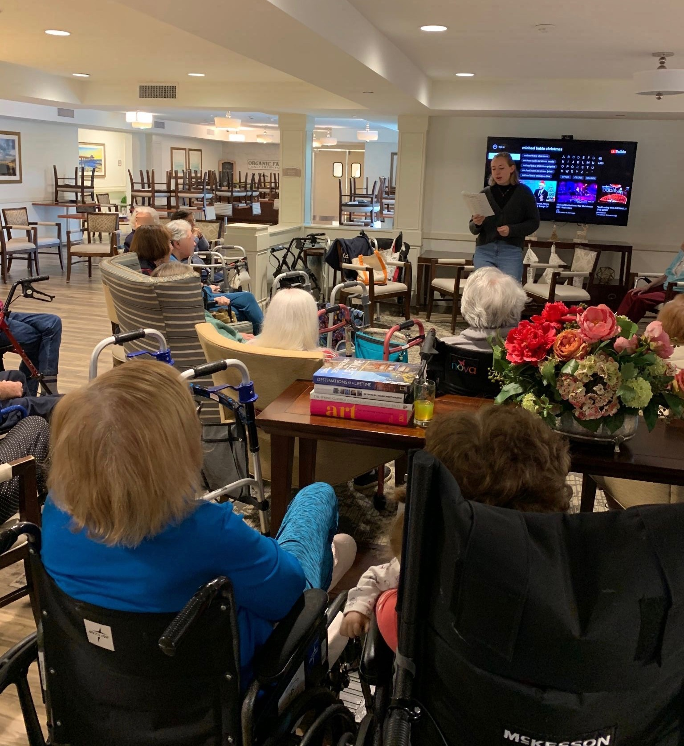
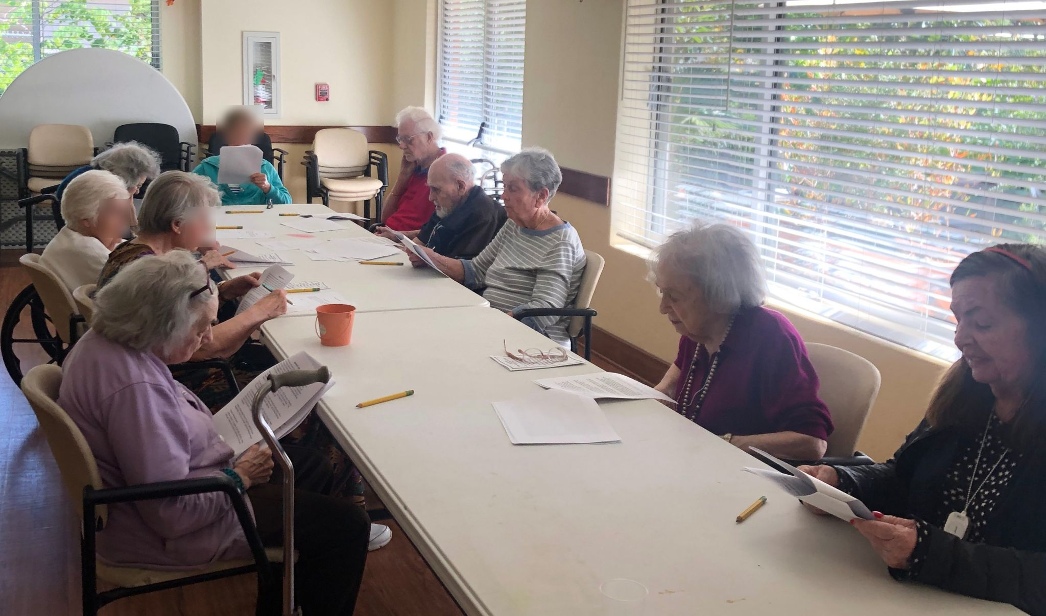
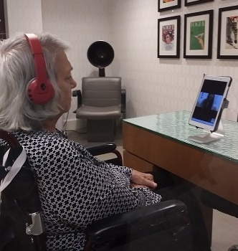
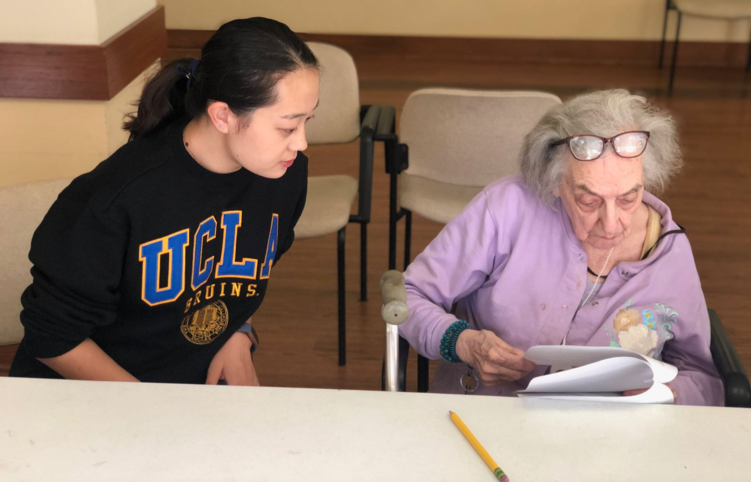
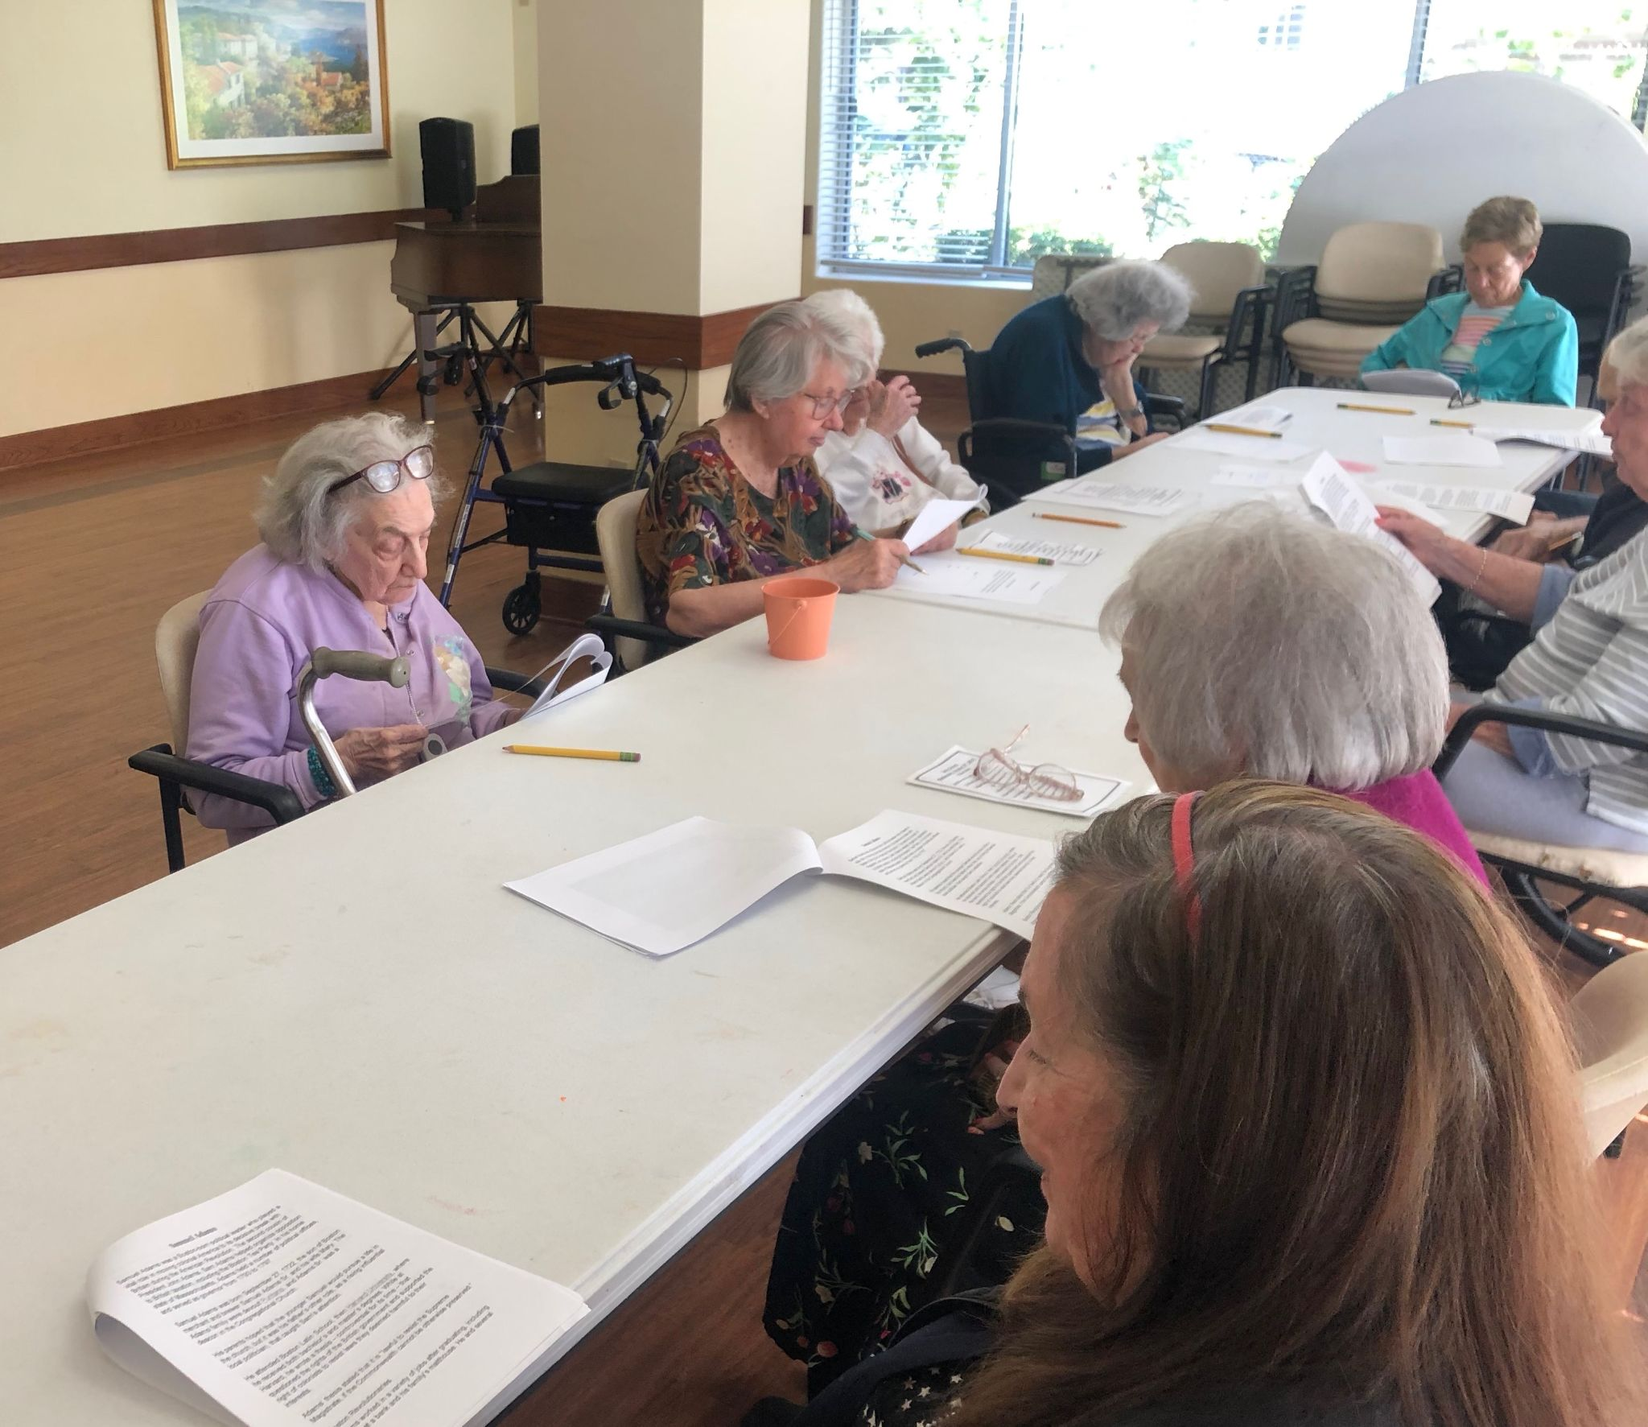

Slide 7
Writing/Trivia Exercise Example
What is the capital of Arizona?
Which president is on the penny?

Slide 8
Math Exercise Examples
4 + 4 = 11 x 3 =
16 ÷ 8 = 24 ÷ 12 =

Slide 9
Reading Section Example
“Michael Joseph Jackson (August 29, 1958 – June 25, 2009) was an American singer, songwriter, and dancer. Dubbed the " King of Pop ", he is widely regarded as one of the most significant cultural figures of the 20th century and one of the greatest entertainers of all time. He was also known for his unorthodox lifestyle, residing in a private amusement park he called Neverland Ranch , and often becoming the focus of tabloid scrutiny. Jackson's contributions to music, dance, and fashion, along with his publicized personal life, made him a global figure in popular culture for over four decades.”

Slide 10
What are the Benefits of BEI for students?
Learn more about yourself and grow as a person!
  Do you enjoy people-oriented jobs/opportunities? Do you enjoy working with elderly individuals? Do you flourish in leadership and teaching positions?
Earn invaluable volunteer experience
  Can help with applying for Graduate School, Medical School, Job opportunities, etc.
BEI sessions count as volunteer hours for Honors Program

Slide 11
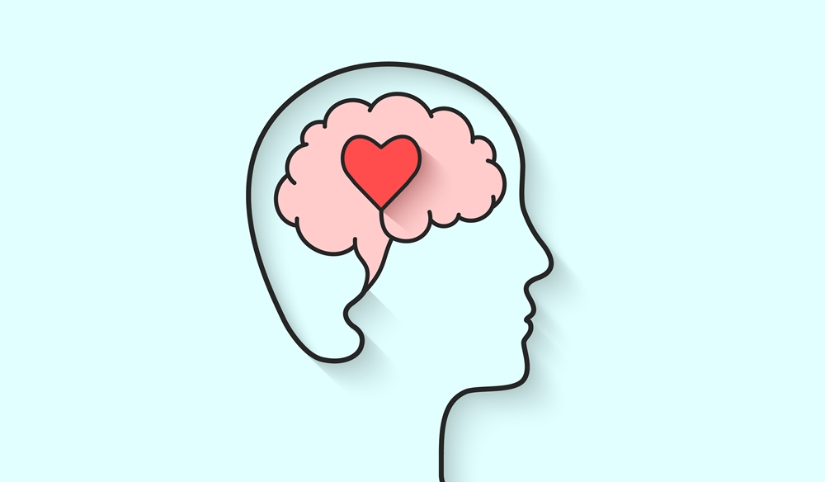
We Believe
We can create a positive, engaging program for seniors. Doing ​simple brain exercises of math, writing, and reading aloud for about 45 minutes a day, can brighten the day and improve cognitive functioning!

