Slide 1
Course Agenda
Classification
Deep Learning
  Deep Neural Network (DNN, ANN)
  Convolution Neural Network (CNN)
  Autoencoder (AE)
  Recurrent Neural Network (RNN)
  Transformer (Trm)
  Matrix Factorization (MF)
Reinforcement Learning (RL)
  Actor-based, Critic-based, Actor-Critic
Generative Adversarial Network (GAN)

Slide 2
Classification
Yi-Cheng Chen (陳以錚)
Dept. of Information Management,
National Central University
(Some materials are borrowed from Dr. Eamonn Keogh)

Slide 3
Classification: Definition
Given a collection of records (training set )
  Each record contains a set of attributes, one of the attributes is the class attribute.
Find a model for class attribute as a function of the values of other attributes.
Goal: previously unseen records should be assigned a class as accurately as possible.
  A test set is used to determine the accuracy of the model. Usually, the given data set is divided into training and test sets, with training set used to build the model and test set used to validate it.

Slide 4
Illustrating Classification Task

Slide 5

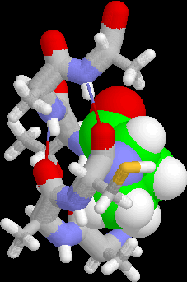
Examples of Classification Task
Predicting tumor cells as benign or malignant
Classifying credit card transactions
as legitimate or fraudulent
Classifying secondary structures of protein
as alpha-helix, beta-sheet, or random
coil
Categorizing news stories as finance,
weather, entertainment, sports, etc

Slide 6
Classification Techniques
Decision Tree based Methods
Naïve Bayes and Bayesian Belief Networks
Support Vector Machines
Neural Networks
Others

Slide 7
Example of a Decision Tree
categorical
categorical
continuous
class
Splitting Attributes
Refund
Yes
No
NO
MarSt
Single, Divorced
Married
TaxInc
NO
< 80K
> 80K
NO
YES
Training Data
Model: Decision Tree

Slide 8
Another Example of Decision Tree
categorical
categorical
continuous
class
MarSt
Single, Divorced
Married
NO
Refund
Yes
No
NO
TaxInc
< 80K
> 80K
NO
YES
There could be more than one tree that fits the same data!

Slide 9
Decision Tree Classification Task
Decision Tree

Slide 10
Apply Model to Test Data
Test Data
Start from the root of tree.
Refund
Yes
No
NO
MarSt
Single, Divorced
Married
TaxInc
NO
< 80K
> 80K
NO
YES

Slide 11
Apply Model to Test Data
Test Data
Refund
Yes
No
NO
MarSt
Single, Divorced
Married
TaxInc
NO
< 80K
> 80K
NO
YES

Slide 12
Apply Model to Test Data
Test Data
Refund
Yes
No
NO
MarSt
Single, Divorced
Married
TaxInc
NO
< 80K
> 80K
NO
YES

Slide 13
Apply Model to Test Data
Test Data
Refund
Yes
No
NO
MarSt
Single, Divorced
Married
TaxInc
NO
< 80K
> 80K
NO
YES

Slide 14
Apply Model to Test Data
Test Data
Refund
Yes
No
NO
MarSt
Single, Divorced
Married
TaxInc
NO
< 80K
> 80K
NO
YES

Slide 15
Apply Model to Test Data
Test Data
Refund
Yes
No
NO
MarSt
Single, Divorced
Married
Assign Cheat to “No”
TaxInc
NO
< 80K
> 80K
NO
YES

Slide 16
Decision Tree Classification Task
Decision Tree

Slide 17
Supervised vs. Unsupervised Learning
Supervised Learning (classification)
  Supervision: The training data (observations, measurements, etc.) are accompanied by labels indicating the class of the observations
  New data is classified based on the training set
Unsupervised learning (clustering)
  The class labels of training data is unknown
  Given a set of measurements, observations, etc. with the aim of establishing the existence of classes or clusters in the data

Slide 18
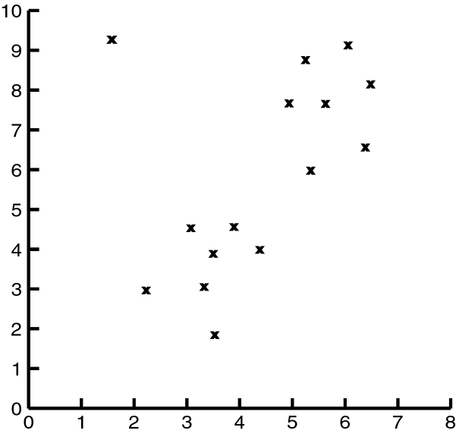
Example of Clustering with Outlier

Slide 19
Decision Tree

Slide 20
Training Dataset

Slide 21
Output: A Decision Tree for “buys_computer”
age?
<=30
overcast
>40
30..40
student?
yes
credit rating?
no
yes
excellent
fair
no
yes
no
yes

Slide 22
Algorithm for Decision Tree Induction
Basic algorithm (a greedy algorithm)
  Tree is constructed in a top-down recursive divide-and-conquer manner
  At start, all the training examples are at the root
  Attributes are categorical (if continuous-valued, they are discretized in advance)
  Training records are partitioned recursively based on selected attributes
  Test attributes are selected on the basis of a heuristic or statistical measure (e.g., information gain)

Slide 23
age?
<=30
31…40
>40
income | student | credit_rating | class
high | no | fair | no
high | no | excellent | no
medium | no | fair | no
low | yes | fair | yes
medium | yes | excellent | yes
income | student | credit_rating | class
medium | no | fair | yes
low | yes | fair | yes
low | yes | excellent | no
medium | yes | fair | yes
medium | no | excellent | no
income | student | credit_rating | class
high | no | fair | yes
low | yes | excellent | yes
medium | no | excellent | yes
high | yes | fair | yes

Slide 24
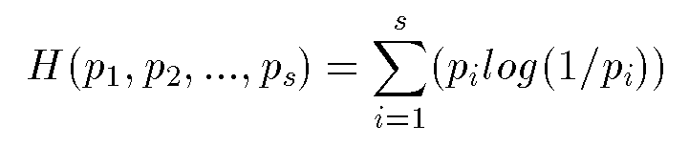
Information/Entropy
Given probabilitites p₁, p₂, .., p_{s} whose sum is 1, Entropy is defined as:
Entropy measures the amount of randomness or surprise or uncertainty.
Goal in classification
  no surprise
  entropy = 0

Slide 25
Example of Entropy (cont’d)
Entropy can be measured for a set, e.g.:
S = {a, a, a, a, a, a, a, a, b, b, b, b, b}
(8 a’s and 5 b’s, 13 total)
Remember negative!
for the a’s
for the b’s

Slide 26
Example of Entropy
Entropy is a measure of ‘uncertainty’ in a probability distribution.
Probability(event 1) = 0.5
Probability(event 2) = 0.5
Entropy = 1.0
Probability(event 1) = 0.1
Probability(event 2) = 0.9
Entropy = 0.469

Slide 27
Example of Entropy (cont’d)
This is zero entropy, i.e. zero uncertainty about which event is the ‘true’ one.
Probability(event 1) = 0
Probability(event 2) = 1
Entropy = 0.0

Slide 28
Attribute Selection Measure: Information Gain (ID3/C4.5)
Select the attribute with the highest information gain
S contains s_{i} tuples of class C_{i} for i = {1, …, m}
Information measures info. required to classify any arbitrary tuple
Entropy of attribute A with values {a₁,a₂,…,a_{v}}
Information gained by branching on attribute A
Notes:
Then how can we decide a test attribute on each node?
One of the popular methods is using information gain measure, which we covered in chapter 5.
It involves rather complicated equations, and I’ll not present the details here. Just basic ideas.
The basic idea is that we select the attribute with the highest information gain.
This information gain can be calculated from the expected information I and entropy of each attribute, E
I : the expected information needed to classify a given sample
E (entropy) : expected information based on the partitioning into subsets by A

Slide 29
Example (Step by Step)
Entropy = I(9, 5) =0.940
(from 14 examples)

Slide 30
age?
<=30
31…40
>40
income | student | credit_rating | class
high | no | fair | no
high | no | excellent | no
medium | no | fair | no
low | yes | fair | yes
medium | yes | excellent | yes
income | student | credit_rating | class
medium | no | fair | yes
low | yes | fair | yes
low | yes | excellent | no
medium | yes | fair | yes
medium | no | excellent | no
income | student | credit_rating | class
high | no | fair | yes
low | yes | excellent | yes
medium | no | excellent | yes
high | yes | fair | yes
Entropy =0.971
(from 5 examples)
Entropy =I(2,3)
=0.971
(from 5 examples)
Entropy =0
(from 4 examples)

Slide 31
age?
<=30
31…40
>40
0.971
(5 examples)
0
(4 examples)
0.971
(5 examples)
5 tuples with ‘<=30’
4 tuples
with ’31..40’
5 tuples
with ’>40’

Slide 32
Attribute Selection by Information Gain Computation
Class P: buys_computer = “yes”
Class N: buys_computer = “no”
I(p, n) = I(9, 5) =0.940
Compute the entropy for age:
means “age <=30” has 5 out of 14 samples, with 2 yes’es and 3 no’s. Hence
Similarly,

Slide 33
Algorithm for Decision Tree Induction (cont’d)
Conditions for stopping partitioning
  All samples for a given node belong to the same class
  There are no remaining attributes for further partitioning – majority voting is employed for classifying the leaf
  There are no samples left

Slide 34
Notes on Decision Trees
Training Data
Choosing Splitting Attributes
Splits
Tree Structure
Stopping Criteria
Pruning

Slide 35

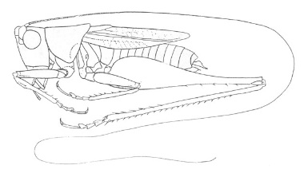
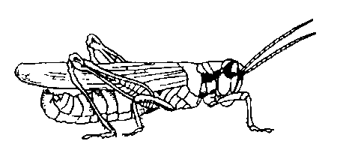
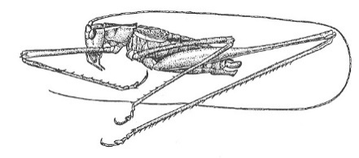
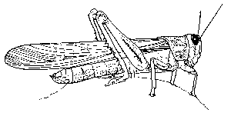
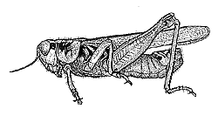
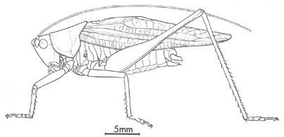
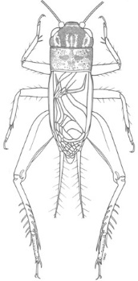
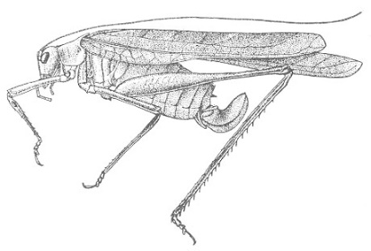
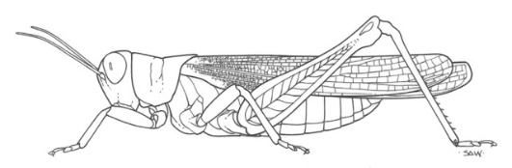
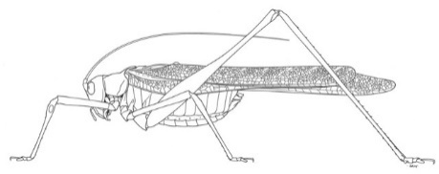
Classifier
10
9
Katydids
8
7
6
Antenna Length
5
4
3
2
1
1
2
3
4
5
6
7
8
9
10
Abdomen Length
Grasshoppers

Slide 36
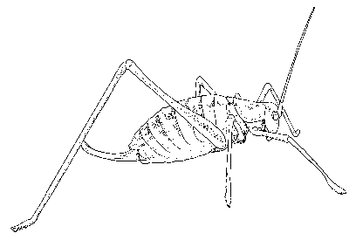
previously unseen instance =
11 | 5.1 | 7.0 | ???????
We can “project” the previously unseen instance into the same space as the database.
We have now abstracted away the details of our particular problem. It will be much easier to talk about points in space.
10
9
8
7
6
Antenna Length
5
4
3
2
1
Katydids
Grasshoppers
1
2
3
4
5
6
7
8
9
10
Abdomen Length

Slide 37
Simple Linear Classifier
10
9
If previously unseen instance above the line
then
class is Katydid
else
class is Grasshopper
8
7
6
5
4
Katydids
Grasshoppers
3
2
1
1
2
3
4
5
6
7
8
9
10

Slide 38
Decision Tree Classifier
10
Abdomen Length > 7.1?
9
8
no
yes
7
Antenna Length > 6.0?
Katydid
6
Antenna Length
5
no
yes
4
Grasshopper
Katydid
3
2
1
1
2
3
4
5
6
7
8
9
10
Abdomen Length

Slide 39
The problem of correlated features
10
9
8
7
6
Deep Bushy Tree
Useless
Deep Bushy Tree
5
4
3
2
1
1
2
3
4
5
6
7
8
9
10
?
100
10
90
9
The Decision Tree has a hard time with correlated attributes
80
8
70
7
60
6
50
5
40
4
30
3
20
2
10
1
10
20
30
40
50
60
70
80
90
100
1
2
3
4
5
6
7
8
9
10

Slide 40
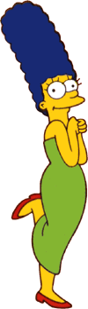



Overfitting Problem
With few data points, decision tree may perfectly classify the training data
Model built is not generalized to future datasets
Yes
No
Wears green?
Female
Male

Slide 41
Extracting Classification Rules from Trees
Represent the knowledge in the form of IF-THEN rules
One rule is created for each path from the root to a leaf
Each attribute-value pair along a path forms a conjunction
The leaf node holds the class prediction
Rules are easier for humans to understand
Example
  IF age = “<=30” AND student = “no” THEN buys_computer = “no”
  IF age = “<=30” AND student = “yes” THEN buys_computer = “yes”
  IF age = “31…40” THEN buys_computer = “yes”
  IF age = “>40” AND credit_rating = “excellent” THEN buys_computer = “yes”
  IF age = “<=30” AND credit_rating = “fair” THEN buys_computer = “no”

Slide 42
Advantages/Disadvantages of Decision Trees
Advantages:
  Easy to understand
  Easy to generate rules
Disadvantages:
  May suffer from overfitting
  Classifies by rectangular partitioning (so does not handle correlated features very well)
  Can be quite large – pruning is necessary
  Does not handle streaming data easily

Slide 43
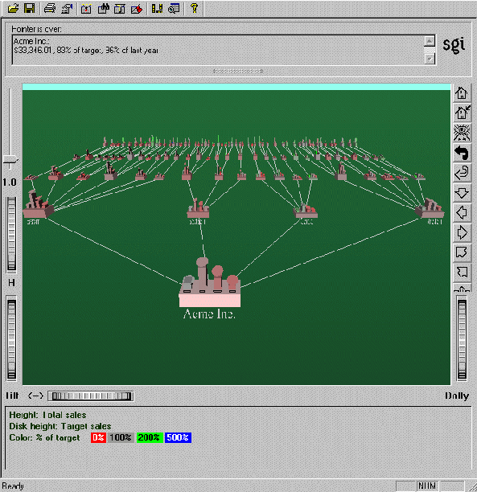
Visualization of a Decision Tree in SGI/MineSet 3.0

Slide 44
Bayes Classifier

Slide 45
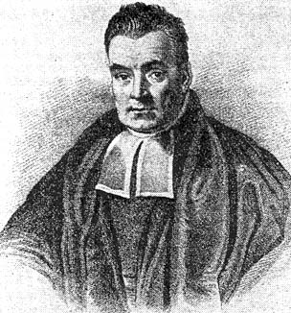
Thomas Bayes
1702 - 1761

Slide 46
Grasshoppers
Katydids
10
9
8
7
6
Antenna Length
5
4
3
2
1
1
2
3
4
5
6
7
8
9
10
Abdomen Length

Slide 47
With a lot of data, we can build a histogram. Let us just build one for “Antenna Length” for now…
10
Katydids
Grasshoppers
9
8
7
6
Antenna Length
5
4
3
2
1
1
2
3
4
5
6
7
8
9
10

Slide 48
We can leave the histograms as they are, or we can summarize them with two normal distributions.
Let us us two normal distributions for ease of visualization in the following slides…

Slide 49
p(c_{j} | d) = probability of class c_{j}, given that we have observed d
P(Grasshopper | 3 ) = 10 / (10 + 2) = 0.833
P(Katydid | 3 ) = 2 / (10 + 2) = 0.166
10
2
3
Antennae length is 3

Slide 50
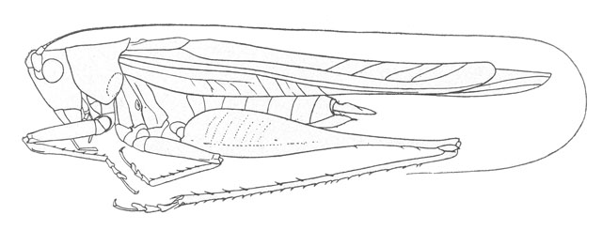
p(c_{j} | d) = probability of class c_{j}, given that we have observed d
P(Grasshopper | 7 ) = 3 / (3 + 9) = 0.250
P(Katydid | 7 ) = 9 / (3 + 9) = 0.750
9
3
7
Antennae length is 7

Slide 51
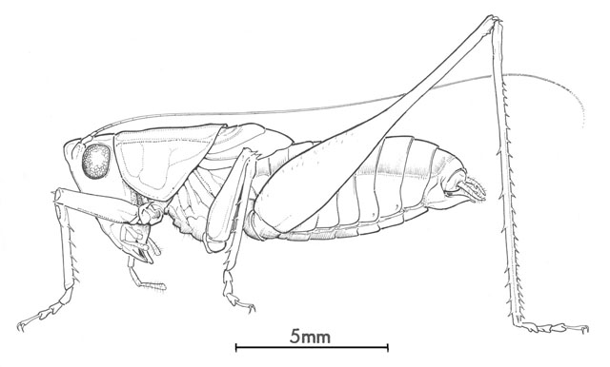
p(c_{j} | d) = probability of class c_{j}, given that we have observed d
P(Grasshopper | 5 ) = 6 / (6 + 6) = 0.500
P(Katydid | 5 ) = 6 / (6 + 6) = 0.500
6
6
5
Antennae length is 5

Slide 52
Bayesian Theorem: Basics
Let X be a data sample whose class label is unknown and Let H be a hypothesis that X belongs to class C
  E.g.: X: a red and round object, H: being an apple
For classification problems, determine P(H/X): the probability that the hypothesis holds given the observed data sample X
  P(H): prior probability of hypothesis H
  P(X): probability that sample data is observed
  P(X|H) : probability of observing the sample X, given that the hypothesis holds

Slide 53
Bayesian Theorem
Given training data X, posteriori probability of a hypothesis H, P(H|X) follows the Bayes theorem
Informally, this can be written as
  posterior =likelihood x prior / evidence
Practical difficulty: require initial knowledge of many probabilities, significant computational cost

Slide 54
An Example
Is Chris a Male or Female?
Name | Sex
Chris | Male
Claudia | Female
Chris | Female
Chris | Female
Alberto | Male
Karin | Female
Nina | Female
Sergio | Male
p(male |Chris) = 1/3 * 3/8 = 0.125
3/8 3/8
p(female |Chris) = 2/5 * 5/8 = 0.250
3/8 3/8

Slide 55
Naïve Bayes Classifier
A simplified assumption: attributes are conditionally independent and each data sample has n attributes
No dependence relation between attributes
By Bayes theorem,
As P(X) is constant for all classes, assign X to the class with maximum P(X|C_{i})*P(C_{i})

Slide 56
Training dataset
Class:
C1:buys_computer=
‘yes’
C2:buys_computer=
‘no’
Data sample
X =(age<=30,
Income=medium,
Student=yes
Credit_rating=
Fair)

Slide 57
Naïve Bayesian Classifier: Example
X=(age<=30, income=medium, student=yes, credit_rating=fair)
P(buys_computer=“yes”)=9/14, P(buys_computer=“no”)=5/14
Compute P(X/Ci) for each class
P(age=“<30” | buys_computer=“yes”) = 2/9=0.222
P(age=“<30” | buys_computer=“no”) = 3/5 =0.6
P(income=“medium” | buys_computer=“yes”)= 4/9 =0.444
P(income=“medium” | buys_computer=“no”) = 2/5 = 0.4
P(student=“yes” | buys_computer=“yes)= 6/9 =0.667
P(student=“yes” | buys_computer=“no”)= 1/5=0.2
P(credit_rating=“fair” | buys_computer=“yes”)=6/9=0.667
P(credit_rating=“fair” | buys_computer=“no”)=2/5=0.4
X=(age<=30 ,income =medium, student=yes, credit_rating=fair)
P(X|Ci) : P(X|buys_computer=“yes”)= 0.222 x 0.444 x 0.667 x 0.667 =0.044
P(X|buys_computer=“no”)= 0.6 x 0.4 x 0.2 x 0.4 =0.019
P(X|Ci)*P(Ci ) : P(X|buys_computer=“yes”) * P(buys_computer=“yes”)=0.028
P(X|buys_computer=“no”) * P(buys_computer=“no”)=0.007
X belongs to class “buys_computer=yes”

Slide 58
Naïve Bayesian Classifier: Comments
Advantages :
  Easy to implement
  Good results obtained in most of the cases
Disadvantages
  Assumption: class conditional independence
  Practically, dependencies exist among variables
  E.g., hospitals: patients: Profile: age, family history etc
  Symptoms: fever, cough etc., Disease: lung cancer, diabetes etc
  Dependencies among these cannot be modeled by Naïve Bayesian Classifier
How to deal with these dependencies?
  Bayesian Belief Networks

Slide 59
Bayesian Networks
Bayesian belief network allows a subset of the variables conditionally independent
A graphical model of causal relationships
  Represents dependency among the variables
  Gives a specification of joint probability distribution
Nodes: random variables
Links: dependency
X,Y are the parents of Z, and Y is the parent of P
No dependency between Z and P
Has no loops or cycles
X
Y
Z
P

Slide 60
Support vector machine (SVM)

Slide 61
Classification
Classification:
  predicts categorical class labels
Typical Applications
  {credit history, salary}-> credit approval ( Yes/No)
  {Temp, Humidity} --> Rain (Yes/No)
Mathematically

Slide 62
Support Vector Machine (SVM)
Support Vector Machines (SVM)
  The classifier is a separating hyperplane
  Most “important” training points are support vectors; they define the hyperplane
  Quadratic optimization algorithms can identify which training points xi are support vectors with non-zero Lagrangian multipliers α_{i}

Slide 63
Linear Classifiers
α
x
f
y^{est}
f(x,w,b) = sign(w x + b)
denotes +1
denotes -1
w x + b>0
w x + b=0
How would you classify this data?
w x + b<0

Slide 64
Linear Classifiers
α
x
f
y^{est}
f(x,w,b) = sign(w x + b)
denotes +1
denotes -1
How would you classify this data?

Slide 65
Linear Classifiers
α
x
f
y^{est}
f(x,w,b) = sign(w x + b)
denotes +1
denotes -1
How would you classify this data?

Slide 66
Linear Classifiers
α
x
f
y^{est}
f(x,w,b) = sign(w x + b)
denotes +1
denotes -1
Any of these would be fine..
..but which is best?

Slide 67
α
Linear Classifiers
x
f
y^{est}
f(x,w,b) = sign(w x + b)
denotes +1
denotes -1
How would you classify this data?
Misclassified
to +1 class

Slide 68
α
α
Classifier Margin
Classifier Margin
x
x
f
f
y^{est}
y^{est}
f(x,w,b) = sign(w x + b)
f(x,w,b) = sign(w x + b)
denotes +1
denotes -1
denotes +1
denotes -1
Define the margin of a linear classifier as the width that the boundary could be increased by before hitting a datapoint.
Define the margin of a linear classifier as the width that the boundary could be increased by before hitting a datapoint.

Slide 69
α
Maximum Margin
x
f
y^{est}
Maximizing the margin is good according to intuition and PAC theory
Implies that only support vectors are important; other training examples are ignorable.
Empirically it works very very well.
f(x,w,b) = sign(w x + b)
denotes +1
denotes -1
The maximum margin linear classifier is the linear classifier with the maximum margin.
This is the simplest kind of SVM (Called an LSVM)
Support Vectors are those datapoints that the margin pushes up against
Linear SVM

Slide 70
Linear SVM Mathematically
x⁺
M=Margin Width
“Predict Class = +1” zone
X⁻
wx+b=1
“Predict Class = -1” zone
wx+b=0
wx+b=-1
What we know:
w . x⁺ + b = +1
w . x⁻ + b = -1
w . (x⁺-x⁻⁾ = 2

Slide 71
Linear SVM Mathematically
Goal: 1) Correctly classify all training data
if y_{i} = +1
if y_{i} = -1
for all i
2) Maximize the Margin
same as minimize
We can formulate a Quadratic Optimization Problem and solve for w and b
Minimize
subject to

Slide 72
Solving the Optimization Problem
Find w and b such that
Φ(w) =½ w^{T}w is minimized;
and for all {(x_{i} ,y_{i})}: y_{i} (w^{T}x_{i} + b) ≥ 1
Need to optimize a quadratic function subject to linear constraints.
Quadratic optimization problems are a well-known class of mathematical programming problems, and many (rather intricate) algorithms exist for solving them.
The solution involves constructing a dual problem where a Lagrange multiplier α_{i} is associated with every constraint in the primary problem:
Find α₁…α_{N} such that
Q(α) =Σα_{i} - ½ΣΣα_{i}α_{j}y_{i}y_{j}x_{i}^{T}x_{j} is maximized and
(1) Σα_{i}y_{i} = 0
(2) α_{i} ≥ 0 for all α_{i}

Slide 73
Dataset with noise
denotes +1
denotes -1
Hard Margin: So far we require all data points be classified correctly
- No training error
What if the training set is noisy?
- Solution 1: use very powerful kernels
OVERFITTING!

Slide 74
Soft Margin Classification
Slack variables ξi can be added to allow misclassification of difficult or noisy examples.
What should our quadratic optimization criterion be?
Minimize
ε₁₁
ε₂
wx+b=1
ε₇
wx+b=0
wx+b=-1

Slide 75
Hard Margin v.s. Soft Margin
The old formulation:
The new formulation incorporating slack variables:
Parameter C can be viewed as a way to control overfitting.
Find w and b such that
Φ(w) =½ w^{T}w is minimized and for all {(x_{i} ,y_{i})}
y_{i} (w^{T}x_{i} + b) ≥ 1
Find w and b such that
Φ(w) =½ w^{T}w + CΣξ_{i} is minimized and for all {(x_{i} ,y_{i})}
y_{i} (w^{T}x_{i} + b) ≥ 1- ξ_{i} and ξ_{i} ≥ 0 for all i

Slide 76
Discriminative Classifiers
Advantages
  Prediction accuracy is generally high
  Robust, works when training examples contain errors
  Fast evaluation of the learned target function
Criticism
  Could not easily applied on huge dataset
    Computation time, and memory for matrix
  Usually has good performance only on binary classification

Slide 77
Other Classification Methods
Case-based reasoning
Genetic algorithm
Rough set approach
Fuzzy set approaches

