Slide 1
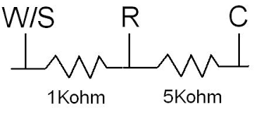
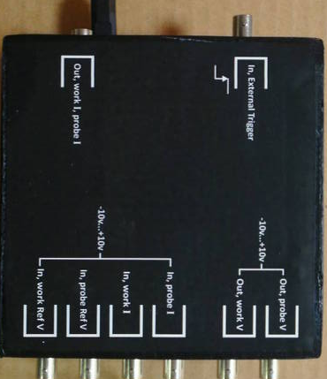
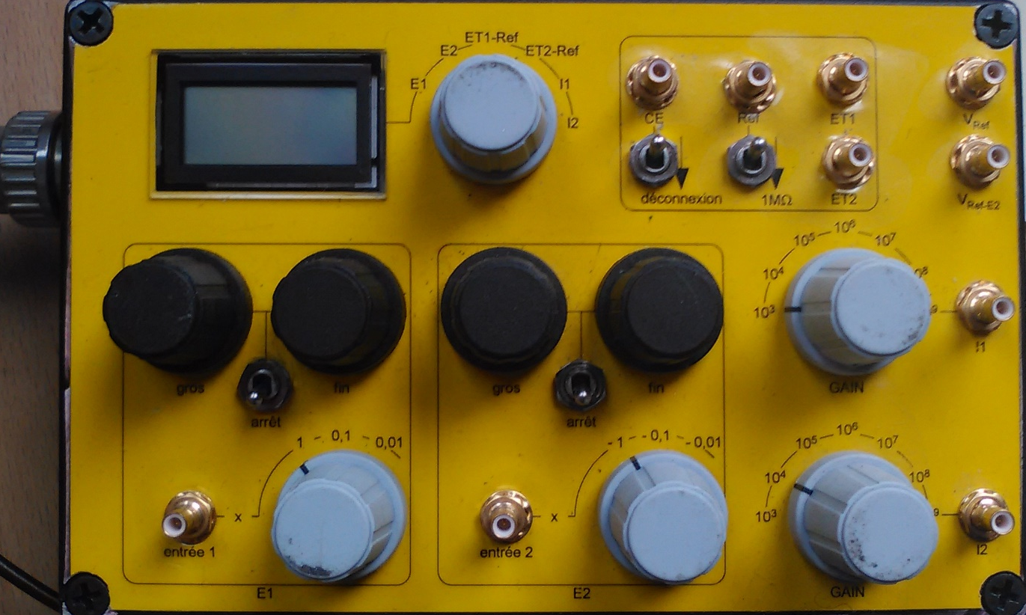
Wiring
Use a « Dummy » electrochemical cell made of an assembly of resistors and connect as shown here:
~ 500 KOhm
W2
~ 1KOhm
~ 5KOhm
CE
W1
Ref

Slide 2
Bipotentiostat description
ET1 and ET2 stand for « Working electrode » W1( substrate) and W2 (probe)
Coarse and fine adjustment of an offset applied to W1 : set to 0 if switch on downward position
Switch to disconnect internally the CE: keep the upward position
Reading of E1/E2/ET1-Ref/ET2-Ref/I1/I2
Switch to set a high input impedance on the ref (to minimize noise on low current measurement): : keep the upward position
Output multiplying gain for the current (voltage) measured at W1 (substrate)
Output multiplying gain for the current (voltage) measured at W2 (probe)
Coarse and fine adjustment of an offset applied to W2 : set to 0 if switch on downward position
The input voltage applied to W1 (substrate) will be multiplied by either 1, 0.1 or 0.01: set to 1
The input voltage applied to W2 (probe) will be multiplied by either 1, 0.1 or 0.01: set to 1

