Slide 1

Implicit Representations of Surfaces and Polygonalization Algorithms
Dr. Scott Schaefer

Slide 2
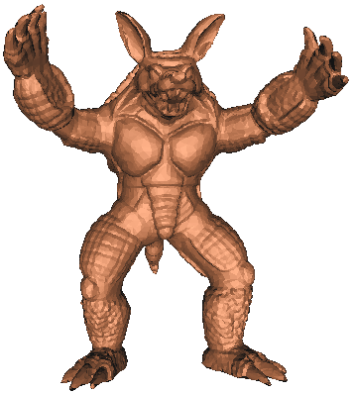
Polygon Models
Advantages
  Explicit connectivity information
  Easy to render
  (Relatively) small storage
Disadvantages
  Topology changes difficult
  Inside/Outside test hard
<number>/47

Slide 3
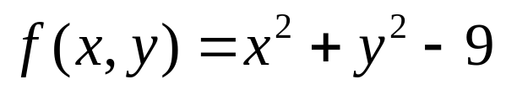
Implicit Representations of Shape
Shape described by solution to f(x)=c
<number>/47

Slide 4
Implicit Representations of Shape
Shape described by solution to f(x)=c
<number>/47

Slide 5
Implicit Representations of Shape
Shape described by solution to f(x)=c
-
-
-
-
-
-
-
-
-
-
-
-
-
-
-
-
<number>/47

Slide 6
Implicit Representations of Shape
Shape described by solution to f(x)=c
+
+
-
-
-
-
+
-
+
-
-
-
-
-
-
-
-
-
+
-
-
+
+
+
<number>/47

Slide 7
Advantages
No topology to maintain
Always defines a closed surface!
Inside/Outside test
CSG operations
<number>/47

Slide 8
Advantages
No topology to maintain
Always defines a closed surface!
Inside/Outside test
CSG operations
+
+
-
-
-
-
+
+
-
-
-
-
-
-
-
-
-
-
+
-
-
+
+
+
<number>/47

Slide 9
Advantages
No topology to maintain
Always defines a closed surface!
Inside/Outside test
CSG operations
<number>/47

Slide 10
Advantages
No topology to maintain
Always defines a closed surface!
Inside/Outside test
CSG operations
  Union
<number>/47

Slide 11
Advantages
No topology to maintain
Always defines a closed surface!
Inside/Outside test
CSG operations
  Union
<number>/47

Slide 12
Advantages
No topology to maintain
Always defines a closed surface!
Inside/Outside test
CSG operations
  Union
+
+
-
-
-
-
+
-
-
+
-
-
-
-
+
+
<number>/47

Slide 13
Advantages
No topology to maintain
Always defines a closed surface!
Inside/Outside test
CSG operations
  Union
+
+
-
-
-
-
+
-
-
+
-
-
-
-
+
+
<number>/47

Slide 14
Advantages
No topology to maintain
Always defines a closed surface!
Inside/Outside test
CSG operations
  Union
+
+
+
+
-
-
-
-
-
-
+
+
+
-
-
+
-
+
-
+
-
-
-
-
-
-
-
-
-
+
+
+
-
-
+
+
+
-
-
-
-
+
+
<number>/47

Slide 15
Advantages
No topology to maintain
Always defines a closed surface!
Inside/Outside test
CSG operations
  Union
+
-
+
-
+
-
-
-
-
-
-
+
+
+
<number>/47

Slide 16
Advantages
No topology to maintain
Always defines a closed surface!
Inside/Outside test
CSG operations
  Union
  Intersection
+
+
+
+
-
-
-
-
-
-
+
+
+
-
-
+
-
+
-
+
-
-
-
-
-
-
-
-
-
+
+
+
-
-
+
+
+
-
-
-
-
+
+
<number>/47

Slide 17
Advantages
No topology to maintain
Always defines a closed surface!
Inside/Outside test
CSG operations
  Union
  Intersection
+
+
-
-
-
-
+
+
<number>/47

Slide 18
Advantages
No topology to maintain
Always defines a closed surface!
Inside/Outside test
CSG operations
  Union
  Intersection
  Subtraction
+
+
+
+
-
-
-
-
-
-
+
+
+
-
-
+
-
+
-
+
-
-
-
-
-
-
-
-
-
+
+
+
-
-
+
+
+
-
-
-
-
+
+
<number>/47

Slide 19
Advantages
No topology to maintain
Always defines a closed surface!
Inside/Outside test
CSG operations
  Union
  Intersection
  Subtraction
-
-
-
-
+
-
-
+
+
+
-
-
+
-
-
-
-
+
+
+
+
-
-
+
-
-
-
-
-
-
+
+
<number>/47

Slide 20
Advantages
No topology to maintain
Always defines a closed surface!
Inside/Outside test
CSG operations
  Union
  Intersection
  Subtraction
+
-
-
+
+
-
-
-
-
+
+
<number>/47

Slide 21

Advantages
No topology to maintain
Always defines a closed surface!
Inside/Outside test
CSG operations
  Union
  Intersection
  Subtraction
<number>/47

Slide 22
Disadvantages
Hard to render - no polygons
Creating polygons amounts to root finding
Arbitrary shapes hard to represent as an analytic function
Certain operations (like simplification) can be difficult
<number>/47

Slide 23
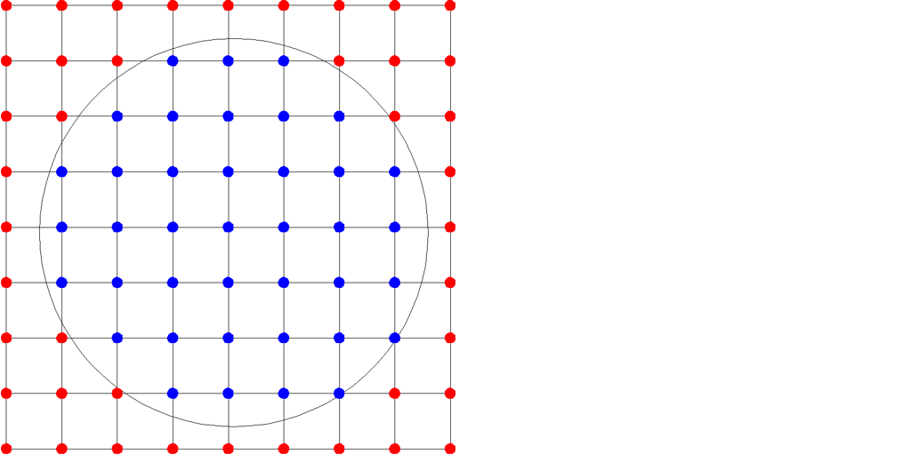
Non-Analytic Implicit Functions
Sample functions over grids
<number>/47

Slide 24
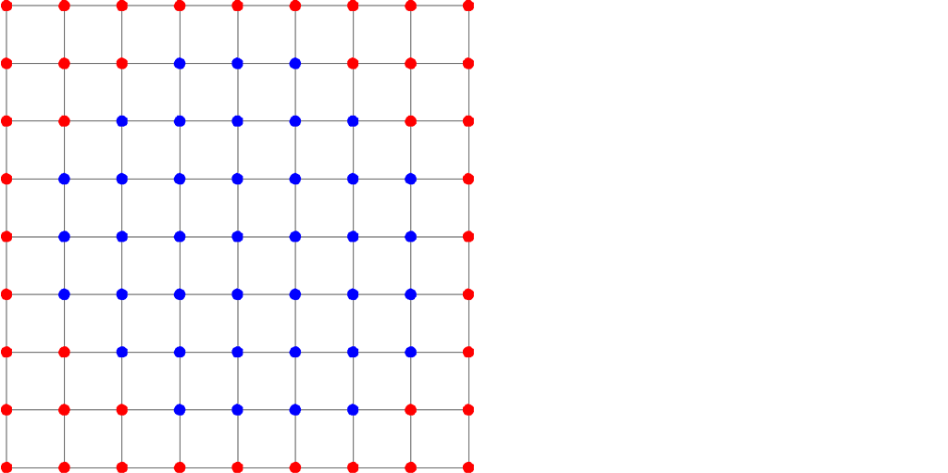
Non-Analytic Implicit Functions
Sample functions over grids
<number>/47

Slide 25
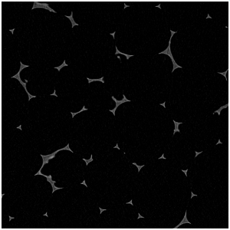
Data Sources
<number>/47

Slide 26
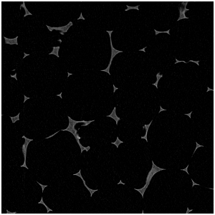
Data Sources
<number>/47

Slide 27
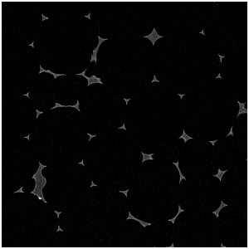
Data Sources
<number>/47

Slide 28
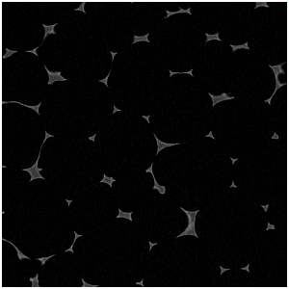
Data Sources
<number>/47

Slide 29
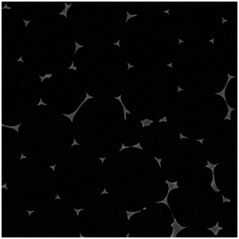
Data Sources
<number>/47

Slide 30
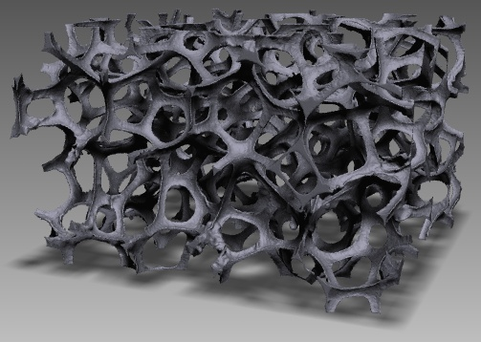
Data Sources
<number>/47

Slide 31
2D Surface Reconstruction
<number>/47

Slide 32
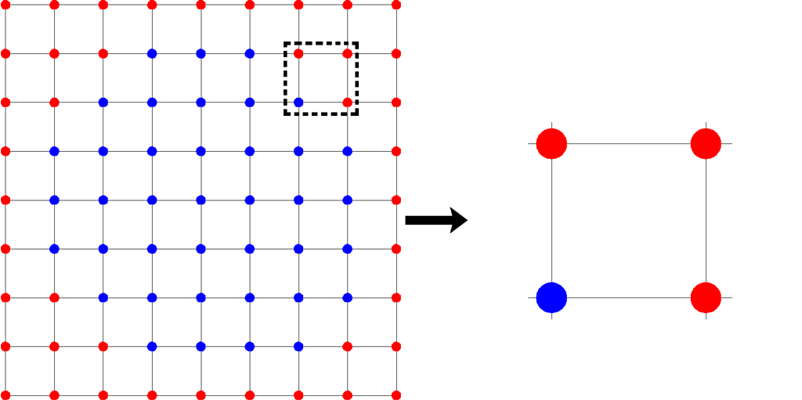
2D Surface Reconstruction
<number>/47

Slide 33
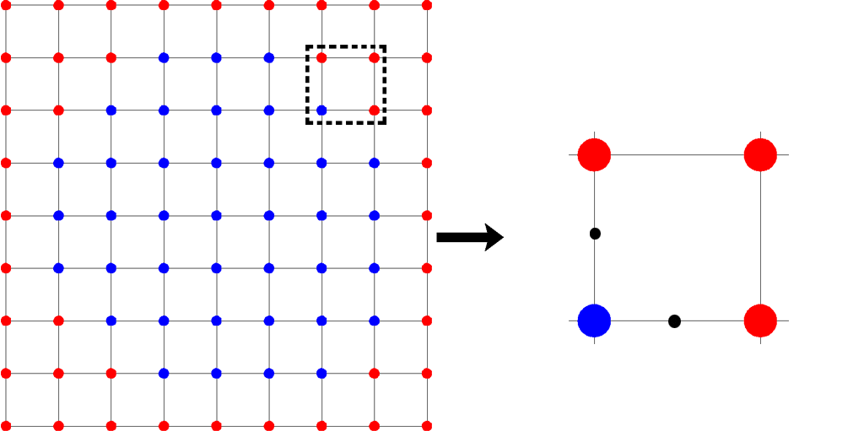
2D Surface Reconstruction
<number>/47

Slide 34
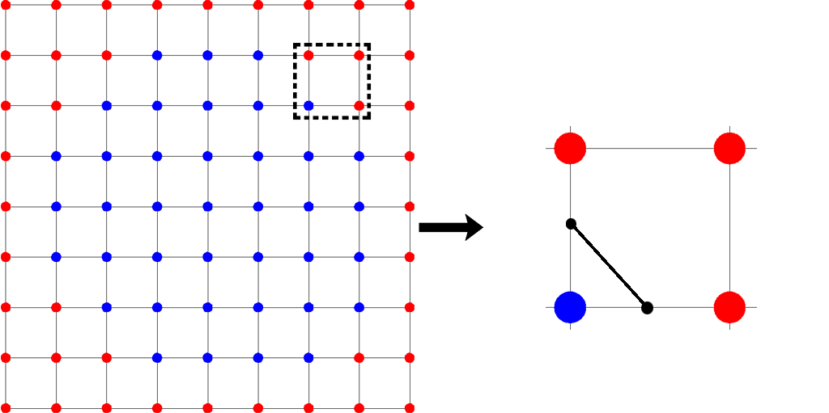
2D Surface Reconstruction
<number>/47

Slide 35
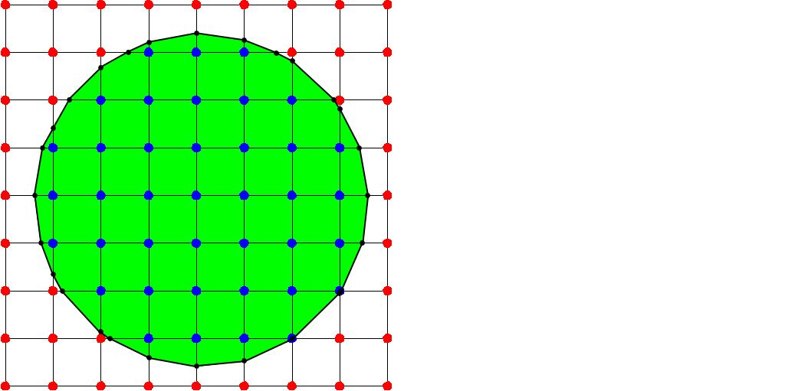
2D Surface Reconstruction
<number>/47

Slide 36
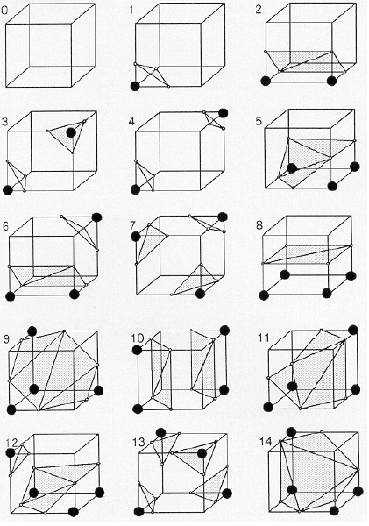
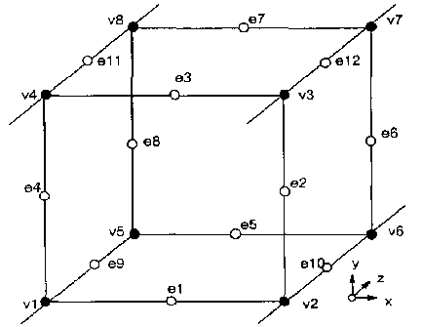
Marching Cubes
<number>/47

Slide 37
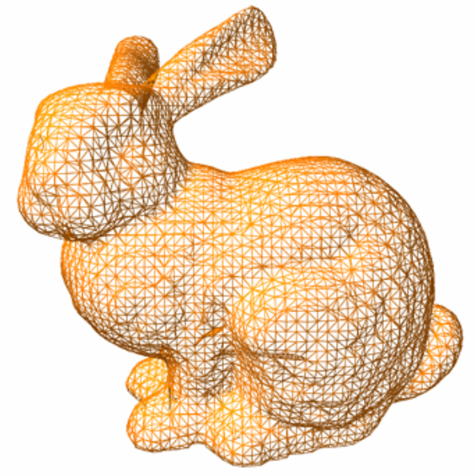
Marching Cubes
<number>/47

Slide 38

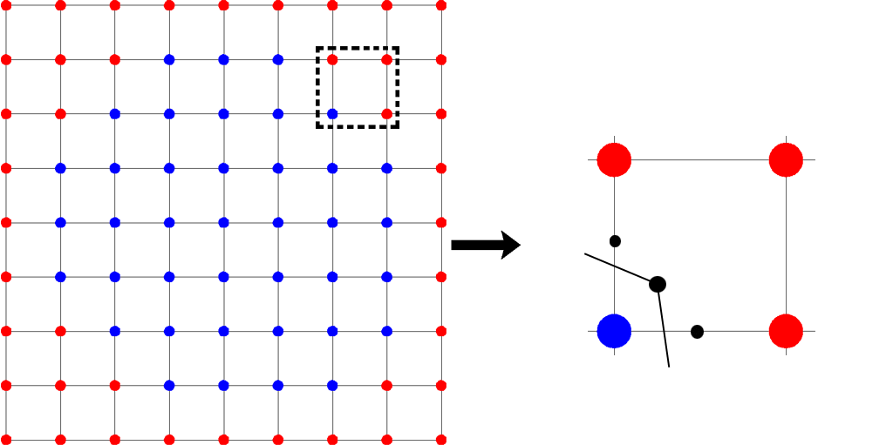
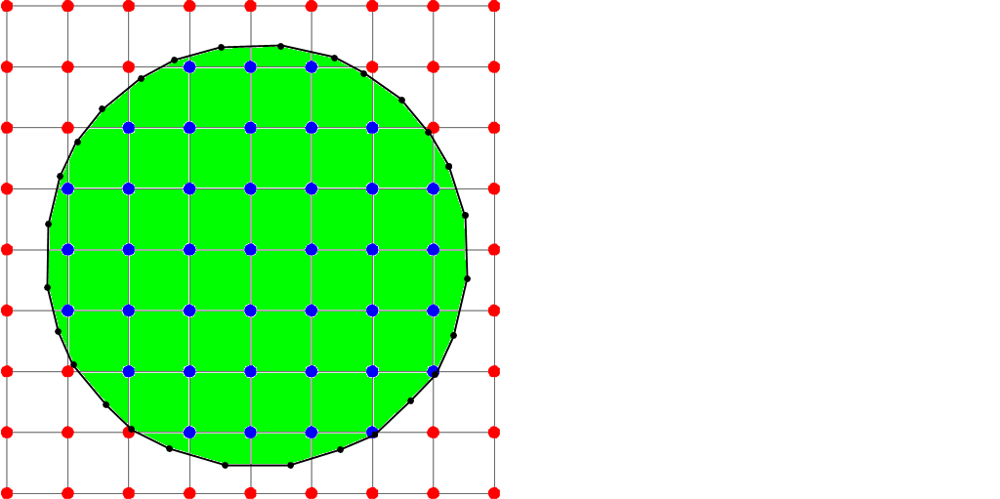
Dual Contouring
Place vertices inside of square
Generate segments across edges with zero
Dual to polygons produced by MC
<number>/47

Slide 39
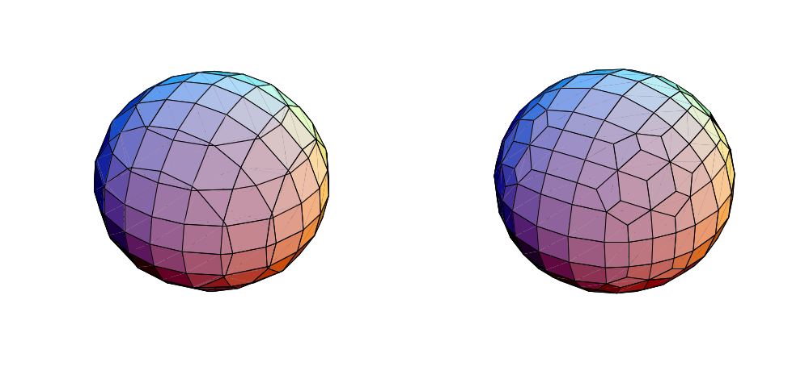
Comparison of Primal/Dual
Produces well-shaped quads
Allows more freedom in positioning vertices
Marching Cubes (Primal) Dual Contouring (Dual)
<number>/47

Slide 40
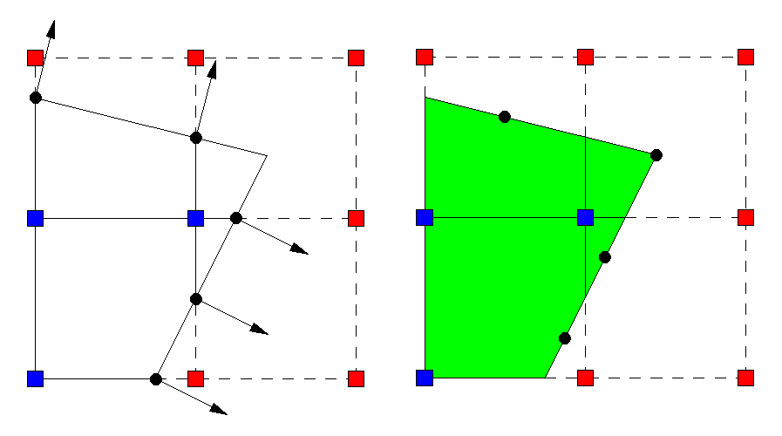
Dual Contouring With Hermite Data
Place vertices at minimizer of QEFs
Generate segments across edges with zeros
<number>/47

Slide 41
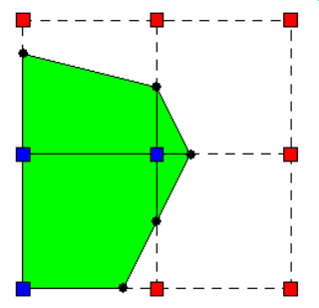
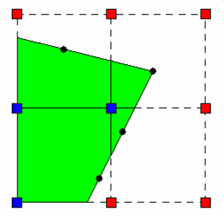
Comparison
Marching Cubes
Dual Contouring
<number>/47

Slide 42
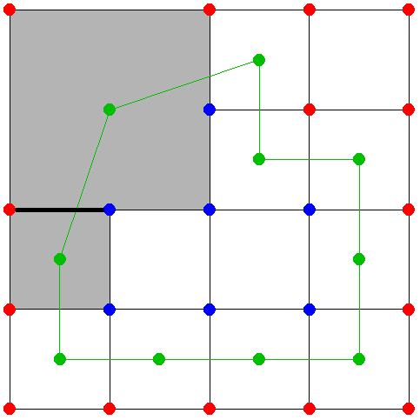
Contouring Signed Octrees
For each minimal edge with zero,
  Connect vertices of cubes containing edge
Constructs closed surface mesh for any octree
<number>/47

Slide 43
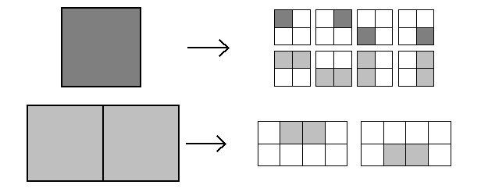
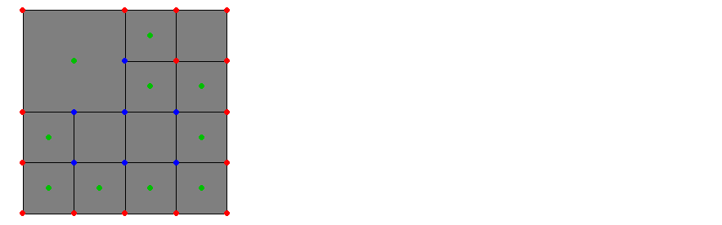
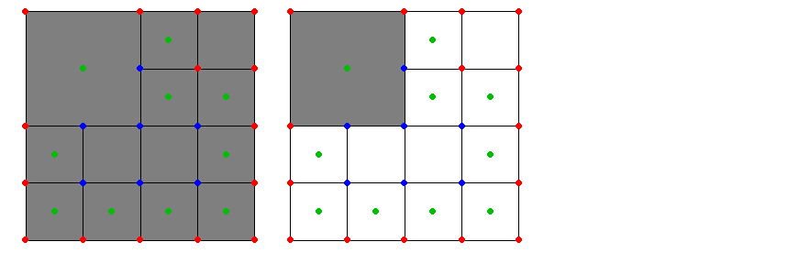
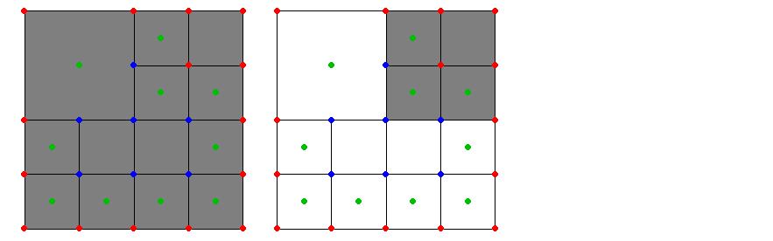
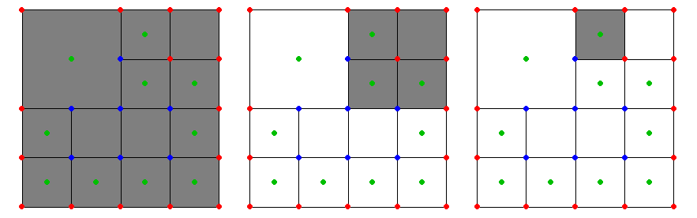
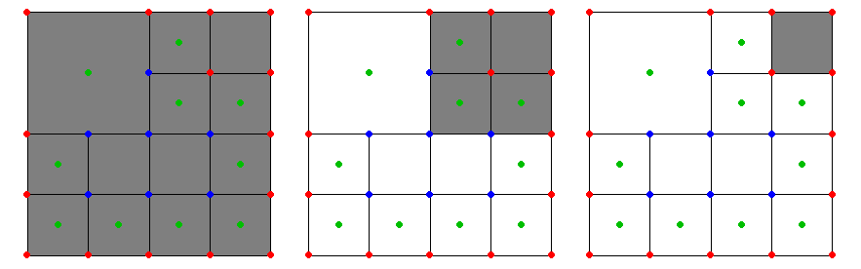
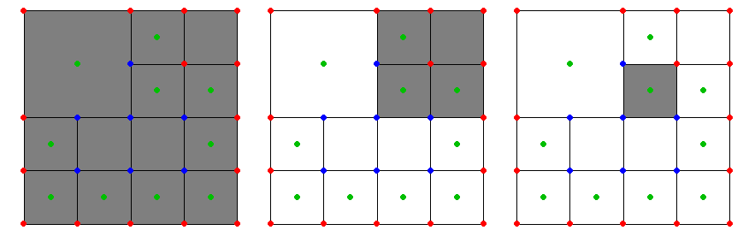
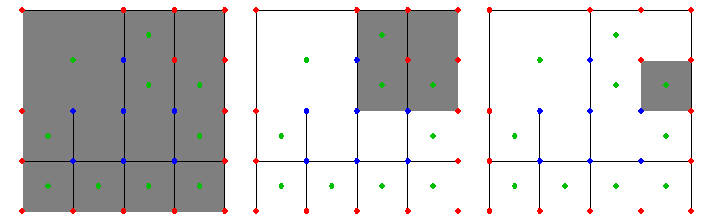
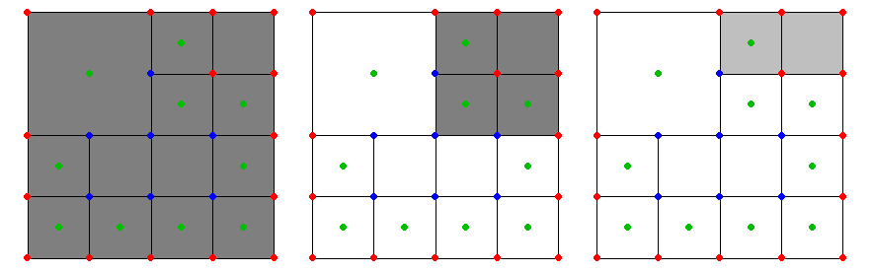
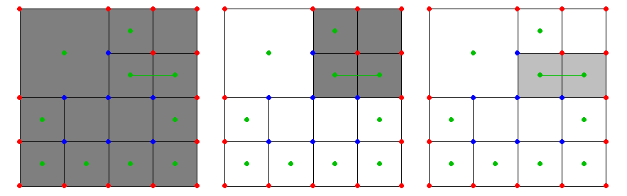
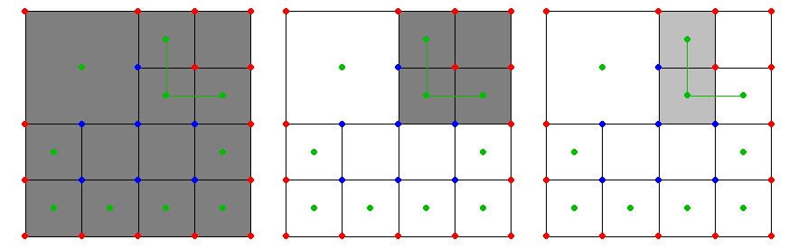
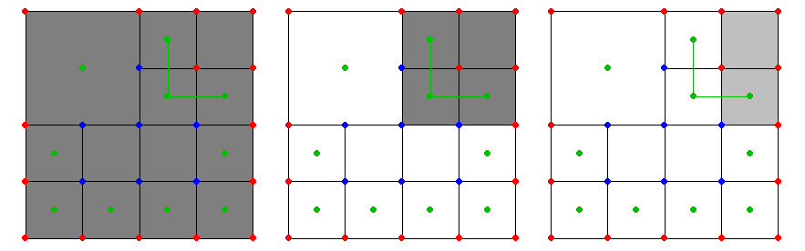
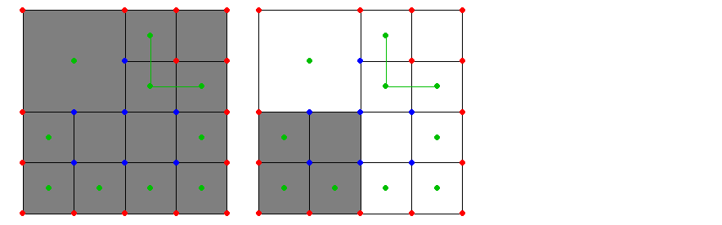
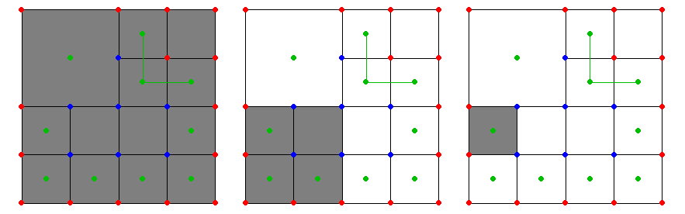
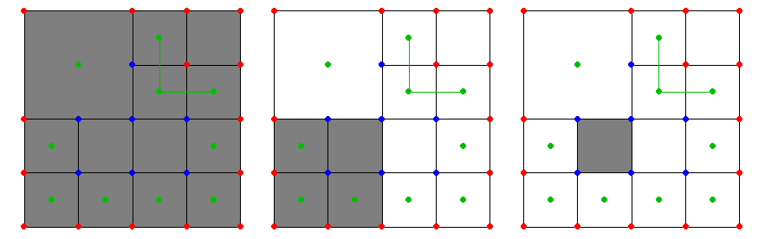
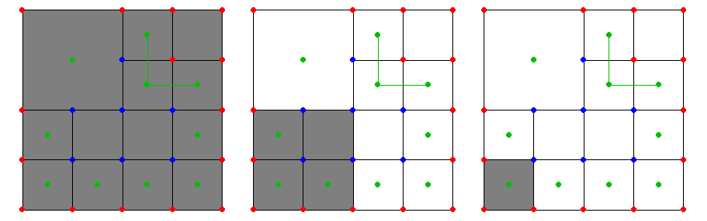
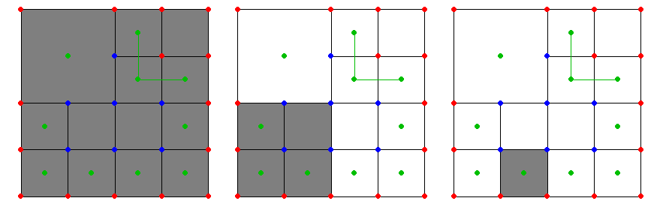

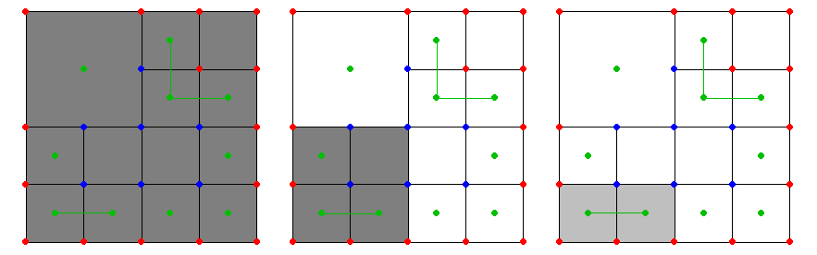
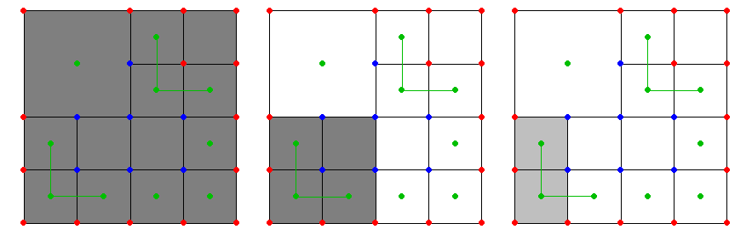
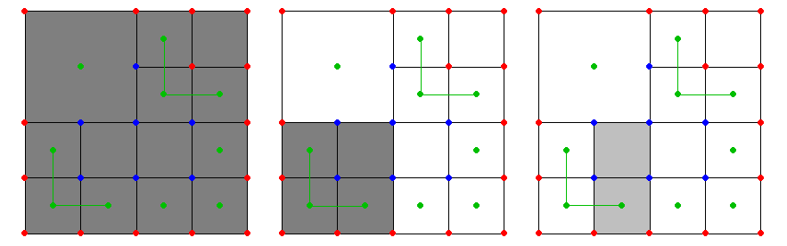
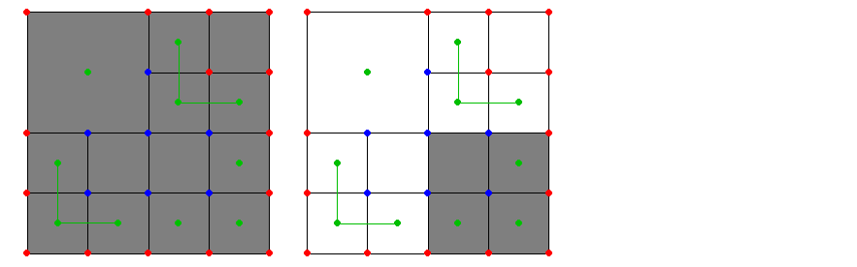
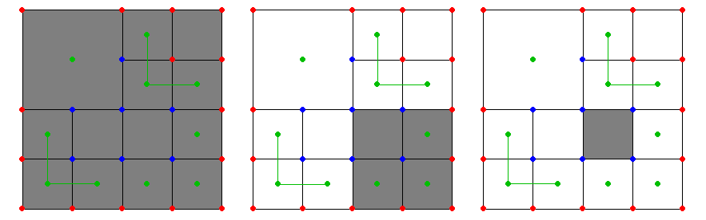
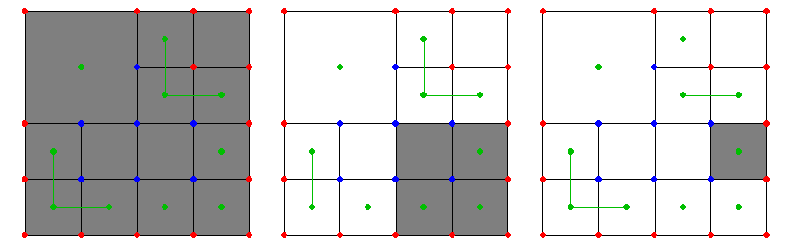
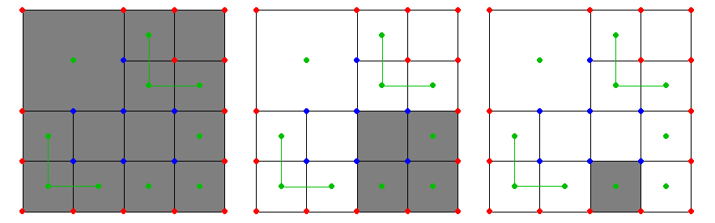
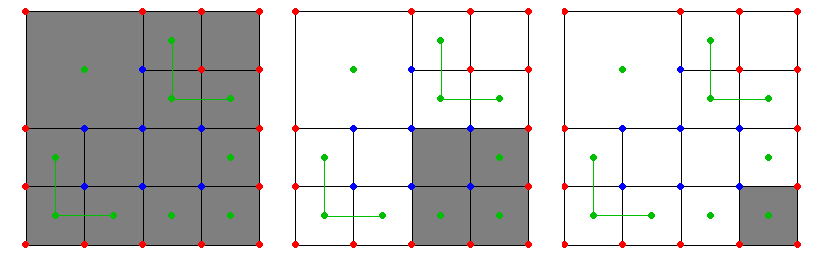
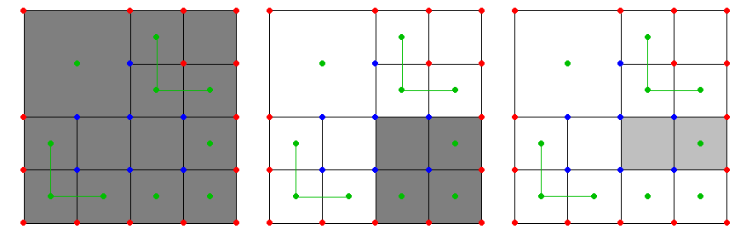















Fast Polygon Generation
Recursive octree traversal
Linear time in size of octree
<number>/47

Slide 44


Extensions
Multiple materials
CSG operations
Simplification via QEFs
Topological safety
<number>/47

Slide 45

Dual Marching Cubes
Generate cells for contouring using the dual of the octree
Creates adaptive, crack-free partitioning of space
Use Marching Cubes on dual
cells to construct polygons
<number>/47

Slide 46



















































Dual Marching Cubes
Enumerate dual grid using
recursive walk
  Three types of recursive calls
<number>/47

Slide 47

Dual Marching Cubes
Advantages
  Always creates a manifold surface
  Same as Marching Cubes over uniform grids
  Works well for data centered in cells
Disadvantages
  Octrees with data at vertices instead of cells
  ?…
<number>/47

