Slide 1
This is preliminary study on Machining sensors on PMMA Machining

Slide 2
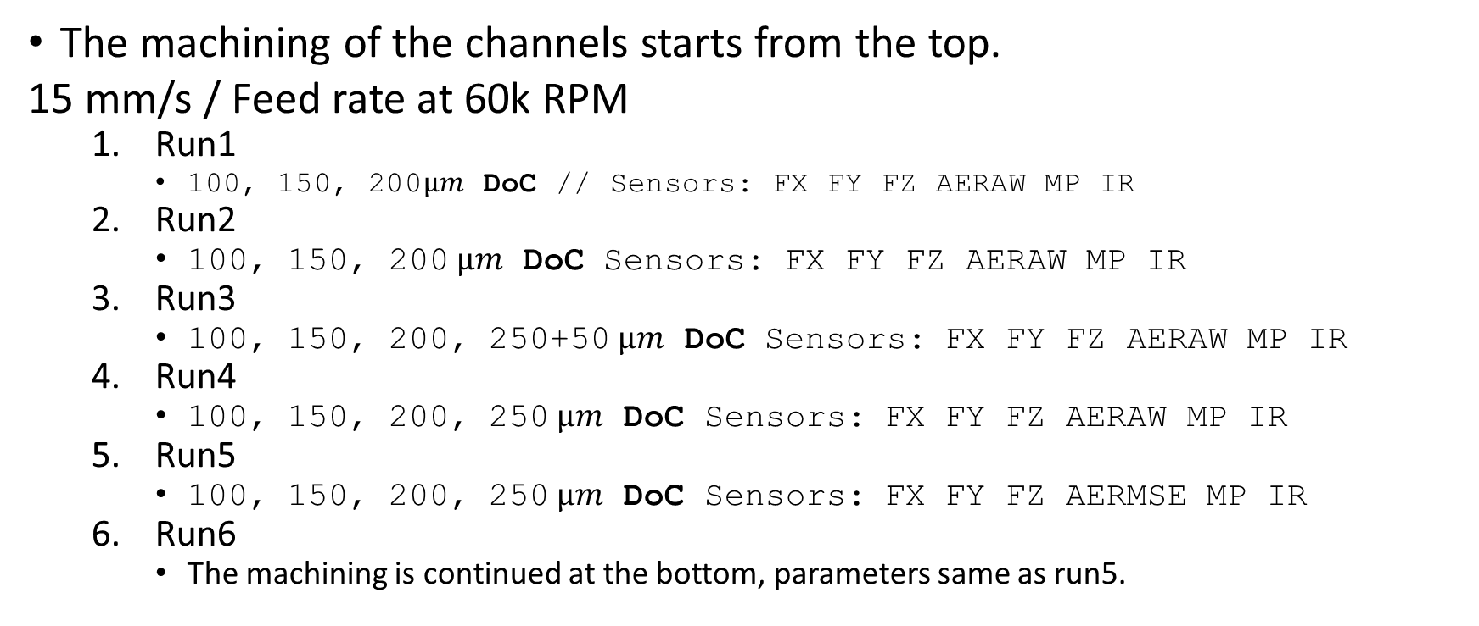
Data content

Slide 3
Data Acquisition info.
6 sensors on BNC2110
Data Acquisition rate is 200k for each sensors/

Slide 4
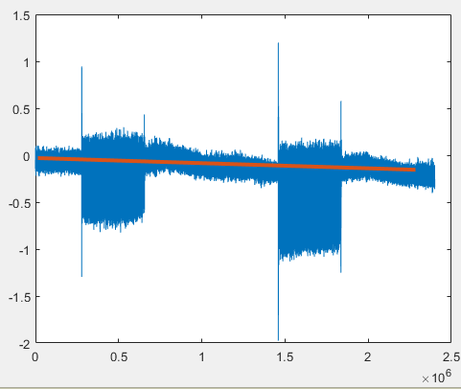
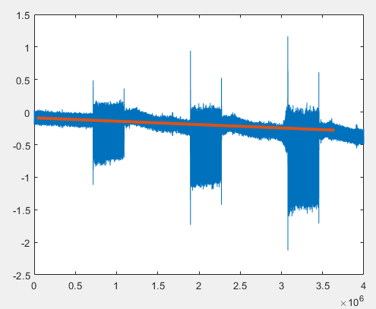
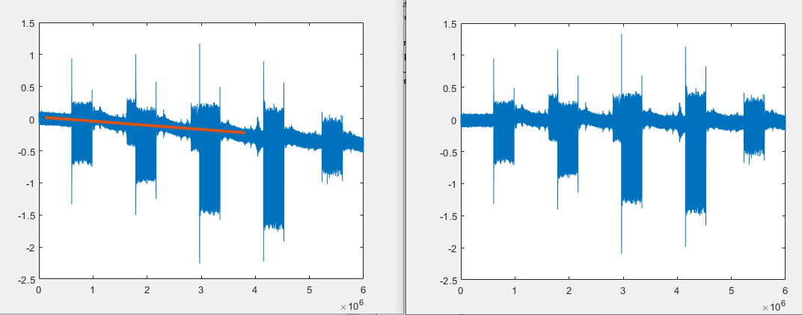
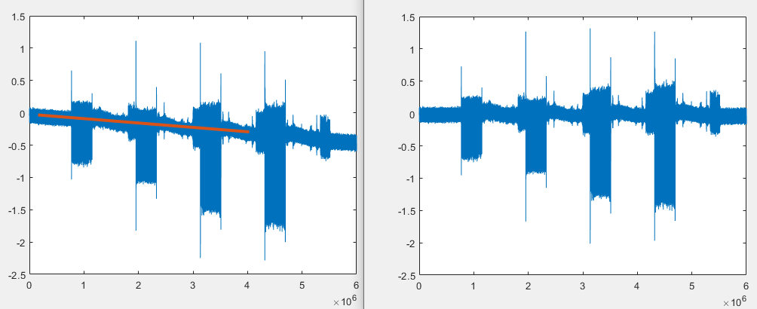
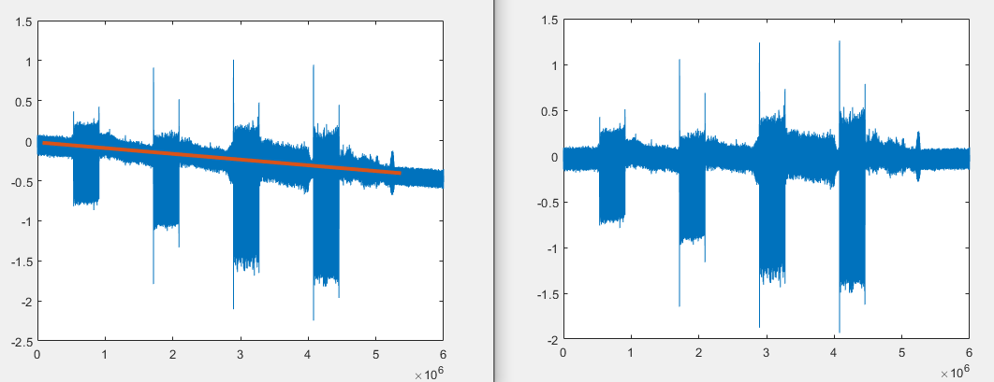
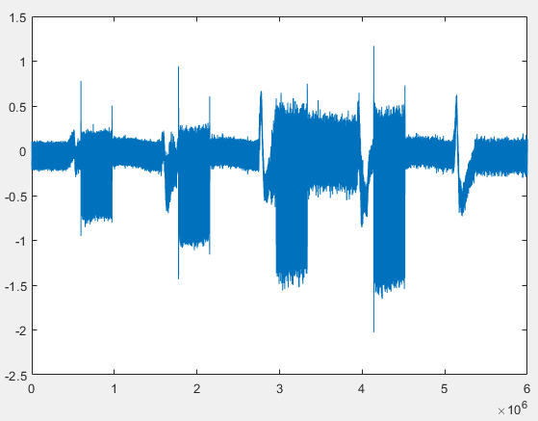
Fx run 1-6 (Force in x-axis)
Run1
Run2
Run3
Run4
Run5
Run6
Each increase in signal shows the machining region. For the first run 2 channels for the second 3 channels were machined. Force sensor has a linear drift which has to be subtracted.

Slide 5
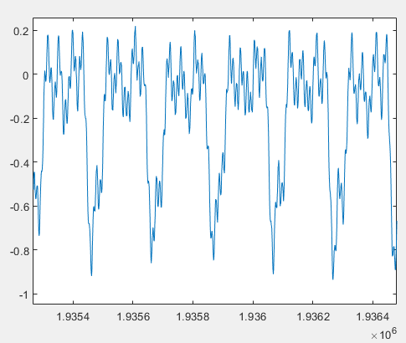
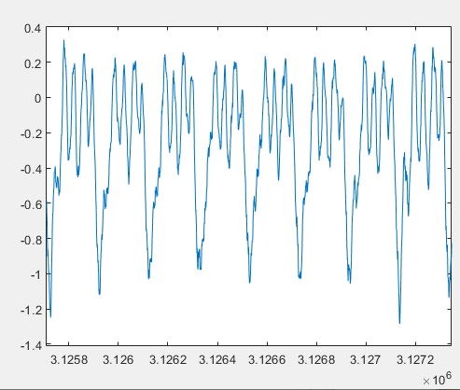
CyCle Fx --- 6 rotation of the tool.
Run_6 towards the bottom location
Run_3 Towards the top location

Slide 6
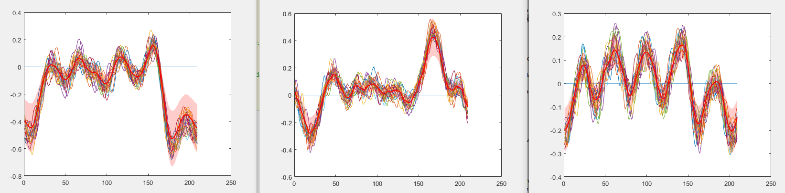
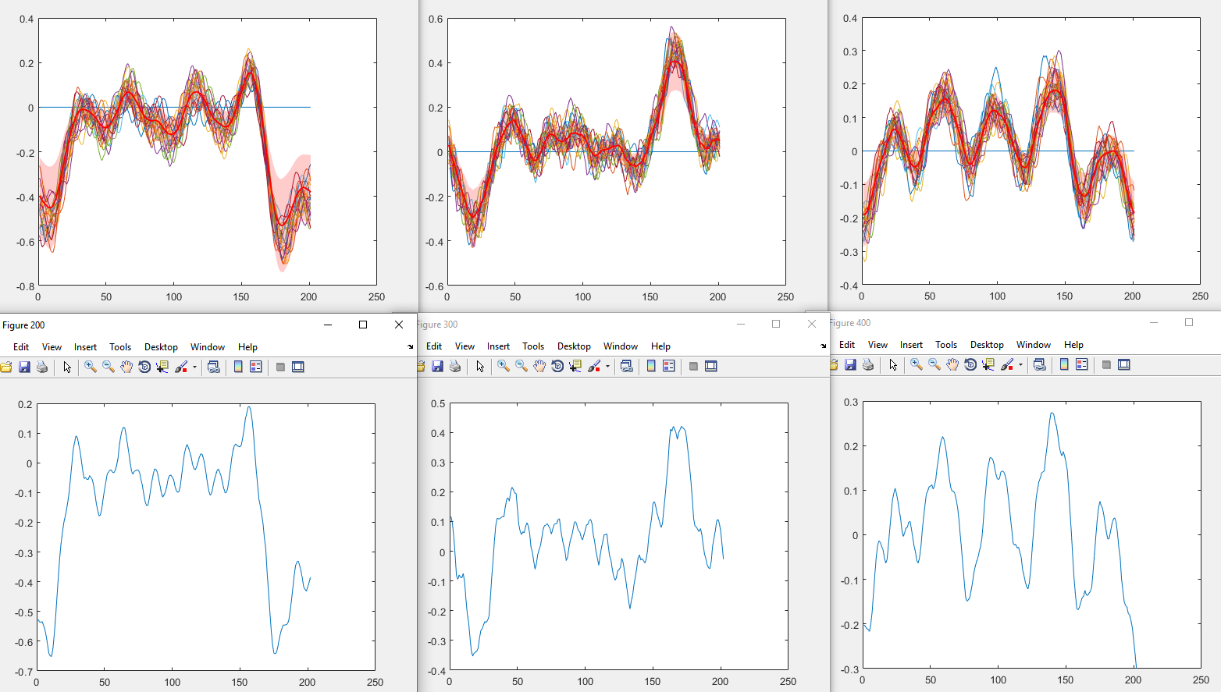
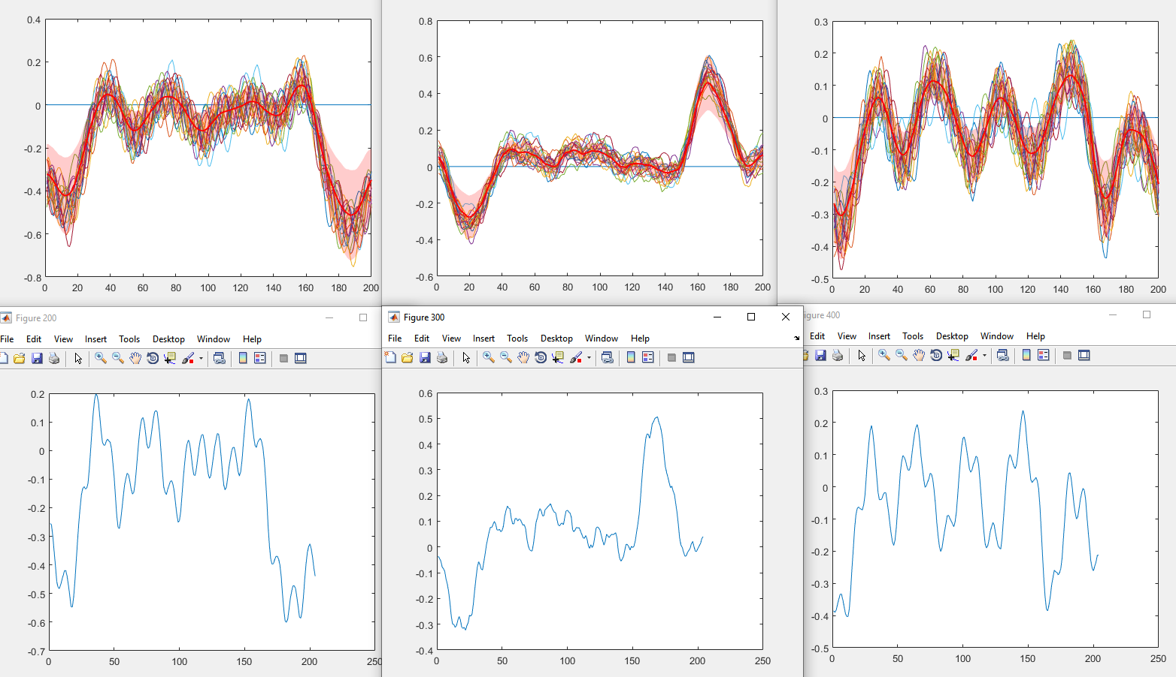
First Channel(100um) for different runs. It shows the average of 20 consecutive cycles
Run 3
Run 4
Run 6

Slide 7
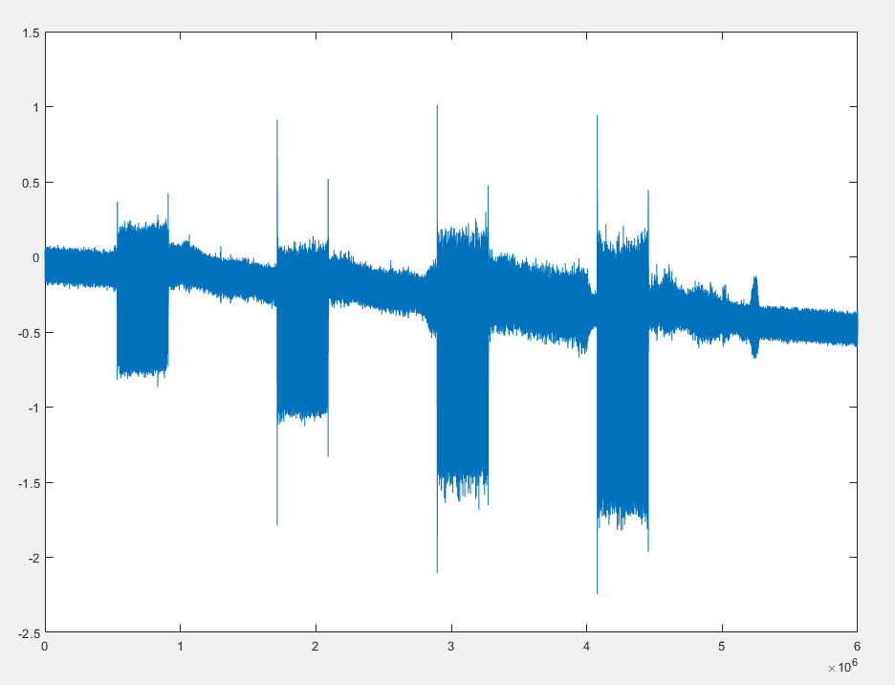
Matlab Code and Functions
function [DataNew,startsearch]=RemoveDrift(data,startsearch)
'Remove Drift on force data by hand-picked 12 points’
A linear function will be fitted to the 12 data points.
Startsearch is an index and manually inputted. It starts the search for the first machining signal where Max and Min forces are < and > than noise average after drift is removed.
First Remove Drift.
RoughstartsearchOnForce= 2e5; %at 200k rate, it is the first second.

Slide 8
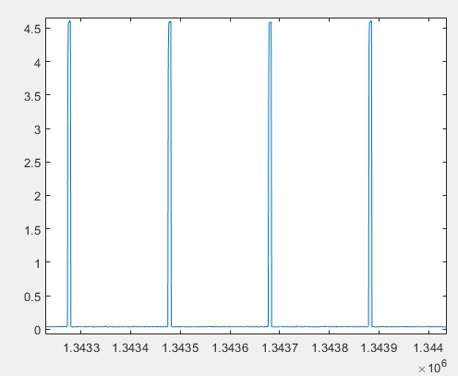
function [ChannelCycle]=LoadMachiningData(ChanNum,SpindleRPM, DAQrate ,NumberOfCycle)
ChannelCycle is a struct
This function aims at outputting sensor data by dividing channels into n number of tool rotation cycles.
It runs RemoveDrift , matches IR sensor with the start of force machining signals and record indices.
I recorded 4 channels data as seen in page 4 run 3-6. After the preprocessing of the first channel, we need to find the start of the consecutive channel. Since the speed of the stage is fixed, we expect same time from end of a channel to start of a new channel.
Line 94 : ChannelCycle=cell(4,10); we create a cell for 4 channels each will have 10 (averages of 100 cycles)
IR sensor

Slide 9
function [lineOut, fillOut] = stdshade(amatrix,alpha,acolor,F,smth)
% usage: stdshading(amatrix,alpha,acolor,F,smth)
% plot mean and sem/std coming from a matrix of data, at which each row is an
% observation. sem/std is shown as shading.
% - acolor defines the used color (default is red)
% - F assignes the used x axis (default is steps of 1).
% - alpha defines transparency of the shading (default is no shading and black mean line)
% - smth defines the smoothing factor (default is no smooth)
% smusall 2010/4/23

Slide 10
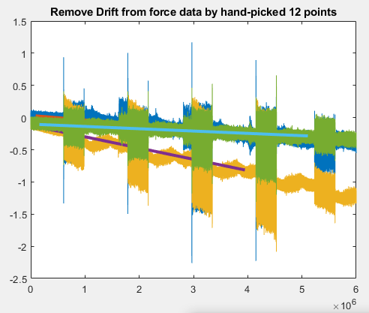
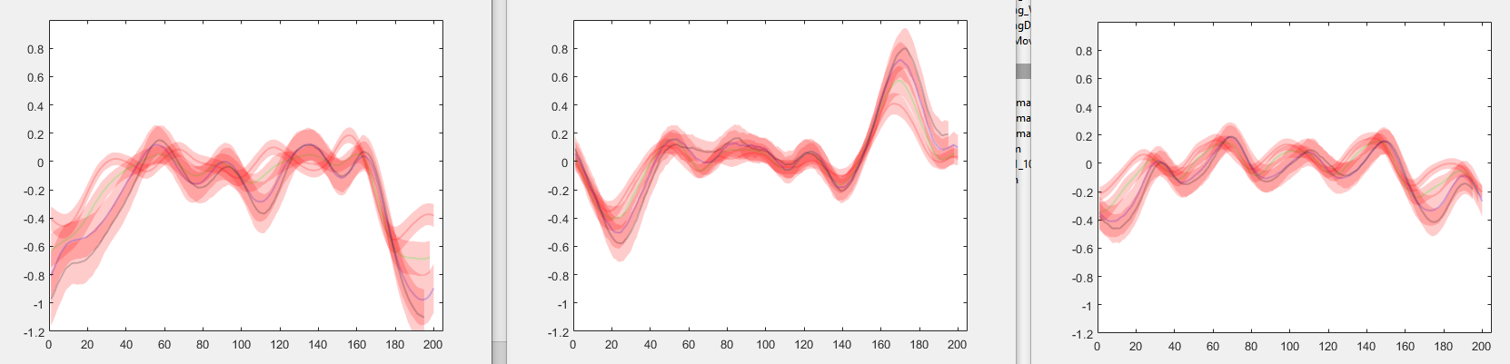
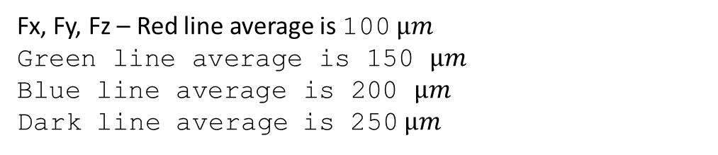
WHEN MAIN Function is run on machining data Run4
When Code runs, it asks you to hand-pick 12 points of Force data. Blue is Fx, Yellow is Fy and Green is Fz.

Slide 11
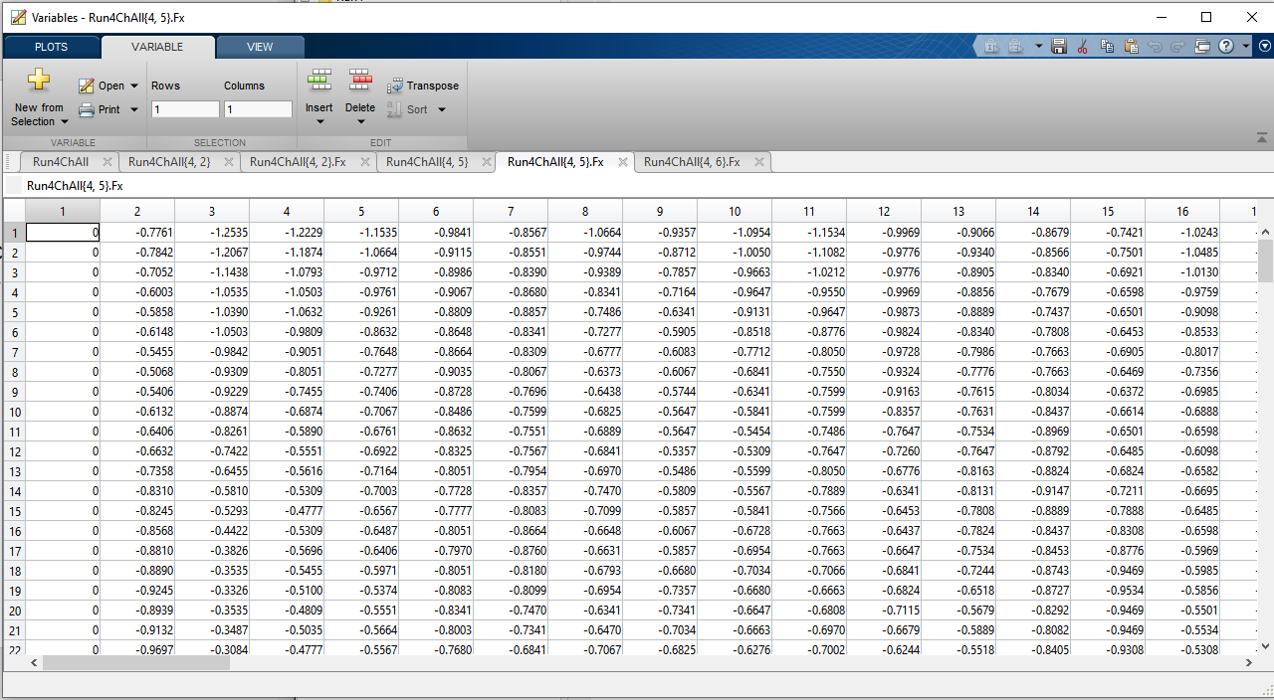
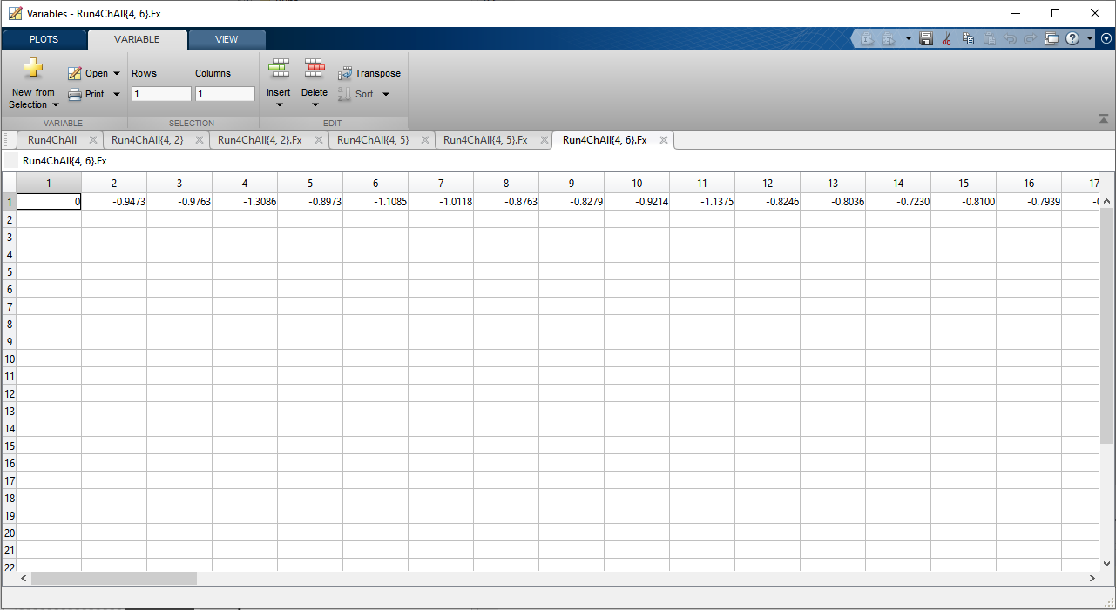
Problems is the code.
Cycle for each index from IR sensor is not fixed, it fluctuates 200-202 even though the spindle speed is supposed to be constant.
Sometimes code fails to detect/record 100 cycles.
For example 4th channel`s 5th 100 cycle average is shown on left but
4th channel`s 6th did not work.

Slide 12
Future Work
Incorporate Microphone and AE sensor.
Make it more robust
Redesign it for our data acquisition plan.

Slide 13
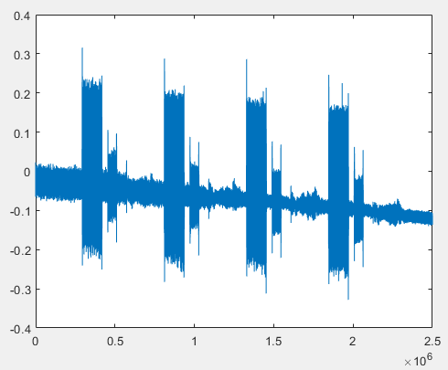
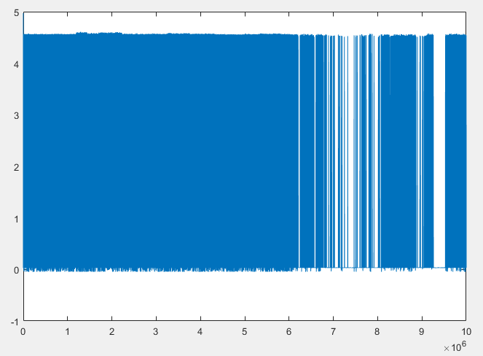
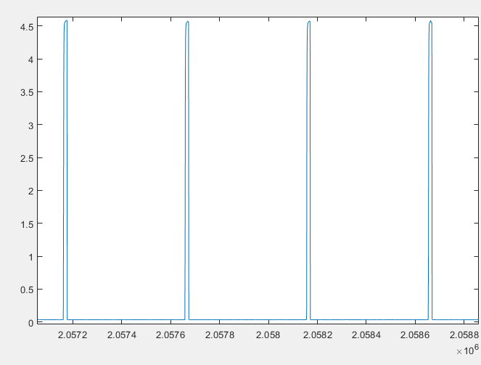
Pre-processing for brass
497- 498 index
N - 125k HZ
4N - 500k HZ

