Slide 1
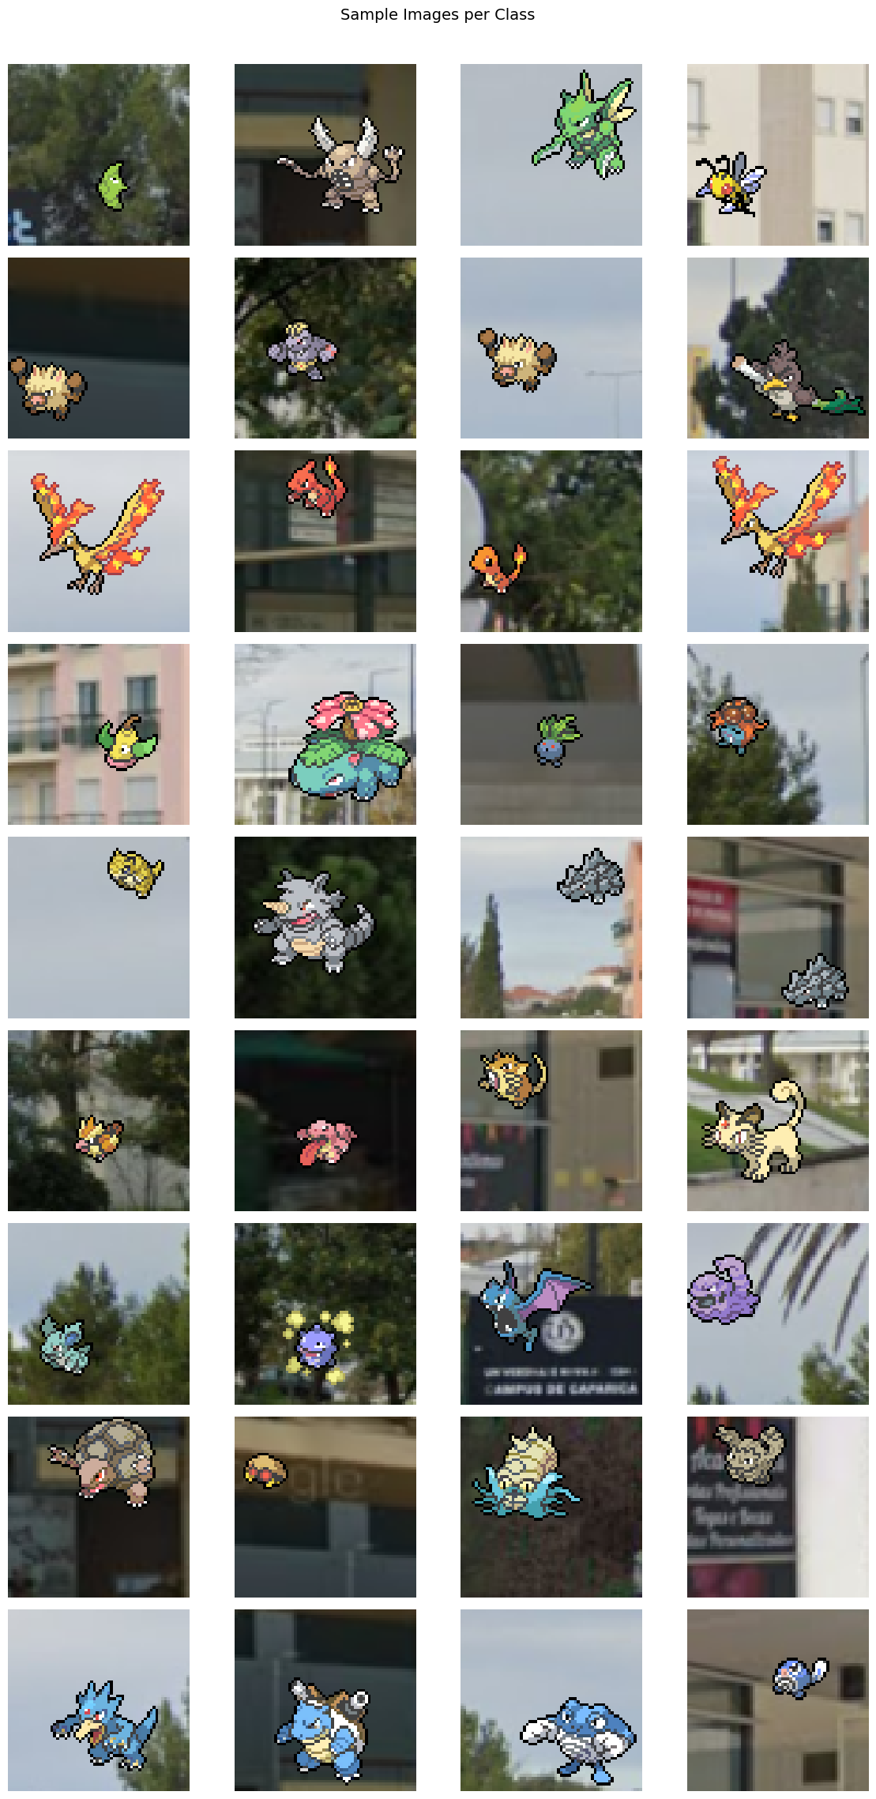
Dataset summary
MLP baseline
Macro-F1 focus
The Pokemon are out there! 2026 Task 1
Duarte Ferreira 75419
Tiago Figueiredo 73187
3,600 train images • 9 classes • Best validation macro-F1: 0.2132
Assignment 1 review
Notes:
Title slide summarizing the uploaded notebook results and scope of the presentation. [Sources] - User-uploaded notebook: assignment1_v1.ipynb [/Sources]

Slide 2
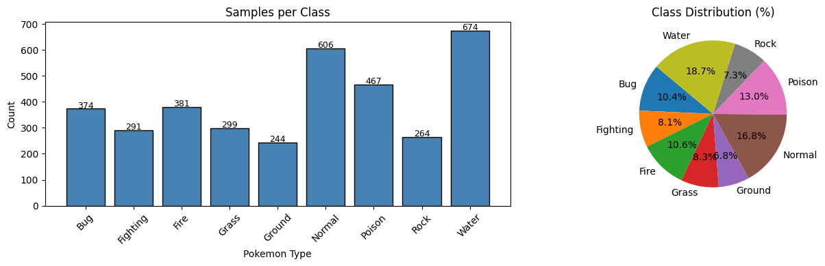
1. Data exploration insights
Why macro-F1 matters
The dataset is manageable but not balanced, so class-sensitive evaluation is more informative than accuracy alone.
• 3,600 labeled training images spread across 9 Pokémon types.
• Each image is 64×64, which limits fine-grained texture and shape detail.
• Label frequencies vary from 244 (Ground) to 674 (Water): a 2.8× imbalance.
Sample sprites show why some classes are easier: Fire/Water are visually distinctive, while Rock/Ground/Fighting often share earthy colors and similar silhouettes.
Notes:
Key claims and visuals come from the data-exploration cells in the uploaded notebook. Counts: 3600 samples, 9 classes, Water 674 vs Ground 244, imbalance ratio 2.8x, image size 64x64. [Sources] - User-uploaded notebook: assignment1_v1.ipynb [/Sources]

Slide 3
2. Model architecture and rationale
Simple baseline, heavy regularization
Input
96×96×3
Flatten
27,648
Dense
2048
Dense
1024
Dense
512
Dense
256
Logits
9 classes
BatchNorm + ReLU after each hidden layer
Dropout = 0.4 on early layers, 0.3 before the output
Why this design
Training setup
15% stratified validation split
Batch size 64
Learning rate 3e-4
Up to 100 epochs, patience 20
• Uses aggressive augmentation before flattening to expand the small training set.
• WeightedRandomSampler and class-weighted cross-entropy both counter label imbalance.
• Adam + ReduceLROnPlateau make optimization stable for a large fully connected network.
• Trade-off: flattening discards spatial locality, while the model still carries 59.4M trainable parameters.
Notes:
Architecture, parameter count, augmentation, sampler, loss, and optimization choices are taken from the notebook code cells. Important correction versus markdown text: the implemented model uses 96x96 inputs and a 27,648-dimensional flattened vector. [Sources] - User-uploaded notebook: assignment1_v1.ipynb [/Sources]

Slide 4
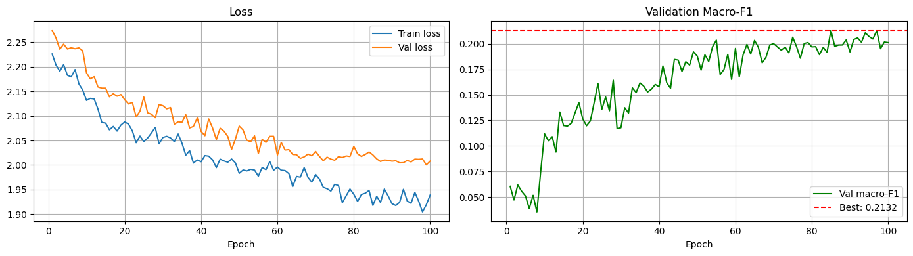
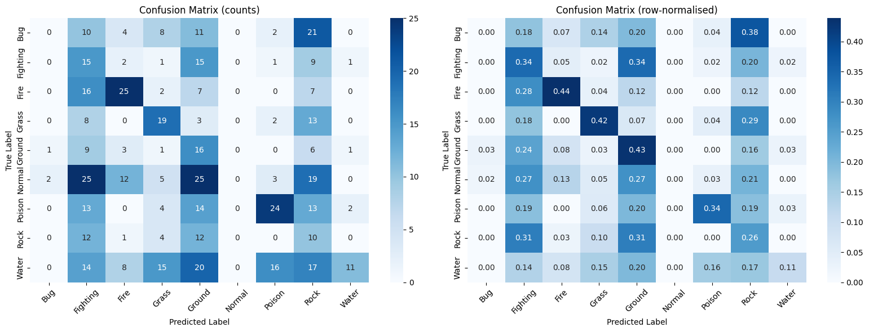
3. Performance metrics and interpretation
Validation-set view
Headline metrics
Best validation macro-F1: 0.2132
Accuracy: 0.22
Macro precision / recall: 0.26 / 0.26
Class-level pattern
Strongest F1: Fire 0.45, Poison 0.41, Grass 0.37
Weakest F1: Bug 0.00, Normal 0.00, Rock 0.13
Water precision is high (0.73) but recall is very low (0.11).
Interpretation
• Validation loss keeps falling, but macro-F1 levels off near 0.20.
• Biggest confusion cluster: Ground, Rock, Fighting, and Grass.
• The baseline separates obvious classes, but flattening limits spatial feature learning that a CNN would preserve.
Notes:
Metrics and plots come from the validation evaluation cells in the uploaded notebook. Classification report values used here: accuracy 0.22, macro avg F1 0.21, strong classes Fire/Poison/Grass, weak classes Bug/Normal/Rock, Water precision 0.73 with recall 0.11. [Sources] - User-uploaded notebook: assignment1_v1.ipynb [/Sources]

