Slide 1
HUGO
Team "Canctra"

Slide 2
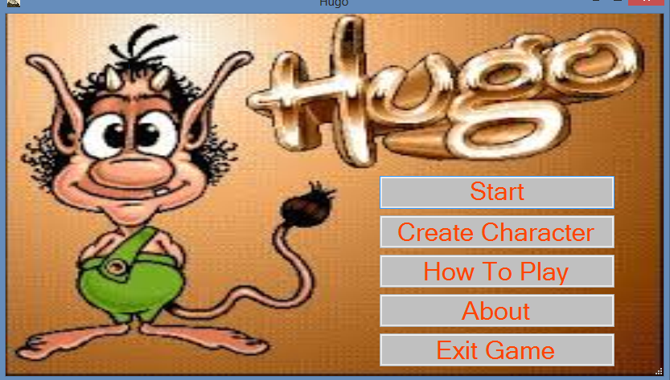
Get Started

Slide 3
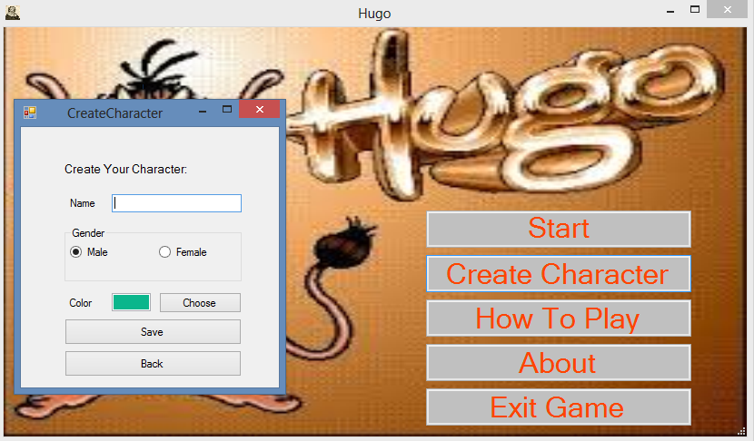
Create Players

Slide 4
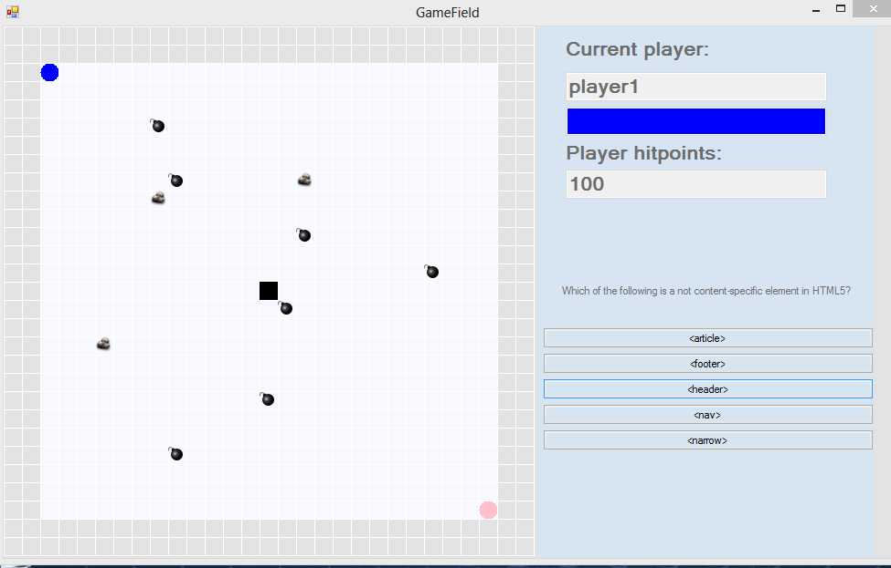
Lets Play

Slide 5
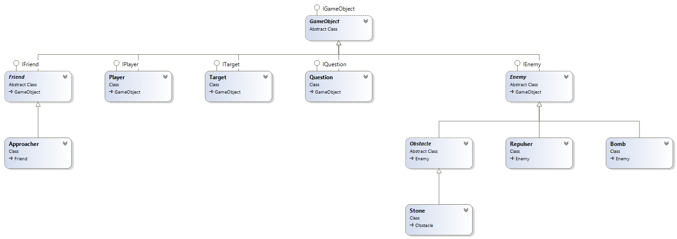
Structure

Slide 6
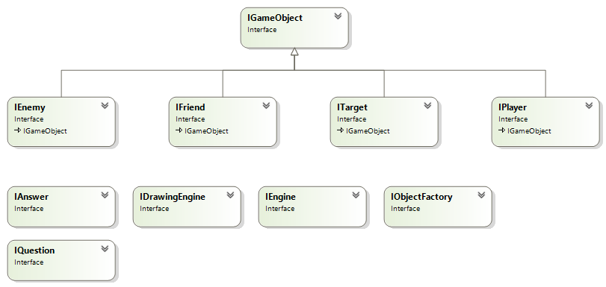
Interfaces

Slide 7
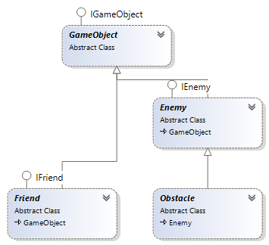
Abstract Classes

Slide 8
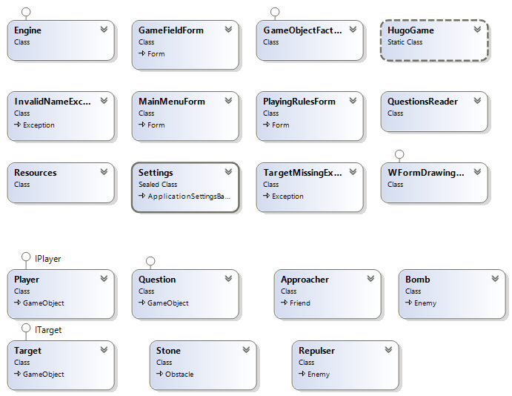
Concrete Classes

Slide 9
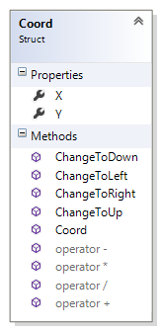
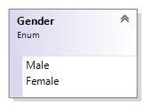
Structures and Enumerations

Slide 10

Exceptions

Slide 11
DEMO

