Slide 1
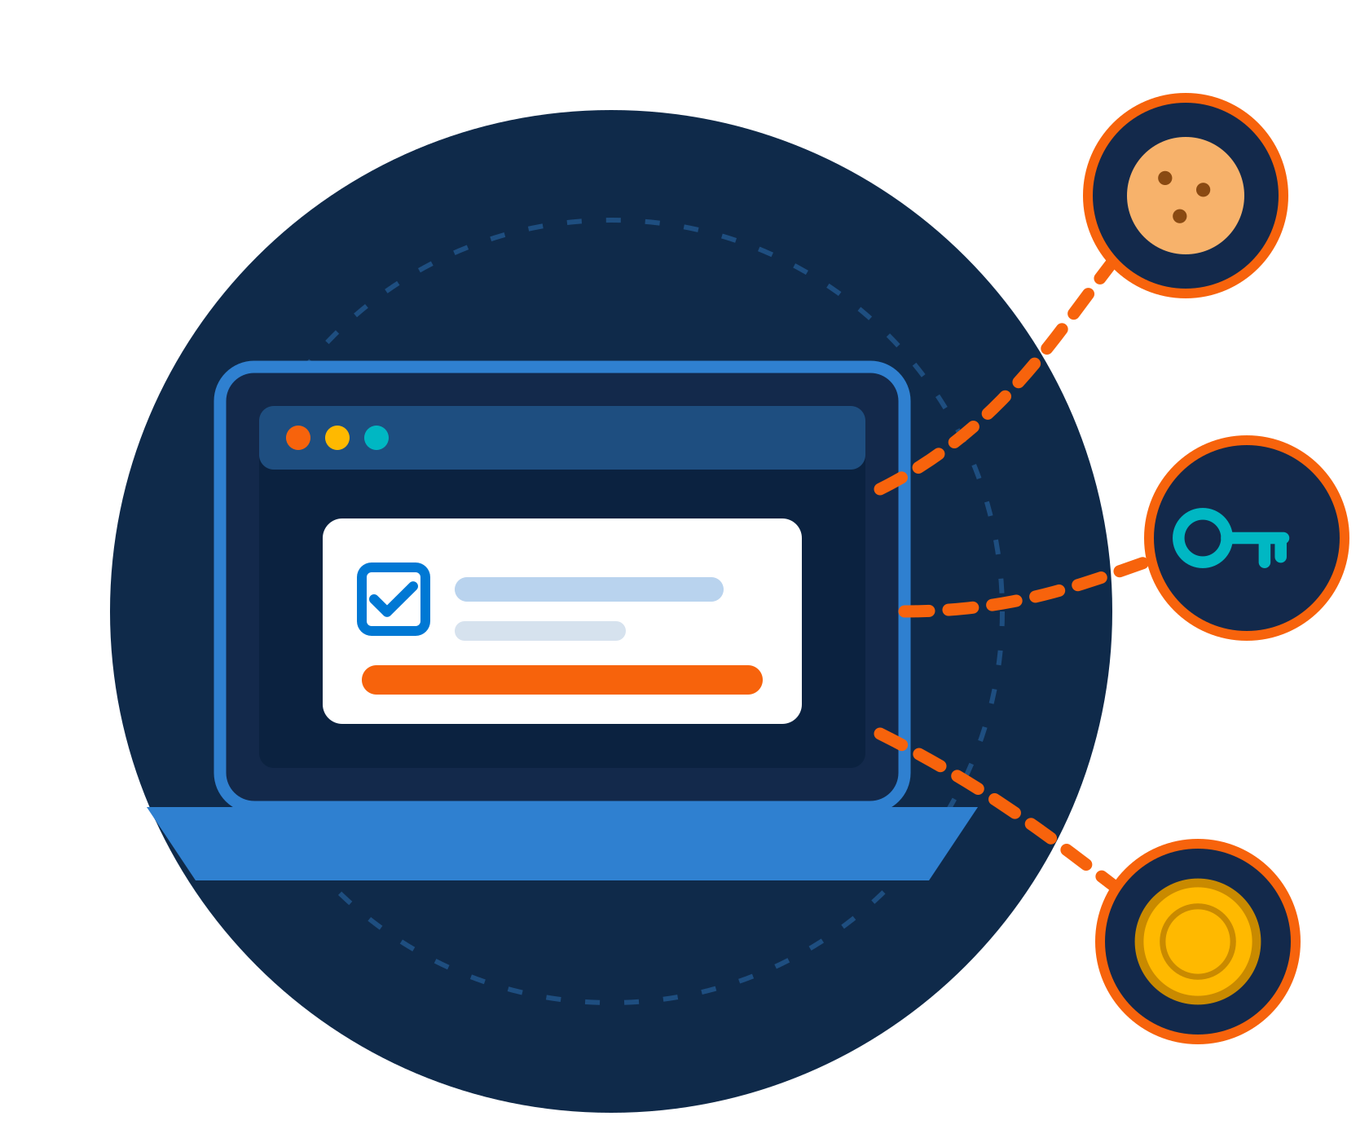
Lumma Stealer (LummaC2)
ZNEXORA TECH | THREAT BRIEFING
The information stealer behind fake CAPTCHA and ClickFix attacks
Presented by: ZNexora Tech
Information stealer
Malware-as-a-Service
Targets Windows
Notes:
[0:00 – 0:35] Good [morning/afternoon], everyone. I'm [Presenter] from ZNexora Tech. In the next ten minutes, I'll brief you on Lumma Stealer, also called LummaC2. It's one of the most widespread pieces of information-stealing malware today, and it often reaches people through a simple trick: a fake 'prove you're human' page. By the end, you'll know what it steals, how it spreads, how to spot it, how to prevent it, and exactly what to do if it hits us.

Slide 2




What is Lumma Stealer?
01 · THREAT PROFILE
A leading information stealer that targets browser data, crypto wallets and session cookies, often distributed via fake CAPTCHA and ClickFix pages.
Malware-as-a-Service
Targets Windows PCs
Fast and evasive
Rented to criminal affiliates since 2022
Built to harvest data from Windows devices
Starts stealing as soon as it runs, then hides
TIMELINE
2022
2024
May 2025
2025 – 2026
First seen on criminal forums
Widespread fake CAPTCHA and ClickFix campaigns
Global takedown: about 2,300 domains seized
Back with new infrastructure and loaders
Notes:
[0:35 – 1:25] So what is Lumma? It's an information stealer: malware designed to quietly collect data from your computer and send it to criminals. It targets browser data, crypto wallets and session cookies, and it's often spread through fake CAPTCHA and ClickFix pages. Lumma is sold as malware-as-a-service, meaning criminals rent it, like a subscription, and run their own campaigns. It's been around since 2022 and targets Windows PCs. In May 2025, Microsoft, Europol and US authorities disrupted it and seized around 2,300 domains. But within weeks it was back, with new infrastructure, and it remains active through new delivery tools. So this is a current threat, not history.

Slide 3
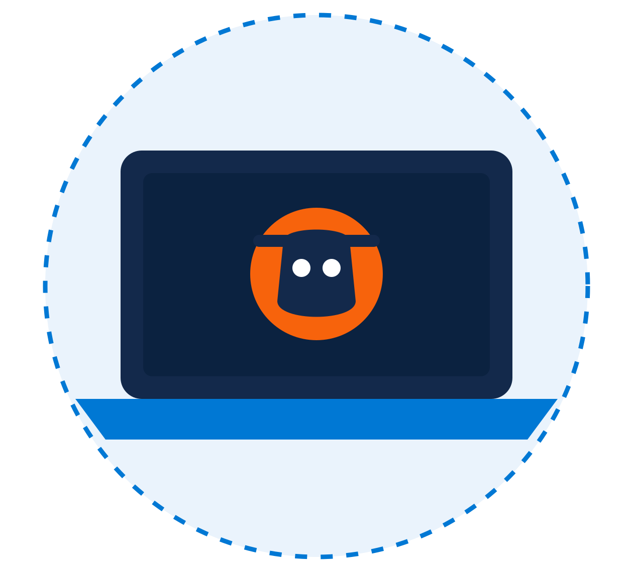





What Lumma steals
02 · WHAT IT TARGETS
Browser data
Crypto wallets
Saved passwords, autofill and card details
Wallet extensions, files and keys
Session cookies
2FA, apps and system info
Let attackers skip passwords and MFA
Authenticator extensions and chat apps
WHY IT MATTERS Stolen data is bundled into “logs” and sold, fuelling account takeover and ransomware.
Notes:
[1:25 – 2:15] Once Lumma is running, it goes after four things. First, browser data: saved passwords, autofill entries and stored card details. Second, session cookies. These are the most dangerous, because a stolen session cookie can let an attacker log in as you without your password, and without triggering MFA. Third, crypto wallets: browser wallet extensions and wallet files. And fourth, other valuable data such as authenticator extensions, messaging apps and details about your device. Everything is packaged into what criminals call 'logs' and sold online. Those logs are then used for account takeover, fraud, and as a starting point for ransomware attacks on organisations like ours.

Slide 4







How Lumma reaches victims
03 · WAYS IN
Fake CAPTCHA pages
Malicious ads
Cracked software
“Verify you’re human” tricks (ClickFix)
Fake results at the top of search pages
“Free” versions of paid apps and tools
Game mods and cheats
Phishing messages
Fake updates
Cheats and mods from unofficial sites
Emails, chats and DMs with malicious links
Fake “browser out of date” pop-ups
COMMON THREAD You are tricked into running something yourself.
Notes:
[2:15 – 3:00] Lumma doesn't rely on one method. Criminals who rent it spread it in many ways. Fake CAPTCHA pages, which we'll look at next. Malicious ads that appear at the top of search results, for example when you search for popular software. Cracked or 'free' versions of paid software. Game mods, cheats and automation scripts from unofficial sites. Phishing emails, chats and direct messages with malicious links. And fake pop-ups claiming your browser needs an urgent update. They all have one thing in common: you're tricked into downloading or running something yourself. That's why our awareness is such an important defence.

Slide 5

The fake CAPTCHA / ClickFix trick
04 · THE CLICKFIX TRICK
Verify you are human
FAKE PAGE
The lure
1
A compromised site, malicious ad or fake download leads you to the page.
I'm not a robot
2
Fake verification
To finish verification:
A “prove you’re human” box shows unusual keyboard steps.
1
Press Windows + R
3
Hidden command
2
Press Ctrl + V
The page has silently copied a malicious command to your clipboard.
3
Press Enter
4
You run it
Verify
Pasting and pressing Enter installs Lumma, which starts stealing.
A real CAPTCHA never asks you to open Run, paste or type commands.
Notes:
[3:00 – 4:00] Here's the trick that makes Lumma so effective, known as ClickFix or the fake CAPTCHA. It starts with a lure: you visit a compromised website, click a malicious ad, or try to download free software. You then see what looks like a normal 'I'm not a robot' check. But instead of clicking pictures, it gives you strange instructions: press Windows and R, press Control and V, then press Enter. Behind the scenes, the page has already copied a malicious command to your clipboard. When you paste it into the Run box and press Enter, you are the one who installs the malware, which also helps it slip past some security tools. Lumma then starts collecting your data straight away. Remember this line: a real CAPTCHA never asks you to open Run, paste or type commands.

Slide 6







From one paste to a breach
05 · ATTACK CHAIN
STEP 1
STEP 2
STEP 3
STEP 4
STEP 5
STEP 6
Lure
Execute
Steal
Exfiltrate
Sell
Exploit
Fake page, ad or download
Victim runs the command
Passwords, cookies, wallets
Data sent to attackers
Logs sold on criminal markets
Account takeover, fraud, ransomware
Steps 1 to 4
Happen on your device, often within minutes.
Steps 5 and 6
Other criminals, including ransomware groups, buy access.
Notes:
[4:00 – 4:45] Let's zoom out and look at the full attack chain. Step one, the lure: a fake page, ad or download. Step two, execute: the victim runs the command or file. Step three, steal: Lumma collects passwords, cookies and wallet data. Step four, exfiltrate: the data is sent to the attackers' servers. Those first four steps happen on your device, often within minutes. Then step five, sell: the stolen data is packaged as logs and sold on criminal markets. And step six, exploit: buyers use it for account takeover and fraud, and ransomware groups use it as their way into organisations. So one paste on one laptop can become a company-wide incident.

Slide 7




Warning signs to watch for
06 · DETECTION
WHAT YOU MIGHT NOTICE
WHAT IT AND SECURITY CAN DETECT
A web page asks you to press Windows + R or paste a command
PowerShell or mshta launched from the Run dialog
A command or PowerShell window flashes open
New Run history (RunMRU) entries containing web commands
Sudden logouts, or “new sign-in” alerts you don’t recognise
Unusual processes reading browser password and cookie files
MFA prompts or reset emails you didn’t request
Connections to newly registered or known Lumma domains
Missing crypto or unexpected account activity
Sign-ins from new locations reusing valid sessions
Notes:
[4:45 – 5:40] How can we spot Lumma? Here's what you might notice yourself: a web page asking you to press Windows and R or paste a command, which is the biggest red flag of all. A command or PowerShell window that briefly flashes open. Sudden logouts, or alerts about new sign-ins you don't recognise. MFA prompts or password-reset emails you didn't request. Or missing crypto and unexpected account activity. On the IT and security side, the team can detect PowerShell or mshta launched from the Run dialog, new entries in the Run history containing web commands, unusual processes reading browser password and cookie files, connections to newly registered or known Lumma domains, and sign-ins from new locations that reuse valid sessions.

Slide 8






Six habits that stop Lumma
07 · PROTECT YOURSELF
Never paste commands
Use official sources
Use a password manager
No real website asks you to run anything.
No cracks or unofficial downloads.
Don’t save passwords in the browser.
Use MFA and read alerts
Keep everything updated
Keep crypto off work devices
Report prompts you didn’t expect.
Browser, Windows and security tools.
Never store personal wallets at work.
If a page tells you to press Windows + R: close it and report it.
Notes:
[5:40 – 6:40] Here are six habits that protect you. One: never paste commands. No real website, CAPTCHA or support page will ever ask you to run something. Two: use official sources only. No cracked software, unofficial game mods, or pop-up updates; get updates from the app itself or our IT team. Three: use our approved password manager, and don't save passwords in your browser, which is exactly where Lumma looks first. Four: use MFA and read your alerts, and report any prompt you didn't expect. Five: keep your browser, Windows and security tools updated. And six: keep personal crypto wallets off work devices. If you remember one rule: if a page tells you to press Windows and R, close it and report it.

Slide 9





Layered controls for IT and security teams
08 · PREVENT
Endpoint
EDR in block mode and ASR rules; restrict the Run dialog, PowerShell and mshta for standard users (GPO, AppLocker or WDAC).
Identity
Phishing-resistant MFA, Conditional Access for compliant devices, short session lifetimes and token protection.
Browser
Disable built-in password saving by policy, allowlist extensions and keep browsers patched.
Network
DNS and web filtering; block newly registered domains, malvertising and known Lumma infrastructure.
Monitoring
Threat-intel IOC feeds, alerts on suspicious PowerShell, and stealer-log monitoring for our domains.
Notes:
[6:40 – 7:50] For our IT and security teams, prevention works in layers. On the endpoint: run EDR in block mode with attack surface reduction rules, and restrict the Run dialog, PowerShell and mshta for standard users using Group Policy, AppLocker or WDAC. That alone breaks the ClickFix trick. On identity: phishing-resistant MFA, Conditional Access that requires compliant devices, short session lifetimes and token protection, so stolen cookies are less useful and expire quickly. On the browser: disable built-in password saving by policy, allowlist extensions and keep browsers patched. On the network: DNS and web filtering that blocks newly registered domains, malvertising and known Lumma infrastructure. And for monitoring: subscribe to threat-intelligence feeds, alert on suspicious PowerShell, and monitor stealer-log markets for our company domains, so we can act before stolen credentials are used.

Slide 10

Ran a suspicious command? Act fast
09 · IF YOU RAN IT
1
Disconnect: Unplug the network cable or turn off Wi-Fi.
2
Report immediately: Contact IT / Security on [contact].
WHY SPEED MATTERS
Reset from a clean device: Change passwords and sign out of all sessions.
Every minute counts: stolen cookies work until sessions are revoked.
3
4
Protect crypto funds: Move funds to a new wallet; watch accounts.
5
Let IT rebuild: IT investigates and reimages the device.
You will never be blamed for reporting.
Notes:
[7:50 – 8:30] If you ever run a command like this, or suspect Lumma on your device, act fast. One: disconnect from the network straight away. Two: report it to IT and Security on [contact] immediately; you will never be blamed for reporting. Three: from a different, clean device, change your passwords and sign out of all active sessions, because stolen cookies keep working until those sessions end. Four: if you use crypto wallets on that computer, move your funds to a new wallet and watch your accounts. And five: let IT investigate and rebuild the device. Don't try to clean it yourself.

Slide 11






Remediation playbook for IT
10 · REMEDIATION
1
2
3
Contain
Scope
Revoke
Isolate the device with EDR; block the attacker’s domains.
Review the timeline: what ran, what was stolen, which accounts.
Reset passwords, revoke all sessions and tokens, rotate keys and secrets.
4
5
6
Eradicate
Recover
Report and learn
Reimage the device; don’t just delete files.
Monitor accounts and check for persistence or lateral movement.
Meet reporting duties, update blocklists, share lessons.
REMEMBER A password reset alone is not enough: stolen session cookies work until revoked.
Notes:
[8:30 – 9:30] For the IT and security team, here's the remediation playbook. One, contain: isolate the device using EDR and block the attacker's domains. Two, scope: use the EDR timeline to understand what ran, what data was accessed, and which accounts and services are affected. Three, revoke: reset passwords, revoke all active sessions and refresh tokens, re-register MFA if needed, and rotate any API keys or secrets stored on the device. Four, eradicate: reimage the device. Don't just delete the files, because loaders can leave other malware behind. Five, recover: monitor affected accounts closely and check for persistence or lateral movement. And six, report and learn: meet any regulatory reporting duties, add new indicators to blocklists, and share what we learned. The most important point: a password reset alone is not enough. Stolen session cookies keep working until the sessions are revoked.

Slide 12





Stop before you paste
11 · KEY TAKEAWAYS
No real website asks you to run commands
Cookies are keys: revoke sessions, not just passwords
Thank you
Layered controls stop one paste becoming a breach
Report fast: minutes matter
Notes:
[9:30 – 10:00] To wrap up, four key takeaways. No real website will ever ask you to run commands. Cookies are keys, so after an infection we revoke sessions, not just passwords. Layered controls stop one paste from becoming a breach. And report fast, because minutes matter. Lumma steals what keeps you logged in, so stop before you paste. Thank you. I'm happy to take any questions.

