Slide 1

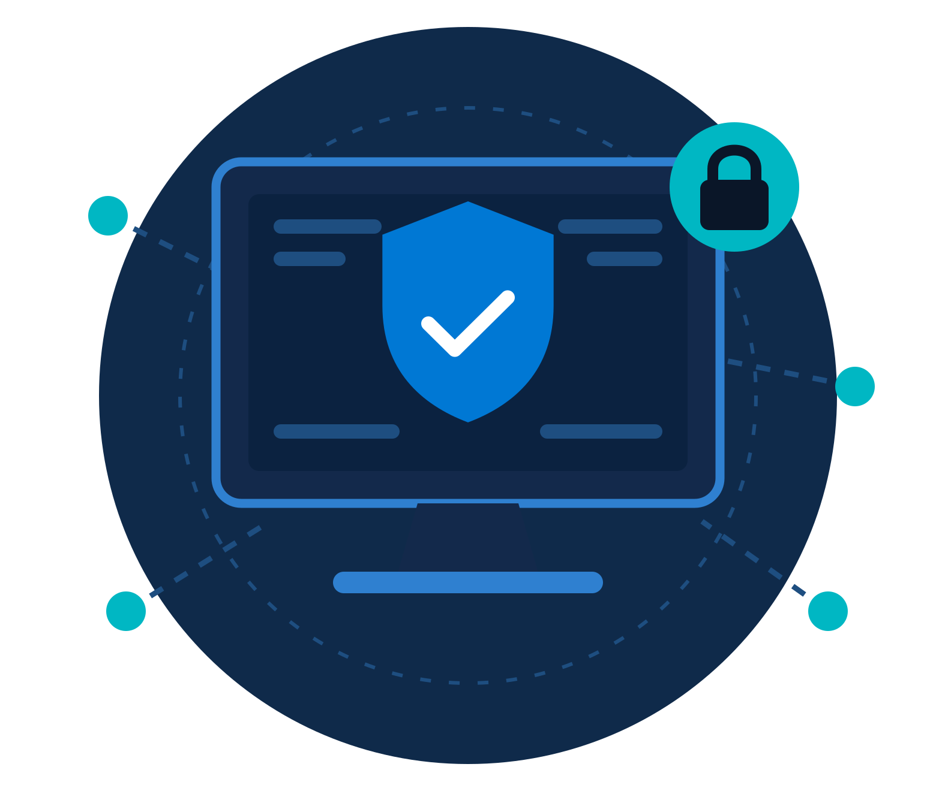
Windows Hardening
ZNEXORA TECH | SECURITY BRIEFING
Protecting Enterprise Endpoints Through Secure Configuration
A Practical Guide for System Administrators and Security Teams
Presented by: ZNexora Tech
REFERENCES
Microsoft Security Baselines
CIS Benchmarks
NIST Cybersecurity Framework
Notes:
Welcome. This session is a practical guide to hardening Windows endpoints, aligned with Microsoft Security Baselines, the CIS Benchmarks and the NIST Cybersecurity Framework.

Slide 2
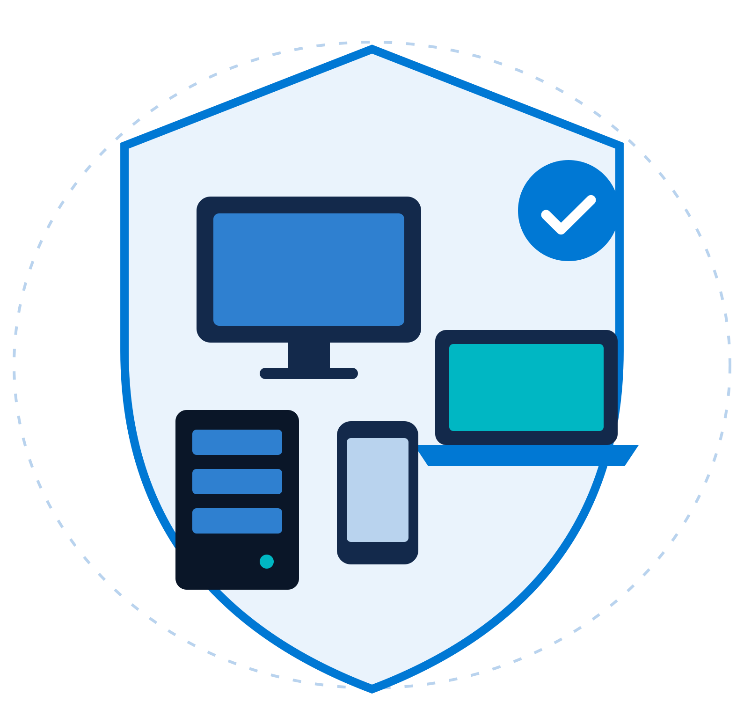





What is Windows Hardening?
01 · REDUCING THE ATTACK SURFACE OF WINDOWS SYSTEMS
Windows hardening is the process of implementing security controls and secure configurations to reduce vulnerabilities and limit opportunities for attackers.
OBJECTIVES
Prevent unauthorized access
Reduce cyber risks
Strengthen endpoint defenses
Improve security visibility
Support regulatory compliance
Notes:
Hardening means changing default and weak configurations so there are fewer ways in. The five objectives on the left are what every control in this deck supports.

Slide 3
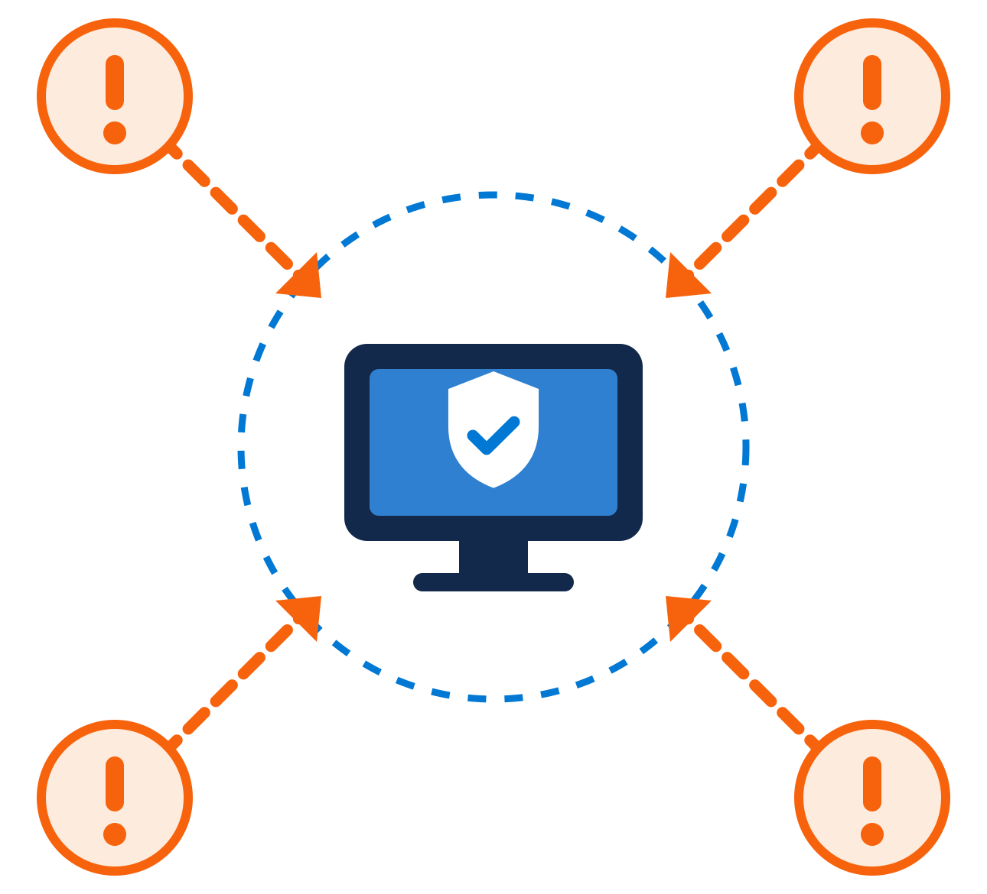




Why Windows Hardening Matters
02 · THREATS FACING ENTERPRISE WINDOWS ENVIRONMENTS
Credential Theft
Pass-the-Hash · Password Spraying · Credential Dumping
Malware & Ransomware
LockBit · Akira · Black Basta
Misconfigurations
Weak permissions · Open RDP · Legacy protocols
KEY MESSAGE Attackers often exploit weak configurations before exploiting zero-day vulnerabilities.
Notes:
Most real-world breaches use known techniques: stolen credentials, commodity ransomware and simple misconfigurations such as exposed RDP. Fixing configuration closes these doors long before a zero-day is needed.

Slide 4







Windows Hardening Framework
03 · DEFENSE-IN-DEPTH APPROACH
01
Identity Security
GOAL
Secure every layer of the Windows environment
02
System Security
03
Network Security
04
Application Security
05
Monitoring & Detection
Independent controls are stacked, so if one layer fails, the next one still protects the endpoint.
06
Data Protection
Notes:
We organise hardening into six layers. No single control is perfect, so defense-in-depth means an attacker who gets past one layer still faces the next. The rest of the deck walks through these layers.

Slide 5
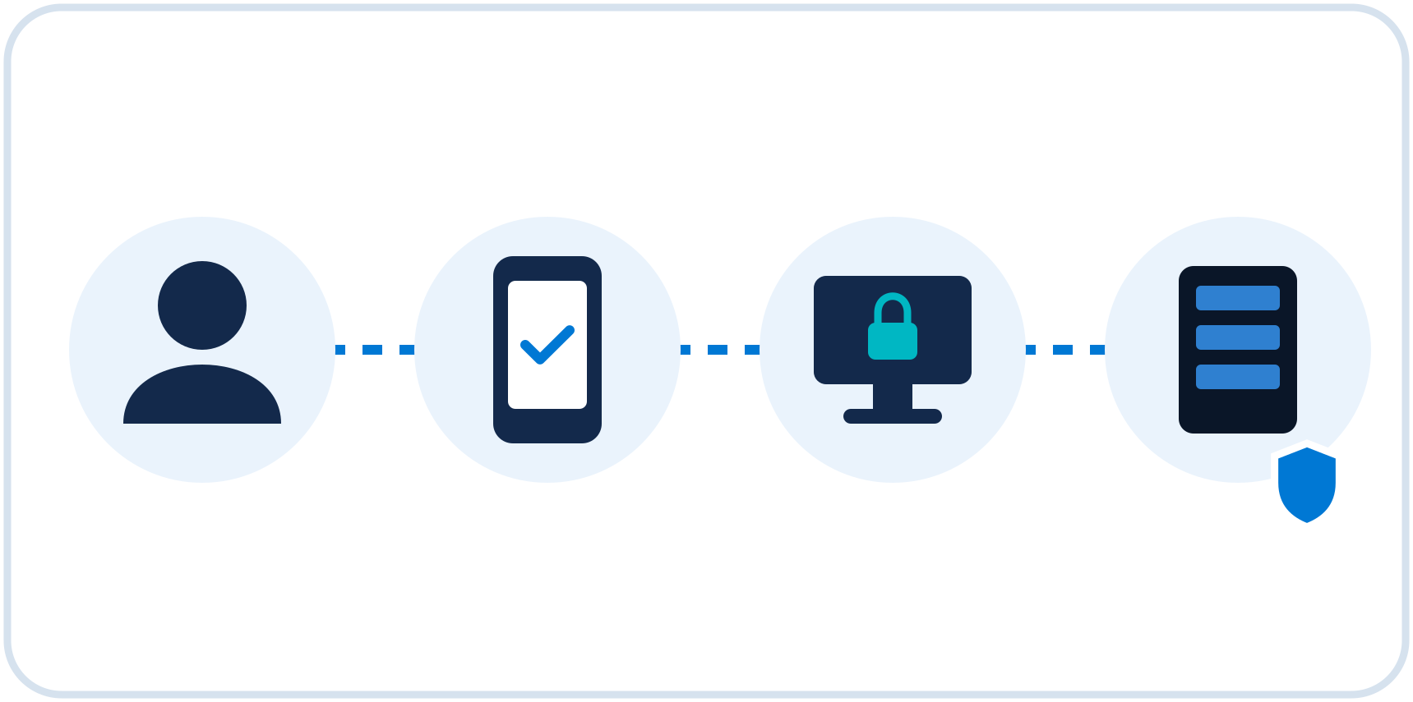




Secure User & Administrator Accounts
04 · IDENTITY PROTECTION FIRST
RECOMMENDED CONTROLS
Multi-Factor Authentication
Least Privilege Principle
Separate Admin Accounts
Privileged Access Workstations
BENEFITS
Account Lockout Policies
Reduced credential compromise
Reduced lateral movement
Improved access control
Notes:
Identity is the new perimeter. Enforce MFA, give users only the rights they need, use separate admin accounts from privileged access workstations, and lock out repeated failed logons. This limits stolen credentials and lateral movement.

Slide 6





Patch & Vulnerability Management
05 · KEEP SYSTEMS UPDATED
1 Scan
2 Prioritize
3 Test
4 Deploy
5 Verify
CRITICAL AREAS
BEST PRACTICES
Windows Updates
Microsoft Office
Monthly patch cycle
Emergency patch deployment
Microsoft Edge
Third-Party Applications
Vulnerability scanning
Risk-based remediation
Notes:
Unpatched software is one of the most exploited weaknesses. Cover Windows, Office, Edge and third-party apps, run a monthly cycle with an emergency path for critical fixes, and prioritise by real risk using vulnerability scans.

Slide 7







Microsoft Defender Security Stack
06 · BUILT-IN WINDOWS PROTECTION
Defender Antivirus
Defender Firewall
SECURITY BENEFITS
Real-time protection
Scans files and processes as they run
Behavioral detection
Flags suspicious activity, not just known malware
Microsoft
Defender
Threat intelligence
Cloud-delivered insight on emerging threats
Defender SmartScreen
Defender for Endpoint
Endpoint visibility
Central view of device health and alerts
Notes:
Windows ships with a strong built-in stack. Antivirus, firewall and SmartScreen protect each device, and Defender for Endpoint adds behavioural detection, threat intelligence and central visibility for the security team.

Slide 8



Attack Surface Reduction
07 · BLOCK COMMON ATTACK TECHNIQUES
RECOMMENDED CONTROLS
Block malicious macros
Block Office child processes
Restrict script execution
Block credential theft attempts
Control executable files
RESULT Reduced ransomware and malware infections
Notes:
Attack Surface Reduction rules in Defender stop the behaviours malware relies on, such as Office macros launching processes, obfuscated scripts and access to LSASS credentials. Start in audit mode, review the impact, then enforce.

Slide 9





RDP & Network Hardening
08 · SECURE REMOTE ACCESS
Admin Device
VPN Gateway
MFA Check
RDP Host
Managed, hardened
No direct exposure
Verify identity
NLA enforced
RDP HARDENING
NETWORK HARDENING
Network Level Authentication
Windows Firewall
VPN Access Only
SMBv1 Disabled
MFA Enforcement
TLS 1.2 / TLS 1.3
Restricted Administrative Access
Unused Services Disabled
Notes:
Never expose RDP directly to the internet. Route remote access through a VPN, require MFA and Network Level Authentication, and restrict who can connect. On the network side, keep the firewall on, disable SMBv1 and unused services, and require modern TLS.

Slide 10
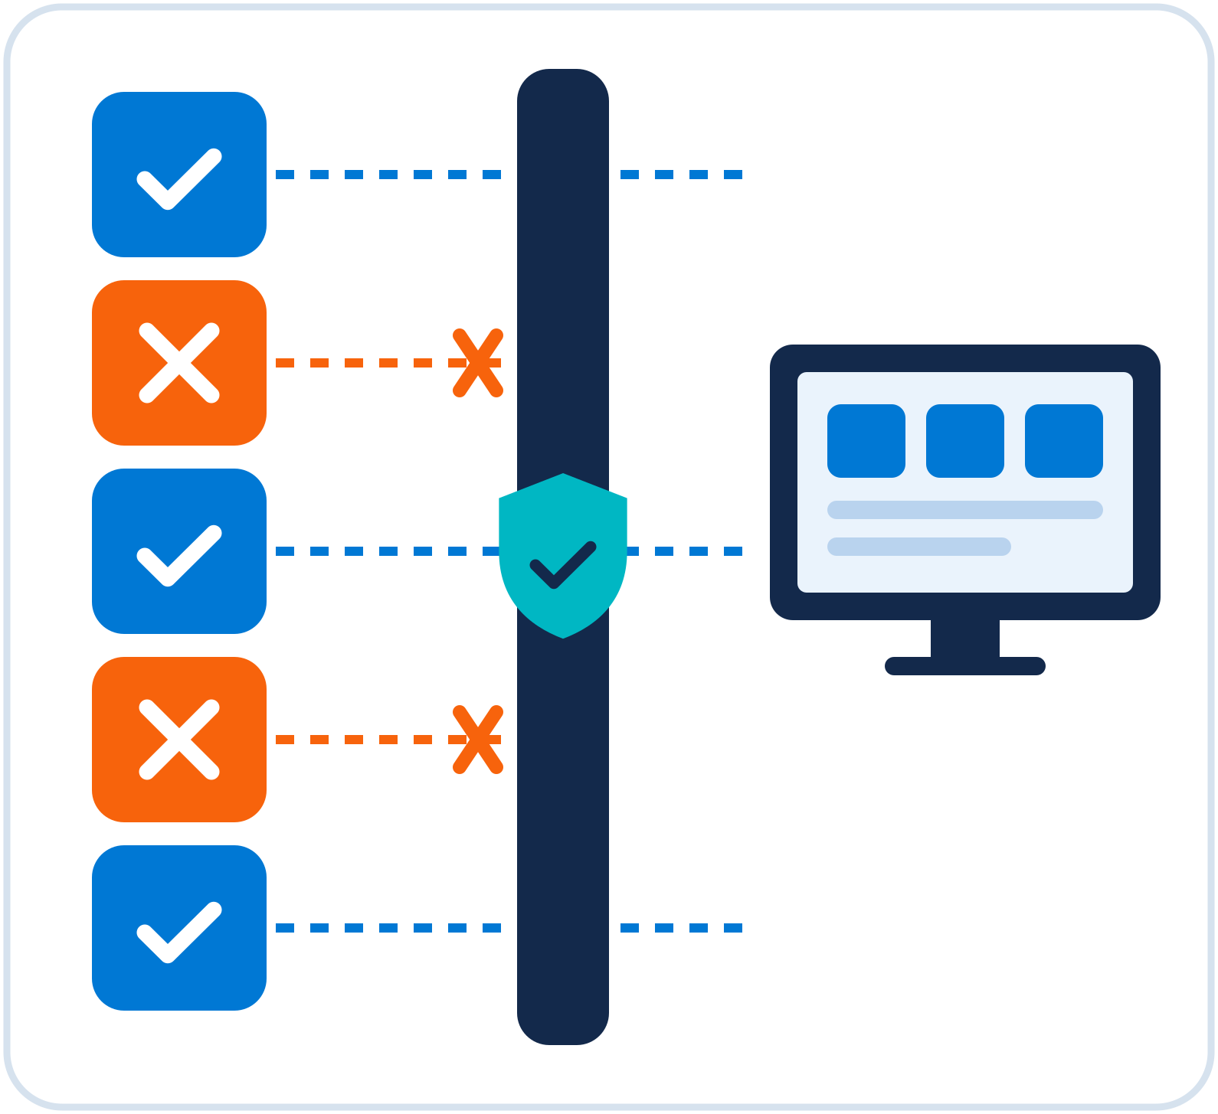






Application Control
09 · PREVENT UNAUTHORIZED SOFTWARE EXECUTION
Microsoft AppLocker Controls:
Executables
Scripts
MSI Installers
DLL Files
Windows Defender Application Control
Enforces trusted application execution.
Reduced malware infection
Reduced insider threats
Notes:
Application control flips the model from blocking known bad to allowing only known good. AppLocker controls executables, scripts, installers and DLLs, while WDAC enforces trust at the kernel level. Roll out in audit mode first.

Slide 11






Logging, Monitoring & Detection
10 · VISIBILITY ENABLES SECURITY
MONITOR
Account Logons
Privilege Escalation
Group Membership Changes
PowerShell Activities
Security Events
INTEGRATE WITH
Microsoft Sentinel
Azure Monitor
SIEM Platforms
Notes:
You cannot defend what you cannot see. Collect logons, privilege changes, group membership changes, PowerShell activity and other security events, and forward them to Microsoft Sentinel, Azure Monitor or your SIEM for correlation and alerting.

Slide 12
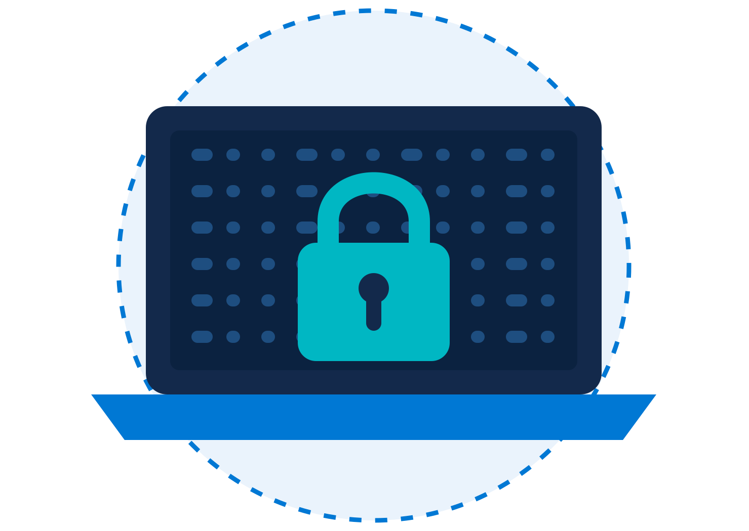





Data Protection with BitLocker
11 · ENCRYPT CRITICAL DATA
ADVANTAGES
Full Disk Encryption
Lost Device Protection
Protects all data on the drive
A stolen laptop reveals nothing
Compliance Support
Secure Remote Workforce
Helps meet data protection rules
Safeguards devices off-site
RECOMMENDED
TPM Enabled
Recovery Key Management
AES-256 Encryption
Notes:
BitLocker encrypts the whole drive, so a lost or stolen laptop does not become a data breach. Use the TPM, escrow recovery keys centrally in Entra ID or Active Directory, and use AES-256 where policy requires.

Slide 13












Windows Hardening Checklist
12 · ESSENTIAL SECURITY BASELINE
MFA Enabled
Windows Fully Patched
Defender Enabled
Firewall Enabled
BitLocker Enabled
RDP Secured
ASR Rules Applied
AppLocker Configured
Security Logs Monitored
Backups Tested
Review this baseline regularly: hardening is a continuous process, not a one-time project.
Notes:
Use this as a quick audit of any Windows estate. If any of these ten items is missing, that is where to start. Re-check the baseline after major updates and at least quarterly.

Slide 14


Key Takeaways
13 · REMEMBER
Protect Identities
Secure Configurations
Patch Continuously
MFA, least privilege, separate admin accounts
Baselines, ASR rules and application control
Monthly cycle plus emergency patching
Monitor Everything
Encrypt Sensitive Data
Prepare for Incidents
Centralise logs in your SIEM
BitLocker with managed recovery keys
Tested backups and response plans
FINAL MESSAGE
Secure Windows systems are built through continuous hardening, monitoring, and improvement.
Notes:
To summarise: protect identities, lock down configurations, patch continuously, monitor everything, encrypt sensitive data and be ready for incidents. Hardening is never finished; it is a cycle of improvement.

Slide 15
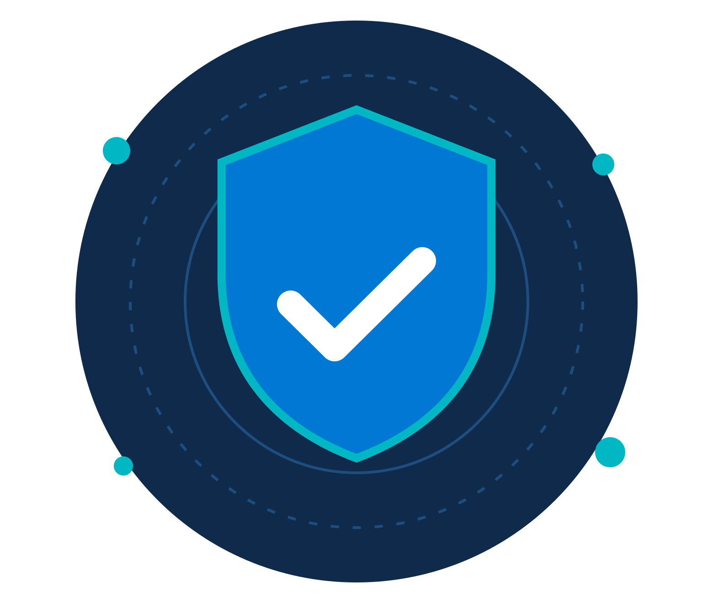

Thank You
QUESTIONS & DISCUSSION
Windows Security Hardening: Practical Defense for Modern Enterprises
Presented by: ZNexora Tech
We welcome your questions and experiences.
Notes:
Thank you. I am happy to take questions or hear how your teams approach Windows hardening today.

