Slide 1
Chapter 3 Logic Gates

Slide 2
Representation about logic relationship（逻辑关系的表示）
Logic expression 逻辑方程
Truth table 真值表
Logic circuits电路图

Slide 3

A
X
The Inverter(反向器、非门)
The inverter (反向器) performs the Boolean NOT operation（布尔非运算）. When the input is LOW, the output is HIGH; when the input is HIGH, the output is LOW.
LOW (0) HIGH (1)
HIGH (1) LOW(0)
The NOT operation (complement) is shown with an overbar. Thus, the Boolean expression （布尔表达式）for an inverter is X = A’.

Slide 4
The Inverter
A
X
Example waveforms（波形图）:
A
X
A group of inverters can be used to form the 1’s complement of a binary number（求补码）:
Binary number
1 0 0 0 1 1 0 1
0 1 1 1 0 0 1 0
1’s complement

Slide 5
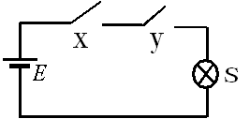
The AND Gate（与门）
A
A
X
X
B
B
The AND gate（与门） produces a HIGH output when all inputs are HIGH; otherwise, the output is LOW. For a 2-input gate（2输入与门）, the truth table（真值表） is
0 0
0 1
1 0
1 1
0
0
0
1
The AND operation is usually shown with a dot between the variables but it may be implied (no dot). Thus, the AND operation is written as X = A .B or X = AB.

Slide 6
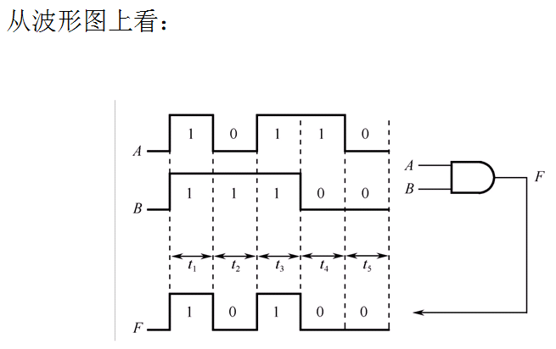
The AND Gate
A
A
X
X
B
B

Slide 7
The AND Gate
A
A
X
X
B
B
Draw the timing diagram(时序图) :
A
B
X

Slide 8
The AND Gate
A
A
X
X
B
B
The AND operation is used in computer programming as a selective mask（选择掩码）. If you want to retain certain bits of a binary number but reset the other bits to 0（将特定位置0）, you could set a mask with 1’s in the position of the retained bits.
Example
If the binary number 10100011 is ANDed with the mask 00001111, what is the result?
00000011

Slide 9
How about a 3-input AND gate?
Try to list the truth table of a 3-input AND gate.
思考：
假设只有三输入与门，怎么实现X=AB？
假设只有两输入与门，怎么实现X=ABC？

Slide 10
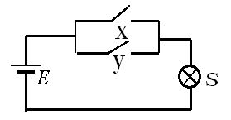
The OR Gate（或门）
A
X
A
X
B
B
The OR gate（或门） produces a HIGH output if any input is HIGH; if all inputs are LOW, the output is LOW. For a 2-input gate, the truth table is
0 0
0 1
1 0
1 1
0
1
1
1
The OR operation is shown with a plus sign (+) between the variables. Thus, the OR operation is written as X = A + B.

Slide 11
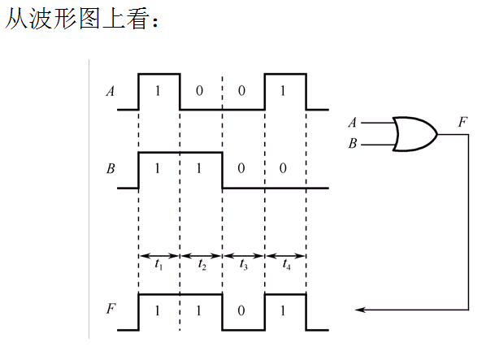
The OR Gate
A
X
A
X
B
B

Slide 12
The OR Gate
A
X
A
X
B
B
Draw the timing diagram(时序图) :
A
B
X

Slide 13
The OR Gate
A
X
A
B
B
X
The OR operation can be used in computer programming to set certain bits of a binary number to 1（将特定位置1）.
ASCII letters have a 1 in the bit 5 position for lower case letters and a 0 in this position for capitals. (Bit positions are numbered from right to left starting with 0.) What will be the result if you OR an ASCII letter with the 8-bit mask 00100000?
Example
Solution
The resulting letter will be lower case.

Slide 14
How about a 3-input OR gate?
Try to list the truth table of a 3-input OR gate.
思考：
假设只有三输入或门，怎么实现X=A+B？
假设只有两输入或门，怎么实现X=A+B+C？

Slide 15

主观题
2分
Try to draw the logic circuits and list the truth table, and draw the timing diagram.
1. AB+ABC.
2. AB+AC.
正常使用主观题需2.0以上版本雨课堂
作答

Slide 16
The NAND Gate（与非门）
A
X
A
X
B
B
The NAND gate （与非门）produces a LOW output when all inputs are HIGH; otherwise, the output is HIGH. For a 2-input gate, the truth table is
0 0
0 1
1 0
1 1
1
1
1
0
The NAND operation is shown with a dot between the variables and an overbar covering them. Thus, the NAND operation is written as X = A .B (Alternatively, X = AB.)

Slide 17
The NAND Gate
A
X
A
X
B
B
Example waveforms:
A
B
X
The NAND gate is particularly useful because it is a “universal” gate（通用门） – all other basic gates can be constructed from NAND gates.
How would you connect a 2-input NAND gate to form a basic inverter?
Question

Slide 18
The NOR Gate（或非门）
A
X
A
X
B
B
The NOR gate （或非门）produces a LOW output if any input is HIGH; if all inputs are HIGH, the output is LOW. For a 2-input gate, the truth table is
0 0
0 1
1 0
1 1
1
0
0
0
The NOR operation is shown with a plus sign (+) between the variables and an overbar covering them. Thus, the NOR operation is written as X = A + B.

Slide 19
A
X
A
X
The NOR Gate
B
B
Example waveforms:
A
B
X
The NOR operation will produce a LOW if any input is HIGH.
Example
When is the LED is ON for the circuit shown?
Solution
The LED will be on when any of the four inputs is HIGH.

Slide 20
A
X
A
X
The XOR Gate（异或门）
B
B
The XOR gate （Exclusive-OR gate,异或门）produces a HIGH output only when both inputs are at opposite logic levels. The truth table is
0 0
0 1
1 0
1 1
0
1
1
0
The XOR operation is written as X = AB + AB. Alternatively, it can be written with a circled plus sign between the variables as X = A + B.

Slide 21
The XOR Gate
A
X
A
X
B
B
Example waveforms:
A
B
X
Notice that the XOR gate will produce a HIGH only when exactly one input is HIGH.
Question
If the A and B waveforms are both inverted for the above waveforms, how is the output affected?
There is no change in the output.

Slide 22
How about a 3-input XOR gate?
Try to list the truth table of a 3-input XOR gate .

Slide 23
The XNOR Gate（异或非门）
A
X
A
X
B
B
The XNOR gate（异或非门，同或门） produces a HIGH output only when both inputs are at the same logic level. The truth table is
0 0
0 1
1 0
1 1
1
0
0
1
The XNOR operation shown as X = AB + AB. Alternatively, the XNOR operation can be shown with a circled dot between the variables. Thus, it can be shown as X = A . B.

Slide 24
The XNOR Gate
A
X
A
X
B
B
Example waveforms:
A
B
X
Notice that the XNOR gate will produce a HIGH when both inputs are the same. This makes it useful for comparison functions.
Question
If the A waveform is inverted but B remains the same, how is the output affected?
The output will be inverted.

Slide 25
Fixed Function Logic（固定功能逻辑）
Two major fixed function logic families are TTL and CMOS.
A third technology is BiCMOS（双CMOS）, which combines the first two.
Packaging for fixed function logic is shown.
DIP package SOIC package

Slide 26
集成电路命名规则（TTL）
SN74LS00
Low power(L)
High speed(H)
Low power Schottky(LS)
Schottky(S)
Advanced Low power Schottky(ALS)
Advanced Schottky(AS)
生产者
CT:中国TTL
SN：德州仪器
HD：日立
54--- 军用温度范围
（-55℃～125℃）
74--- 商用温度范围
（0℃～70℃）

Slide 27
Fixed Function Logic
74LS系列和74HC系列引脚兼容.
Some common gate configurations are shown.

Slide 28
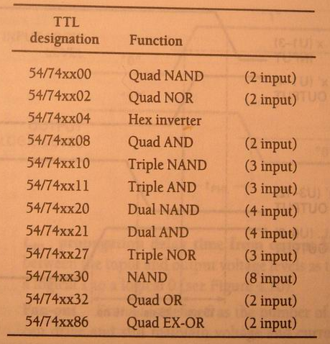

Slide 29
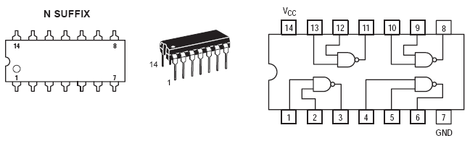
SN74LS00

Slide 30
74LS00逻辑符号

Slide 31
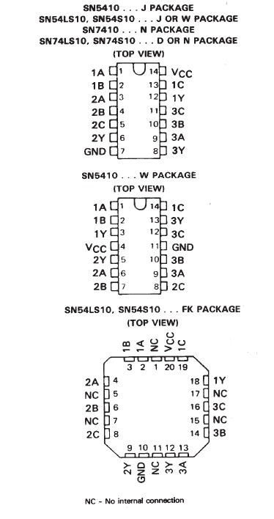
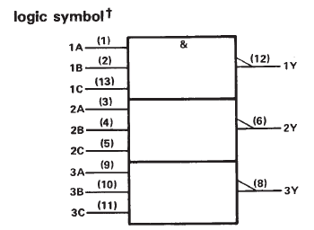
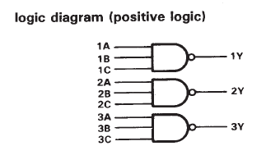
SNXXXX10

Slide 32
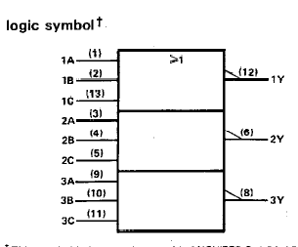
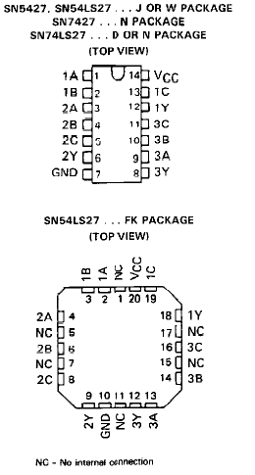
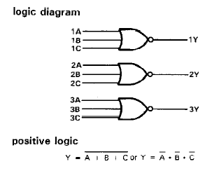
SNXXXX27

Slide 33
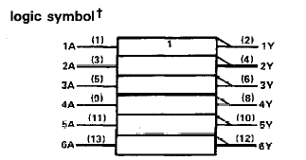
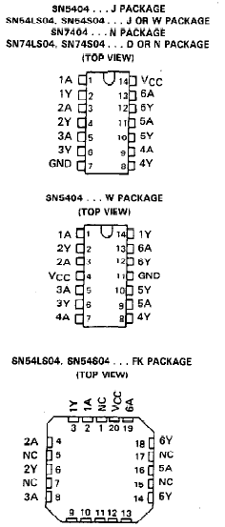
SNXXXX04

Slide 34
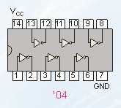
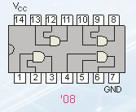
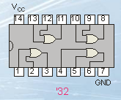
Example：Try to draw the logic circuits for
F=AB+BCD+CD.
Try to draw the logic circuits by using 74LS04、 74LS08、 74LS32.

Slide 35
Fixed Function Logic
Data sheets（数据表） include limits and conditions set（工作条件） by the manufacturer as well as DC and AC characteristics. For example, some maximum ratings for a 74HC00A are:

Slide 36
Selected Key Terms
Inverter
Truth table
Timing diagram
Boolean algebra
AND gate
A logic circuit that inverts or complements its inputs.
A table showing the inputs and corresponding output(s) of a logic circuit.
A diagram of waveforms showing the proper time relationship of all of the waveforms.
The mathematics of logic circuits.
A logic gate that produces a HIGH output only when all of its inputs are HIGH.

Slide 37
Selected Key Terms
OR gate
NAND gate
NOR gate
Exclusive-OR gate
Exclusive-NOR gate
A logic gate that produces a HIGH output when one or more inputs are HIGH.
A logic gate that produces a LOW output only when all of its inputs are HIGH.
A logic gate that produces a LOW output when one or more inputs are HIGH.
A logic gate that produces a HIGH output only when its two inputs are at opposite levels.
A logic gate that produces a LOW output only when its two inputs are at opposite levels.

Slide 38

Quiz
The truth table for a 2-input AND gate is
a.
0 0
0 1
1 0
1 1
0
1
1
0
b.
0 0
0 1
1 0
1 1
1
0
0
0
0 0
0 1
1 0
1 1
0
0
0
1
0 0
0 1
1 0
1 1
0
1
1
1
c.
d.

Slide 39
Quiz
The truth table for a 2-input NOR gate is
a.
0 0
0 1
1 0
1 1
0
1
1
0
b.
0 0
0 1
1 0
1 1
1
0
0
0
0 0
0 1
1 0
1 1
0
0
0
1
0 0
0 1
1 0
1 1
0
1
1
1
c.
d.

Slide 40
Quiz
The truth table for a 2-input XOR gate is
a.
0 0
0 1
1 0
1 1
0
1
1
0
b.
0 0
0 1
1 0
1 1
1
0
0
0
0 0
0 1
1 0
1 1
0
0
0
1
0 0
0 1
1 0
1 1
0
1
1
1
c.
d.

Slide 41
Quiz
A
X
4. The symbol is for a(n)
B
a. OR gate
b. AND gate
c. NOR gate
d. XOR gate

Slide 42
Quiz
A
X
5. The symbol is for a(n)
B
a. OR gate
b. AND gate
c. XNOR gate
d. XOR gate

Slide 43
Quiz
6. A logic gate that produces a HIGH output only when all of its inputs are HIGH is a(n)
a. OR gate
b. AND gate
c. NOR gate
d. NAND gate

Slide 44
Quiz
7. The expression X = A + B means
a. A OR B
b. A AND B
c. A XOR B
d. A XNOR B

Slide 45
Quiz
8. A 2-input gate produces the output shown. (X represents the output.) This is a(n)
a. OR gate
b. AND gate
c. NOR gate
d. NAND gate
A
B
X

Slide 46
Quiz
9. A 2-input gate produces a HIGH output only when the inputs agree. This type of gate is a(n)
a. OR gate
b. AND gate
c. NOR gate
d. XNOR gate

Slide 47
Quiz
Answers:
1. c
2. b
3. a
4. a
5. d
6. b
7. c
8. d
9. d

Slide 48
homework
P92 Self-Test 1-7
P93 8、14
P94 18、22
Draw the logic circuits for F=AB + A+B + ABC

