Slide 1
Chapter 7
Latches, Flip-Flops, and Timers

Slide 2
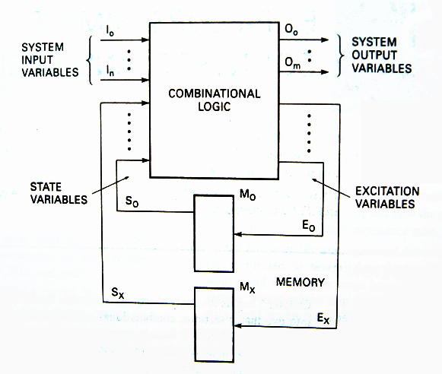
Time sequence logic(时序逻辑)

Slide 3
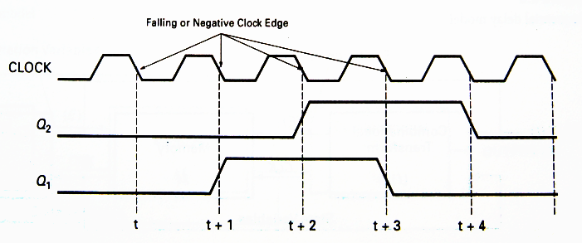
CLOCK：time pulse(时钟脉冲)
Q_{n} ：present state(现态)
Q_{n+1} ：next state(次态)

Slide 4
Flip-Flop / Latch(触发器/锁存器)
A flipflop/latch is a temporary storage device that has two stable states (bistable双稳态).
It is a basic form of memory.
Type of FF
SR
D
JK
T
Type of triggering:
Untriggered (asynchronous) 非触发(异步)
Level-triggered 电平触发
Edge-triggered (rising or falling edge of C) 边沿触发
Notes:
触发器/锁存器，基本存储单元，具有存储二进制信息的能力。也即当输入信息消失时，所置成的状态能够保持不变。
有两个稳定的状态：0状态和1状态。
触发器(flip-flop)和锁存器(latch)有时名称可混用，它们的本质区别在于有无触发方式。
有些锁存器受“使能”信号控制。
从左到右依次为：
1.上升沿触发的触发器
2.下降沿触发的触发器
3.锁存器(电平敏感)

Slide 5
S-R Latch(S-R锁存器)
The S-R (Set-Reset) latch is the most basic type.
It can be constructed from NOR gates or NAND gates.
With NOR gates, it responds to active-HIGH inputs;
with NAND gates, it responds to active-LOW inputs.
R
S
Q
Q
Q
Q
S
R
NOR Active-HIGH Latch NAND Active-LOW Latch
Notes:
基本SR锁存器。有两种配置形式
与非配置/或非配置
或非配置，高有效输入。
与非配置，低有效输入

Slide 6
S’-R’ Latch(S’R’锁存器)
The outputs of a latch are always complements of each others.
0
0
1
1
1
0
S’ | R’ | Qn | Qn+1
0 | 1 | 0 | 1
0 | 1 | 1 | 1
0
1
1
1
0
0

Slide 7
S’-R’ Latch(S’R’锁存器)
1
0
0
S’ | R’ | Qn | Qn+1
0 | 1 | 0 | 1
0 | 1 | 1 | 1
1 | 0 | 0 | 0
1 | 0 | 1 | 0
0
1
1
1
1
0
0
0
1

Slide 8
S’-R’ Latch(S’R’锁存器)
0
0
1
S’ | R’ | Qn | Qn+1
0 | 1 | 0 | 1
0 | 1 | 1 | 1
1 | 0 | 0 | 0
1 | 0 | 1 | 0
0 | 0 | 0 | unkown
0 | 0 | 1 | unkown
0
1
1
0
1
1
0
0
1
Notes:
此处用S’R’命名，表示该锁存器的输入是低电平有效
Q=Q’是非法状态
因此在S’R’锁存器中，同时输入0,0不允许

Slide 9
S’-R’ Latch(S’R’锁存器)
S’ | R’ | Qn | Qn+1
0 | 1 | 0 | 1
0 | 1 | 1 | 1
1 | 0 | 0 | 0
1 | 0 | 1 | 0
0 | 0 | 0 | unkown
0 | 0 | 1 | unkown
1 | 1 | 0 | 0
1 | 1 | 1 | 1
1
0
0
1
1
1
1
1
1
1
0
0

Slide 10
S’-R’ Latch(S’R’锁存器)
R’ | S’ | Q^{n} | Q^{n+1} | Comments
0 | 0 | 0 | Invalid
 |  | 1
0 | 1 | 0 | 0 | Reset (置0)
 |  | 1
1 | 0 | 0 | 1 | Set (置1)
 |  | 1
1 | 1 | 0 | 0 | Remain (保持)
 |  | 1 | 1
00
01
11
10
R’S’
Q^{n}
0
d
0
0
1
1
d
0
1
1
Q^{n+1}=S+R’Q^{n}
S’+R’=1 (约束)
Notes:
简单概念：
现态Q^{n}：输入信号发生变化前锁存器的状态
次态Q^{n+1}: 输入信号发生变化后锁存器的状态

Slide 11
S-R Latch(SR锁存器)
S | R | Q^{n} | Q^{n+1} | Comments
0 | 0 | 0 | 0 | Hold
 |  | 1 | 1
0 | 1 | 0 | 0 | Reset (置0)
 |  | 1
1 | 0 | 0 | 1 | Set (置1)
 |  | 1
0 | 1 | 0 | Invalid
 |  | 1
00
01
11
10
RS
Q^{n}
0
0
1
d
0
1
1
1
d
0
Q^{n+1}=S+R’Q^{n}
SR=0 (约束)

Slide 12
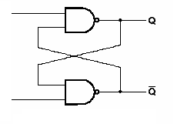
The Timing Diagram of S-R Latch
S’
R’
R’
S’
S’ | R’ | Q^{n+1}
1 | 0 | 0 | reset
0 | 1 | 1 | set
1 | 1 | hold | hold
0 | 0 | invalid
Q
Q’

Slide 13
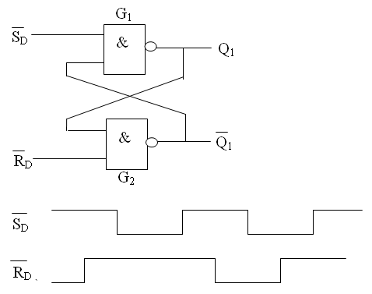
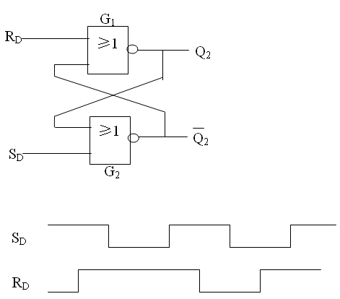
Exercise
Draw the timing diagram, assume Q = 0 initially.
Q
Q
Q’
Q’

Slide 14
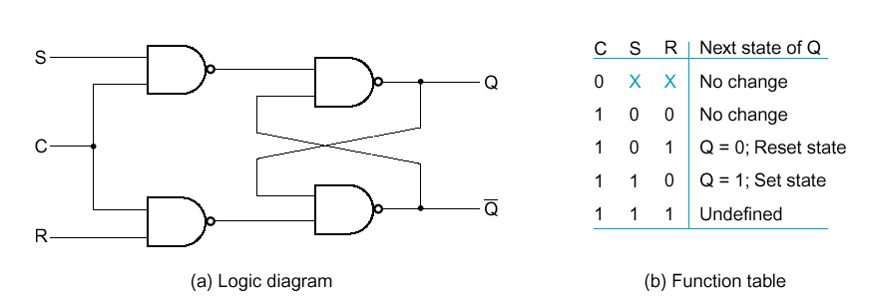
Gated S-R Latch（门控S-R锁存器）
A gated latch is a variation on the basic latch.
Control
S-R Latch

Slide 15
Gated S-R Latch（门控S-R锁存器）
CP
R
S
Q
Q’
hold
hold
Notes:
门控锁存器，也即之前所说，电平触发方式的锁存器。
EN：使能信号。图中使能信号为高有效。

Slide 16
Exercise
Draw the timing diagram for a gated S-R Latch, assume Q = 0 initially.
cp
S
t
0
R
t
0
t
Q
Q’

Slide 17
D Latch（D锁存器）
The D latch is an variation of the S-R latch but combines the S and R inputs into a single D input as shown:
D
D
Q
Q
EN
EN
Q
Q
A simple rule for the D latch is:
Q follows D when the Enable is active.
Notes:
根据SR锁存器的特性，显然能推出D锁存器的特性
D锁存器的特点：让SR触发器不会出现不确定状态，，确保S和R永远不会同时为1。

Slide 18
D Latch（D锁存器）
The truth table for the D latch summarizes its operation. If EN is LOW, then there is no change in the output and it is latched.
Q_{n+1}=S+R’Q_{n}=D+D’’Q_{n}=D

Slide 19
D Latch
Example
Determine the Q output for the D latch, given the inputs shown.
D
Q
EN
Q
Notice that the Enable is not active during these times, so the output is latched.

Slide 20
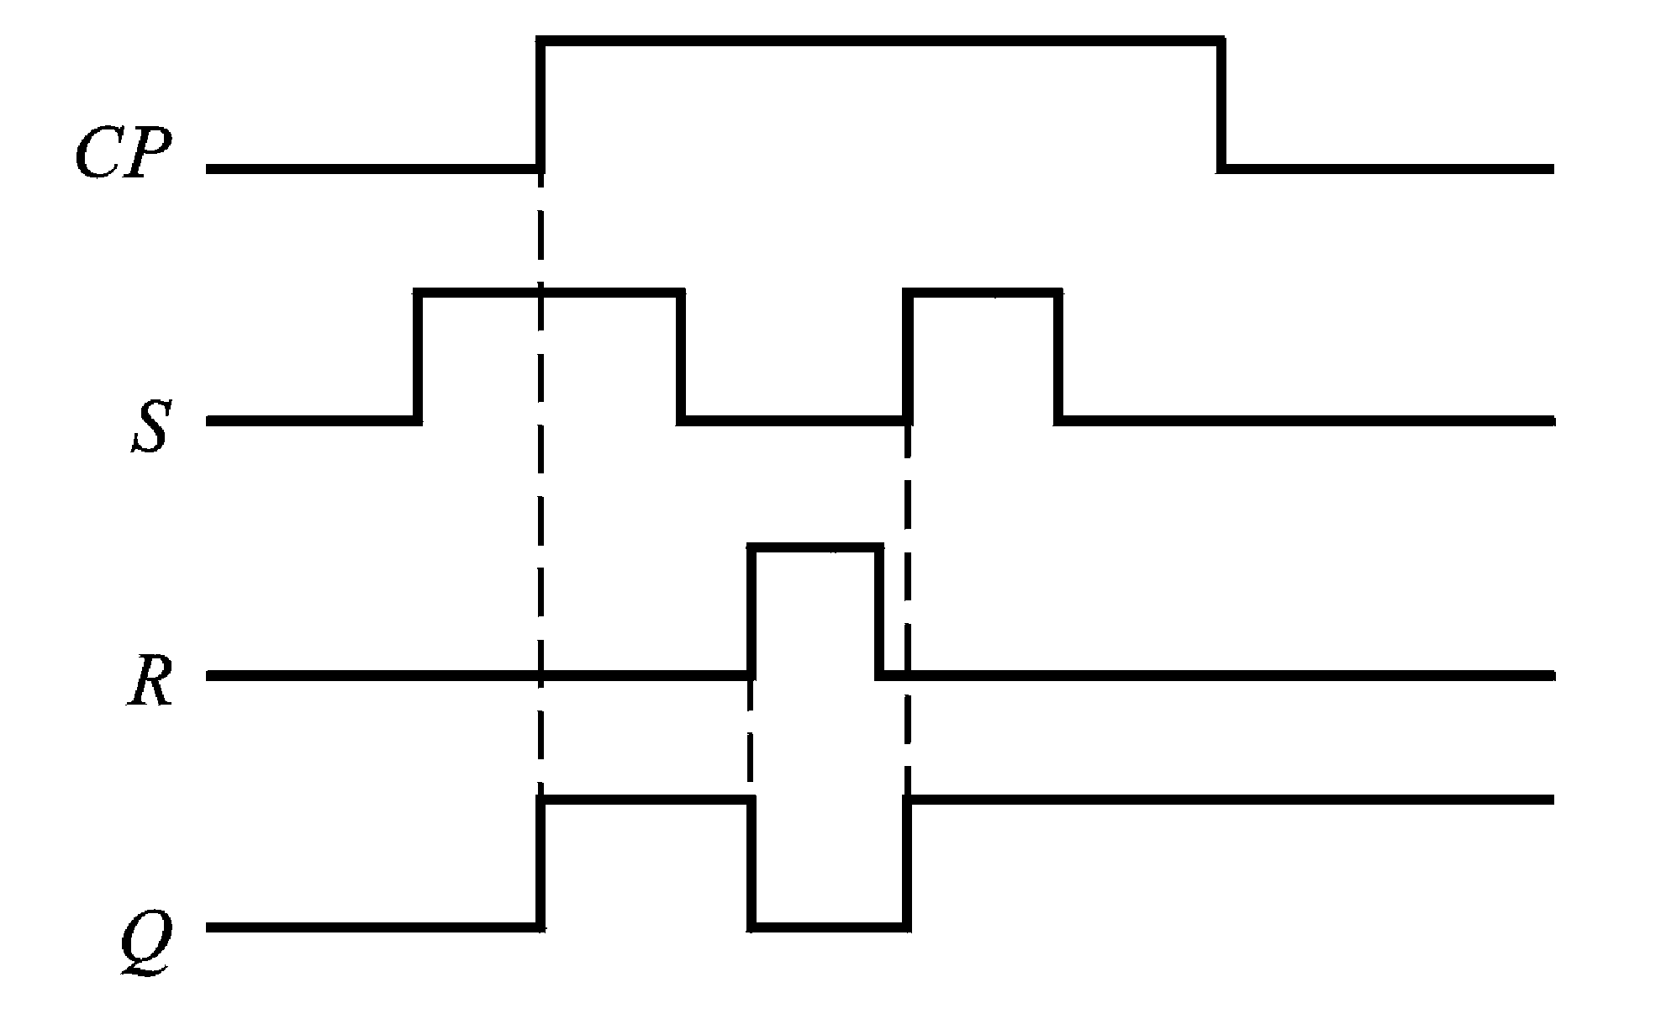
Flip-flops (触发器)
To eliminate flip
Edge-triggered flip-flop
Flip(空翻)

Slide 21
Flip-flops (触发器)
A flip-flop differs from a latch in the manner it changes states.
A flip-flop is a clocked device, in which only the clock edge determines when a new bit is entered.
The active edge can be positive or negative.
Notes:
边沿触发器，只有在时钟的正边沿或者负边沿，也即时钟的转换瞬间才对输入做出响应。

Slide 22
Edge-triggered Flip-flops (边沿触发器)
An edge-triggered flip-flop changes state either at the positive edge or at the negative edge of the clock pulse and is sensitive to its inputs only at this transition of the clock.
S-R
D
J-K
T

Slide 23
D Flip-flop (D触发器)
The truth table for a positive-edge triggered D flip-flop shows an up arrow to remind you that it is sensitive to its D input only on the rising edge of the clock; otherwise it is latched.
The truth table for a negative-edge triggered D flip-flop is identical except for the direction of the arrow.
(a) Positive-edge triggered (b) Negative-edge triggered
Notes:
本课程实际使用中，不要求在真值表中对所有触发器都列出时钟信号

Slide 24
Example
Determine the Q output for the positive edge-triggered D flip-flop, given the inputs shown.

Slide 25
Exercise
Draw the timing diagram for the negative edge-triggered D flip-flop, assume Q = 0 initially.

Slide 26
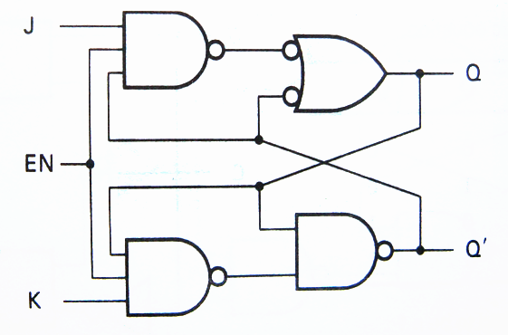
J-K Flip-flop（J-K触发器）
Assume： R’=(KQ^{n})’，S’=(JQ^{n}’)’

Slide 27
E.g. Draw the timing diagram for the negative edge-triggered J-K flip-flop, assume Q = 0 initially.
CP
J
K
Q

Slide 28
Flip-flops
Example
Determine the Q output for the J-K flip-flop, given the inputs shown.
Q
J
Notice that the outputs change on the leading edge of the clock.
CLK
K
Q
Solution
Set
Toggle
Set
Latch
CLK
J
K
Q

Slide 29
Flip-flops
Synchronous(同步的) inputs are transferred in the triggering edge of the clock (for example the D or J-K inputs).
Most flip-flops have other inputs that are asynchronous (异步的), meaning they affect the output independent of the clock.
Two such inputs are normally labeled preset (PRE置位) and clear (CLR复位).
These inputs are usually active LOW. A J-K flip flop with active LOW preset and CLR is shown.
PRE
Q
J
CLK
K
Q
CLR
Notes:
PRE：置1
CLR：清0

Slide 30
Flip-flops
Example
Determine the Q output for the J-K flip-flop, given the inputs shown.
PRE
Q
J
Solution
Set
Toggle
Set
Reset
Toggle
Latch
CLK
CLK
Q
K
J
K
Set
CLR
PRE
Reset
CLR
Q

Slide 31
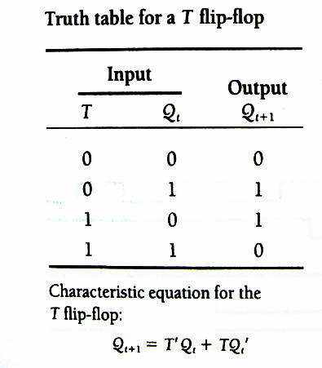
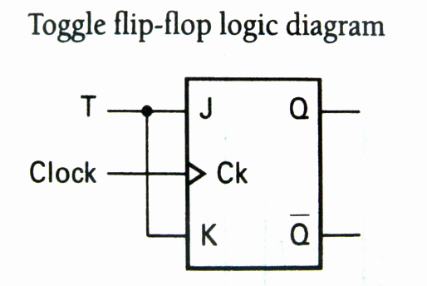
T Flip-flops (T触发器)

Slide 32
Exercise
Draw the timing diagram for the negative edge-triggered T flip-flop, assume Q = 0 initially.
CP
T
Q

Slide 33
Flip-Flops
S-R flip-flop
S | R | Q^{n} | Q^{n+1}
0 | 1 | d | 0 | reset
1 | 0 | d | 1 | set
0 | 0 | d | Q^{n} | hold
1 | 1 | d | d | invalid
D flip-flop
D | Q^{n} | Q^{n+1}
0 | d | 0 | reset
1 | d | 1 | set
J-K flip-flop
J | K | Q^{n} | Q^{n+1}
0 | 0 | d | Q^{n} | hold
0 | 1 | d | 0 | reset
1 | 0 | d | 1 | set
1 | 1 | d | (Q^{n)’} | toggle
T flip-flop
T | Q^{n} | Q^{n+1}
0 | d | Q^{n} | hold
1 | d | (Q^{n)’} | toggle

Slide 34
Notice the different of these trigger modes

Slide 35
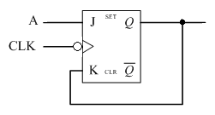
Analyze the function of the circuit in Figure a, and determine the Q output waveforms for the A and CLK input in Figure b.
1. J=A、K=Q
2.
3. A=1，toggle；A=0，reset.
(a)
(b)

Slide 36
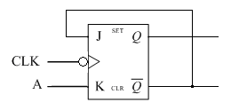
Exercise: analyze the function of the circuit in Figure a, and determine the Q output waveforms for the A and CLK input in Figure b.
(a)
(b)

Slide 37
Flip-flop Characteristics (触发器特性)
Propagation delay time(传输延迟时间) is specified for the rising and falling outputs. It is measured between the 50% level of the clock to the 50% level of the output transition. 传输延迟时间是指施加输入信号导致输出发送变化所需要的时间间隔
50% point on triggering edge
CLK
CLK
50% point
Q
50% point on LOW-to-HIGH transition of Q
Q
50% point on HIGH-to- LOW transition of Q
t_{PLH}
t_{PHL}
The typical propagation delay time for the 74AHC family (CMOS) is 4 ns. Even faster logic is available for specialized applications.
Notes:
传输延迟时间是施加输入信号、导致输出发送变化所需要的时间间隔。
入图所示为：
t_{PLH}：从时钟脉冲的触发边沿到输出的低电平到高电平变换之间所测得的时间。
t_{PHL}：从时钟脉冲的触发边沿到输出的高电平到低电平变换之间所测得的时间。

Slide 38
Flip-flop Characteristics
Another propagation delay time specification is the time required for an asynchronous input to cause a change in the output. Again it is measured from the 50% levels. The 74AHC family has specified delay times under 5 ns.
PRE
50% point
CLR
50% point
Q
50% point
Q
50% point
t_{PLH}
t_{PHL}
Notes:
t_{PLH}：从预置位输入的前沿到输出的低电平到高电平变换之间所测得的时间。
t_{PHL}：从预置位输入的前沿到输出的高电平到低电平变换之间所测得的时间。

Slide 39
Flip-flop Characteristics
Set-up time(建立时间) and hold time(保持时间) are times required before and after the clock transition that data must be present to be reliably clocked into the flip-flop.
set-up time是指在时钟上升沿到来以前，数据需要保持稳定不变的最小时间，如果建立时间不够，数据将不能在这个上升沿被稳定的打入触发器
D
CLK
Set-up time, t_{s}
hold time是指时钟信号上升沿到来以后，数据需要保持稳定不变的最小时间，如果保持时间不够，数据同样不能被稳定的打入触发器
D
CLK
Hold time, t_{H}
Notes:
建立时间：输入先于时钟脉冲触发边沿到达所需要的最小时间间隔
保持时间：在时钟脉冲触发边沿到达之后，输入上的逻辑电平需要保持的最小时间间隔。

Slide 40
Flip-flop Characteristics
Other specifications include maximum clock frequency(最大时钟频率), minimum pulse widths(最小脉冲宽度) for various inputs, and power dissipation(功耗). The power dissipation is the product of the supply voltage and the average current required.
Notes:
最大时钟频率是触发器可以可靠触发的最高速度。
最小脉冲宽度通常指定的是时钟、异步信号的脉冲宽度。

Slide 41
Flip-flop Applications
Output lines
Principal flip-flop applications are for data storage(数据存储), frequency dividers(分频), and counters (计数器)
Q₀
Q₁
Typically, for data storage applications, a group of flip-flops are connected to parallel data lines and clocked together.
Data is stored until the next clock pulse.
Q₂
Parallel data input lines
Q₃
Clock
Clear

Slide 42
Selected Key Terms
Latch
Bistable
Clock
D flip-flop
J-K flip-flop
A bistable digital circuit used for storing a bit.
Having two stable states. Latches and flip-flops are bistable multivibrators.
A triggering input of a flip-flop.
A type of bistable multivibrator in which the output assumes the state of the D input on the triggering edge of a clock pulse.
A type of flip-flop that can operate in the SET, RESET, no-change, and toggle modes.

Slide 43

Quiz
1. The output of a D latch will not change if
a. the output is LOW
b. Enable is not active
c. D is LOW
d. all of the above
b

Slide 44
Quiz
2. The D flip-flop shown will
a. set on the next clock pulse
b. reset on the next clock pulse
c. latch on the next clock pulse
d. toggle on the next clock pulse
D
Q
CLK
CLK
d
Q

Slide 45
Quiz
b
3. For the J-K flip-flop shown, the number of inputs that are asynchronous is
a. 1
b. 2
c. 3
d. 4
PRE
Q
J
CLK
K
Q
CLR

Slide 46
Quiz
c
4. Assume the output is initially HIGH on a leading edge triggered J-K flip flop. For the inputs shown, the output will go from HIGH to LOW on which clock pulse?
a. 1
b. 2
c. 3
d. 4
CLK
J
K
1 2 3 4

Slide 47
Quiz
Answers:
1. b
2. d
3. b
4. c

Slide 48
Homework
Self-test 1-9
2
4
6
8
10
12
14
16
18

