Slide 1
Computer Networks
An Open Source Approach
Chapter 4: Internet Protocol Layer
Ying-Dar Lin, Ren-Hung Hwang, Fred Baker
Chapter 4: Internet Protocol Layer

Slide 2
4.6 Routing
Principle
Intra-domain routing
Inter-domain routing
Chapter 4: Internet Protocol Layer

Slide 3
Routing Principle
Link State Routing
Distance Vector Routing
Chapter 4: Internet Protocol Layer

Slide 4
Link-State Routing
Routing information
  Global information is available by reliable broadcasting
  Dynamic: information exchanged when topology changes or periodically
Path calculation
  Dijkstra algorithm
Chapter 4: Internet Protocol Layer

Slide 5
Distance Vector Algorithm
Routing information
  Only local information is known
    Knows status of adjacent links and routing information of adjacent nodes
  Dynamic: information exchanged when link cost or shortest path changed
Path calculation
  Bellman-Ford
Chapter 4: Internet Protocol Layer

Slide 6
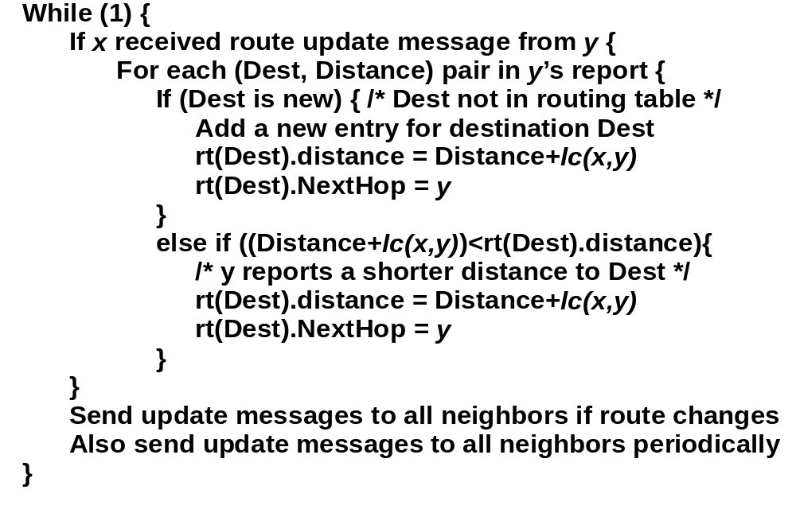
Bellman-Ford Algorithm
Chapter 4: Internet Protocol Layer

Slide 7
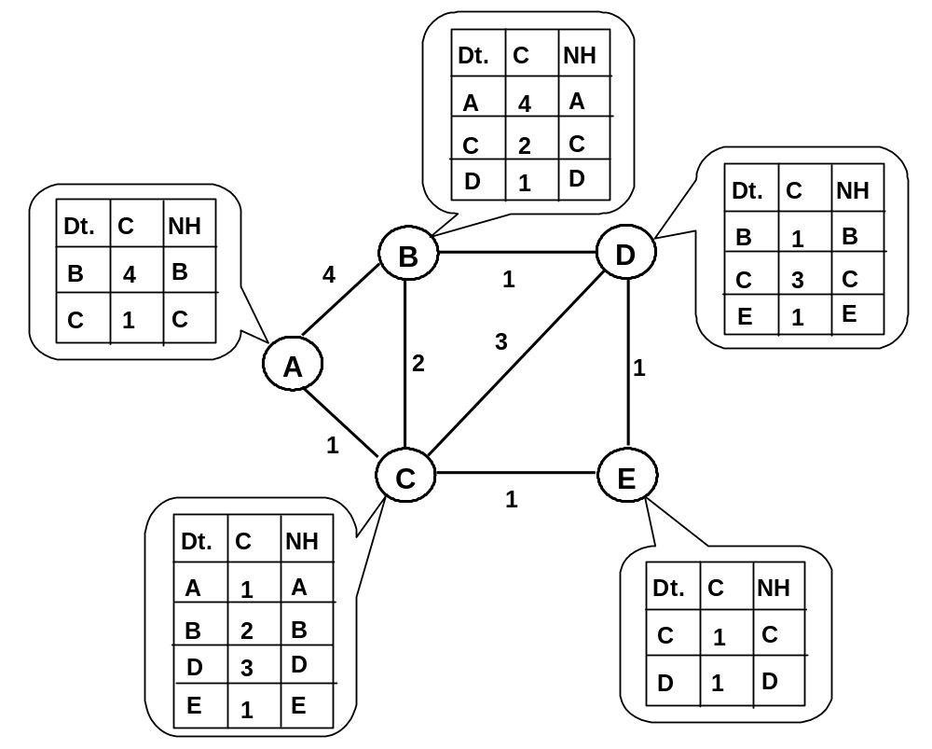
Bellman-Ford Algorithm Example:
Step 1
Chapter 4: Internet Protocol Layer

Slide 8
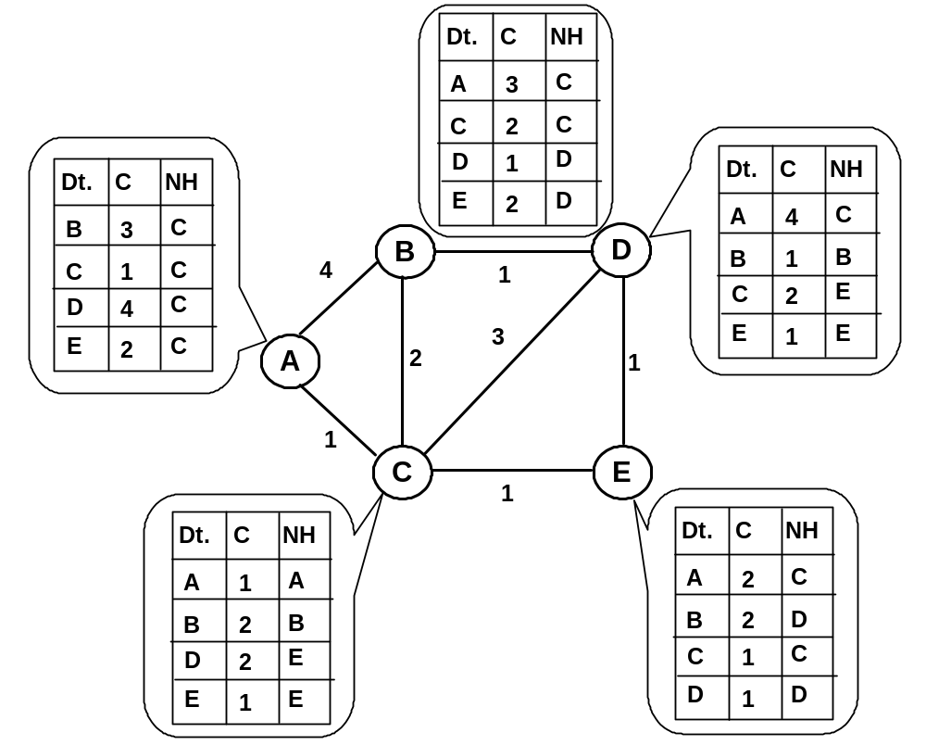
Bellman-Ford Algorithm Example:
Step 2
Chapter 4: Internet Protocol Layer

Slide 9
Bellman-Ford Algorithm Example:
Step 2
Chapter 4: Internet Protocol Layer

Slide 10
Bellman-Ford Algorithm Example:
Step 3
Dt.
C
NH
A
3
C
C
2
C
D
1
D
Dt.
C
NH
Dt.
C
NH
E
D
2
A
3
E
B
3
C
D
B
B
1
B
C
1
C
4
1
D
3
C
C
2
E
E
2
C
3
E
1
E
A
2
1
1
C
E
1
Dt.
C
NH
Dt.
C
NH
A
1
A
A
2
C
B
2
B
B
2
D
D
2
E
C
1
C
E
1
E
D
1
D
Chapter 4: Internet Protocol Layer

Slide 11
Bellman-Ford Algorithm Example:
Step 3
Dt.
C
NH
A
3
C
C
2
C
D
1
D
Dt.
C
NH
Dt.
C
NH
E
D
2
A
3
E
B
3
C
D
B
B
1
B
C
1
C
4
1
D
3
C
C
2
E
E
2
C
3
E
1
E
A
2
1
1
C
E
1
Dt.
C
NH
Dt.
C
NH
A
1
A
A
2
C
B
2
B
B
2
D
D
2
E
C
1
C
E
1
E
D
1
D
Chapter 4: Internet Protocol Layer

Slide 12
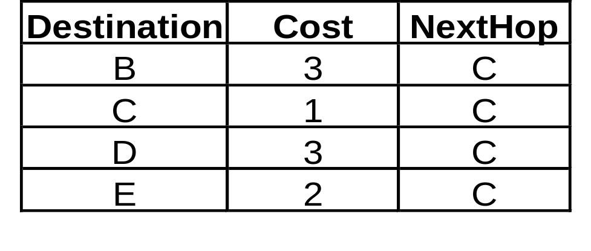
Bellman-Ford Algorithm Example
Routing table of node A after convergence
Chapter 4: Internet Protocol Layer

Slide 13
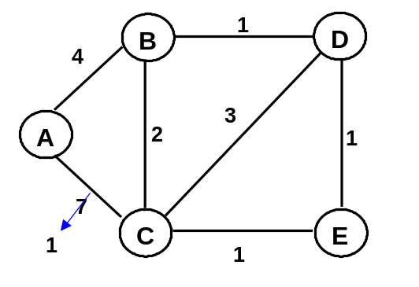

Problem with DV Routing (1/2)
Phenomenon
  good news travels fast
  bad news travels slowly
Route updated in two iterations.
Route updated in more than 25 iterations.
Chapter 4: Internet Protocol Layer

Slide 14
Problem with DV Routing (2/2)
Routing loop
  Due to the above phenomenon
  Loop formed before routing converged
Partial solutions
  Split horizon
    Routing updates sent to a neighbor should not contain route learned from that neighbor.
  Poisoned reverse
    If A learns a route to D from B, then A tells B that he cannot reach D so to poison the route.
  Hold down timer
    When a router receives an update from a neighbor indicating a network is inaccessible, the router marks the route as inaccessible and starts a holddown timer
    Holddown timers help prevent counting to infinity but also increase convergence time
Chapter 4: Internet Protocol Layer

Slide 15
Hierarchical Routing
Not a flat network: too many routing entries
Define an AS
  Routers within an AS are under the same administrative control
Routing within an AS and between AS’s
  Intra-domain routing
  Inter-domain routing
Chapter 4: Internet Protocol Layer

Slide 16
AS
The Internet consists of Autonomous Systems (AS) interconnected with each other:
  Stub AS: small corporation
  Multihomed AS: large corporation (no transit)
  Transit AS: provider
Two-level routing:
  Intra-AS: routing within an AS
  Inter-AS: routing between AS’s
Chapter 4: Internet Protocol Layer

Slide 17
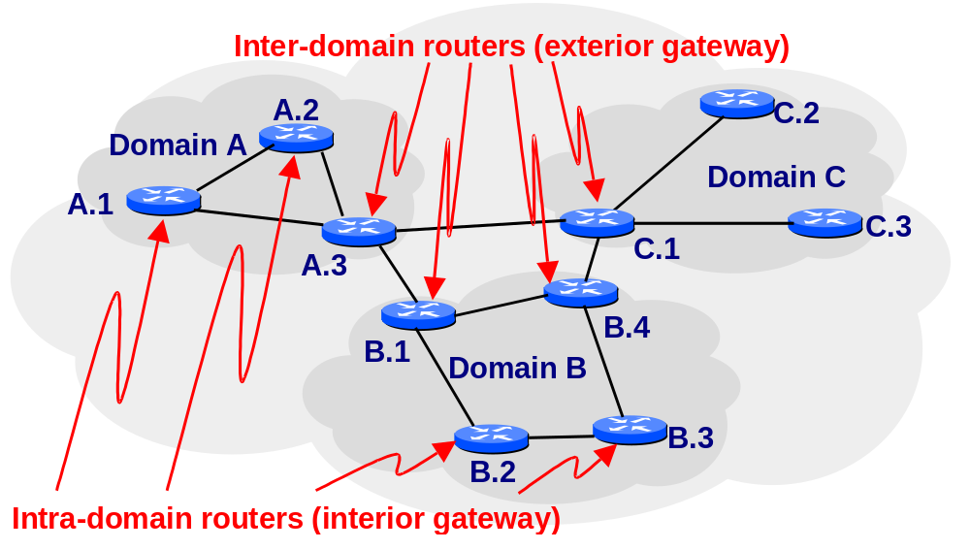
An example of Hierarchical Routing
Chapter 4: Internet Protocol Layer

Slide 18
Example of Internet Routing Protocols
Intradomain routing
  RIP
  OSPF
Interdomain routing
  BGP-4
Chapter 4: Internet Protocol Layer

