Slide 1
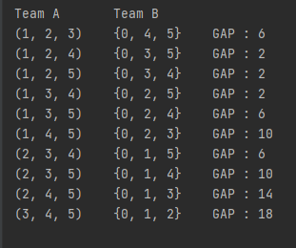
 | 1 | 2 | 3 | 4 | 5 | 6 | s
1 | 0 | 5 | 4 | 5 | 4 | 5 | 23
2 | 4 | 0 | 5 | 1 | 2 | 3 | 15
3 | 9 | 8 | 0 | 1 | 2 | 3 | 23
4 | 9 | 9 | 9 | 0 | 9 | 9 | 45
5 | 1 | 1 | 1 | 1 | 0 | 1 | 5
6 | 8 | 7 | 6 | 5 | 4 | 0 | 30
s | 31 | 30 | 25 | 13 | 21 | 21 | x
TOTAL : 141

