Slide 1

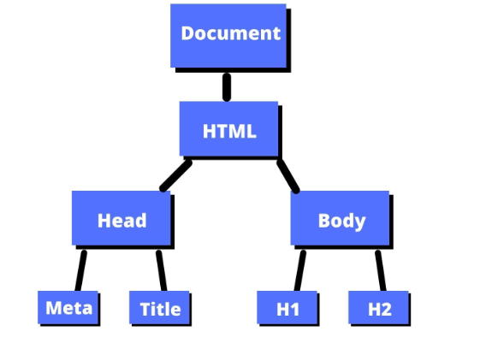

The Document Object Model (DOM)
The Document Object Model (DOM) is an Application Programming Interface(API) for HTML and XML documents. It represents the page so that programs can manipulate the document structure, style, and content.
With the DOM, programmers can use programming languages like JavaScript to dynamically access and update the content, structure, and style of a document. The DOM is a platform and programming interface that allows programs and scripts to dynamically access and update the content, structure, and style of a document.
The hierarchical structure:
Body

Slide 2
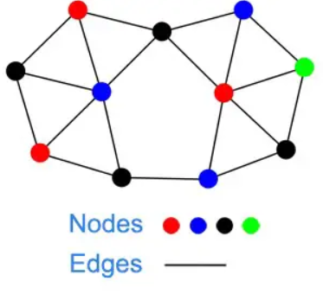

A Tree-like structure
The DOM is known as a tree-like structure because it's structured hierarchically. At the top of the tree, there is the document object, which represents the entire HTML or XML document. The head element has child nodes that correspond to the title and meta, while the body also has child nodes that correspond to other various elements such as 'div', 'p', 'img', 'ul', 'li', and all the other elements within.
In the DOM each "node" representes an element, atribute, or text content in the document where edges or connections meet, rather than a point where the leaves, branches, and flowers merge.
In botany, a node can refer to a point on a stem where leaves, branches, or flowers emerge:

Slide 3

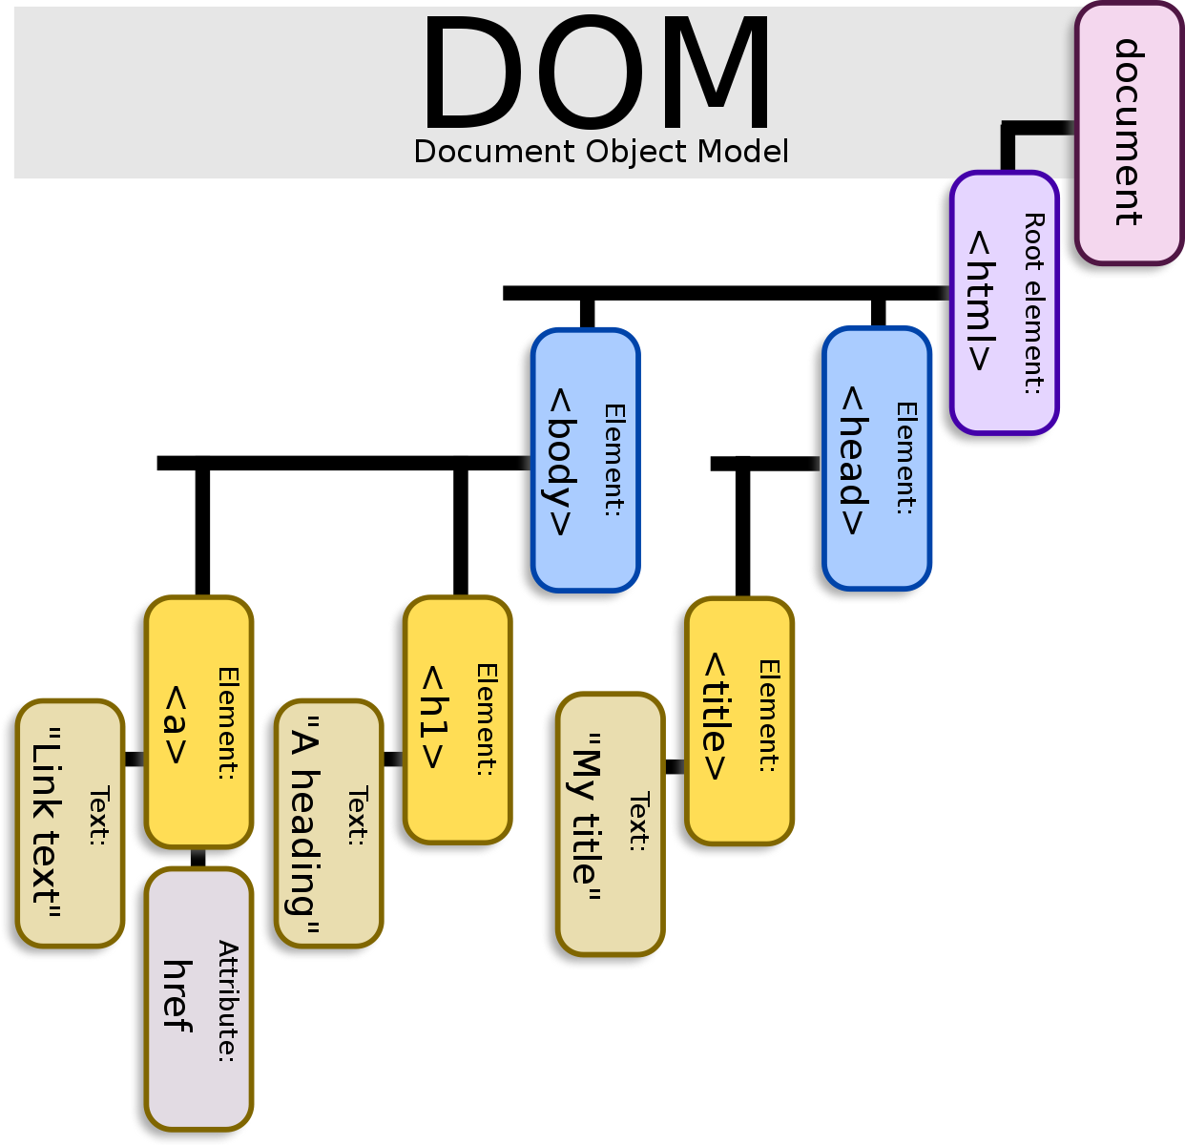

JavaScript and DOM
Remember:
JavaScript is a programming language that is often used to manipulate the Document Object Model (DOM) of HTML and XML documents, JavaScript is not the DOM itself. The DOM is a separate technology that provides a way to represent the structure and content of a document as a hierarchical tree of nodes, while JavaScript is a programming language that can interact with and manipulate the DOM tree using its APIs.
is DOM and JavaScript the same thing?
Though JavaScript is the language that uses and manipulates DOM most, they are not the same. JavaScript is a programming language and DOM is a programming interface, the DOM can be also used by other programming languages besides JavaScript such as Python.

Slide 4
Concluding
Simple ways of definying DOM in a job interview:
The Document Object Model (DOM) is a programming interface for HTML and XML documents, providing a way for scripts to dynamically access and modify the content and structure of a document.
The DOM is a standard platform and language independent API that allows web developers to access and manipulate the structure and content of an HTML or XML document using a consistent set of methods and properties.
The DOM is a hierarchical tree-like structure that represents the elements and content of an HTML or XML document, allowing developers to manipulate the document structure and content using code.

