Slide 1
EmoCaustics: A Framework for Dialogue Emotion Causality Analysis Breaking Long-distance Dependencies
Student: Yuxuan Zhang
Supervisor: Mian Zhou

Slide 2
Content
1. Introduction
2. Project Objective
3. Methodology
4. Experimental Results
5. Conclusion & Future Works
Appendix. Ablation Experiment

Slide 3
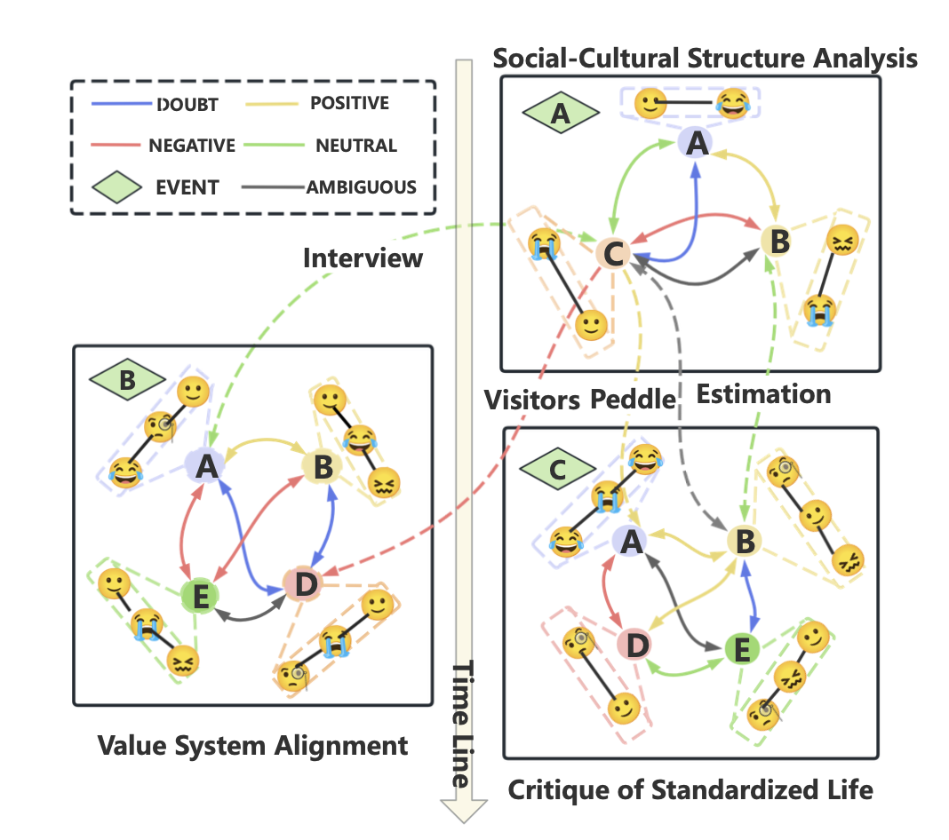
Introductions
Emotional Causality Reasoning (ECR)
Identifies dialogue causes triggering emotional transitions
Essential for emotionally intelligent systems
Challenges
Long-range dependencies
Combinatorial interactions
Evolving emotional pathways
.

Slide 4
Project Objective
Research Motivation
Address critical limitations in emotional causality reasoning:
Insufficient dialogue length in existing datasets
Neglect of multi-party complexity
Shallow causal annotations
Key Objectives
HELIX dataset: 1,000 long-form dialogues (200+ turns)
Capture complex emotional evolution in multi-participant conversations
Provide detailed annotations of causal chains and emotional shifts
EmoCaustics framework:
Long-range dependency limitations
Dynamic emotional evolution challenges
Multi-party interaction complexity
Conduct comprehensive evaluation using:
Multiple LLM backbones
Rigorous ablation studies
Comparison with state-of-the-art models

Slide 5
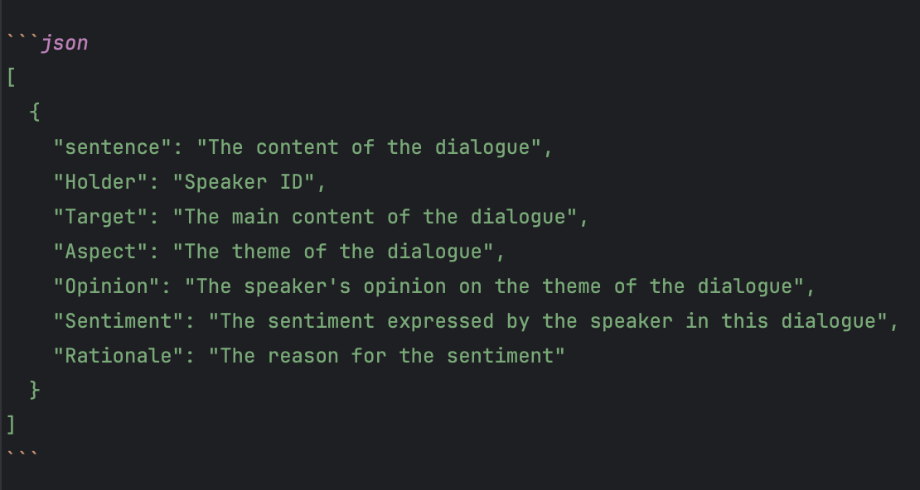
Methodology
Framework Architecture
Dynamic Context Windows:
Maintains emotional fluctuations throughout multi-turn dialogues
Captures long-range dependencies effectively
Dynamic Event Storage:
Manages dialogue events using memory bank
Classifies new utterances via similarity measures
Event Aggregation:
Combines related events into
coherent representation
Enables consistent modeling
of emotional changes

Slide 6
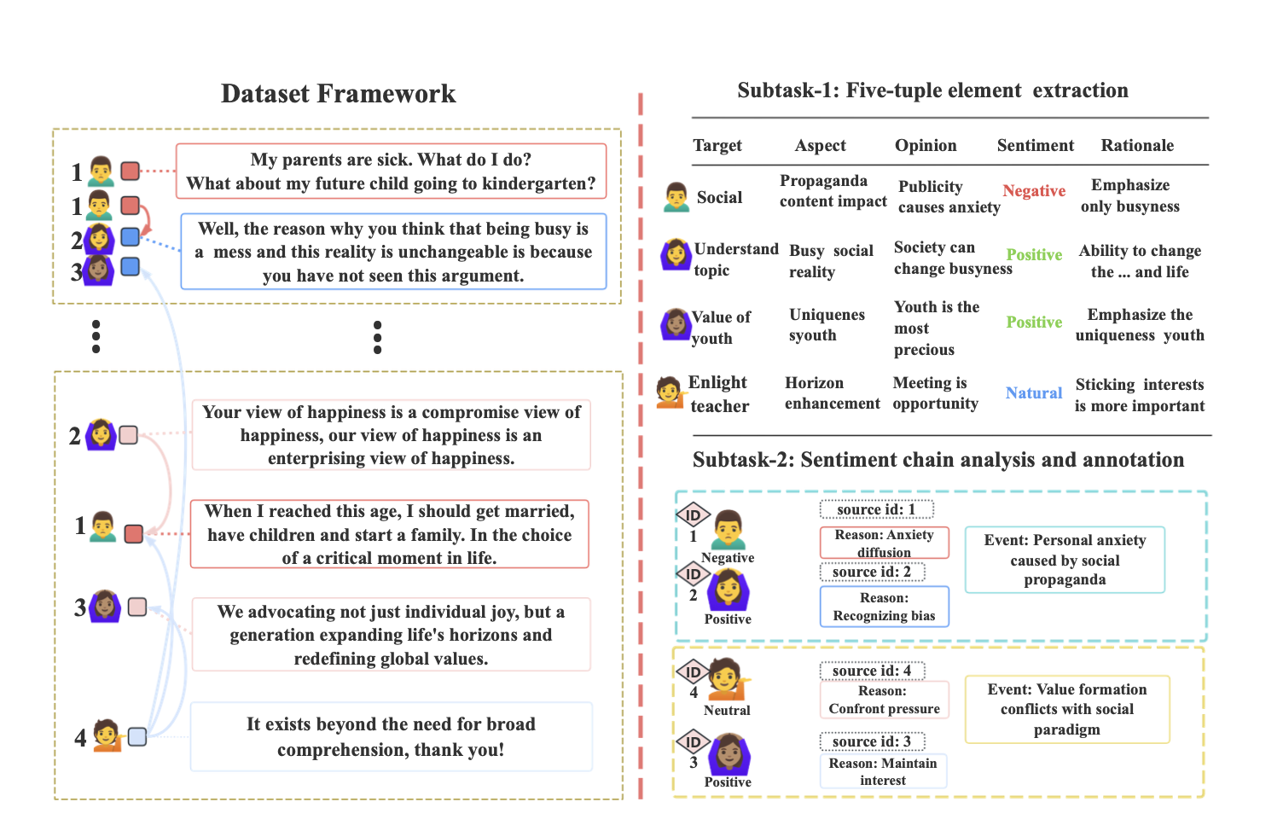

Slide 7
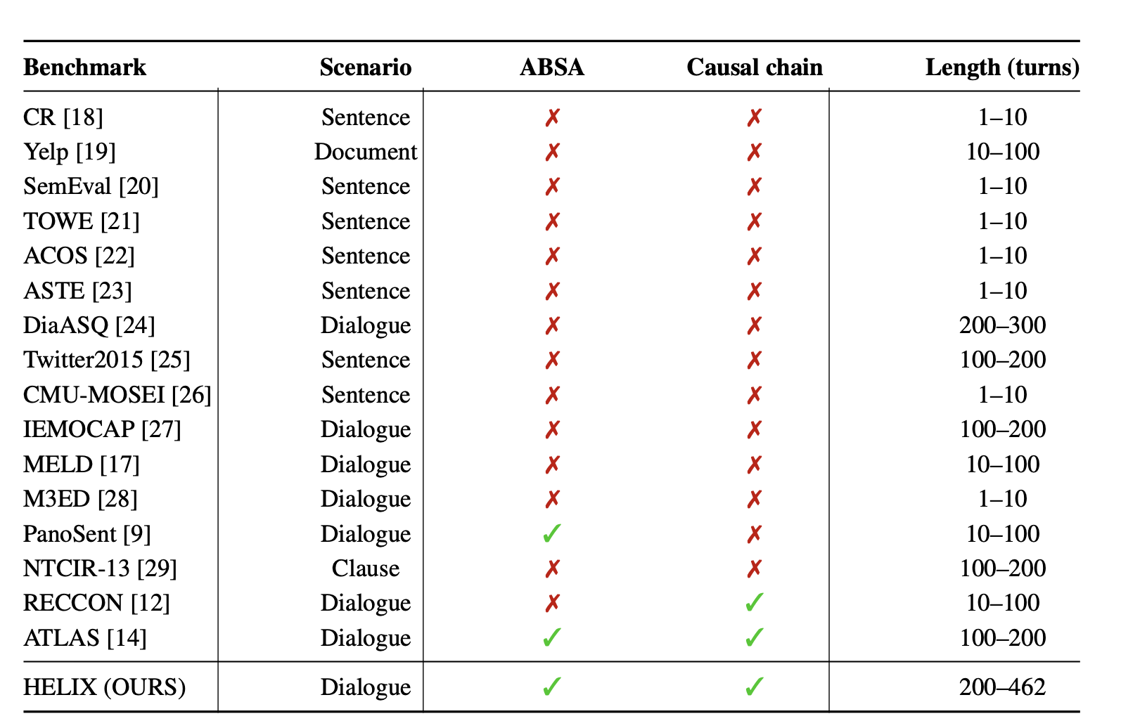
Dataset
Scale: 1,000 dialogues (218,354 utterances)
Length: 200-462 turns per dialogue (avg. 232)
Participants: 2-8 speakers (avg. 5)
Key advantages:
Longest context length among ECR datasets
Fine-grained emotional evolution tracking
Multi-party interaction patterns

Slide 8
Methodology
Technical Implementation
Dynamic Window & Event Storage
Adaptive sliding window:
Window at step t: W_t = {u_max(1,t-K+1), ..., u_t}
Prevents information loss in long dialogues
Event similarity calculation:
Uses sentence embeddings and cosine similarity
New event creation threshold: argmax_p cos(φ(u_t), φ(E_p)) ≥ τ
Memory Optimization
Cache pruning strategy:
Retains only relevant events: E' = {E_p | (1/|I_p|) Σ cos(φ(u_i), φ(E_p)) ≥ τ_retain}
Reduces redundancy and improves efficiency
Event aggregation mechanism:
Merges multiple related events
Updates event descriptions incrementally

Slide 9
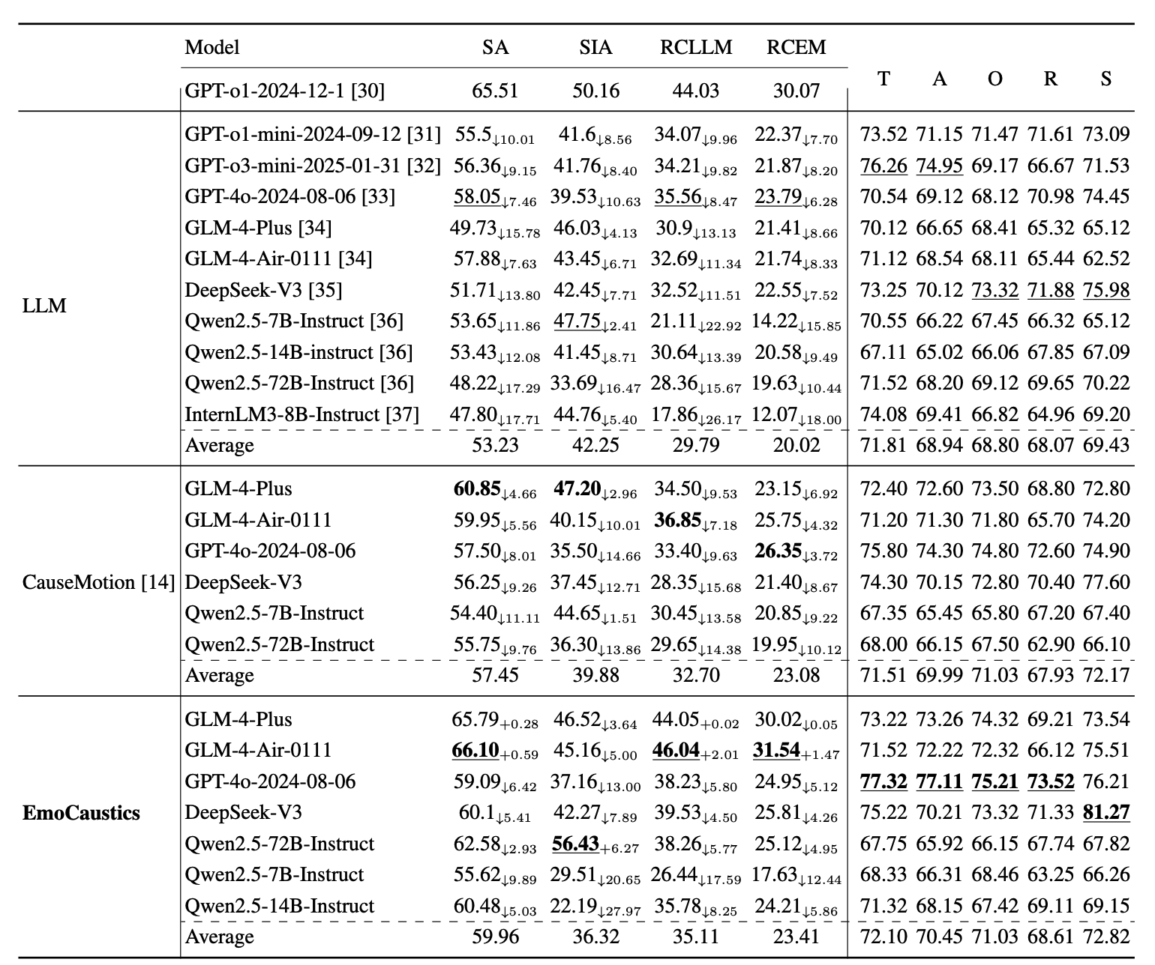
Experimental Results
EmoCaustics framework enhances LLM performance:
GLM-4-Air-0111 achieves 66.10% SA and 46.04% RCLLM
Exceeds GPT-o1 benchmark (65.51% SA, 44.03% RCLLM)
Significant improvements in reason consistency metrics
Cross-model improvements
Average SA increase: 6.73% over base LLMs
Outperforms CauseMotion framework in all primary metrics
DeepSeek-V3 shows highest sentiment scores (81.27%)

Slide 10
Conclusion
EmoCaustics Framework Effectiveness
Successfully addresses core ECR challenges:
Long-range dependencies
Dynamic evolution modeling
Complex interaction disentanglement
Key Components
Synergistic dynamic context windows
Event-centric memory
Structured aggregation mechanisms
Performance
Demonstrates significant performance gains on HELIX benchmark
Matches or exceeds leading baseline models (including GPT-o1)
Empirically validated effectiveness in complex dialogue analysis

Slide 11
Future Work
Multimodal integration
Incorporate video data from the 200 multimodal samples in our dataset. Facial expression analysis could better capture speakers' emotional states than verbal six-tuples. Visual cues may reveal subtle emotional transitions not evident in text
Calibration model
Develop a post-processing calibration layer on top of LLM outputs
Add a simple suffix model to refine predictions
Better align model outputs with ground truth emotional states
Potentially improve performance on challenging multi-party scenarios

Slide 12
Thank You
Question?

Slide 13
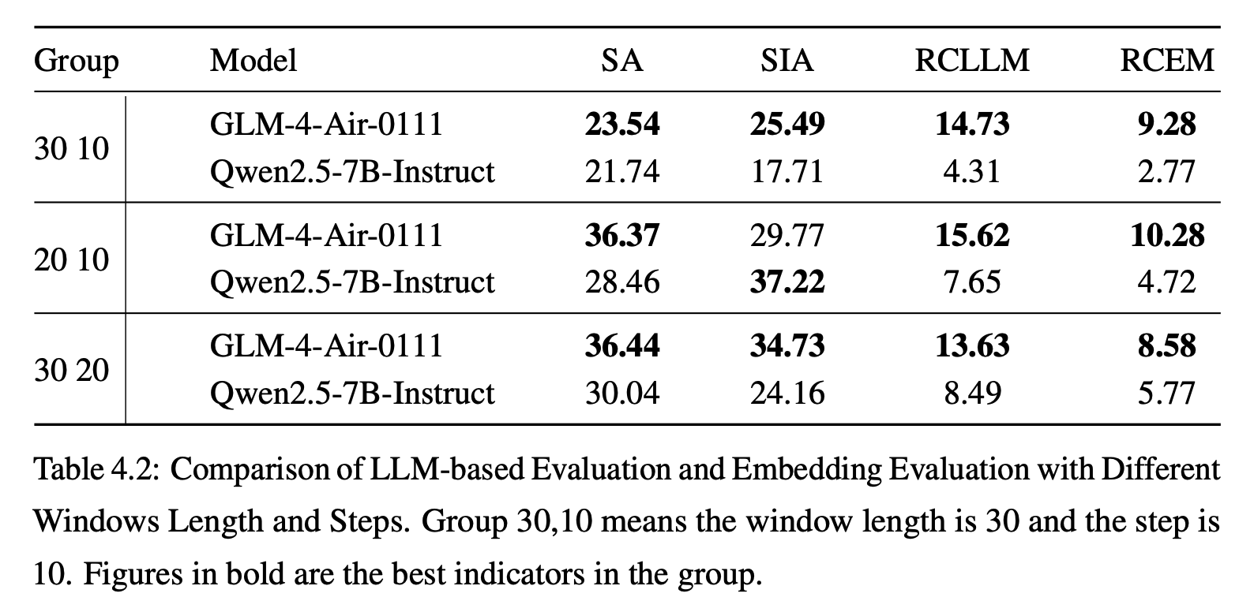
Ablation Experiment
Step size and window size significantly impact model performance.

Slide 14
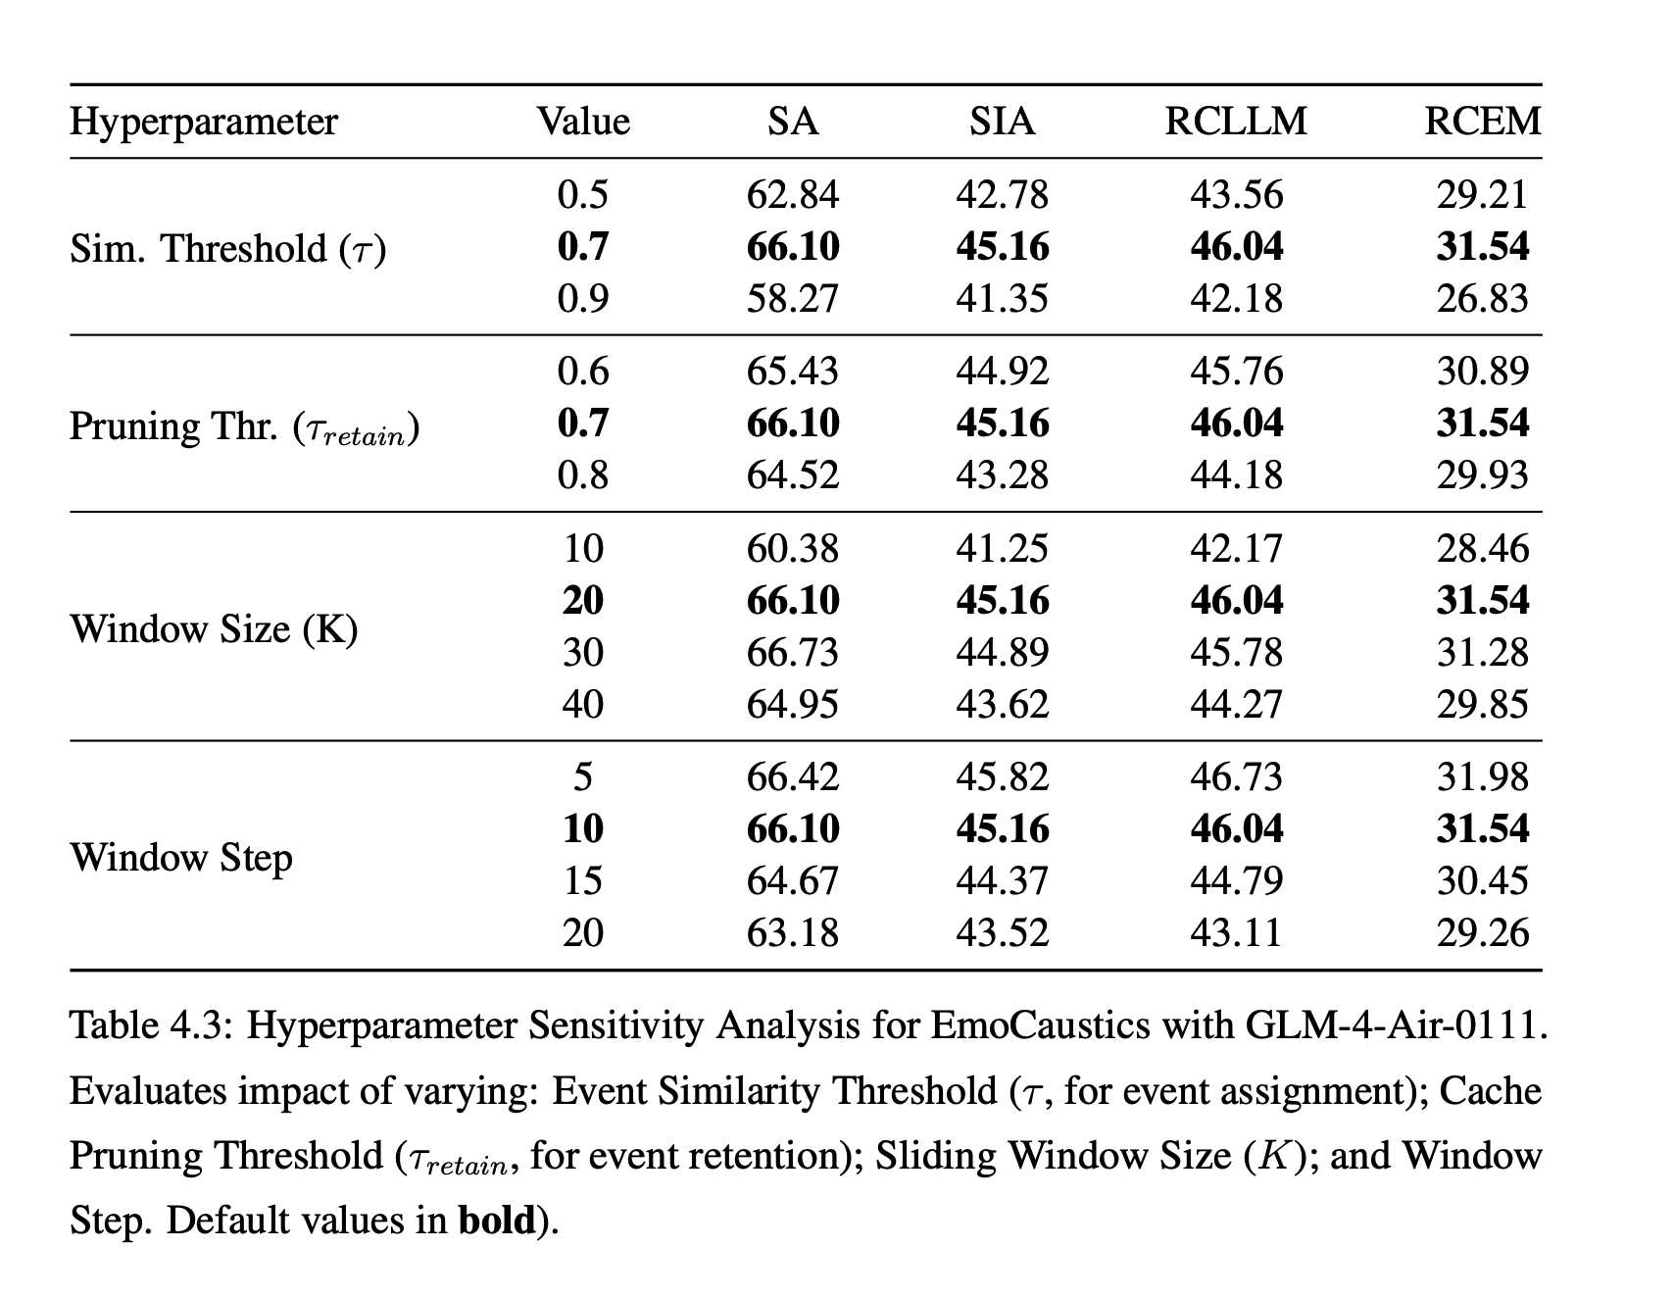
Ablation Experiment
Optimal performance with similarity threshold (τ) of 0.7, pruning threshold of 0.7, window size of 20, and step size of 10, balancing context information and computational efficiency.

