Slide 1
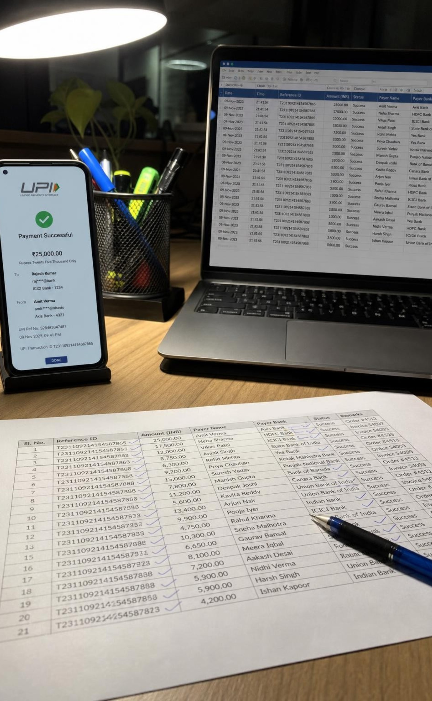
AgentIQ Datathon
FinTech UPI Fraud Intelligence
Track 1: AgentIQ Datathon Submission
Presenter: Zaaki Mohammed & Team
Moving beyond isolated fraud to detect organized criminal networks.

Slide 2
Engineering the Foundation
01
02
Processed 20,000 raw UPI transactions.
Utilized Pandas and Regex to clean and normalize mismatched user and merchant IDs.
20,000
Raw UPI transactions
03
04
5-way join · 100% preserved
Executed a flawless 5-way join across all datasets (KYC, Merchants, Chargebacks).
Achieved 100% data preservation without recklessly dropping missing rows.
2

Slide 3
Uncovering the Hidden Networks
Standard SQL queries miss organized fraud. We used NetworkX.
Modeled the ecosystem as a bipartite graph (Users -> Merchants).
Discovered 203 Merchant Collusion Rings sharing identical bank settlement accounts.
Uncovered 1,340 Synthetic Identity Clusters operating under the exact same PAN credentials.
203
1,340
Merchant Collusion Rings
Synthetic Identity Clusters
Identical bank settlement accounts
The exact same PAN credentials
3

Slide 4
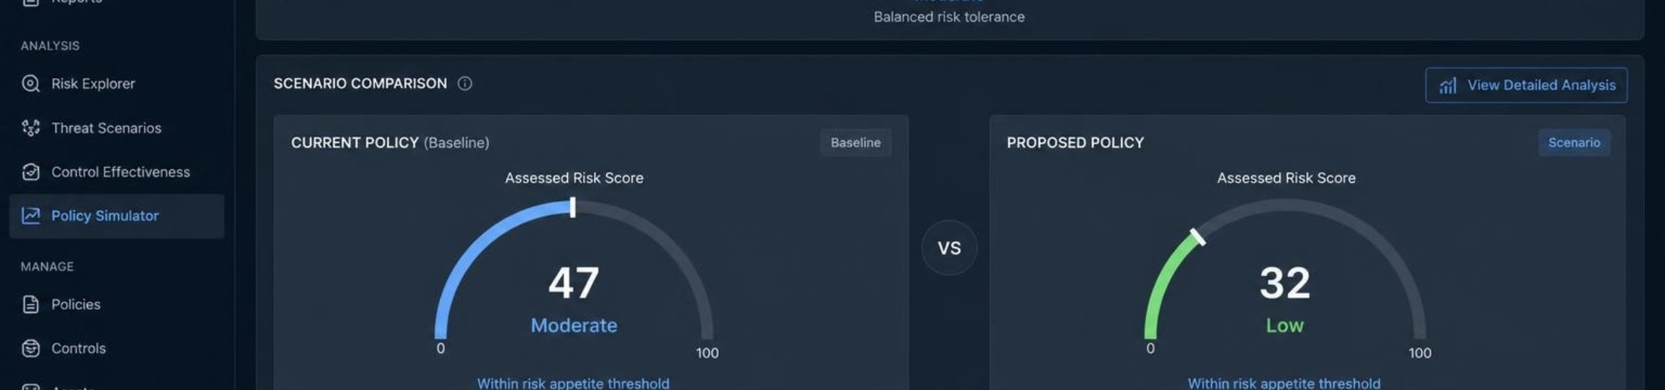
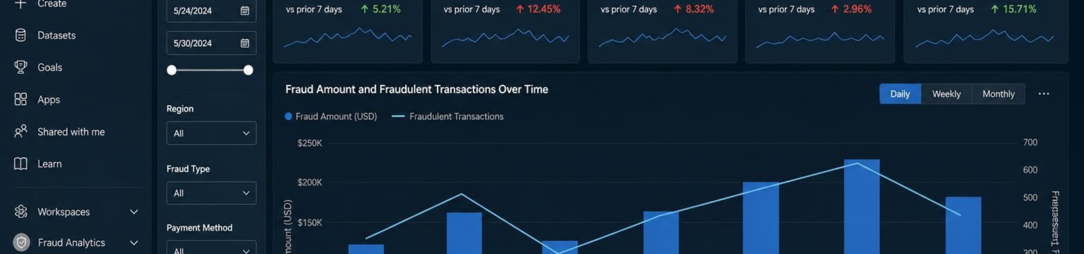
The Risk Policy Simulator
Moving beyond static charts to actionable risk mitigation.
Risk Policy Simulator
Power BI Dashboard
Built in custom HTML/JS.
Enterprise analyst reporting.
Executives instantly balance fraud prevention against false-positive customer friction.
A fully integrated Power BI dashboard drives deep-dive analyst reporting.
4

Slide 5
Securing the 30-Point AI Bonus
01
02
03
04
Model layer
Query layer
Visual layer
Trust layer
Powered by Groq (Qwen 27B) and LangChain.
Translates natural English into secure DuckDB SQL queries in real-time.
Dynamically renders Matplotlib charts (Bar, Line, Pie, Scatter) based on intent.
Every answer ships with a transparent SQL trace UI, so each query is fully auditable end to end.
Layer | Component | Guarantee
Inference | Groq · Qwen 27B | Real-time
Orchestration | LangChain | Intent routing
Execution | DuckDB SQL | Secure
Audit | SQL trace UI | Fully auditable
5

