Slide 1
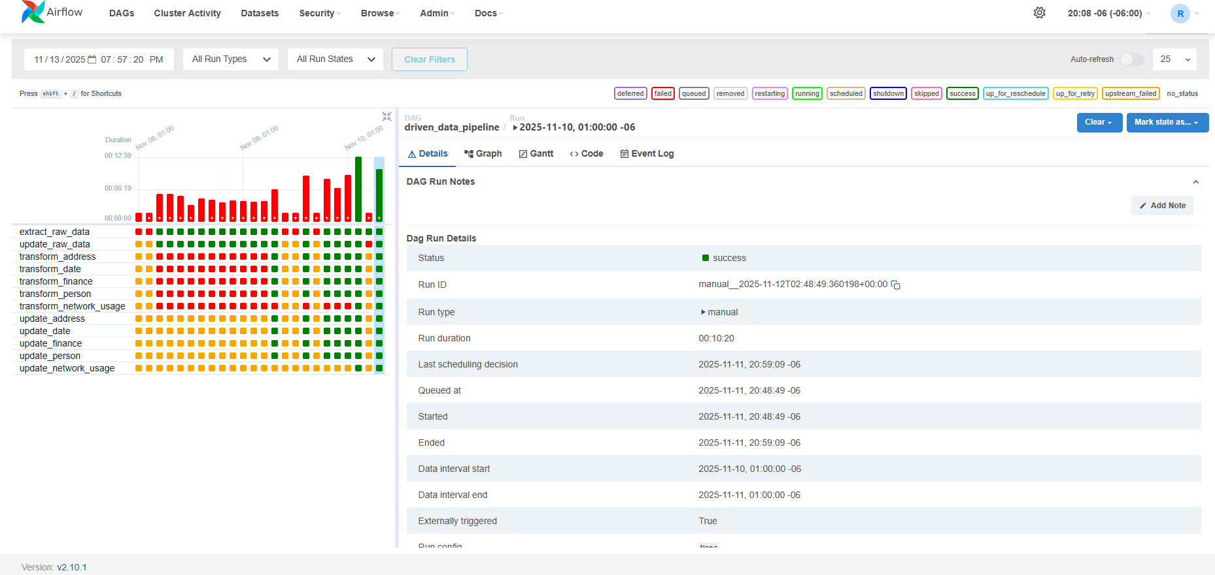
AirFlow Runing

Slide 2
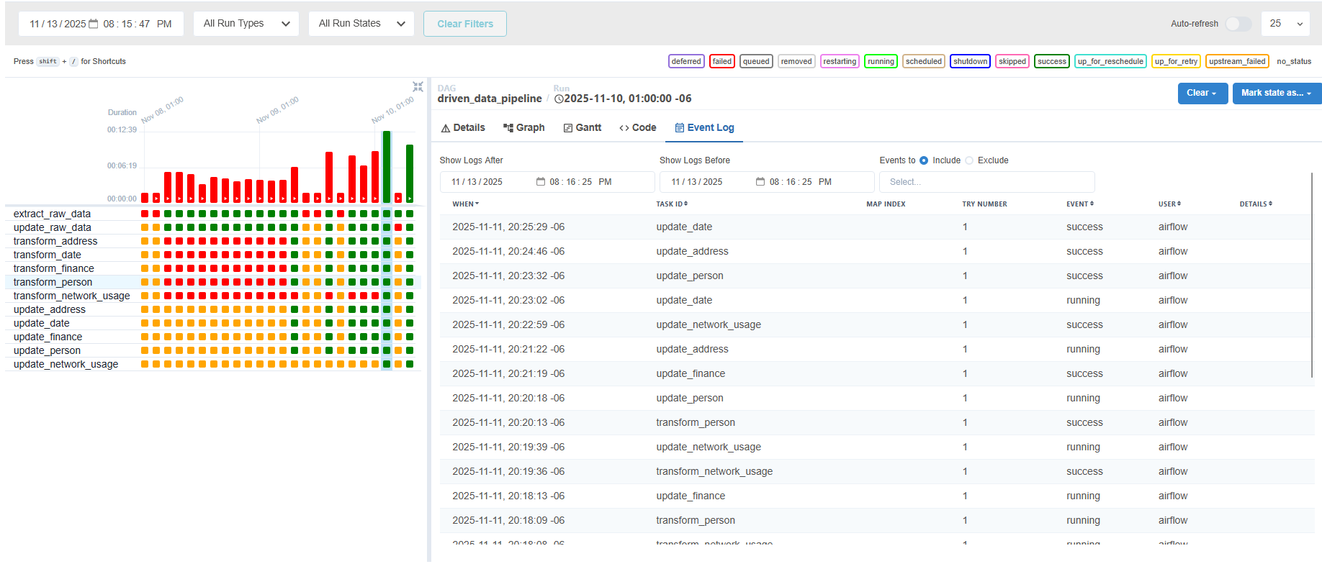
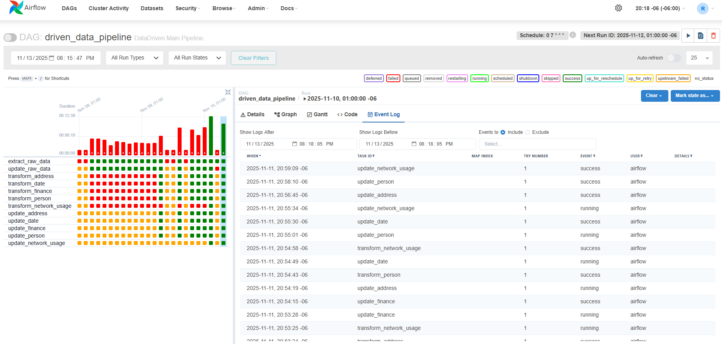
AirFlow EventLog

Slide 3

Raw data Generated

Slide 4


Addres &Date data

Slide 5


Fianance & Person

Slide 6

Network usage

Slide 7
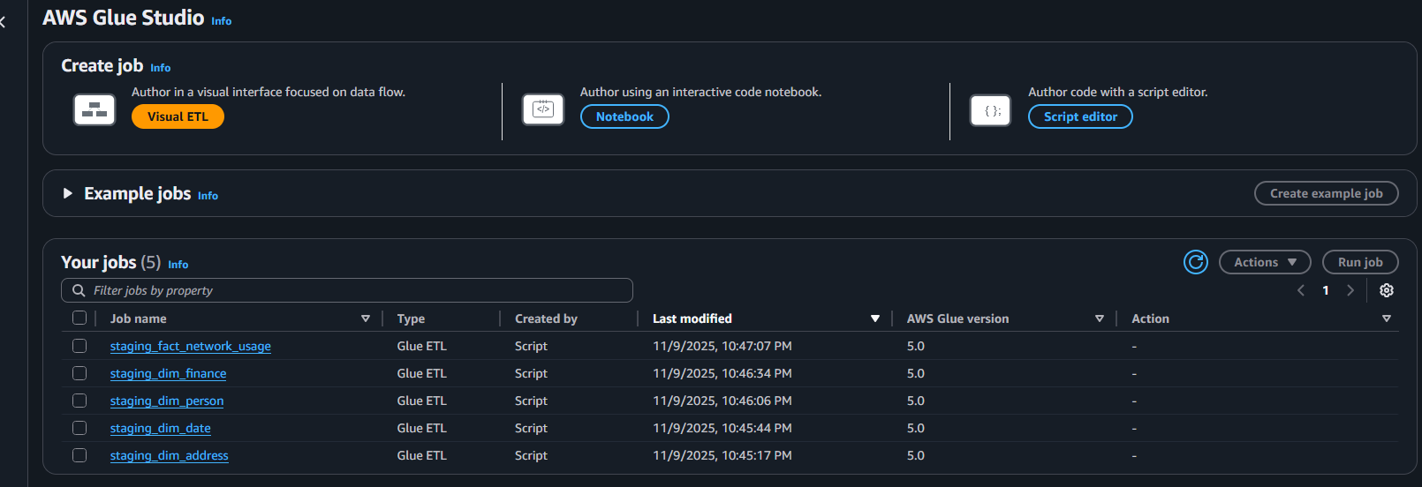
Glue Jobs

Slide 8

Crawlers

Slide 9
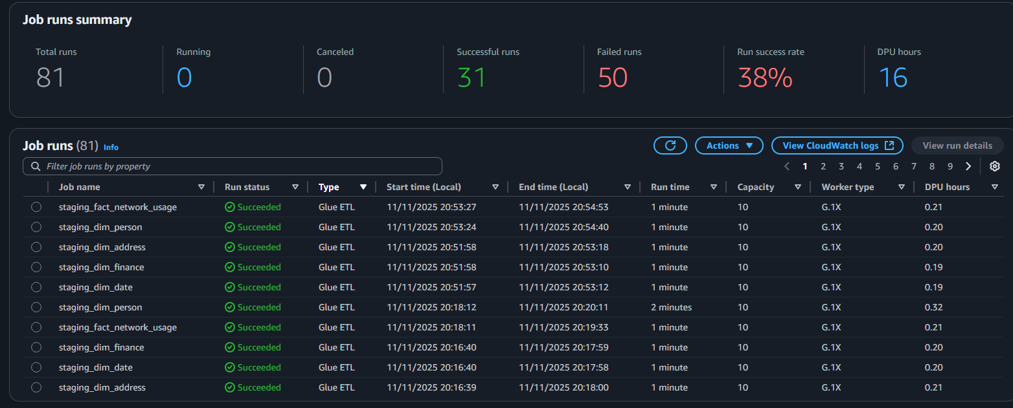
Glue Jobs

Slide 10


DBC & Tables

Slide 11

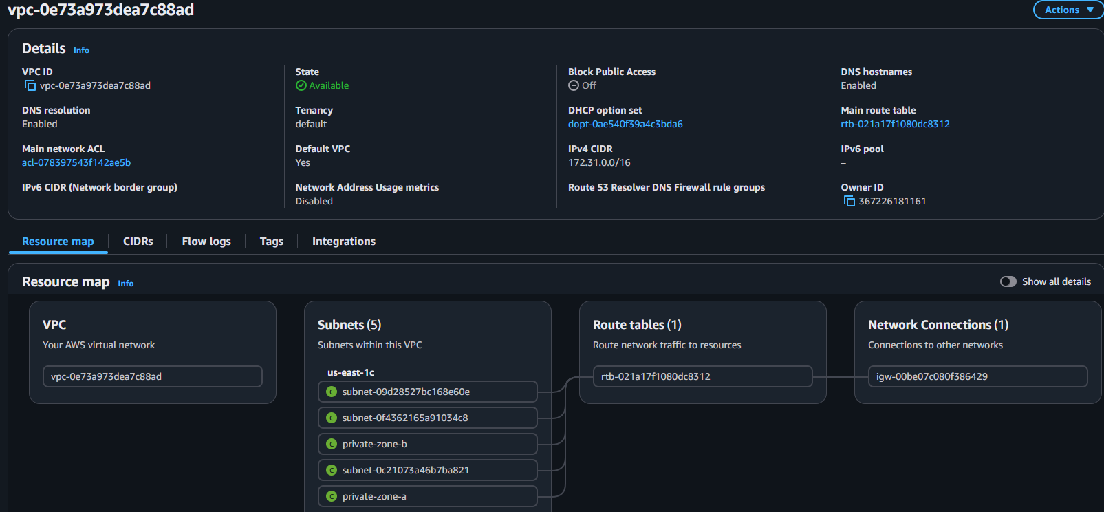
VPCs

Slide 12
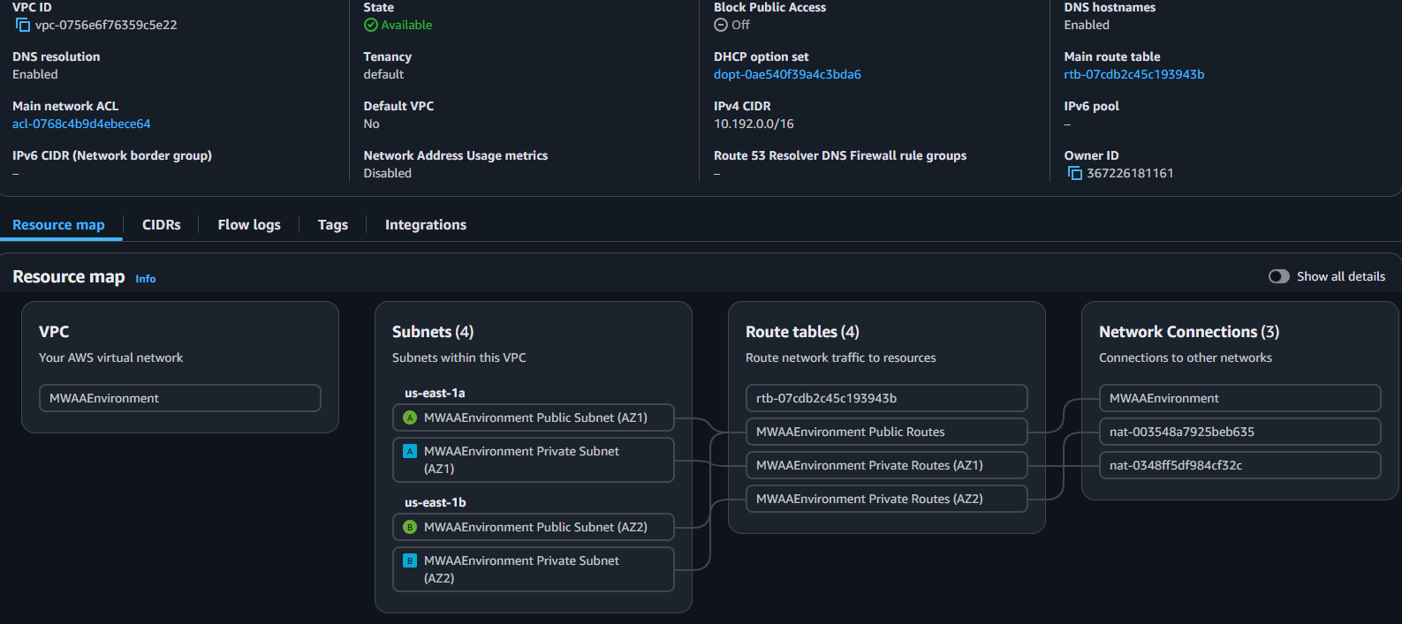
VPC (MWAAEnvironment)

Slide 13

Subnets

