Slide 1

Unidad 3
Enrique Rodriguez Toscano
Workflow con Docker

Slide 2
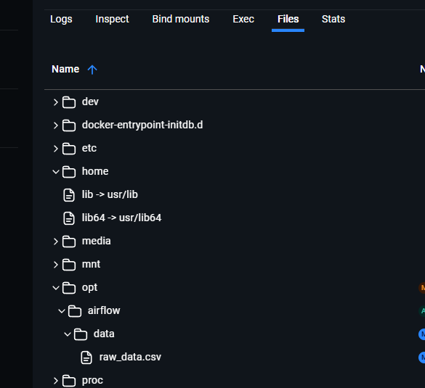

Synthetic Raw Data generated

Slide 3
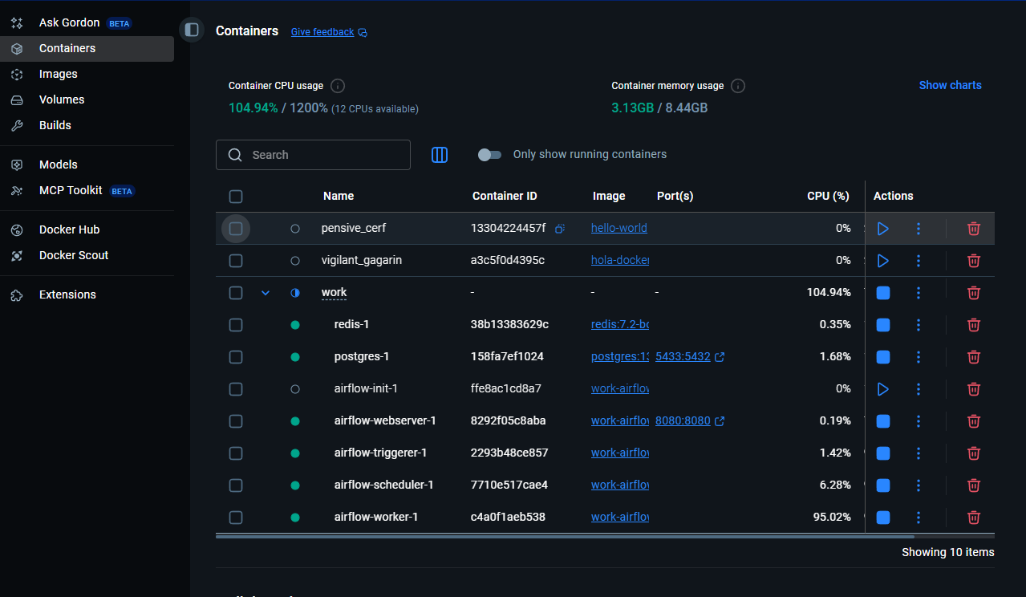
Docker-compose up and running

Slide 4
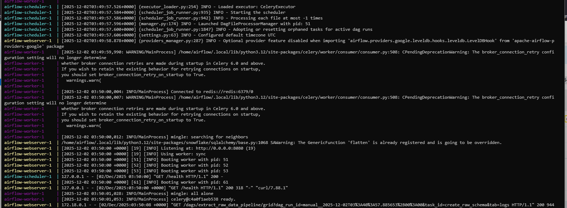
Docker up and build

Slide 5

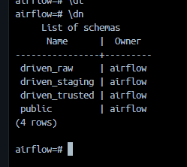
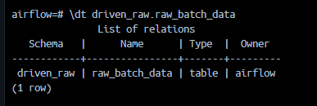
Raw Schema creation and raw data import
Raw Data imported into the schema

Slide 6
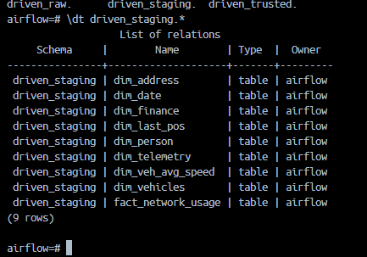
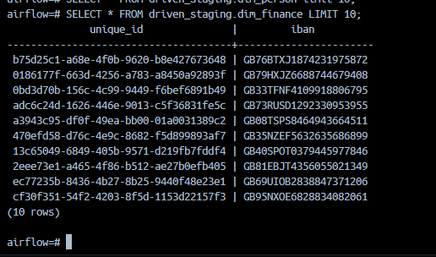
Stagin Schema creation and table creation

Slide 7
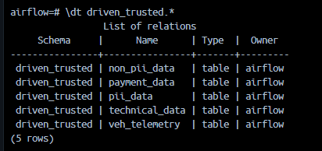
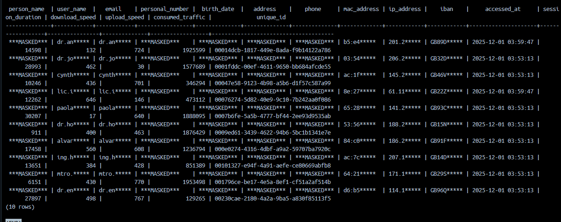
Driven Trusted
No PII data

Slide 8
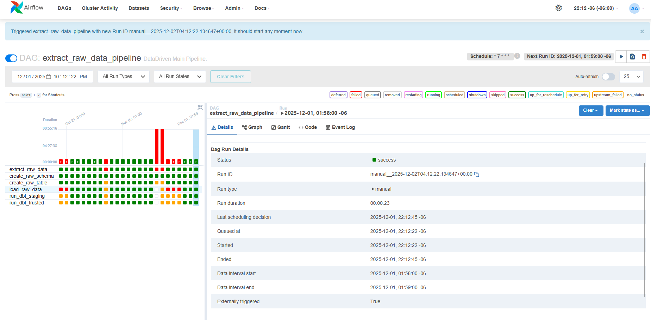
Airflow DAG execution

