Slide 1

Using transfer learning for diagnosing LPR signs
By Fadi Srour & Pier Mbariky
Advisor Dr. Elena Kleiman
Phase I
Project Code 25-1-R-4

Slide 2
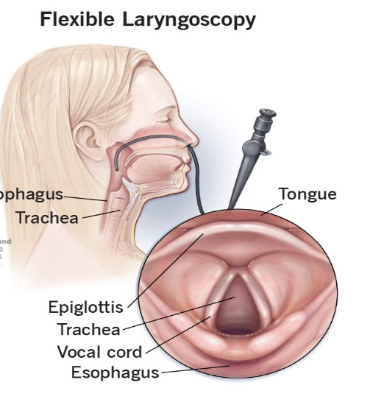
Introduction
- Laryngopharyngeal Reflux (LPR) – is a condition when stomach acid backflows and irritates the throat and voice box.
- Symptoms:
Hoarseness or voice changes.
Chronic throat clearing.
Sensation of lump in throat.
- Laryngoscopy

Slide 3
Challenges in LPR Diagnosis
Subjectivity
Time-consuming
Video quality issues
Cognitive load
Limited review

Slide 4
Motivation
Diagnosing LPR signs:
Healthy larynx
Ventricular Obliteration
Erythema
Posterior Commissure Hypertrophy

Slide 5
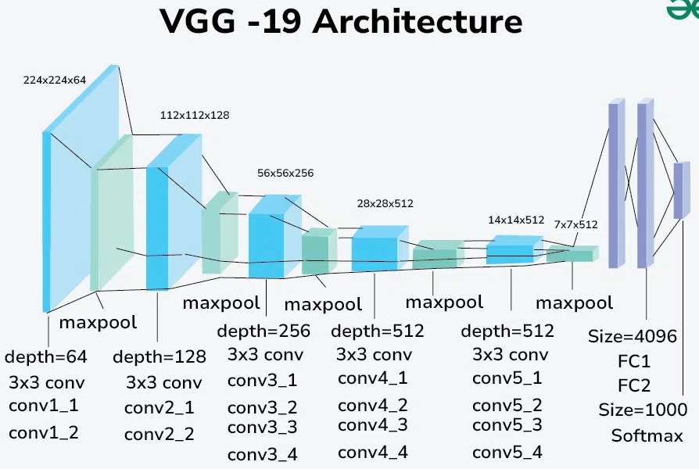
VGG-19 A deep convolutional neural network (CNN)

Slide 6
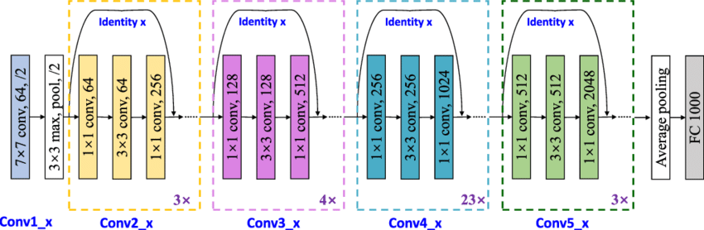
ResNet-101 A deep convolutional neural network (CNN)

Slide 7
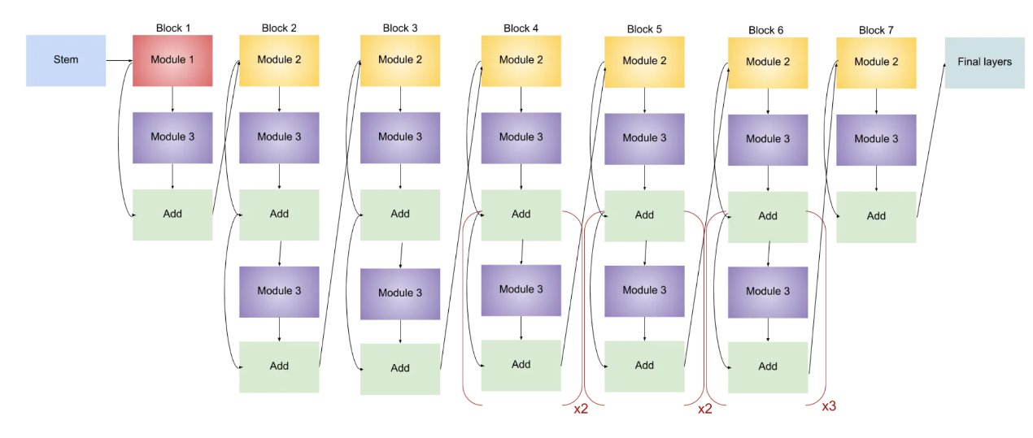
EfficientNet-B2 A deep convolutional neural network (CNN)

Slide 8
Attention Mechanism in EfficientNet-B2
EfficientNet uses Squeeze and Excitation (SE) blocks as part of the attention mechanism.
SE block:
- Squeeze operation
Excitation operation
Recalibration
EfficientNet’s use of attention contributes to its efficiency, reducing computational cost while maintaining high accuracy.

Slide 9
How Transfer Learning Operates
Select a pre-trained model
Configure the model
Fine-tune the model
Adjust loss functions and hyperparameters
Train and validate

Slide 10
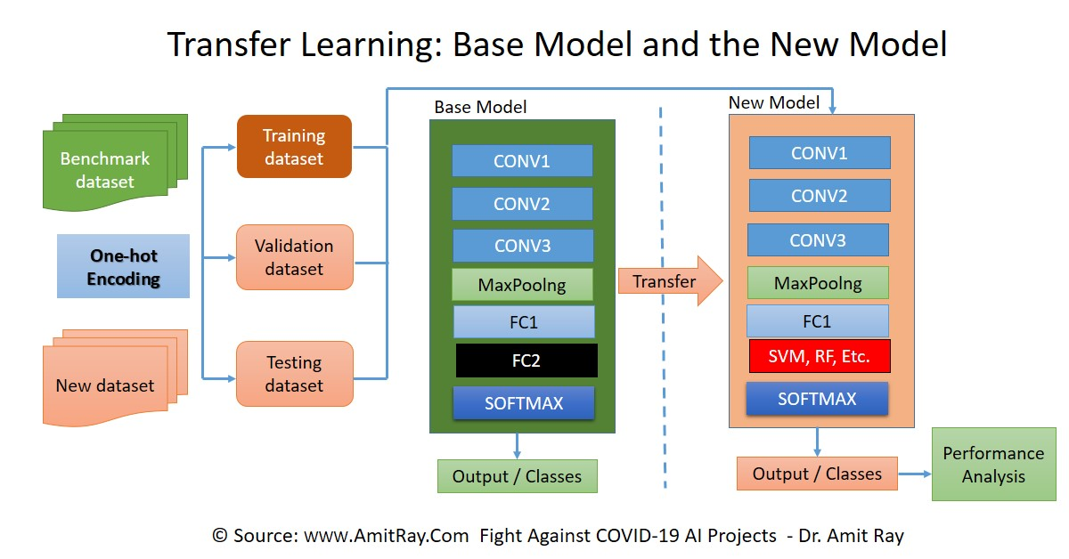
Transfer Learning
Why Transfer Learning is Used:
Works Well with Limited Data
Better Performance

Slide 11
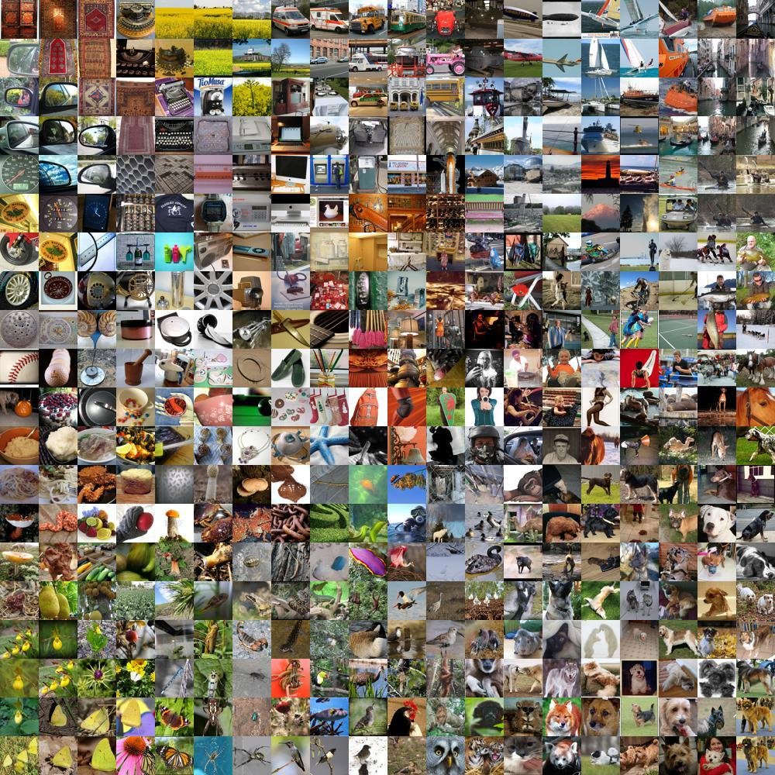
ImageNet
What is ImageNet
A large-scale visual database for computer vision research.
Contains millions of labeled images across thousands of categories.
Why do we use it
Used for training deep learning models like VGG, ResNet, EfficientNet and other models.
Our three models will first be trained on ImageNet before applying transfer learning to enhance their performance.

Slide 12
Data Augmentation
The enhancement of a dataset by applying transformations to existing data.
Types of data augmentation:
Rotation
Flipping
Zooming
Cropping
Stretching

Slide 13
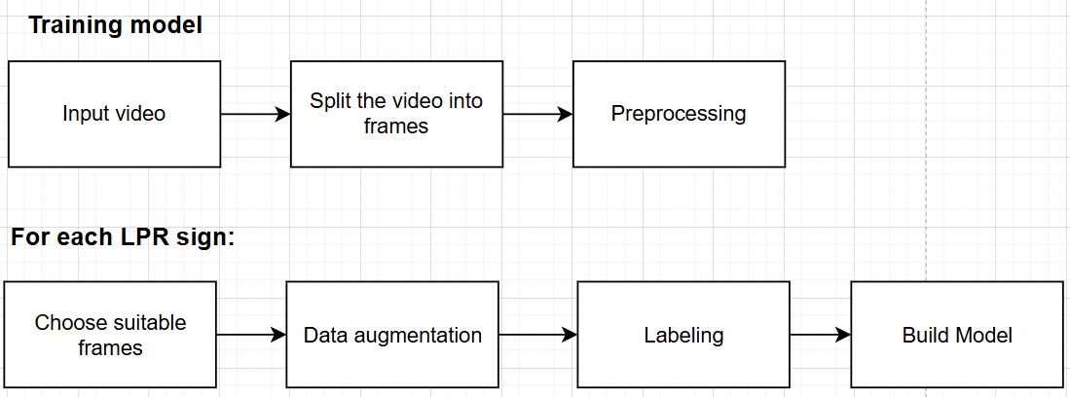
Training model

Slide 14
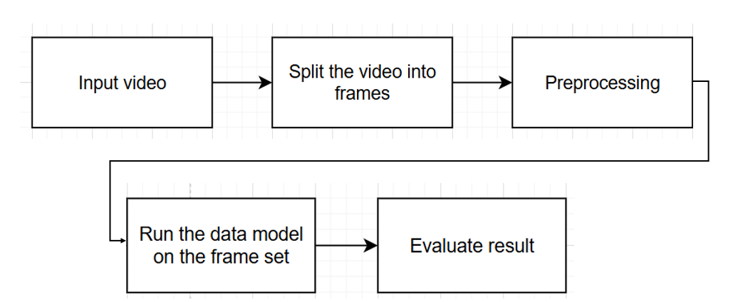
Test Model
For each model:

Slide 15
Test Plan – Preprocessing
Ensure video frames are extracted properly.
Verify how different types of augmentation work.

Slide 16
Test Plan – Testing Experiments
For each model:
Train the model from scratch with our data, without transfer learning.
Train the model using transfer learning and fine-tune the last few layers.
Explore different layer-freezing strategies for the model.
Compare all three models' performance after transfer learning with scores of three doctors.
Evaluate the ability of all three models to generalize to unseen data.

Slide 17
Expected Challenges
Limited Computing Power for Processing Large Data Volumes and Training
Limited datasets for LPR signs
Manual Labeling of Frames
Challenges in Dataset Construction (correctly labeling each frame to ensure accuracy)

Slide 18
Expected Results
Efficient processing.
Enhanced LPR signs diagnosis accuracy.

Slide 19
Thank you

