Slide 1
Functional programming
Notes:
函数式编程的汇报
首先谈谈我愿景
这是一个金字塔的机构
测试驱动的开发
ts
和函数编程 看过源码。。。

Slide 2
读懂框架源码
TDD思想
函数式编程
TypeScript

Slide 3
读懂框架源码
TDD思想
函数式编程
TypeScript

Slide 4
What of Functional programming will we talk about today?

Slide 5
Functional programming
Introduce the paradigm
How to write the codes
Notes:
我们会不会聊怎么写代码？不会的，这是范式

Slide 6
Functional programming
Introduce the paradigm
How to write the codes

Slide 7
Functional programming
What is FP?
How does FP look like?
When was EP invented?
Who invented EP?
Where is EP used?
Why do we need EP?

Slide 8
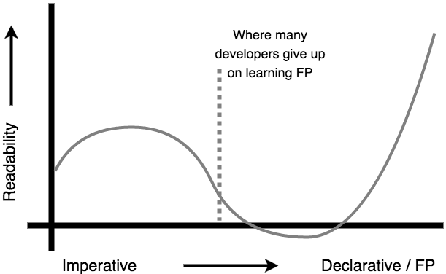
Why shall we know FP

Slide 9
When is FP?
1930
λ-calculus was introduced by Alonzo Church to serve the Mathematic problem
1958
The lisp as the first FP language was invented
1967:
Currying is introduced by Christopher Strachey
1980
Haskell as the most successful FP language was invented
1990
Functional programming grows fast with the enlargement of applications
Notes:
罗素悖论：设有一性质P(EX:"年收入高于三千万"就是一个性质)，并立以一性质函数P(x)，且其中的自变量x有此特性：“x∉{P(x)}”，
现假设由性质P能够确定一个满足性质P的集合A——也就是说“A={x|x ∉ A}”。那么现在的问题是：A∈A是否成立？
首先，若A∈A，则A是A的元素，那么A不具有性质P，由命题函数P可以得知A∉A；
其次，若A∉A，根据定义，A是由所有满足性质P的类组成，也就是说，A具有性质P，所以A∈A。
最开始，邱奇试图创制一套完整的形式系统作为数学的基础，当他发现这个系统易受罗素悖论的影响时，就把lambda演算单独分离出来，用于研究可计算性，最终导致了他对判定性问题的否定回答。
在λ演算中，每个表达式都代表一个函数，这个函数有一个参数，并且会返回一个值。不论是参数和返回值，也都是一个单参的函数。可以这么说，λ演算中只有一种“类型”，那就是这种单参函数。函数是通过λ表达式匿名地定义的，这个表达式说明了此函数将对其参数进行什么操作。
例如，“加2”函数f(x)= x + 2可以用lambda演算表示为λx.x + 2（或者λy.y + 2，参数的取名无关紧要），而f(3)的值可以写作(λx.x + 2) 3。函数的应用（application）是左结合的：f x y =(f x) y。
邱奇数
0 = λf.λx.x
1 = λf.λx.f x
2 = λf.λx.f (f x)
3 = λf.λx.f (f (f x))

Slide 10
What is FP?
a style of building the structure and elements of computer programs—that treats computation as the evaluation of mathematical functions and avoids changing-state and mutable data. It is a declarative programming paradigm, which means programming is done with expressions or declarations instead of statements. Functional programming has its origins in λ-calculus.
Notes:
函数式编程是种编程范式，它将电脑运算视为函数的计算
这种编程范式源于 λ-calculus - λ演算的函数可以接受函数当作输入和输出
因此它是表达式（expression）形式的，而不是语句（statement）形式的
"表达式"（expression）是一个单纯的运算过程，总是有返回值；"语句"（statement）是执行某种操作，没有返回值。函数式编程要求，只使用表达式，不使用语句。也就是说，每一步都是单纯的运算，而且都有返回值。

Slide 11
Which is(are) FP(s)?
var p = 5; var Fn = (a) => { return a/100 * (100 + p) }
var Fn = (a) => a
var Fn = {f : (a) => {return a} }
var Fn = () => {}
function fn(a) { console.log(a) }

Slide 12
Summery
A function must always take an argument.
A function must always return a value.
A function should act only on its receiving arguments (i.e., X) not the outside world.
For a given X, there will be only one Y.
Notes:
• 函数总是有传入的参数
• 函数必须有且只有一个返回值
• 函数必须只依靠它内部的传参运行
一一对应的

Slide 13
Pure FP language or not?
Haskell
Erlang
ML
LOGO
Concurrent Clean
Scala
Miranda
R
LISP
Lazy K
Clojure
Mathematica

Slide 14
pure FP languages
non-pure FP languages
Scala
ML
Erlang
Haskell
LOGO
Lazy K
R
Miranda
LISP
Concurrent Clean
Clojure
Mathematica
Notes:
Haskell（发音为 /ˈhæskəl/）[1] 是一种标准化的，通用纯函数式编程语言，有非限定性语义和强静态类型。它的命名源自美国逻辑学家Haskell Brooks Curry，他在数学逻辑方面的工作使得函数式编程语言有了广泛的基础。在Haskell中，“函数是一等公民”。[2] 作为函数式编程语言，主要控制结构是函数。

Slide 15
Is JavaScript a Functional Programming Language?

Slide 16
JavaScript is not a pure functional language (like Haskell) but rather a Multi-paradigm language. However the language is very much suitable for the functional programming
JavaScript treats functions as its first-class citizens

Slide 17
Higher-Order Function
What, How & Why?

Slide 18
Higher-Order Function
Currying & Partial Application
Composition & Pipelines

Slide 19
What is HOF?
higher-order function is a function that:
takes one or more functions as arguments,
returns a function as its result.

Slide 20
How does HOF work?
const tap = (value) =>
(fn) =>
typeof(fn) === 'function' && fn(value)
const logger = (it) => console.log("value is ",it)
tap(“fun")(logger)
//value is fun

Slide 21
Why do we need HOF?
Higher-Order Function concepts help the developer to write the code that abstracts away the difficult parts!

Slide 22
Abstraction is Art
In software engineering and computer science, abstraction is a technique for managing complexity of computer systems. It works by establishing a level of complexity on which a person interacts with the system, suppressing the more complex details below the current level. The programmer works with an idealized interface (usually well defined) and can add additional levels of functionality that would otherwise be too complex to handle.

Slide 23
people.sort(/* function */)
let people = [
{ firstname: 'aaFirstName', lastname: 'cclastName' },
{ firstname: 'bbFirstName', lastname: 'bblastName' },
{ firstname: 'ccFirstName', lastname: 'aalastName' }
]
people.sort((a,b) => {
return (a.lastname < b.lastname) ? -1 : (a.lastname > b.lastname) ? 1 : 0
})

Slide 24
const sortBy = (property) => {
return (a,b) => {
let result = (a[property] < b[property]) ? -1 : (a[property] > b[property]) ? 1 : 0;
return result;
}
}
people.sort(sortBy("lastname"))
people.sort(sortBy("firstname"))

Slide 25
Higher-Order Function（HOF）
What：functions as arguments and result
How：fn(a)(b)
Why：abstraction

Slide 26
Currying 柯里化
What, How & Why?

Slide 27
What is currying?
Currying is a process of converting a function with n number of arguments into a nested unary function.

Slide 28


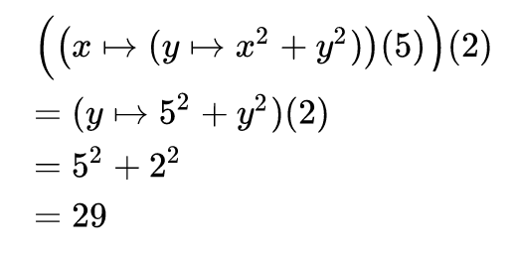
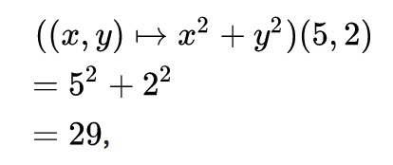
How does currying look like?

Slide 29
Partial Application 偏函数
setTimeout(() => console.log("Do X task"),10)
const setTimeoutWrapper = (time,fn) => {
setTimeout(fn,time);
}
const delayTenMs = curry(setTimeoutWrapper)(10)
delayTenMs(() => console.log("Do X task"))
delayTenMs(() => console.log("Do Y task”))

Slide 30
const partial = function (fn, …partialArgs){
let args = partialArgs;
return function(...fullArguments) {
let arg = 0;
for (let i = 0; i < args.length && arg < fullArguments.length; i++) {
if (args[i] === undefined) {
args[i] = fullArguments[arg++];
}
}
return fn.apply(null, args);
};
};
let delayTenMs = partial(setTimeout, undefined,10);
delayTenMs(() => console.log("Do X task"))
delayTenMs(() => console.log("Do Y task"))

Slide 31
variadic Functions -> curry
const variadic = (a,...variadic) => {
console.log(a)
console.log(variadic)
}
const curry = (binaryFn) => {
return function (firstArg) {
return function (secondArg) {
return binaryFn(firstArg, secondArg);
}
}
}

Slide 32
Why need currying?
Make each program do one thing well. To do a new job, build a fresh rather than complicate old programs by adding new “features”.

Slide 33
Currying 柯里化
What：unary function
How：nested
Why：atomization

Slide 34
Composition & Pipelines
let data = parseFloat("3.56")
let number = Math.round(data)
const compose = (a, b) => (c) => a(b(c))
let number = compose(Math.round, parseFloat)
number("3.56")

Slide 35
let data = parseFloat("3.56")
let number = Math.round(data)
const compose = (a, b) => (c) => a(b(c))
let number = compose(Math.round, parseFloat)
number("3.56")
const compose = (...fns) =>
(value) =>
fns.reduce((acc, fn) => fn(acc), value);
let splitIntoSpaces = (str) => str.split(" ");
let count = (array) => array.length;
let oddOrEven = (ip) => ip % 2 == 0 ? "even" : "odd"
const oddOrEvenWords = compose(splitIntoSpaces, count, oddOrEven);
countWords("hello your reading about composition”)
// "odd"

Slide 36
Lazy evaluation（懒惰计算法）
let async = (fn) => {
//some async operation
}
let async2 = (fn) => {
fn(/* result data */)
}
let async3 = (fn) => {
fn(/* result data */)
}
async(function(x){
async2(function(y){
async3(function(z){
…
});
});
});
let getDataOne = (cb) => {
setTimeout(function(){
//calling the callback
cb('dummy data one')
}, 1000);
}
let getDataTwo = (cb) => {
setTimeout(function(){
//calling the callback
cb('dummy data two')
}, 1000);
}
function* main() {
let dataOne = yield getDataOne();
let dataTwo = yield getDataTwo();
console.log("data one",dataOne)
console.log("data two",dataTwo)
}

Slide 37
What： 有入参，有返回，且对应，外部无关的编程范式
When：上世纪30年代
Where：Haskell等语言
Who：Christopher Strachey，Alonzo Church
Why：抽象且可预测，可读性
How：高阶函数，柯里化，偏函数，管道

