Slide 1

Plum DA Assessment
Insights from Email Metrics at Plum
Created by: Bishwajit Ghorai
Dated: 10-02-2024

Slide 2
Table of Content
Insights from Email Metrics at Plum
Objective
Efficiency Analysis
Comparative Analysis
Ticket Type Analysis
Calculations Used

Slide 3
Objective
Analyze the efficiency and performance of the customer success team at Plum based on email metrics, identify areas of improvement, and infer additional insights from the data.
Focused questions
1. How are the efficiency numbers looking like?
2. Can you share your views? Which groups are quick, slow etc. Create a table + relevant charts.
3. What type of tickets are taking the most time to resolve? Create a table + relevant charts. Create the different type of data types we can infer from this data.

Slide 4
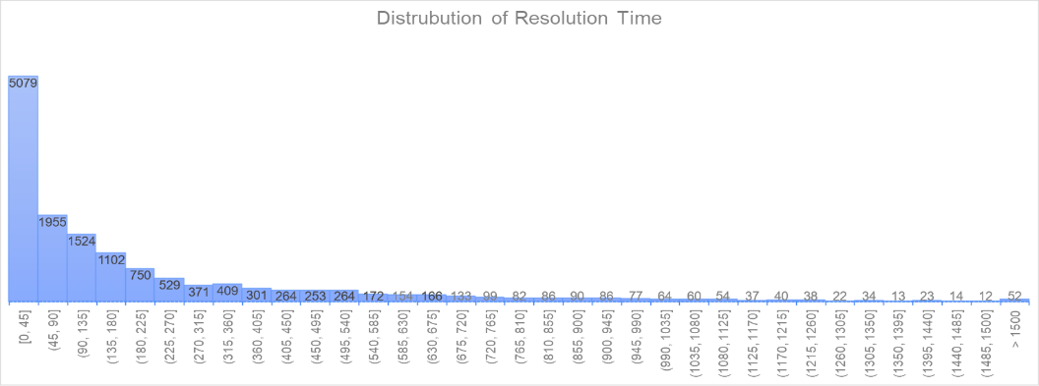
Efficiency Analysis
Divergence between the average and median values of key metrics suggests a notable disparity, signaling the potential presence of outliers.
Over 58.6% of tickets are resolved within 180 hours, as evidenced by the distribution of resolution times.
When factoring in both full resolution time and wait time to close tickets, the efficiency rate stands at 56%. While this figure may seem suboptimal, it's important to acknowledge potential skewness in the data caused by outliers, suggesting the situation may be more favorable than initially perceived.
Factoring in 'Offered' responses as Not sure, the calculated average satisfaction rating for support tickets stands at 4.33, indicating a favorable level of satisfaction.
Key Metrics |  | Average | Median
First Resolution Time |  | 5131.84 | 2154
First Reply Time |  | 1852.11 | 478
Full Resolution Time[Closed/Solved] |  | 6196.64 | 2880
Average Wait Time[Closed/Solved] |  | 4513.05 | 1893

Slide 5
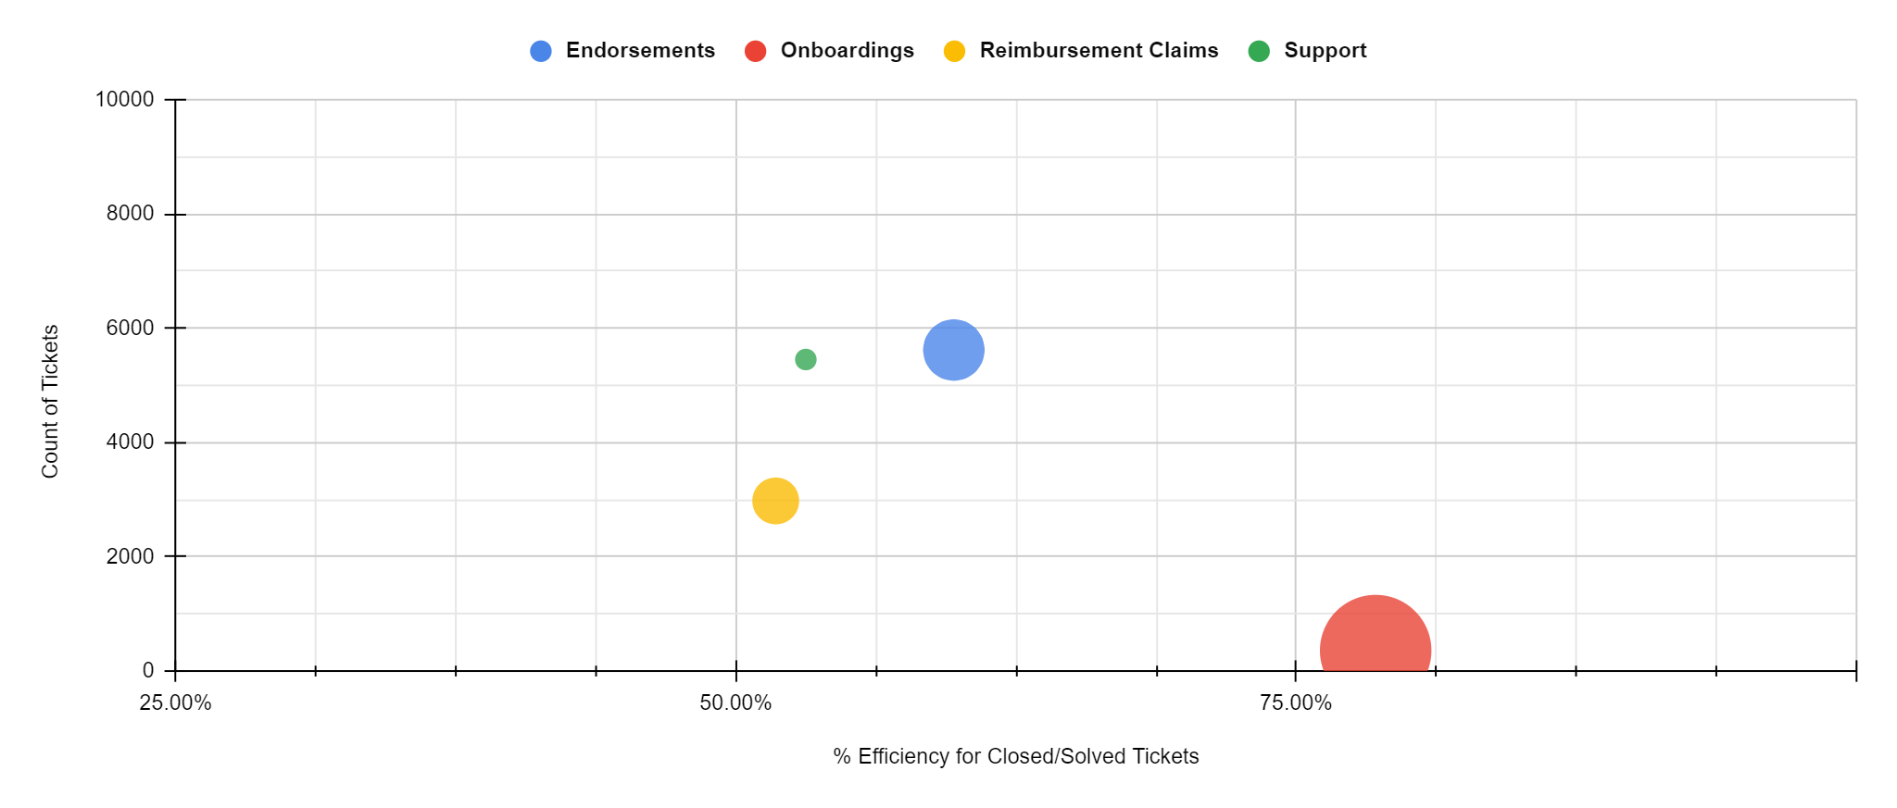
2. Comparative Analysis
Endorsements and Onboardings show slower response and resolution times, suggesting constraint in addressing inquiries, while Reimbursement and Support groups demonstrate quicker, more efficient handling of customer issues.
Onboardings demonstrate more efficiency despite longer resolution times, while Endorsements and Support groups indicate potential for process streamlining.
Onboardings, despite lower ticket volume, face challenges in timely issue resolution, highlighting the importance of optimizing processes.
Groups |  | Response | Resolution | Fulfillment | Tickets
Endorsements |  | 2324.50 | 4389.50 | 4518.00 | 6449
Onboardings |  | 600.50 | 16309.00 | 17591.00 | 530
Reimbursement Claims |  | 969.50 | 1473.00 | 2565.00 | 3827
Support |  | 115.00 | 892.50 | 1275.00 | 5670

Slide 6
3.1 Ticket Type Analysis
The table summarizes performance metrics for different ticket categories in a support system, providing insights into handling efficiency and effectiveness across various priority levels and categories.
By analyzing these metrics, we can assess the performance of different ticket categories and prioritize areas for improvement.
Prioritizing tickets based on their category and priority level can enhance overall support system effectiveness.
Understanding the distribution of resolution times and efficiency metrics helps identify trends and optimize support processes.
Group |  | Priority | Avg Job Eff. | First-Reply Median | FRT Median | Median Business Res Time | Median Wait (Biz Hrs) | Total Tickets
Endorsements |  | Low | 59.70% | 2327 | 8829.5 | 4512 | 2978 | 6441
 |  | Urgent | 69.29% | 271 | 7566.5 | 5644 | 3328 | 8
Onboardings |  | Low | 78.54% | 600.5 | 32869 | 17591 | 1809.5 | 530
Reimbursement Claims |  | Low | 51.77% | 969.5 | 2917 | 2564 | 3219 | 3825
 |  | Normal | 51.89% | 2053 | 13018 | 15068 | 14251 | 2
Support |  | Low | 52.99% | 112 | 1669 | 1279 | 1152.5 | 5486
 |  | Normal | 52.14% | 178 | 501 | 437 | 470 | 10
 |  | Urgent | 56.91% | 181 | 1825 | 1210 | 822.5 | 174

Slide 7
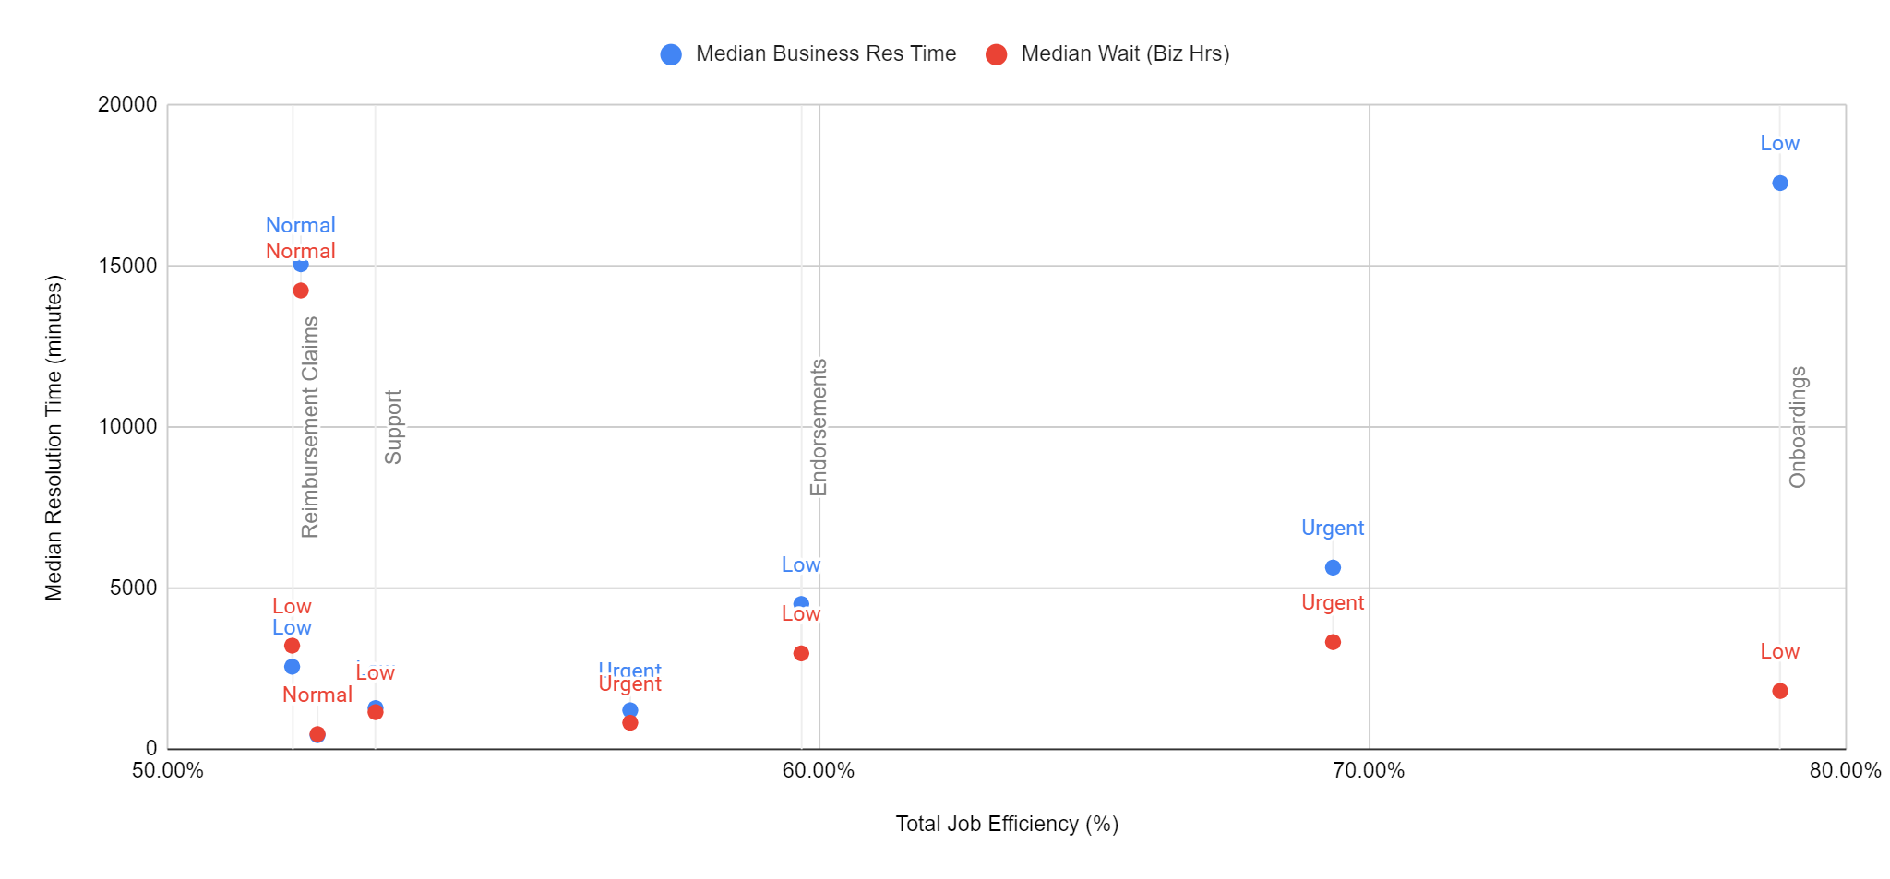
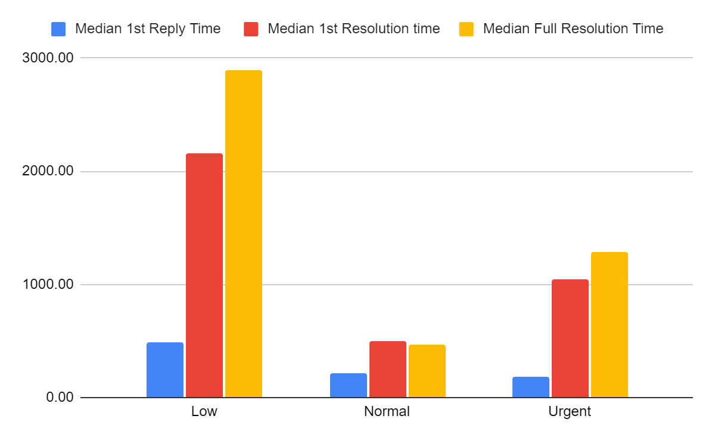
3.2 Ticket Type Analysis
Support tickets with low priority have a low median wait time (1152.5 min) and median full resolution time (1,279 min), indicating quick resolution compared to other groups. However, their average total job efficiency is moderate (52.99%), suggesting potential efficiency improvements despite quick resolutions.
Reimbursement claims, irrespective of priority, exhibit low median first resolution times (2,917 minutes for low priority and 13,018 minutes for normal priority). However, their median full resolution times match or exceed those of other groups, implying a longer duration for complete resolution despite reasonable initial response times.
Onboardings with low priority have a relatively high median first resolution time (32,869 minutes) and median full resolution time (17,591 minutes), indicating that these tickets take a more time to resolve. However, their average total job efficiency is relatively high (78.54%), suggesting that despite the longer resolution times, they are being handled efficiently once they are picked up.

Slide 8
Calculations Used
Employing both average and median for outlier detection
Efficiency calculation: Full resolution time divided by total closing ticket time (wait time + full resolution time during business hours)
Deriving an average efficiency score to gauge overall performance
Evaluating the overall satisfaction score for support tickets
Created pivot tables to examine key metrics, allowing for a comprehensive analysis of data trends and patterns.
Utilized pivot tables to dissect key metrics, enabling a granular exploration of various performance indicators.

Slide 9
THANK YOU!!!

