Slide 1
Efficient Synthetic Target Generation for Transaction Data
Student: Artem Zabolotnyi
Course: High Performance Python Lab 2024

Slide 2
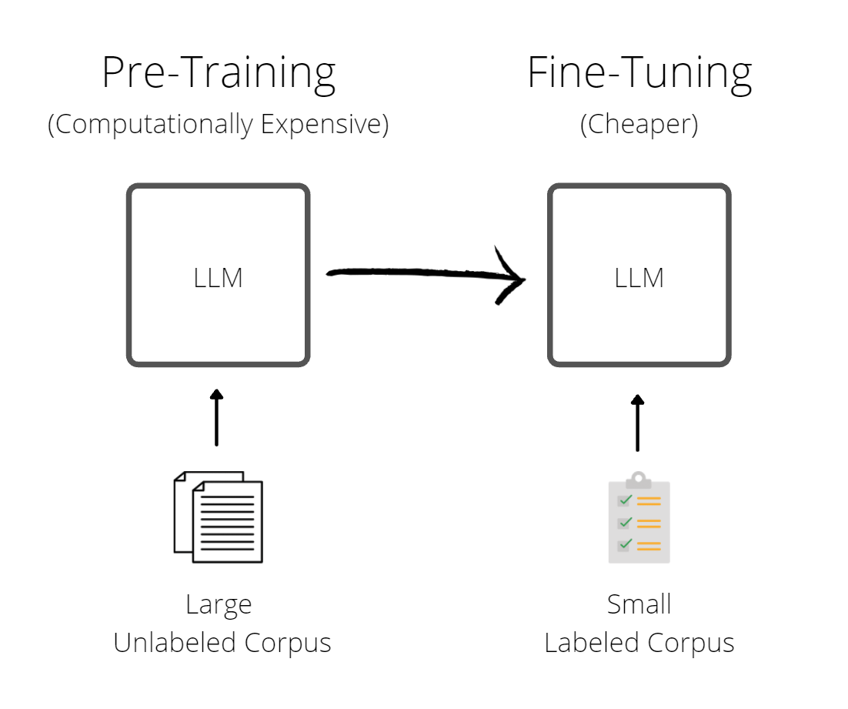
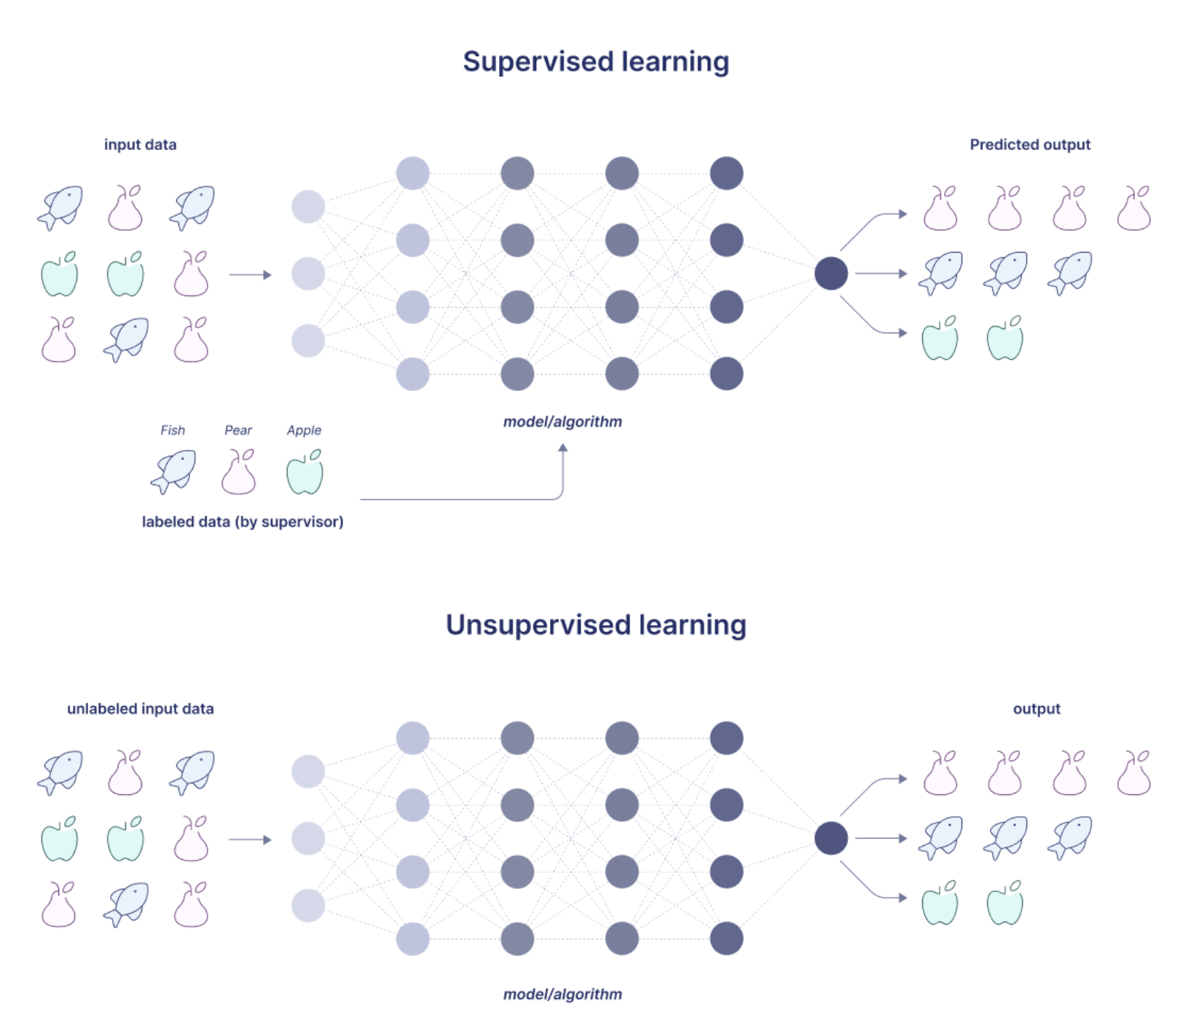
Machine learning training Supervised and unsupervised learning
Supervised learning - training with labeled dataset
Unsupervised learning - training with unlabeled dataset
Supervised data requires annotations.
A large amount of data remains unlabeled
Generative synthetic targets can help solve downstream tasks
Training large models requires substantial data and corresponding labels, which are often unavailable for many datasets
2

Slide 3
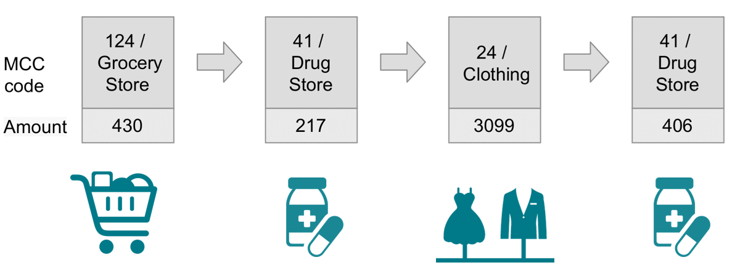

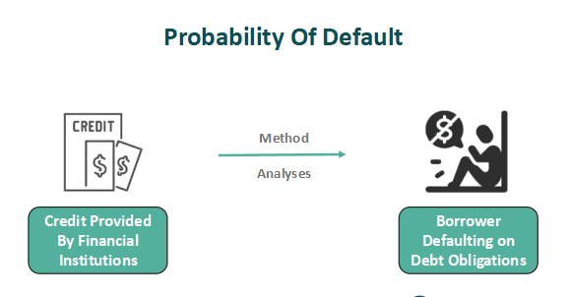
Financial transaction Data structure
Features:
Amount
Merchant category code (MCC)
Time of transaction
Tasks:
Fraud detection (low target rate)
Probability of Default (low target rate)
Synthetic targets provide a solution for datasets with limited labeled samples
3

Slide 4
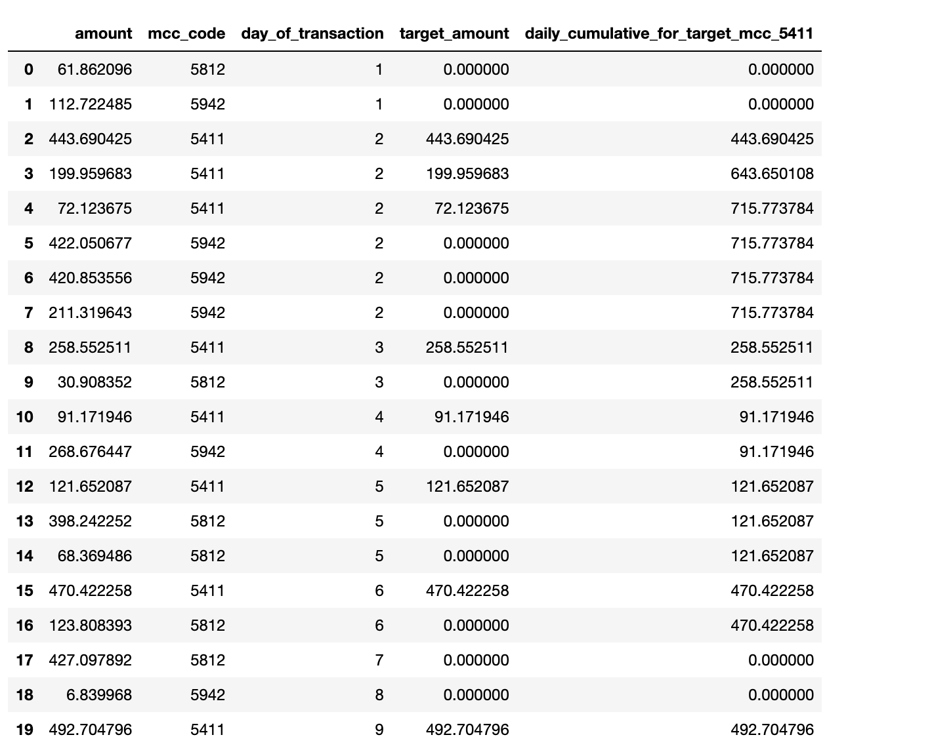
Financial transaction Synthetic targets
Synthetic targets examples
Average transaction amount at drug stores over a week
Maximum transaction amount at grocery stores during a month
Minimum transaction amount for rent during a month
4

Slide 5
Synthetic target generation Performance bottleneck
Configurable pipeline:
Aggregation by different MCC codes
Time-based feature grouping (transactions per day, month, week)
Type of aggregation (e.g., sum, mean, max, top 3)
Requires real-time performance for training ML models
Challenges:
Large volumes of user transactions cannot be precomputed
Need real time performance for training ML model (hundred of users per / sec)
Should be integrated into Pytorch training pipeline
5

Slide 6
Synthetic target generation Baseline
Pure Python + NumPy
Expanding window (Python)
Filter elements (NumPy)
Aggregate (NumPy)
Insufficient speed
Filter + aggregate
Filter + aggregate
Filter + aggregate
6

Slide 7
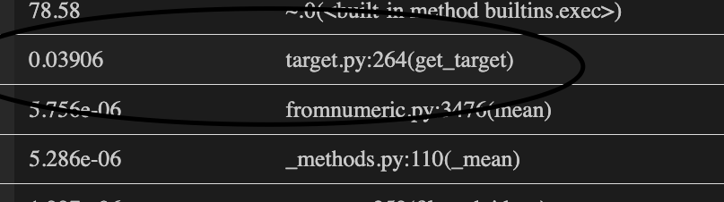
Synthetic target generation Baseline
Pure Python + NumPy
Expanding window (Python)
Filter elements (NumPy)
Aggregate (NumPy)
Insufficient speed
Implementation | Transactions | User per seconds
Python + numpy | 4096 | 25
Profiler:
Target generation per user: 0.039s
7

Slide 8
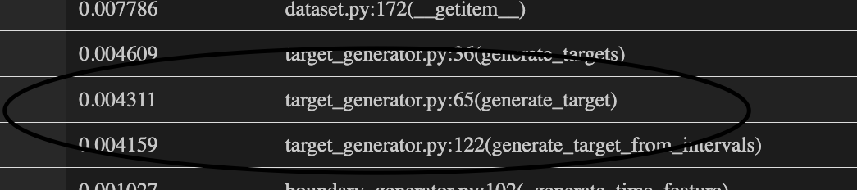
Synthetic target generation Numba optimization
Pure Python + NumPy + Numba
Expanding window (Numba + NumPy)
Filter elements (Numba + NumPy)
Aggregate (Numba + NumPy)
Profiler:
Target generation per user: 0.0043s
Achieved a 10x speedup in target generation
Implementation | Transactions | User per seconds
Python + numpy | 4096 | 25
Numba + numpy | 4096 | 230
8

Slide 9
Synthetic target generation Numba optimization with multiprocessing
Pure Python + NumPy + Numba
Expanding window (Numba + NumPy)
Filter elements (Numba + NumPy)
Aggregate (Numba + NumPy)
Multiprocessing:
Independent generation for each user
Achieved an ≈26x speedup
Implementation | Transactions | User per seconds
Python + numpy | 4096 | 25
Numba + numpy | 4096 | 230
MP (8 processes) + Numba + numpy | 4096 | 667
9

Slide 10
Synthetic target generation Numba challenges
JIT compiled class is not serializable (need for Pytorch dataloader)
Static typing challenge python dict storing all features
For some function you should manual provide signature with static types to force convertation in proper datatypes
10

Slide 11
Synthetic target generation Final speed up
JIT | Num process | Num users | Targets per transaction | Time (s) | Speedup | User per s
- | 0 | 2000 | 1 | 80 | 1 | 25
+ | 0 | 2000 | 1 | 15 | 5 | 133
+ | 4 | 2000 | 1 | 4.5 | 18 | 444
+ | 8 | 2000 | 1 | 4.5 | 18 | 444
+ | 0 | 2000 | 20 | 212 | 1 | 9
+ | 4 | 2000 | 20 | 67 | 3 | 30
+ | 8 | 2000 | 20 | 45 | 5 | 44
11

Slide 12
Synthetic target generation Results
Reimplemented slow functions using Numba
Achieved up to a 10x speedup in synthetic target generation with Numba
Achieved a 4x speedup in multiprocessing generation with 8 processes
The combination of multiprocessing and JIT resulted in a throughput of 50 users per second
12

