Slide 1
Efficient Synthetic Target Generation for Transaction Data
Student: Artem Zabolotnyi
Course: High Performance Python Lab 2024

Slide 2
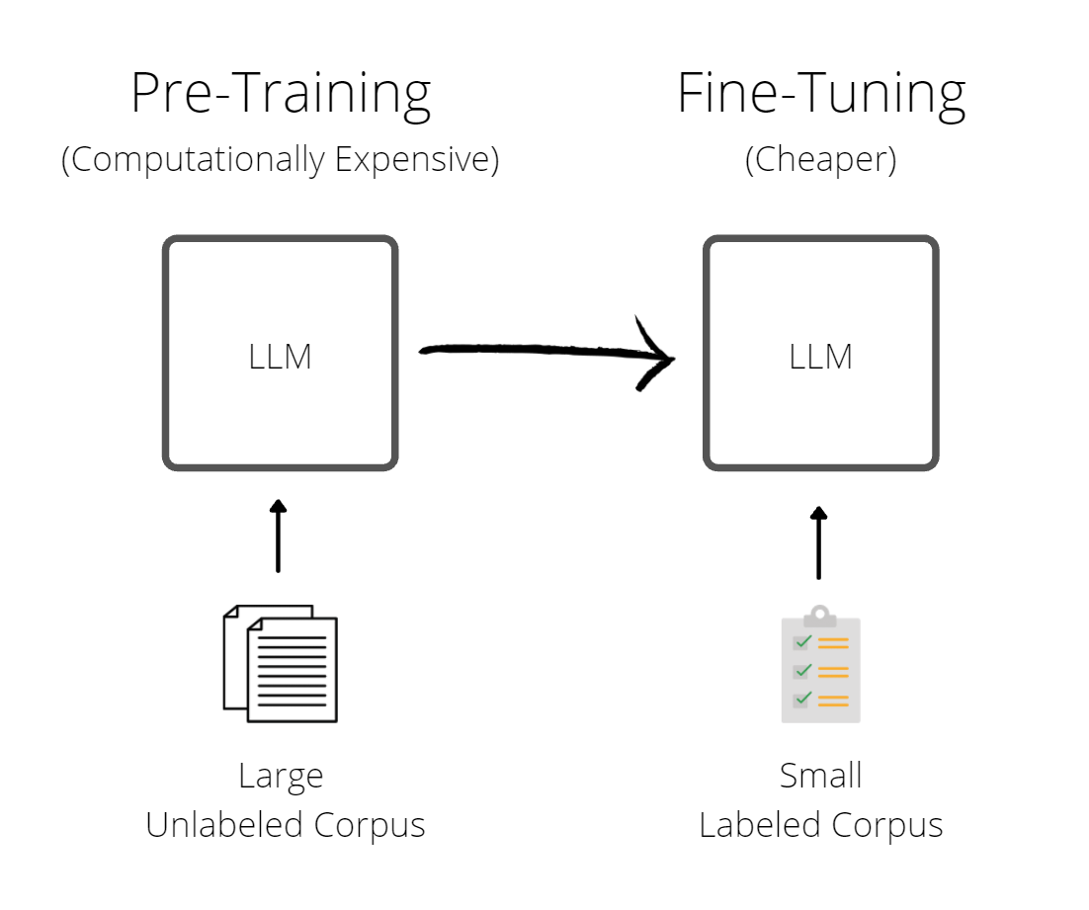
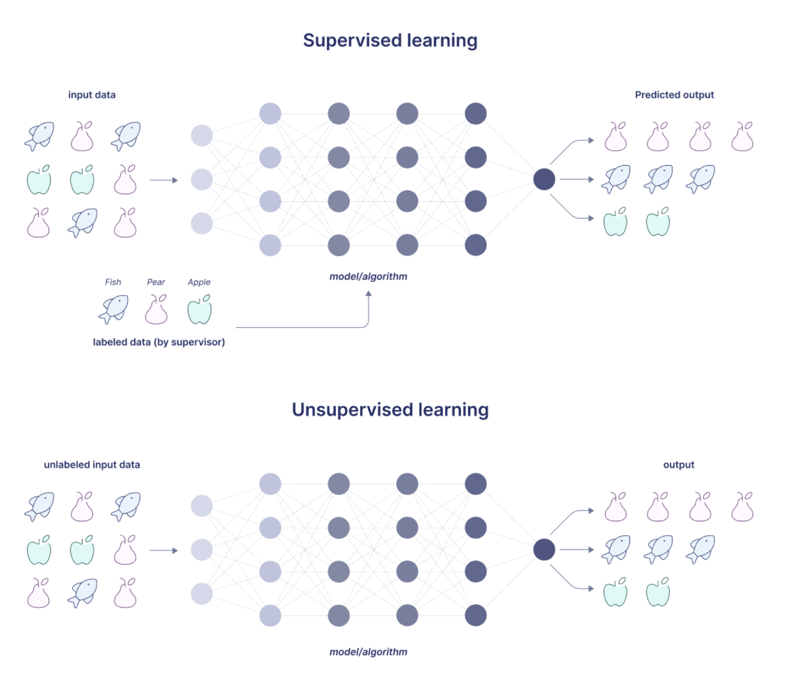
ML training Supervised and unsupervised learning
Supervised data required annotations
A large amount of data is unlabeled
Generative synthetic target could help to solve downstream task
2

Slide 3
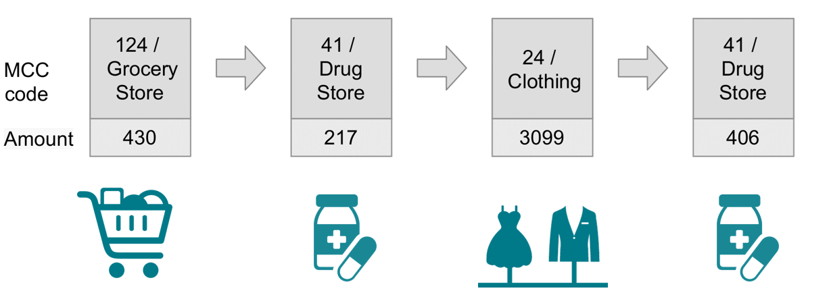
Financial transaction Data structure
Features
Amount (numerical)
Merchant category code (MCC)
Time of transaction
3

Slide 4
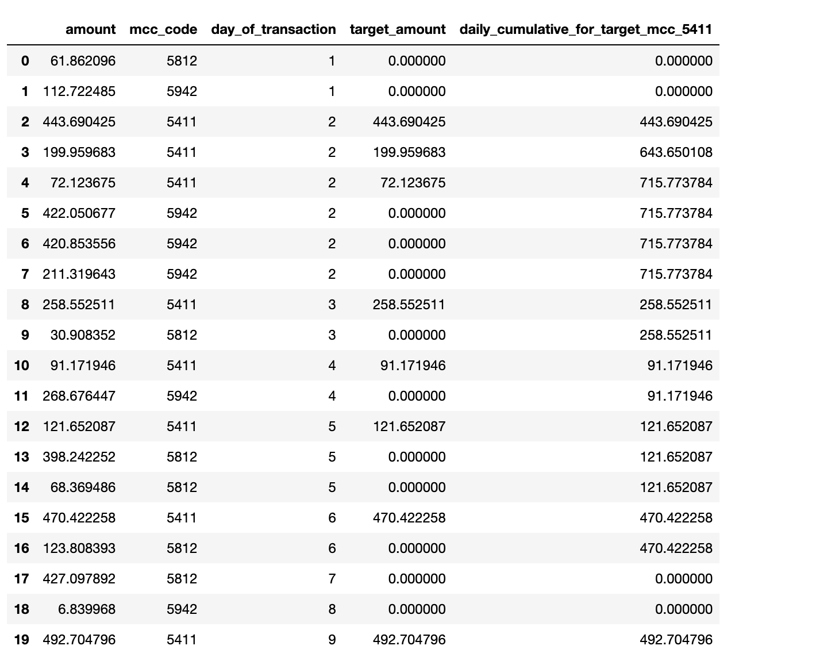
Financial transaction Synthetic aggregates
Aggregates examples
Mean by drug store over the week
Max amount by grocery during month
Minimum transaction amount for rent
Etc
4

Slide 5
Synthetic target generation Performance bottleneck
Configurable pipeline
Aggregation by different MCC code
Time feature group (trans per day, month, week)
Type of aggregation (sum, mean, max and etc)
Combination of generated features
Problems
Large volume of user transactions
Need real time performance for training ML model (hundred user per / sec)
5

Slide 6
Synthetic target generation Baseline
Pure python + numpy
Increasing size rolling window
Filter only elements we want
Aggregate
Not sufficient speed!
Filter + aggregate
Filter + aggregate
Filter + aggregate
6

Slide 7
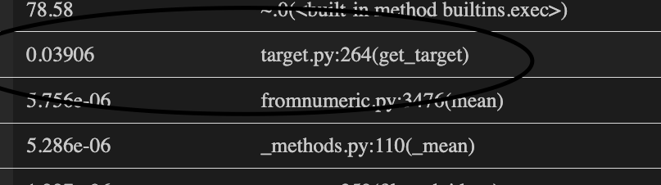
Synthetic target generation Baseline
Pure python + numpy
Increasing window size
Filter only elements we want
Aggregate
VERY SLOW
2000 user
1 target per transaction
4096 transaction per user
120 second
Profiling = 0.04 sec per user
7

Slide 8
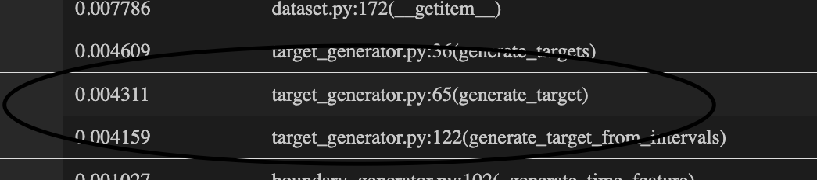
Synthetic target generation Numba JIT
Code optimization strategy
Group by use time feature -> JIT
Filter function by mcc code -> JIT
Reduce -> JIT
Speedup 10x target generation speed
2000 user
1 target per transaction
4096 transaction per user
12 second
Profiling = 0.004 sec per user
8

Slide 9
Synthetic target generation Numba JIT + Multiprocessing
JIT | Num process | Num users | Targets per transaction | Time (s) | Speedup | User per sec
- | 0 | 2000 | 1 | 75 | 1 | 27
+ | 0 | 2000 | 1 | 12 | 6.25 | 167
+ | 4 | 2000 | 1 | 4 | 18.75 | 500
+ | 8 | 2000 | 1 | 3 | 25 | 667
+ | 0 | 2000 | 20 | 180 | 1 | 11
+ | 4 | 2000 | 20 | 50 | 3.6 | 40
+ | 8 | 2000 | 20 | 39 | 4.61 | 51.28
9

Slide 10
Synthetic target generation Implementation problem
JIT classes not serializable
Strong typing = pain if your data in dict like structure
JIT does not support some numpy functions and python structures
10

Slide 11
Synthetic target generation Further improvements
JIT classes not serializable
Strong typing = pain if your data in Dict like structure
JIT does not support some numpy functions and python structures
11

