Slide 1
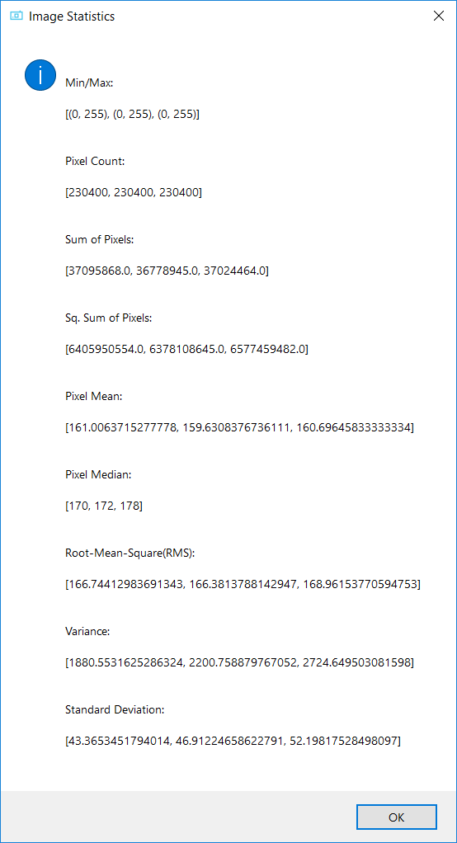
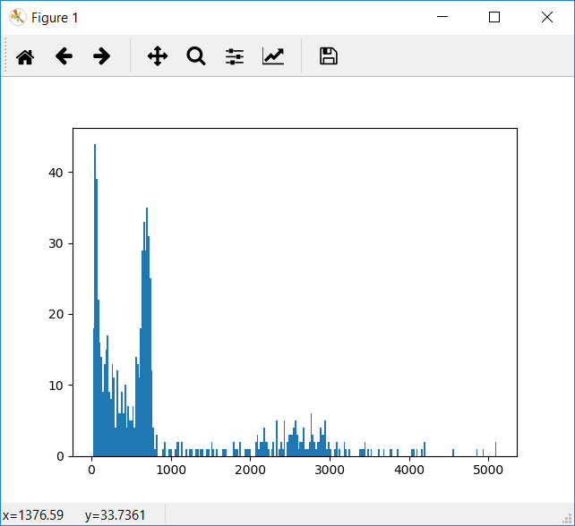
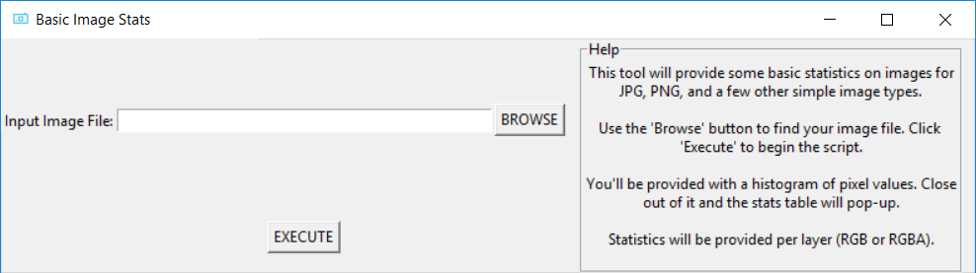
BasicImageStats
Tkinter GUI that uses PIL to get image statistics and matplotlib to display the image’s histogram.
Zach Aaberg
Foundations of Software Development - Python
SEIS 603 - Section 01: Course ID # 22137

