Slide 1
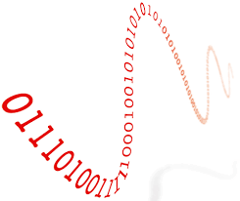
DA/AD Conversion

Slide 2
AD/DA Characteristics
Analog pins voltage is between 0-5 volts
Max resolution is 2^8= (0-255)
Can be updated with the help of map function

Slide 3
CODE AD/DA
Int sensorPin=A0;
Int info=0;
Int info2=0;
Int pwm=3;
Void setup()
{Serial.begin(9600);
}
Void loop()
{
Info=analogRead(sensorPin);
analogWrite(pwm,info);
Info2=map(info,0,1023,0,255);
Serialprintln(info);
Serialprintln(info2);
}

Slide 4
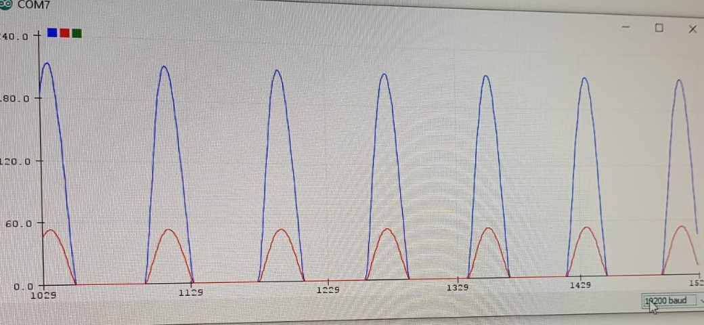
Serial Monitor Result for AD/DA

Slide 5
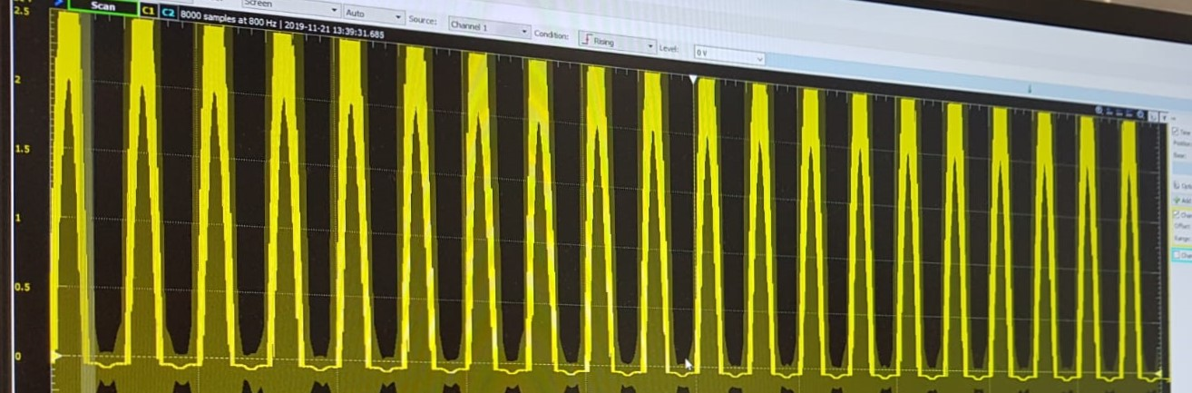
Analog Discovery Output

