Slide 1
Netflix Content Analysis: Storytelling Through Data Visualization
Submitted By: Zaara Khan
Tools Used:
Python
Pandas
Matplotlib
Seaborn
Jupyter Notebook
Notes:
1

Slide 2

Project Objective
Objective
The objective of this project is to analyze Netflix's content library using data visualization techniques and communicate insights through an effective data story.
Goals
Understand Netflix's content distribution.
Identify trends and patterns.
Create meaningful visualizations.
Interpret the results using business insights.
Demonstrate how visualization helps in decision-making.
Notes:
2

Slide 3
Dataset Overview
Dataset Information
Dataset: Netflix Movies and TV Shows
The dataset contains information about Netflix content including:
Content Fields
Data Cleaning Performed
Type (Movie / TV Show)
Title
Director
Country
Release Year
Rating
Genre
Duration
Checked missing values
Replaced missing values with "Unknown"
Verified data types
Prepared dataset for visualization
Notes:
3

Slide 4

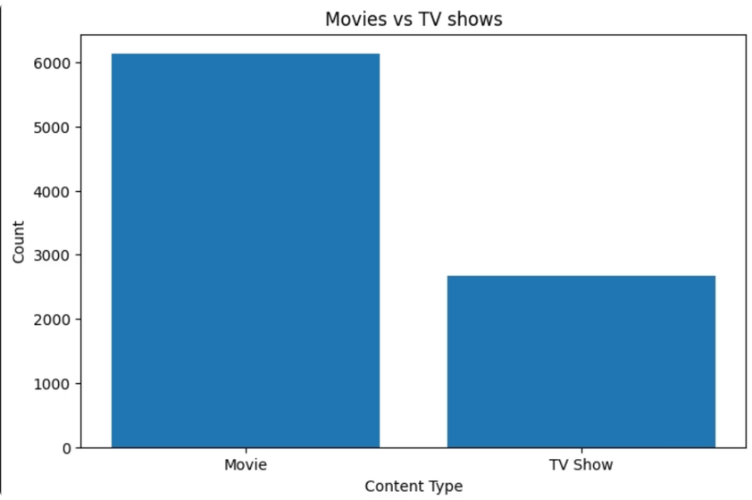

Visualization 1 – Movies vs TV Shows
Insight
Movies account for a much larger portion of Netflix's catalog than TV Shows.
This suggests Netflix has invested more heavily in movie production and licensing.
TV Shows represent a smaller but significant portion of the platform.
Business Interpretation
Netflix attracts a wide audience by offering a large collection of movies while continuing to expand its TV Show library.
Notes:
4

Slide 5

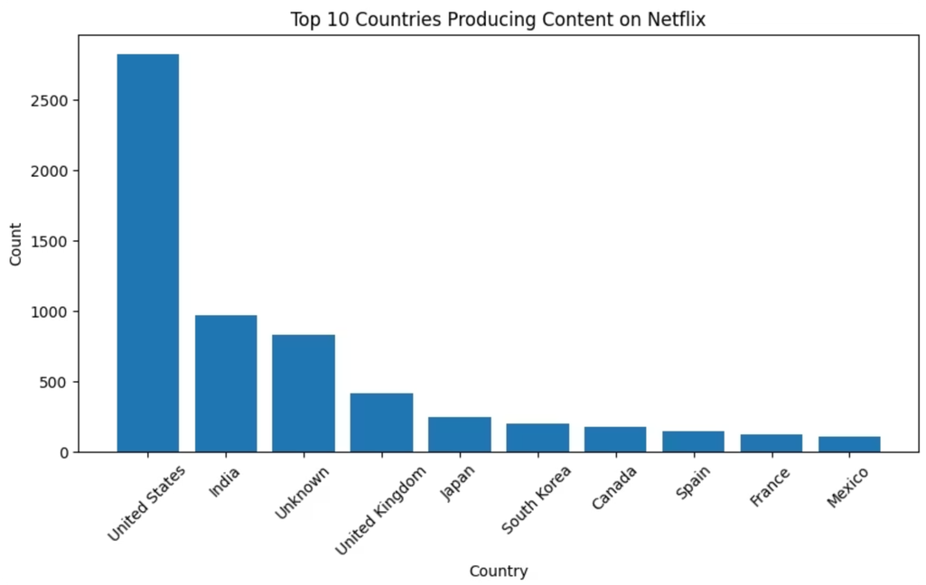
Visualization 2 – Top Countries Producing Content
Insight
The United States contributes the highest number of Netflix titles.
India is another major content producer.
Several other countries contribute smaller amounts of content.
Business Interpretation
Netflix has successfully expanded internationally while maintaining a strong content base from major entertainment markets.
Notes:
5

Slide 6

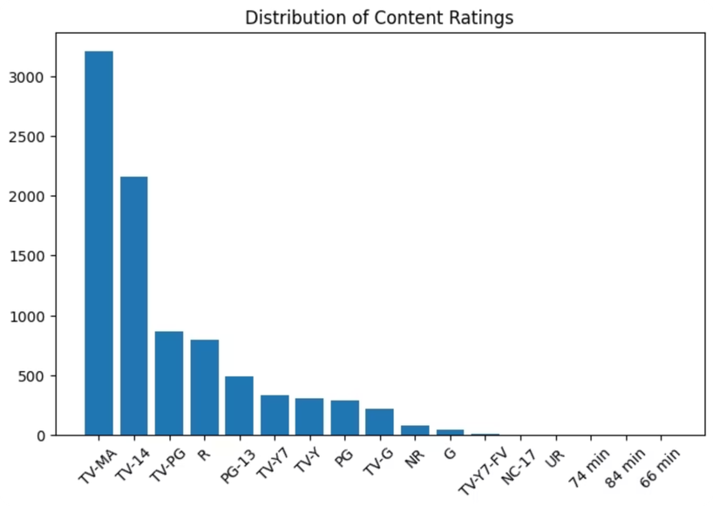
Visualization 3 – Content Ratings
Insight
TV-MA is the most common rating.
TV-14 also represents a large share.
Family-friendly ratings occupy a smaller portion.
Business Interpretation
Netflix primarily targets adult and teenage audiences while maintaining content suitable for children and families.
Notes:
6

Slide 7
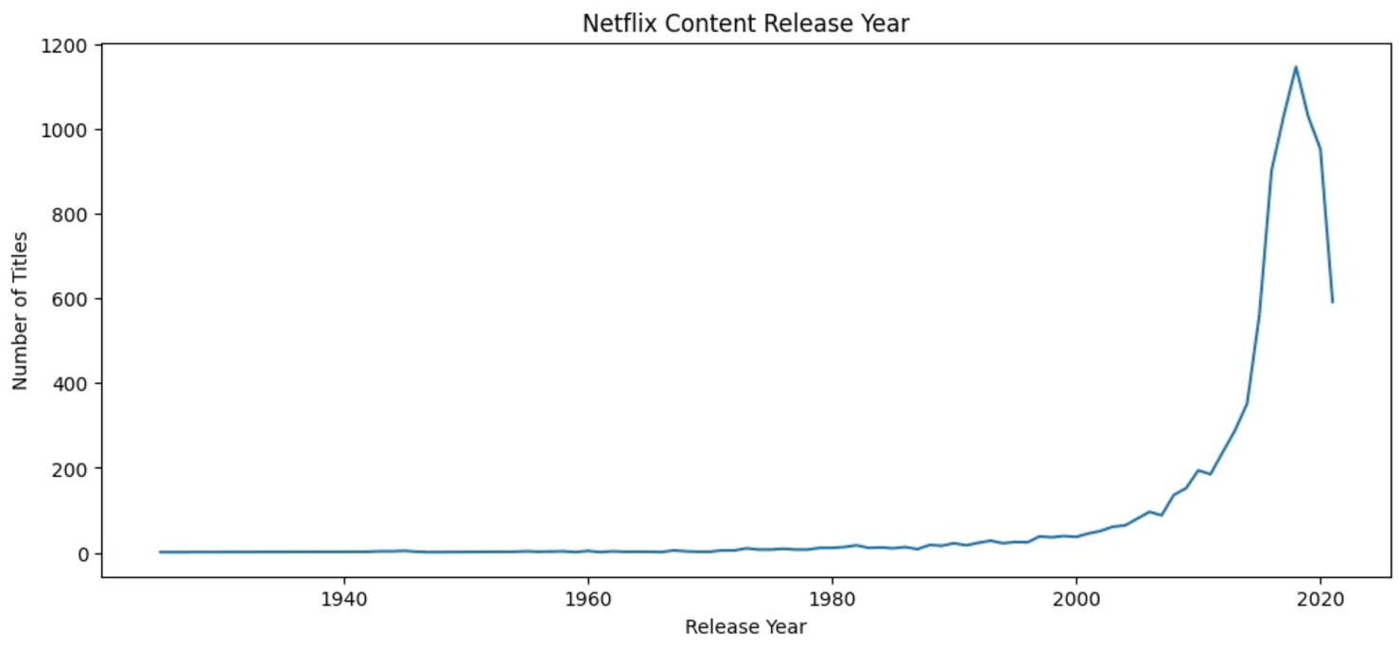
Visualization 4 – Release Year Trend
Insight
Netflix content increased steadily over the years.
Rapid growth is observed after 2015.
This reflects Netflix's expansion into original productions and global markets.
Business Interpretation
The company significantly increased its investment in content production to meet growing subscriber demand.
Notes:
7

Slide 8

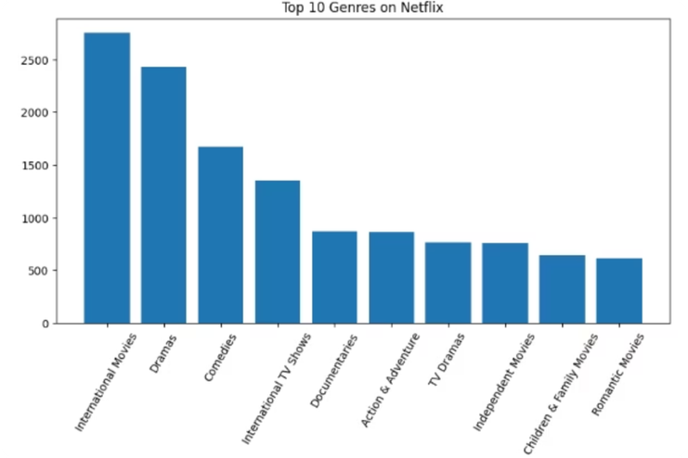
Visualization 5 – Top Genres
Insight
Drama is one of the most common genres.
International Movies have become increasingly popular.
Comedy also contributes significantly to Netflix's library.
Business Interpretation
Netflix offers diverse genres to satisfy different audience preferences across the world.
Notes:
8

Slide 9

Overall Story from the Data
Key Findings
01
02
03
Movies dominate Netflix's content library.
The United States produces the largest number of titles.
Netflix has expanded rapidly since 2015.
04
05
Most content is intended for mature audiences.
Drama and International Movies are the most popular genres.
Overall Story
The visualizations show Netflix's transformation into a global entertainment platform with a diverse and rapidly growing collection of content designed for audiences across different countries and age groups.
Notes:
9

Slide 10
Conclusion
This project demonstrated how data visualization can convert raw data into meaningful insights.
What I Learned
Final Outcome
Data cleaning before visualization
Choosing appropriate chart types
Creating effective visualizations using Matplotlib
Interpreting visual patterns
Communicating insights through storytelling
The project successfully transformed Netflix data into a clear and engaging story using visualizations, highlighting trends that support better understanding and decision-making.
Notes:
10

