Slide 1

Student Performance Prediction Using Machine Learning
Data Science Internship Capstone Project — Zaara Khan
Aim: Predict mathematics scores from demographic and academic indicators to inform targeted interventions.
Notes:
1

Slide 2
Problem Statement
Objective
Why it matters
Stakeholders
Predict student mathematics scores using demographic and academic features to enable data-driven support.
Identify performance drivers, inform targeted interventions, and improve academic outcomes across student groups.
Teachers, school administrators, policymakers, and students/families.
Notes:
2

Slide 3
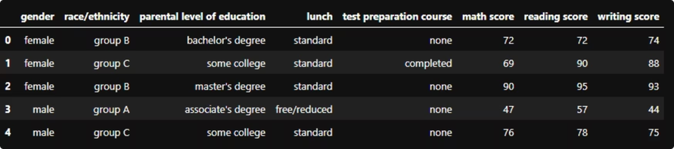
Dataset Overview
Features: Gender; Race/Ethnicity; Parental Education; Lunch Type; Test Preparation Course; Reading Score; Writing Score; Mathematics Score.
Dataset size: 1,000 student records. Balanced mix of demographics and academic indicators suitable for supervised learning.
Tabular educational assessment data
Numeric targets (math score) with numeric predictors (reading/writing) and categorical controls
Notes:
3

Slide 4

Data Preprocessing
We prepared the data to ensure model reliability and interpretability.
01
02
Load & Inspect
Cleaning
Read CSV, verify schema, and preview rows.
Checked for missing values and duplicates; none significant after validation.
03
04
Encoding
Feature Selection
Label encoding for categorical features (e.g., gender, lunch, test preparation).
Selected predictors with high explanatory potential: reading_score, writing_score, parental education, test prep, lunch.
Notes:
4

Slide 5
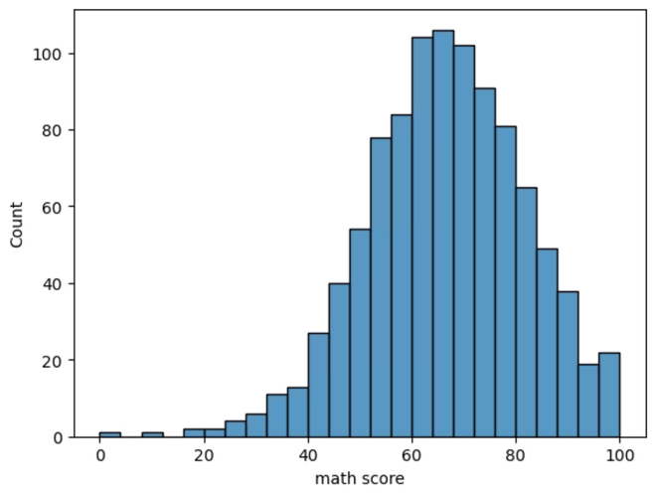
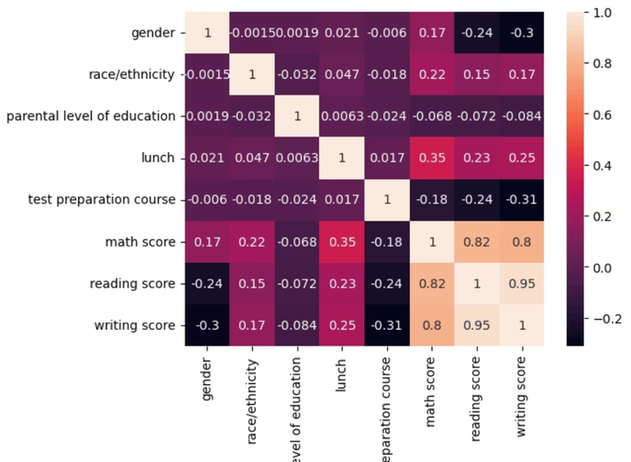
Exploratory Data Analysis (EDA)
Two visuals highlight the most important patterns in the data.
Distribution
Correlations
Math scores show a central spread with a few outliers.
Reading and writing are strongly linked to math performance.
Reading and writing scores show the strongest association with mathematics, making them key predictors.
Notes:
5

Slide 6

Model Building
1
2
Algorithm
Procedure
Linear Regression — chosen for interpretability and baseline benchmarking.
Train-test split: 80:20
Fit linear model on training set
Generate predictions on test set
Notes:
6

Slide 7
Model Evaluation
Performance metrics computed on the held-out test set:
28.28
88.4%
MSE
R² Score
Mean Squared Error: 28.28 (lower is better)
Explained variance: 88.4% — model captures most variability in math scores.
Interpretation: The linear model is a strong baseline. Residual analysis indicates minor non-linear patterns for a small subset of students, suggesting room for non-linear models.
Notes:
7

Slide 8


Key Insights
Reading as Primary Predictor
Writing Correlation
Test Preparation Effect
Writing score also correlates highly with math, reinforcing literacy’s role in quantitative success.
Students who completed test preparation performed measurably better, consistent across demographics.
Reading score shows the strongest weight in the regression — improving reading is likely to raise math performance.
Parental Education & Lunch
Higher parental education associates with better scores; standard lunch students showed slightly higher averages than free/reduced lunch peers.
Notes:
8

Slide 9

Recommendations
Scale test preparation programs targeted at lower-performing cohorts.
Integrate literacy interventions (reading & writing) into math curricula.
Provide focused support (tutoring, mentoring) for students from disadvantaged lunch categories.
Engage parents through workshops and progress reports to boost at-home support.
Monitor outcomes and retrain models with new data periodically.
Short-term: pilot expanded test prep and reading workshops. Long-term: collect larger, longitudinal datasets to evaluate impact.
Notes:
9

Slide 10



Conclusion & Future Scope
Conclusion: The linear regression baseline achieved strong predictive performance (R² = 88.4%), indicating reading and writing scores are powerful predictors of mathematics achievement.
Next Models
Evaluate Random Forest and XGBoost to capture non-linear relationships and reduce residual error.
Deployment
Develop a lightweight web app for teachers to input student features and receive predicted math scores and suggested interventions.
Data Expansion
Collect larger and longitudinal educational datasets to validate model generalization and fairness across subgroups.
Thank you
Notes:
10

