Slide 1
Problem 2: Extended Warranty
The Bloxiteers

Slide 2
The actors
Register fault
Record ownership changes
Retailer
Repair Shop
Zurich Insurance
Customer
Issue warranty certificate
Pay incoming invoices
Authorise larger claims
Record extended warranty sale
Issue invoice for replacement products
Record repair decision
Issue invoice for repair work

Slide 3
Problems with the current situation
Customers throw warranties in a safe place and lose them.
Reconciliation of policies sold with retailers.
Emails, paper, invoices, or just dialogue.

Slide 4
The Solution
Customers can access their policy online via app with their secure login.
Smart contracts allow claims logic to be leveraged to automate situations.
Centralised database removes the requirement for reconciliation.

Slide 5
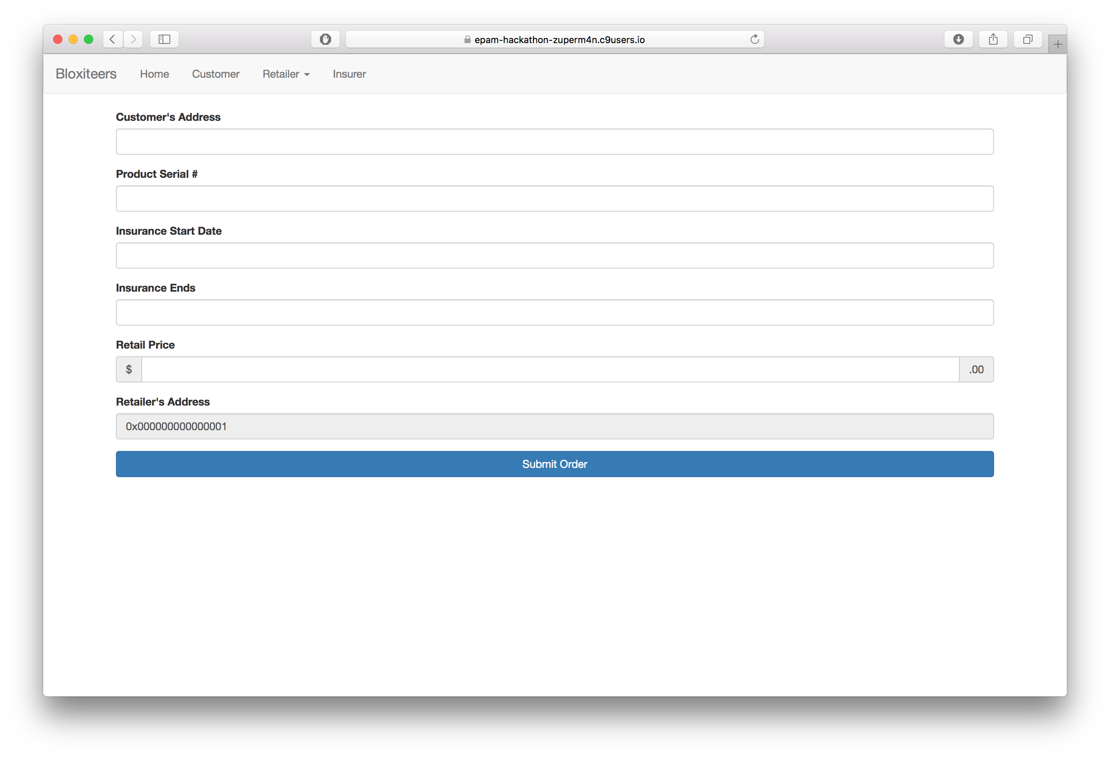
At the Point of Sale

Slide 6
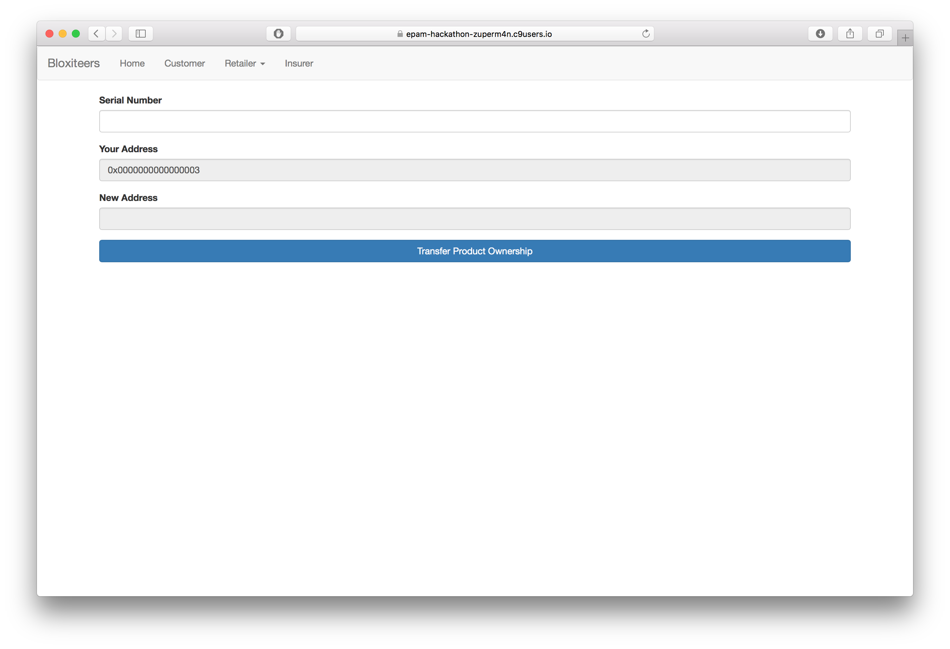
To transfer ownership…

Slide 7
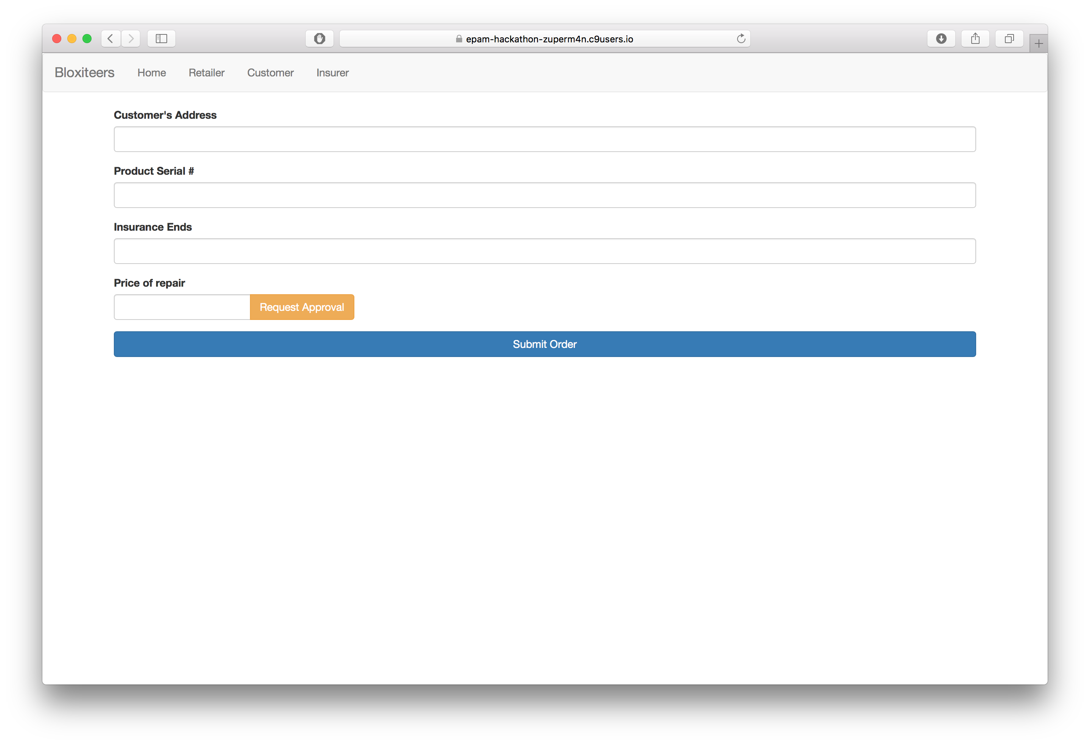
For the repair shop

Slide 8
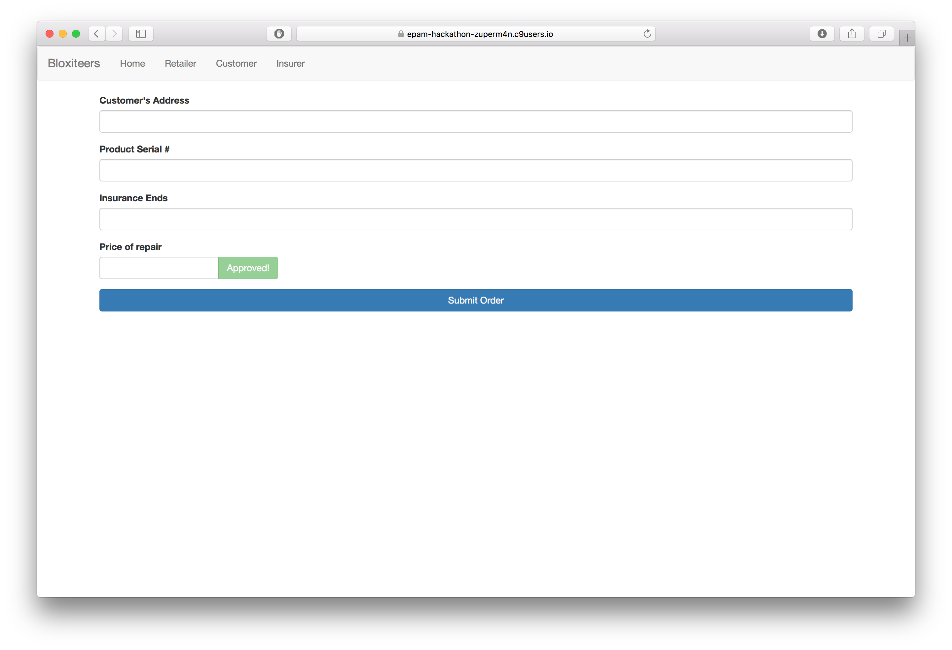
For the repair shop

Slide 9
Brief Demo

Slide 10
Future work
User Interface
Integration between Front-End UI and backend REST API
Testing

