Slide 1



OUR LADY OF THE SACRED HEART COLLEGE OF GUIMBA INC.
Bachelor of science in information technology
Iso 9001: 2015 certified
IPT102- INTEGRATIVE PROGRAMMING AND TECHNOLOGIES 2
ROOTED IN FAITH.
GROUNDED IN EXCELLENCE.

Slide 2
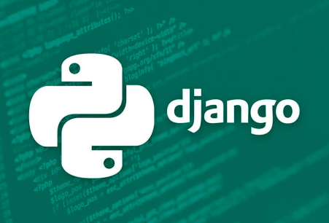
OUR LADY OF THE SACRED HEART COLLEGE OF GUIMBA INC.
Bachelor of science in information technology
Iso 9001: 2015 certified
IPT102- INTEGRATIVE PROGRAMMING AND TECHNOLOGIES 2
ROOTED IN FAITH.
GROUNDED IN EXCELLENCE.

Slide 3
OUR LADY OF THE SACRED HEART COLLEGE OF GUIMBA INC.
Bachelor of science in information technology
Iso 9001: 2015 certified
Django is a high-level, open-source web framework written in Python that enables developers to build complex, database-driven websites and applications quickly and efficiently.
Python is the core programming language of the Django framework, and familiarity with Python is essential for using it.
IPT102- INTEGRATIVE PROGRAMMING AND TECHNOLOGIES 2
ROOTED IN FAITH.
GROUNDED IN EXCELLENCE.

Slide 4

OUR LADY OF THE SACRED HEART COLLEGE OF GUIMBA INC.
Bachelor of science in information technology
Iso 9001: 2015 certified
1. Instagram
One of the most famous examples.
Used Django in its early backend.
Helps power features like user authentication, feeds, notifications, and media management.
IPT102- INTEGRATIVE PROGRAMMING AND TECHNOLOGIES 2
ROOTED IN FAITH.
GROUNDED IN EXCELLENCE.

Slide 5
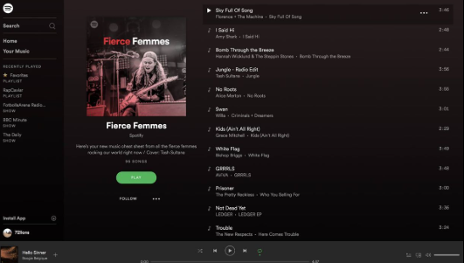
OUR LADY OF THE SACRED HEART COLLEGE OF GUIMBA INC.
Bachelor of science in information technology
Iso 9001: 2015 certified
Spotify (web version)
Some parts of Spotify’s web app and backend services use Django.
Django helps manage user accounts, playlists, and interactions efficiently.
IPT102- INTEGRATIVE PROGRAMMING AND TECHNOLOGIES 2
ROOTED IN FAITH.
GROUNDED IN EXCELLENCE.

Slide 6
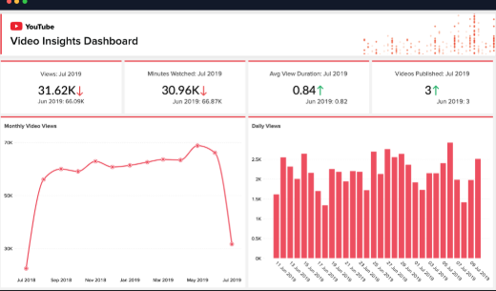
OUR LADY OF THE SACRED HEART COLLEGE OF GUIMBA INC.
Bachelor of science in information technology
Iso 9001: 2015 certified
YouTube (analytics & internal tools)
YouTube uses Django for some internal tools and admin dashboards.
It’s great for handling analytics and managing content.
IPT102- INTEGRATIVE PROGRAMMING AND TECHNOLOGIES 2
ROOTED IN FAITH.
GROUNDED IN EXCELLENCE.

Slide 7
OUR LADY OF THE SACRED HEART COLLEGE OF GUIMBA INC.
Bachelor of science in information technology
Iso 9001: 2015 certified
CORE COMPONENTS OF DJANGO
Django organizes an application's code according to the Model-View-Template (MVT) architectural pattern.
IPT102- INTEGRATIVE PROGRAMMING AND TECHNOLOGIES 2
ROOTED IN FAITH.
GROUNDED IN EXCELLENCE.

Slide 8
OUR LADY OF THE SACRED HEART COLLEGE OF GUIMBA INC.
Bachelor of science in information technology
Iso 9001: 2015 certified
Models: Python classes that define the structure of your application's data. Each model corresponds to a table in your database.
Views: Request handlers that take a web request and return a web response. A view's function is to query the appropriate model and delegate the formatting of the response to a template.
IPT102- INTEGRATIVE PROGRAMMING AND TECHNOLOGIES 2
ROOTED IN FAITH.
GROUNDED IN EXCELLENCE.

Slide 9
OUR LADY OF THE SACRED HEART COLLEGE OF GUIMBA INC.
Bachelor of science in information technology
Iso 9001: 2015 certified
Templates: Text files, most often HTML, that define the layout of a web page. They contain placeholders for dynamic data that is inserted by the view.
URL Dispatcher (urls.py): Maps URL patterns to the correct view functions, directing incoming requests to the code that handles them.
IPT102- INTEGRATIVE PROGRAMMING AND TECHNOLOGIES 2
ROOTED IN FAITH.
GROUNDED IN EXCELLENCE.

Slide 10
OUR LADY OF THE SACRED HEART COLLEGE OF GUIMBA INC.
Bachelor of science in information technology
Iso 9001: 2015 certified
Admin Site: An automatically generated, ready-to-use administrative interface that allows authorized users to add, edit, and delete data within your application.
IPT102- INTEGRATIVE PROGRAMMING AND TECHNOLOGIES 2
ROOTED IN FAITH.
GROUNDED IN EXCELLENCE.

Slide 11
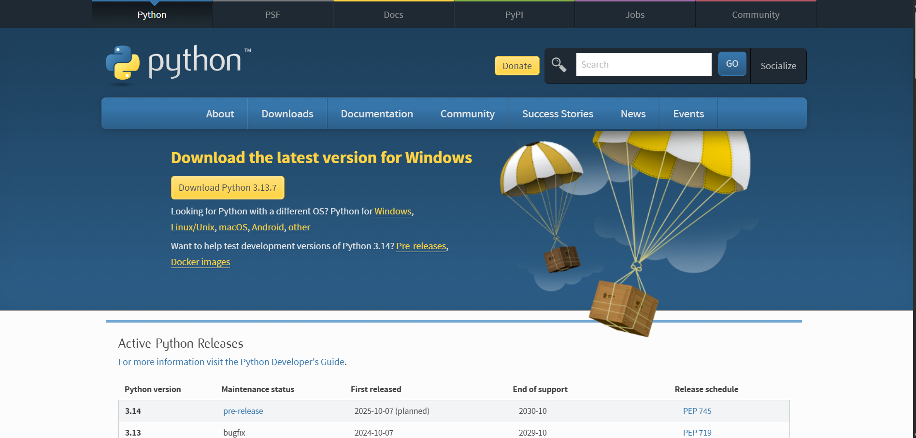
OUR LADY OF THE SACRED HEART COLLEGE OF GUIMBA INC.
Bachelor of science in information technology
Iso 9001: 2015 certified
IPT102- INTEGRATIVE PROGRAMMING AND TECHNOLOGIES 2
ROOTED IN FAITH.
GROUNDED IN EXCELLENCE.

Slide 12
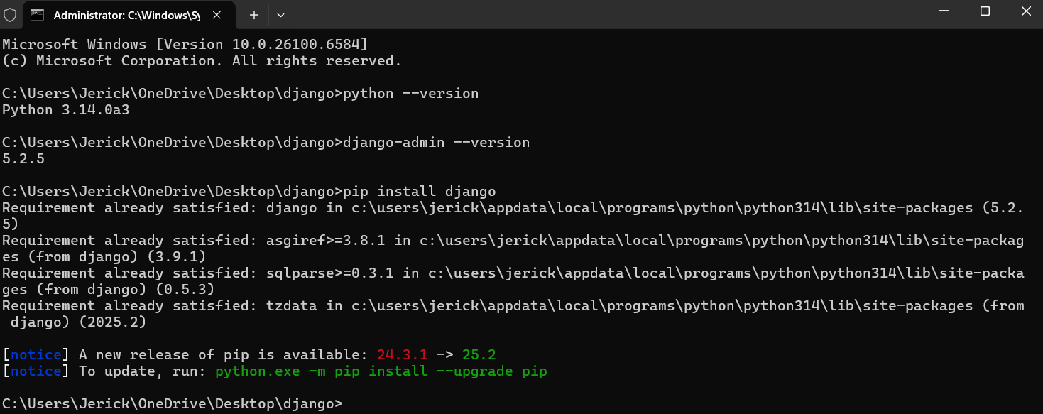
OUR LADY OF THE SACRED HEART COLLEGE OF GUIMBA INC.
Bachelor of science in information technology
Iso 9001: 2015 certified
IPT102- INTEGRATIVE PROGRAMMING AND TECHNOLOGIES 2
ROOTED IN FAITH.
GROUNDED IN EXCELLENCE.

Slide 13
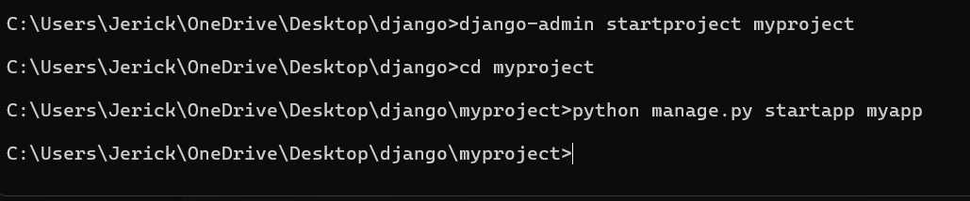
OUR LADY OF THE SACRED HEART COLLEGE OF GUIMBA INC.
Bachelor of science in information technology
Iso 9001: 2015 certified
IPT102- INTEGRATIVE PROGRAMMING AND TECHNOLOGIES 2
ROOTED IN FAITH.
GROUNDED IN EXCELLENCE.

Slide 14
OUR LADY OF THE SACRED HEART COLLEGE OF GUIMBA INC.
Bachelor of science in information technology
Iso 9001: 2015 certified
IPT102- INTEGRATIVE PROGRAMMING AND TECHNOLOGIES 2
ROOTED IN FAITH.
GROUNDED IN EXCELLENCE.

Slide 15
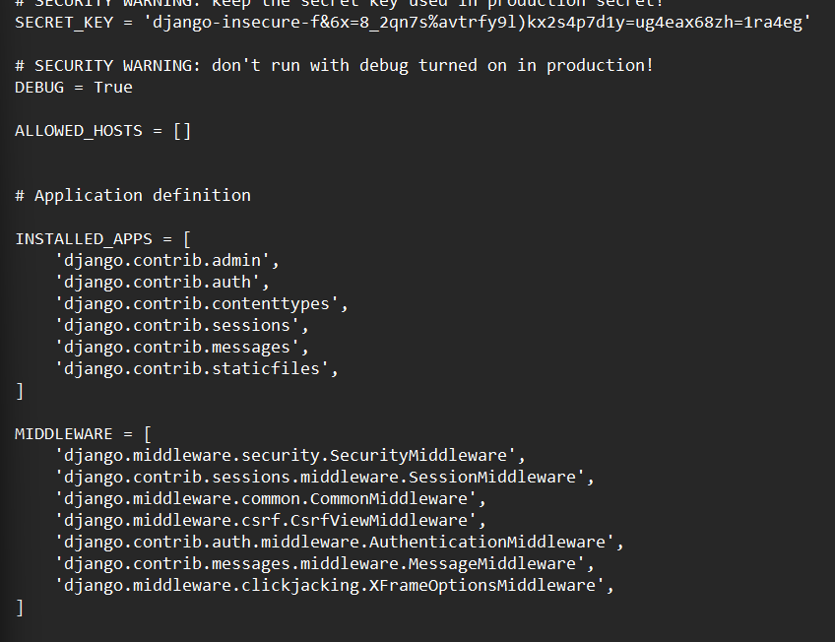
OUR LADY OF THE SACRED HEART COLLEGE OF GUIMBA INC.
Bachelor of science in information technology
Iso 9001: 2015 certified
IPT102- INTEGRATIVE PROGRAMMING AND TECHNOLOGIES 2
ROOTED IN FAITH.
GROUNDED IN EXCELLENCE.

Slide 16
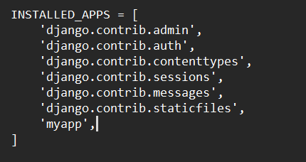
OUR LADY OF THE SACRED HEART COLLEGE OF GUIMBA INC.
Bachelor of science in information technology
Iso 9001: 2015 certified
IPT102- INTEGRATIVE PROGRAMMING AND TECHNOLOGIES 2
ROOTED IN FAITH.
GROUNDED IN EXCELLENCE.

Slide 17
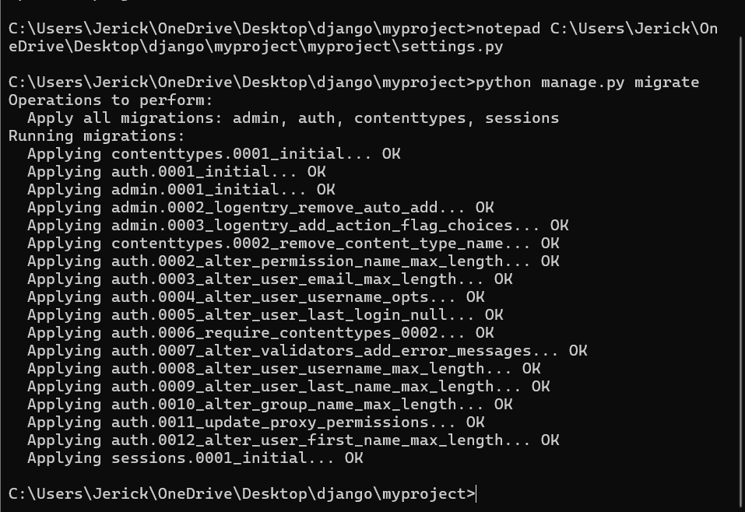
OUR LADY OF THE SACRED HEART COLLEGE OF GUIMBA INC.
Bachelor of science in information technology
Iso 9001: 2015 certified
IPT102- INTEGRATIVE PROGRAMMING AND TECHNOLOGIES 2
ROOTED IN FAITH.
GROUNDED IN EXCELLENCE.

Slide 18
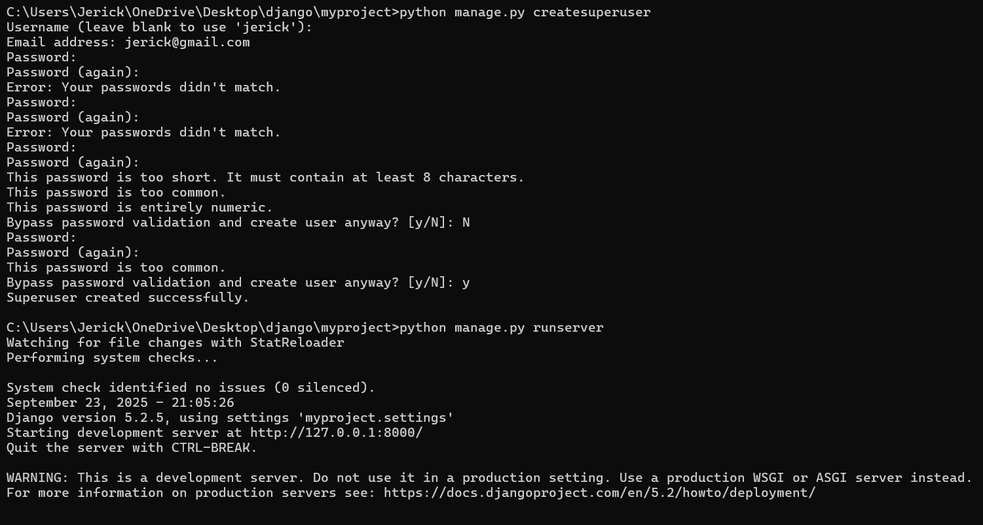
OUR LADY OF THE SACRED HEART COLLEGE OF GUIMBA INC.
Bachelor of science in information technology
Iso 9001: 2015 certified
IPT102- INTEGRATIVE PROGRAMMING AND TECHNOLOGIES 2
ROOTED IN FAITH.
GROUNDED IN EXCELLENCE.

Slide 19
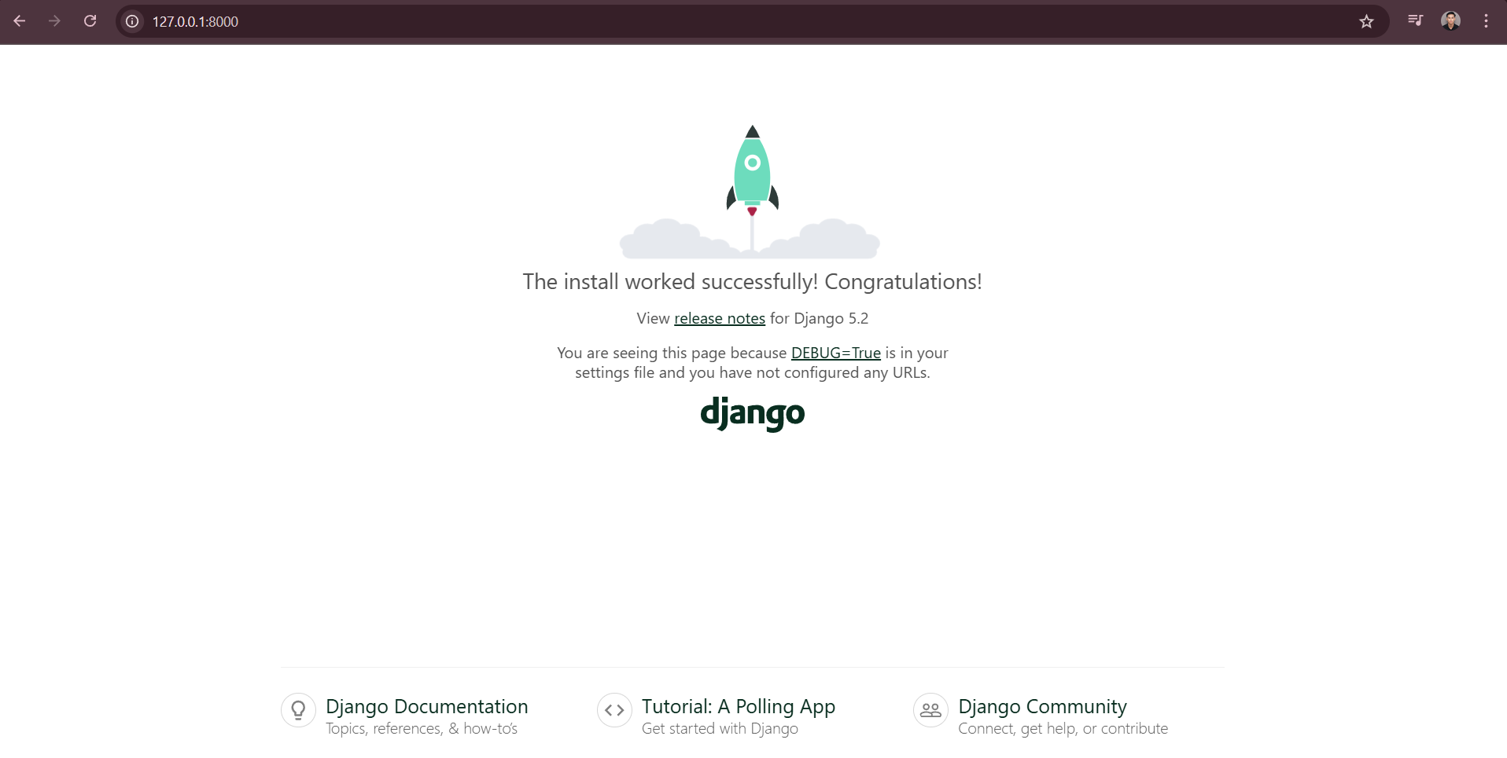
OUR LADY OF THE SACRED HEART COLLEGE OF GUIMBA INC.
Bachelor of science in information technology
Iso 9001: 2015 certified
IPT102- INTEGRATIVE PROGRAMMING AND TECHNOLOGIES 2
ROOTED IN FAITH.
GROUNDED IN EXCELLENCE.

Slide 20
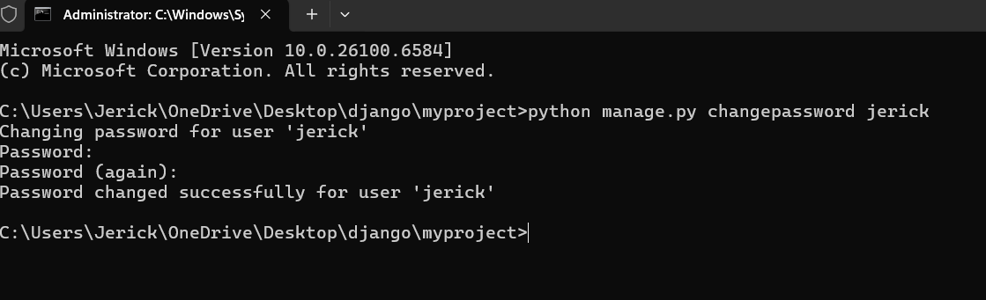
OUR LADY OF THE SACRED HEART COLLEGE OF GUIMBA INC.
Bachelor of science in information technology
Iso 9001: 2015 certified
IPT102- INTEGRATIVE PROGRAMMING AND TECHNOLOGIES 2
ROOTED IN FAITH.
GROUNDED IN EXCELLENCE.

Slide 21
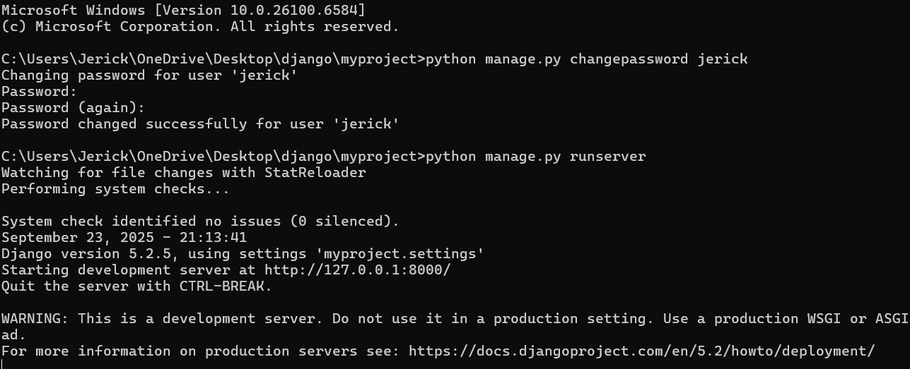
OUR LADY OF THE SACRED HEART COLLEGE OF GUIMBA INC.
Bachelor of science in information technology
Iso 9001: 2015 certified
IPT102- INTEGRATIVE PROGRAMMING AND TECHNOLOGIES 2
ROOTED IN FAITH.
GROUNDED IN EXCELLENCE.

Slide 22
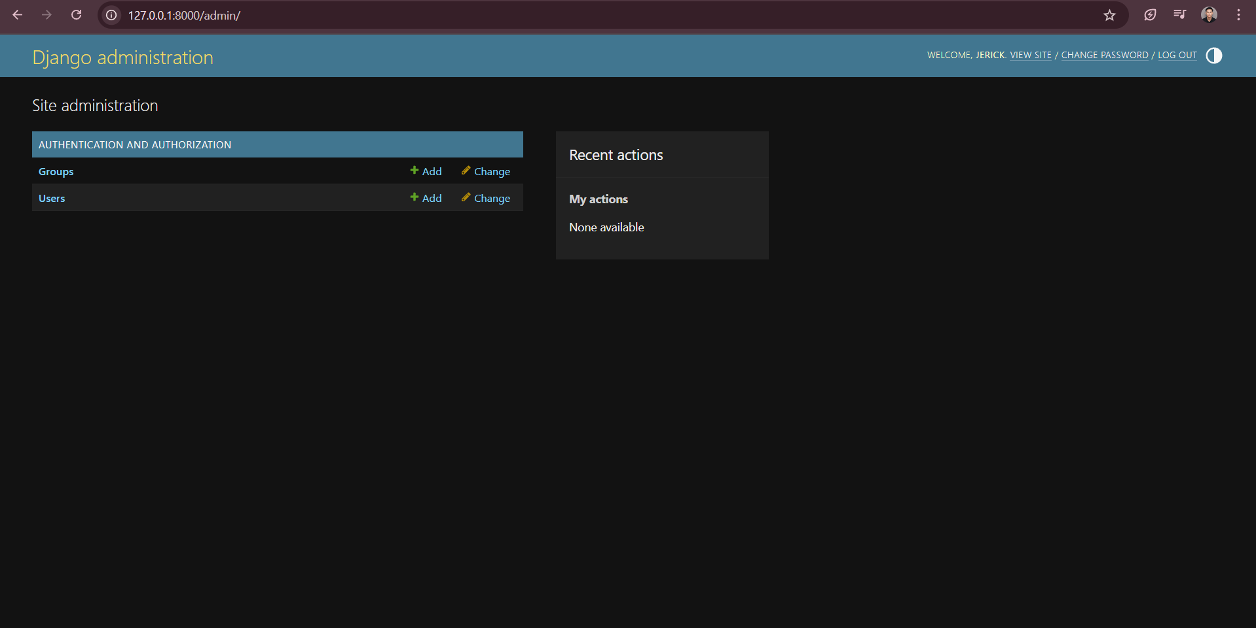
OUR LADY OF THE SACRED HEART COLLEGE OF GUIMBA INC.
Bachelor of science in information technology
Iso 9001: 2015 certified
IPT102- INTEGRATIVE PROGRAMMING AND TECHNOLOGIES 2
ROOTED IN FAITH.
GROUNDED IN EXCELLENCE.

Slide 23
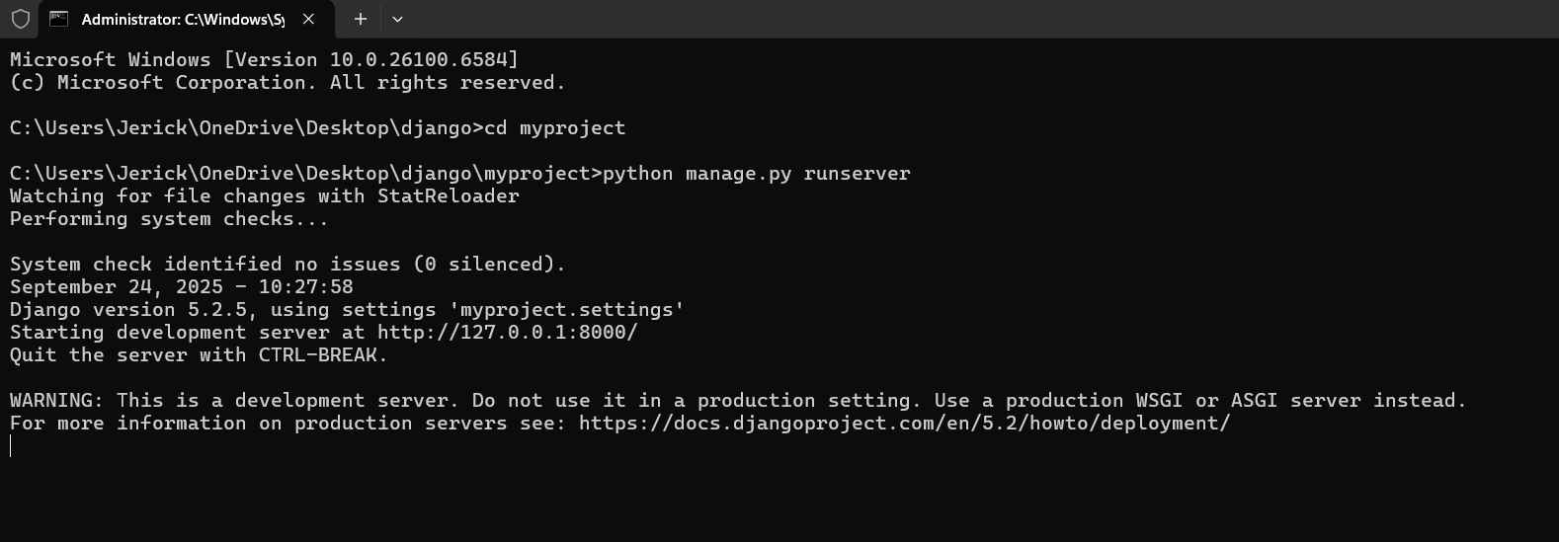
OUR LADY OF THE SACRED HEART COLLEGE OF GUIMBA INC.
Bachelor of science in information technology
Iso 9001: 2015 certified
IPT102- INTEGRATIVE PROGRAMMING AND TECHNOLOGIES 2
ROOTED IN FAITH.
GROUNDED IN EXCELLENCE.

Slide 24
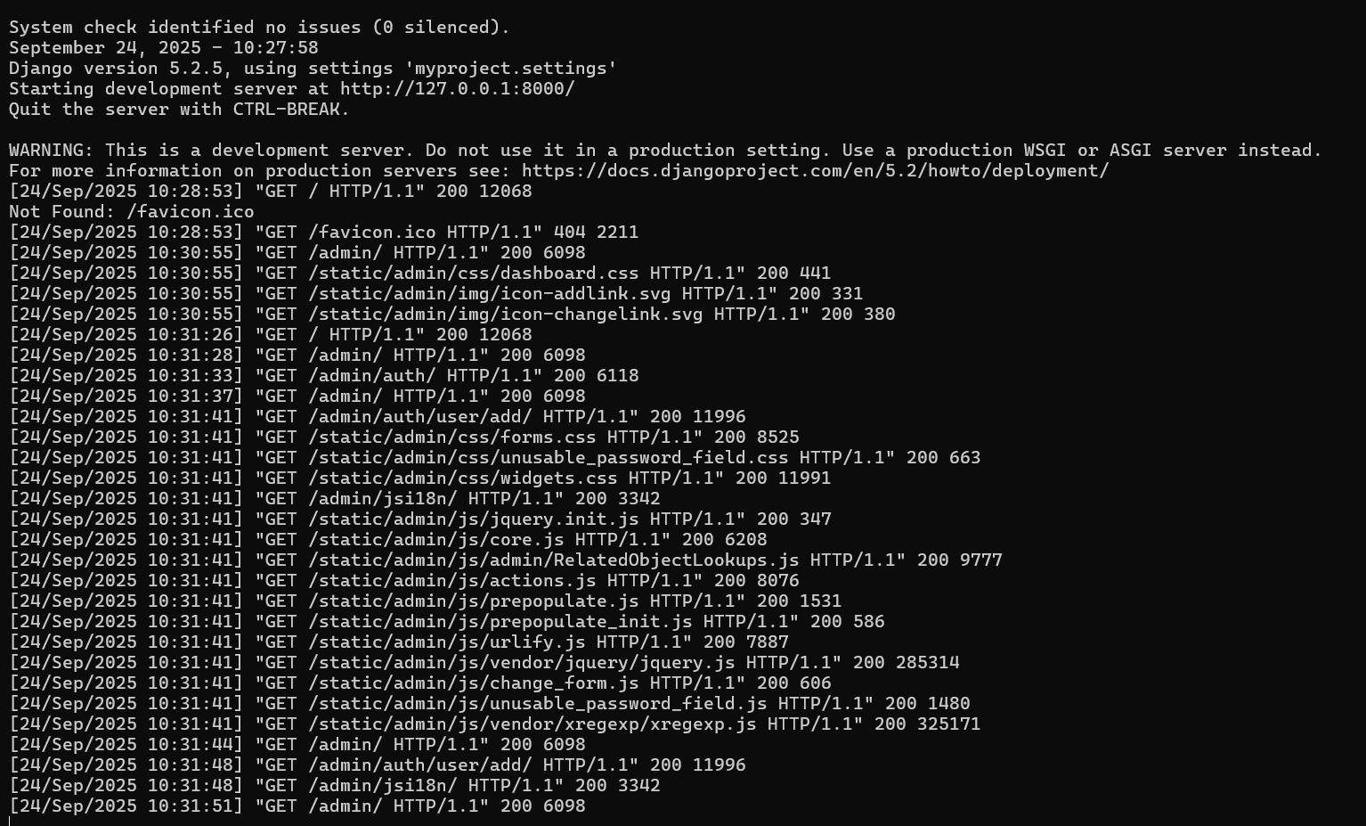
OUR LADY OF THE SACRED HEART COLLEGE OF GUIMBA INC.
Bachelor of science in information technology
Iso 9001: 2015 certified
IPT102- INTEGRATIVE PROGRAMMING AND TECHNOLOGIES 2
ROOTED IN FAITH.
GROUNDED IN EXCELLENCE.

Slide 25
OUR LADY OF THE SACRED HEART COLLEGE OF GUIMBA INC.
Bachelor of science in information technology
Iso 9001: 2015 certified
Home page: http://127.0.0.1:8000/
IPT102- INTEGRATIVE PROGRAMMING AND TECHNOLOGIES 2
ROOTED IN FAITH.
GROUNDED IN EXCELLENCE.

Slide 26
OUR LADY OF THE SACRED HEART COLLEGE OF GUIMBA INC.
Bachelor of science in information technology
Iso 9001: 2015 certified
Admin panel: http://127.0.0.1:8000/admin/
IPT102- INTEGRATIVE PROGRAMMING AND TECHNOLOGIES 2
ROOTED IN FAITH.
GROUNDED IN EXCELLENCE.

Slide 27
OUR LADY OF THE SACRED HEART COLLEGE OF GUIMBA INC.
Bachelor of science in information technology
Iso 9001: 2015 certified
ACTIVITY
Replace Django’s default welcome page with a custom home page. Create a view and corresponding template that display a message such as “Hello World”, and configure the URL routing so that the root URL directs users to this personalized page instead of Django’s default welcome screen.
IPT102- INTEGRATIVE PROGRAMMING AND TECHNOLOGIES 2
ROOTED IN FAITH.
GROUNDED IN EXCELLENCE.

