Slide 1
Asset Pricing Reinforcement Learning Agent
Adversarial-Robust Multi-Head Attention Deep Q-Network (DQN)
AI 894 Capstone Project
Group 2:
Zelalem Abahana

Slide 2
1.1 Introduction
THE CHALLENGE:
  Everyone wants to trade stocks (assets) in some way!(?)
  Markets generate massive, multi-source data in real time.
  Human traders can't process 43+ features across 8 categories simultaneously.
  Traditional models break under adversarial conditions and data corruption.
  Sequential decisions require long-term optimization, not single-step predictions.
WHAT IF an AI Agent:
  could autonomously integrate all this information?
  learned from experience and adapted to market changes?
  remained robust even when attacked or fed corrupted data?
  achieved ~70% annual returns with a 2.88 Sharpe ratio?

Slide 3
1.2 Related Solutions / State of the Art
Statistical Models: ARIMA, GARCH for time series forecasting
  Linear assumptions, can't capture complex patterns
Machine Learning:
  Supervised learning, no sequential decision optimization
Basic RL:
  Single-head attention, struggles with feature interactions
Deep Reinforcement Learning:
  Limited feature interaction modeling, no adversarial robustness
Transformer-based Trading:
  Not integrated with RL, no robustness guarantees
Adversarial ML:
  Gap: Rarely applied to financial AI, often sacrifices performance
Potential Improvements:
Integration of multi-head attention with deep Q-learning
Adversarial robustness specifically designed for financial markets
Agentic AI systems that autonomously process multi-source data
Systems that maintain high performance while being attack-resistant

Slide 4
1.3 Why Agentic AI for Asset Pricing?
A Multi-head Attention Deep Q-network (MHA-DQN) learning agent can address:
  Autonomous decision-making under uncertainty
  Multi-source information integration
  Sequential decision optimization
  Robustness to adversarial conditions
  Continuous learning and adaptation
  Collaborative integration

Slide 5
2.1 Data Sourcing
Alpha Vantage API
  Stock prices, macro indicators, commodities, market indices, forex, crypto
Financial Modeling Prep (FMP) API
  Earnings data, transcripts, financial statements
3. Internal Computation
  Technical indicators, feature engineering
OpenAI GPT API (AI Agent)
  Earnings transcript analysis, sentiment scoring, SEC report summary

Slide 6
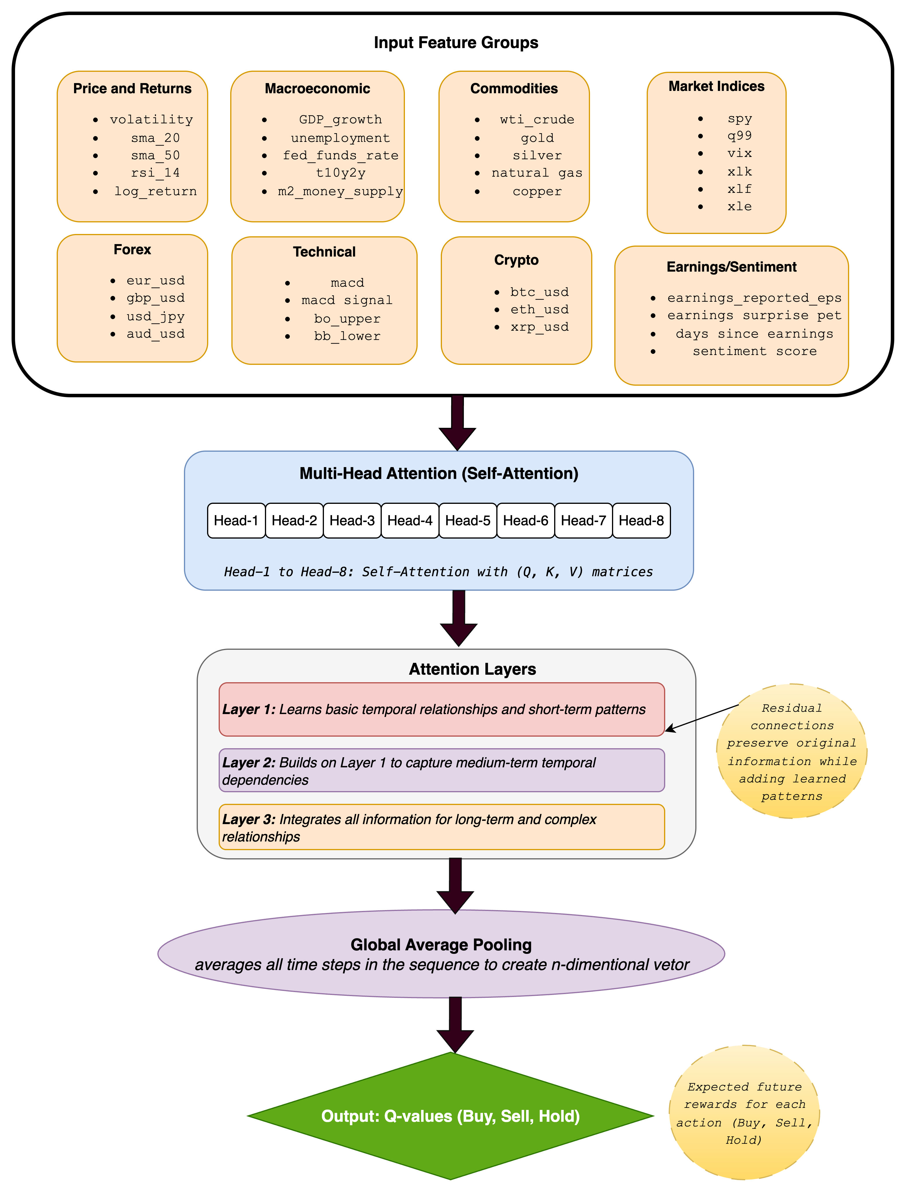
2.2 System Architecture: Multi-Head Attention DQN

Slide 7
2.3 Input Feature Groups
💱 Forex
  EUR/USD, GBP/USD, JPY/USD → reflect global capital flows
  FX strength/weakness impacts multinational earnings
  Serves as a proxy for global macro regime
📐 Technical Indicators
  MACD + signal → trend acceleration
  Bollinger bands → volatility expansion/contraction
  Capture pure price-pattern information independent of fundamentals
₿ Crypto
  BTC, ETH, XRP → high-volatility risk sentiment indicators
  Often lead equity volatility in risk-on/risk-off transitions
📰 Earnings / Sentiment
  Earnings surprise → fundamental mispricing
  Days since earnings → decaying influence of events
  Sentiment score → NLP-derived future-movement predictor
📊 Market Indices
  SPY, QQQ → broad US equity benchmarks
  VIX → real-time measure of market risk
  Sector ETFs (XLK, XLF, XLE) → rotation signals across industries
📈 Price & Returns
  Capture short-term and long-term price dynamics
  Volatility provides regime-shift sensitivity
  Moving averages (sma20/sma50) detect trend shifts
  RSI gauges momentum and overbought/oversold conditions
  Log returns normalize price movements
🏛️ Macroeconomic Indicators
  GDP, unemployment → reflect growth cycles
  Fed funds rate → signals monetary tightening/loosening
  10Y–2Y yield spread → recession predictor
  M2 money supply → liquidity regime indicator
🛢️ Commodities
  Oil, gold, silver → inflation hedge signals
  Natural gas, copper → industrial demand indicators
  Provide macro-sensitive features independent of equities

Slide 8
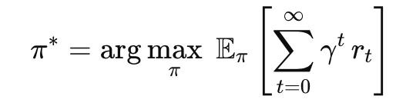
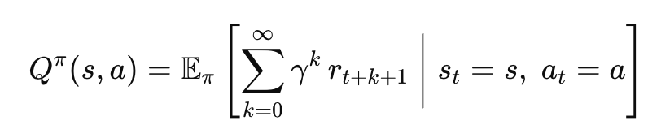
3.1 Deep Q-Network (DQN) Formulation (1)
Markov Decision Process (MDP) Framework:
MDP = (S, A, P, R, γ)
  S: State space (43 features × 20 time steps)
  A: Action space {BUY, HOLD, SELL}
  P: Transition probability P(s'|s,a)
  R: Reward function (portfolio return)
  γ = 0.99: Discount factor
Objective Function:
Q-Function (Action-Value Function):

Slide 9


3.1 Deep Q-Network (DQN) Formulation (2)
Bellman Optimality Equation:
Q-Learning Update Rule:
Loss Function (MSE):

Slide 10
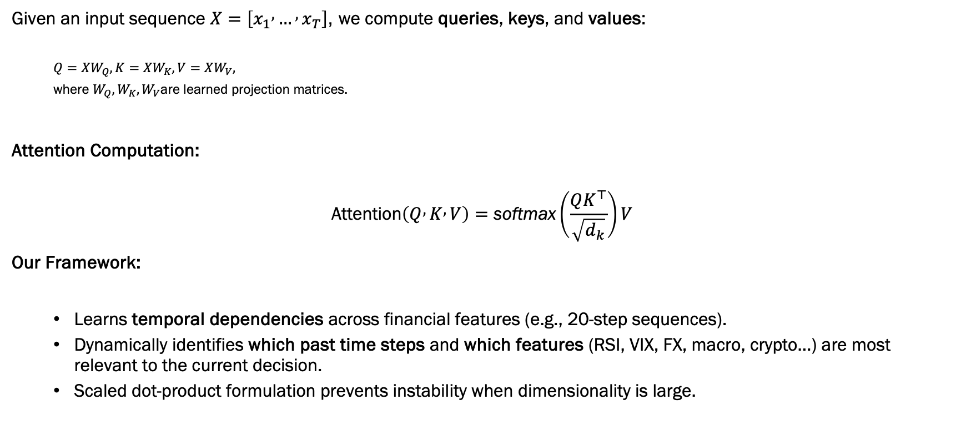
3.2 Self-Attention Mechanism
Given an input sequence $X=\left[x_{1} , … , x_{T}\right]$, we compute queries, keys, and values:
  $$Q=XW_{Q}, K=XW_{K}, V=XW_{V},$$
  where $W_{Q},W_{K},W_{V}$are learned projection matrices.
Attention Computation:
$$\text{Attention}\left(Q , K , V\right)=\text{softmax}\left(\frac{QK^{⊤}}{\sqrt{d_{k}}}\right)V$$
Our Framework:
  Learns temporal dependencies across financial features (e.g., 20-step sequences).
  Dynamically identifies which past time steps and which features (RSI, VIX, FX, macro, crypto…) are most relevant to the current decision.
  Scaled dot-product formulation prevents instability when dimensionality is large.

Slide 11
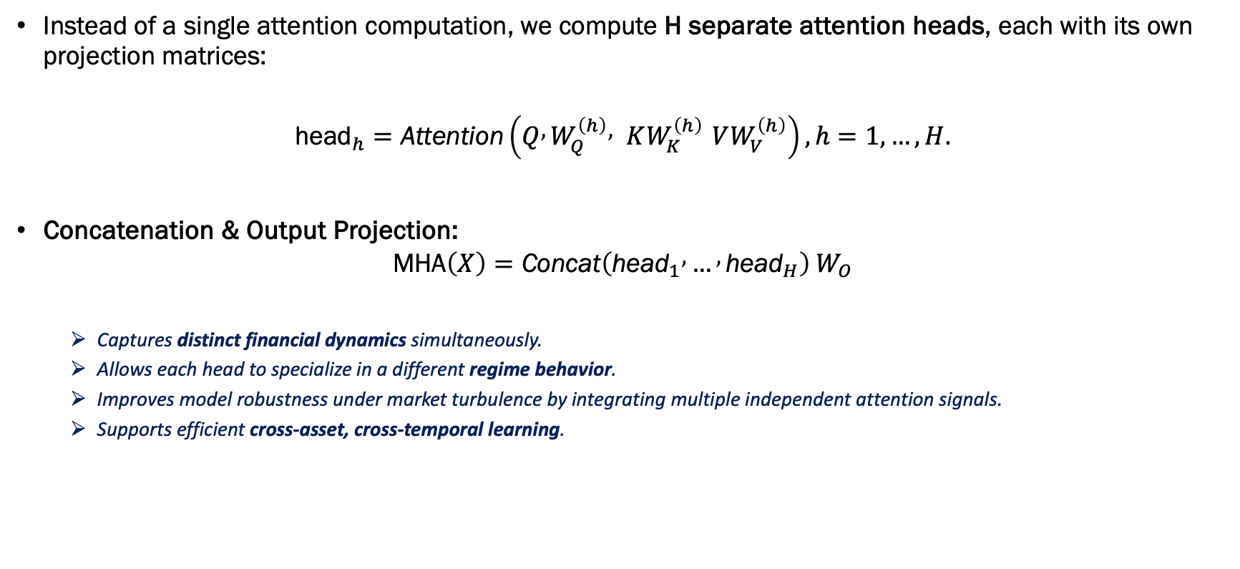
3.3 Multi-Head (Parallel Subspace Attention)
Instead of a single attention computation, we compute H separate attention heads, each with its own projection matrices:
$${\text{head}}_{h}=\text{Attention}\left(Q , W_{Q}^{\left(h\right)} , KW_{K}^{\left(h\right)} VW_{V}^{\left(h\right)}\right), h=1,…,H.$$
Concatenation & Output Projection:
$$\text{MHA}\left(X\right)=\text{Concat}\left({\text{head}}_{1} , … , {\text{head}}_{H}\right) W_{O}$$
  Captures distinct financial dynamics simultaneously.
  Allows each head to specialize in a different regime behavior.
  Improves model robustness under market turbulence by integrating multiple independent attention signals.
  Supports efficient cross-asset, cross-temporal learning.

Slide 12
3.4. 3-Layer Attention Stack
Each layer applies self-attention + residual connections + layer normalization, progressively learning richer temporal and cross-feature patterns.
Layer 1 — Short-Term Pattern Extraction
  Learns immediate temporal dependencies (1–3 day effects).
  Detects fast signals: momentum bursts, volatility spikes, sentiment jumps.
  Provides a “local view” of short-term market behavior.
Layer 2 — Medium-Term Context Modeling
Builds on Layer 1 to capture multi-day relationships.
Learns context such as macro drift, sector rotation, lagged correlations.
Integrates signals across intermediate time horizons.
Layer 3 — Long-Term Structure & Regime Understanding
Aggregates all earlier features to learn market-level structures.
Captures regime changes, volatility cycles, macro trends.
Produces the final high-level representation used for decision-making.
Residual Connections (Across All Layers)
Preserve original feature information while adding learned patterns.
Stabilize gradients and prevent over-smoothing.

Slide 13
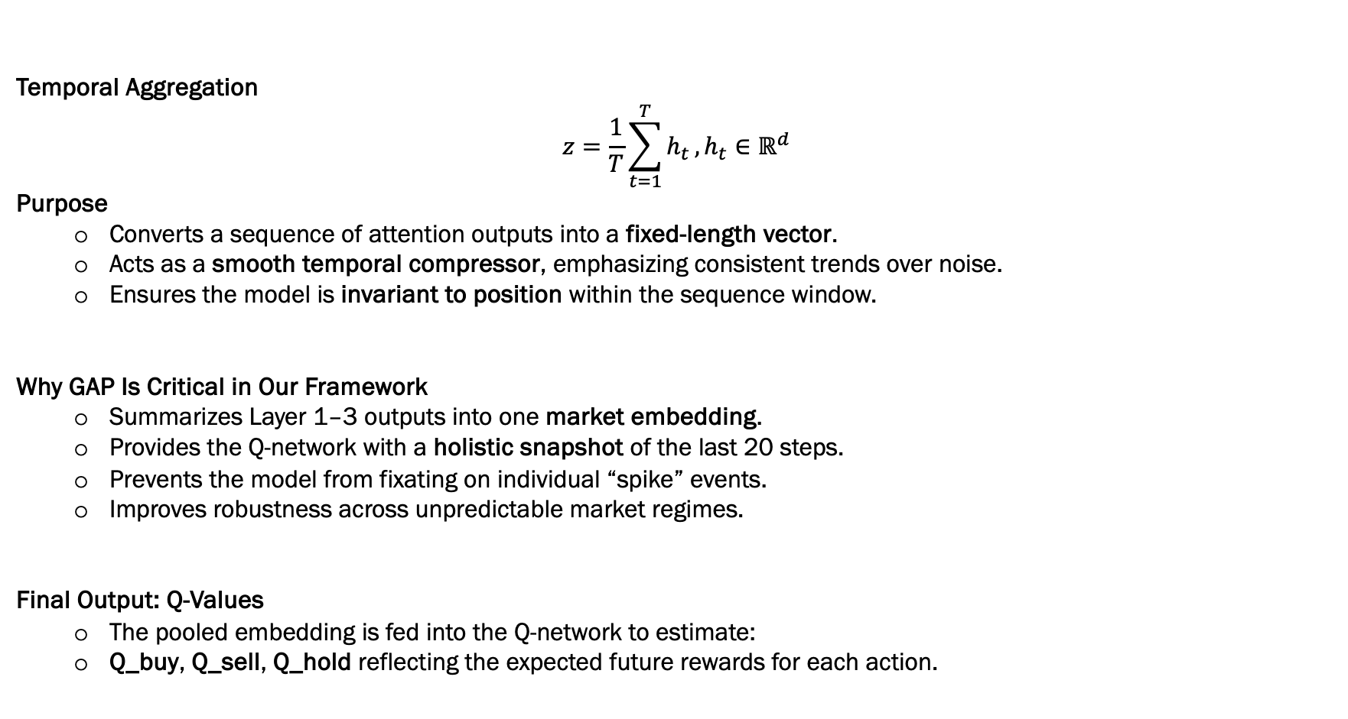
3.5 Global Average Pooling (GAP)
Temporal Aggregation
$$z=\frac{1}{T}\sum_{t=1}^{T}{h_{t}}, h_{t}∈ℝ^{d}$$
Purpose
  Converts a sequence of attention outputs into a fixed-length vector.
  Acts as a smooth temporal compressor, emphasizing consistent trends over noise.
  Ensures the model is invariant to position within the sequence window.
Why GAP Is Critical in Our Framework
  Summarizes Layer 1–3 outputs into one market embedding.
  Provides the Q-network with a holistic snapshot of the last 20 steps.
  Prevents the model from fixating on individual “spike” events.
  Improves robustness across unpredictable market regimes.
Final Output: Q-Values
  The pooled embedding is fed into the Q-network to estimate:
  Q_buy, Q_sell, Q_hold reflecting the expected future rewards for each action.

Slide 14
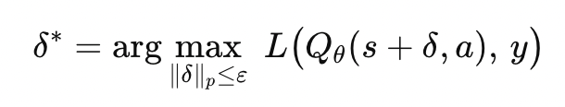
3.6 Adversarial Attacks
Threat Model:
Find perturbation δ such that:
1. FGSM (Fast Gradient Sign Method):
  A single, quick shove that pushes the model in the direction it is easiest to fool.
  A tiny decrease in RSI and a tiny increase in MACD tricks the model into flipping META from BUY → SELL.
2. PGD (Projected Gradient Descent):
  repeated many times, each step making the deception stronger — like several small nudges until the model loses balance.
  Several micro-adjustments to volatility, sentiment, and FX inputs over 10 steps slowly push the Q-network into predicting SELL instead of BUY.
3. C&W (Carlini & Wagner):
  A stealth attack that finds the smallest possible change that still fools the model
  A microscopic tweak to RSI (<0.01) and sentiment (+0.004) that no human would notice causes the model to switch from HOLD → BUY.
4. Deep Fool:
  DeepFool walks directly toward the model’s decision boundary, until it finds the exact point where the model changes its mind — the “closest edge” method.
  DeepFool finds the minimum shift in VIX and MACD that moves the agent exactly across the Buy/Hold boundary, causing an unintended SELL.

Slide 15
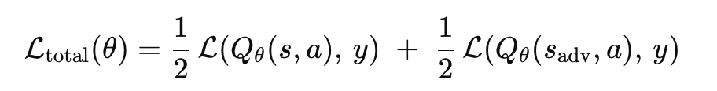
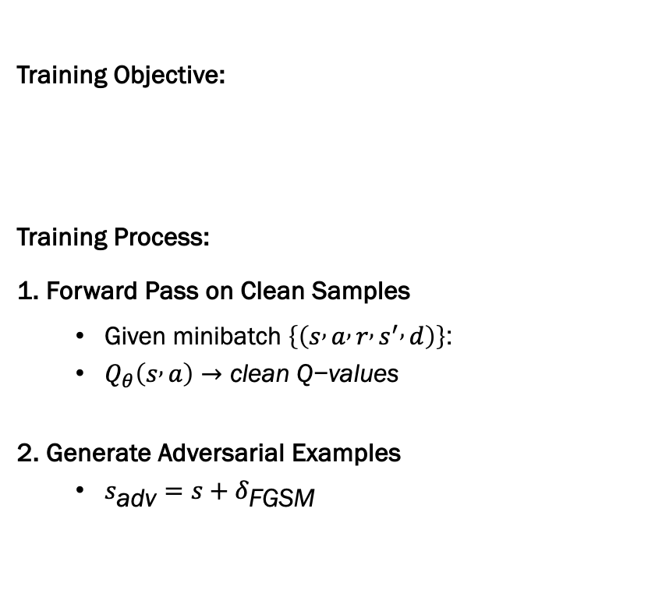
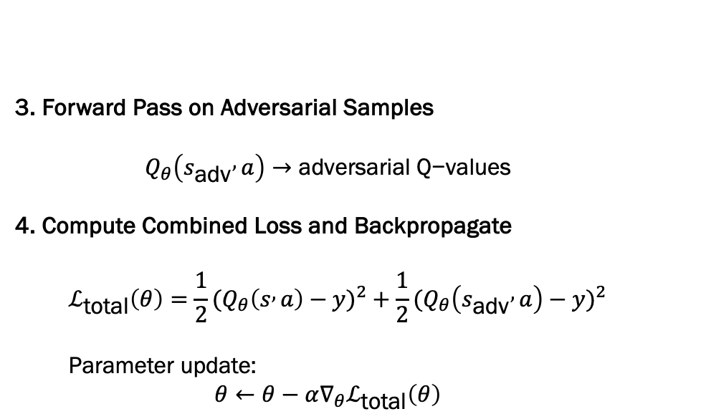
3.7 Adversarial Training: Building Robust Models
Training Objective:
Training Process:
1. Forward Pass on Clean Samples
  Given minibatch $\left\{\left(s , a , r , s^{′} , d\right)\right\}$:
  $Q_{θ}\left(s , a\right)→\text{clean} \text{Q}\text{−}\text{values}$
2. Generate Adversarial Examples
  $s_{\text{adv}}=s+δ_{\text{FGSM}}$
3. Forward Pass on Adversarial Samples
  $$Q_{θ}\left(s_{\text{adv}} , a\right)→\text{adversarial} \text{Q}\text{−}\text{values}$$
4. Compute Combined Loss and Backpropagate
  $$ℒ_{\text{total}}\left(θ\right)=\frac{1}{2}(Q_{θ}\left(s , a\right)−y)^{2}+\frac{1}{2}(Q_{θ}\left(s_{\text{adv}} , a\right)−y)^{2}$$
  Parameter update:
  $$θ←θ−α∇_{θ}ℒ_{\text{total}}\left(θ\right)$$

Slide 16
4. Performance Measurements
RISK-ADJUSTED RETURN METRICS:
  1. Sharpe Ratio:
    Measures risk-adjusted return
  3. Maximum Drawdown:
    Largest peak-to-trough decline
RETURN METRICS:
  4. CAGR (Compound Annual Growth Rate):
    Annualized return over period
  5. Total Return:
    Overall portfolio appreciation
TRADING PERFORMANCE METRICS:
  6. Win Rate:
    Percentage of profitable trades
  7. Number of Trades:
    Total trading actions executed
    Measures trading frequency
ROBUSTNESS METRICS:
  8. Robustness Score:
    Formula: R_index = 1 - (Δ_performance / Performance_clean)
    Measures performance degradation under attack
    Range: 0-1 (1.0 = perfect robustness)
  9. Adversarial Resistance:
    Percentage: 100% - Performance_Degradation%
    Measures resistance to attacks (FGSM, PGD, BIM, C&W)
    Example: 100% resistance = No performance loss under attack

Slide 17
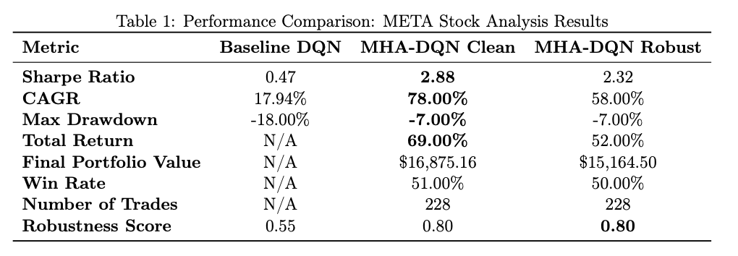
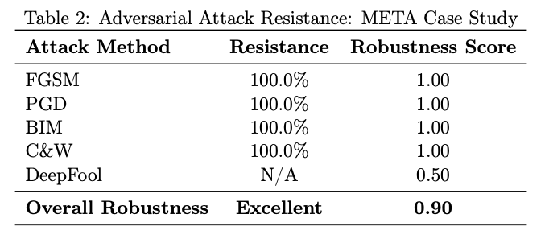
5. Outcome/findings
MHA-DQN Clean Model: Achieved 2.88 Sharpe ratio and 78% CAGR on META stock:
  69% total return ($10,000 → $16,875) over 229 days with only -7% maximum drawdown.
Multi-Head Attention:
  Sharpe and CAGR improvement over baseline DQN
Adversarially-trained model:
  2.32 Sharpe ratio while achieving 100% resistance to FGSM, PGD, BIM, and C&W attacks, validating robust performance.
Risk reduction in maximum drawdown:
  combined with exceptional returns demonstrates superior risk-adjusted performance

Slide 18
Demo https://github.com/zabahana/adversarial-asset-pricing-ai-etrade-ui

Slide 19
5. Asset Pricing Agent Achievements
1. Observed Environment
  continuously monitors market data, prices, indicators
  Fetches real-time data from multiple APIs
2. Made Autonomous Decisions
  Analyzes 43 features across 8 groups using MHA-DQN
  Selects optimal action: BUY/HOLD/SELL
3. Suggested Actions
  Suggests trades based on Q-values and sentiment analysis signals
4. Learned from Experience
  Updates Q-function based on rewards
  Adapts strategy to market conditions
5. Collaborated with Other AI Systems
  Uses OpenAI GPT for earnings call analysis
  Integrates sentiment analysis from NLP models

