Slide 1
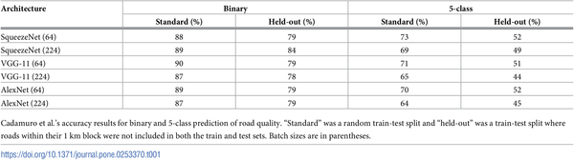

Table 1. Cadamuro et al. results.
Brewer E, Lin J, Kemper P, Hennin J, Runfola D (2021) Predicting road quality using high resolution satellite imagery: A transfer learning approach. PLOS ONE 16(7): e0253370. https://doi.org/10.1371/journal.pone.0253370
https://journals.plos.org/plosone/article?id=10.1371/journal.pone.0253370

