Slide 1

Data Science Bootcamp
Chest CT scan images classification for Diagnosis of lung cancer
Zahra ZABIHINPOUR
Notes:
this project is about Chest CT scan images classification using deep learnings method and deploying an application for that

Slide 2

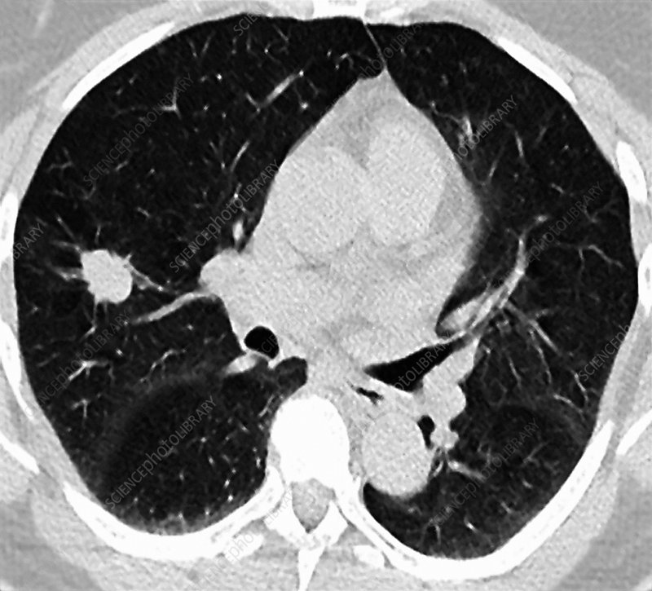
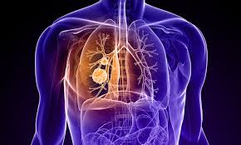
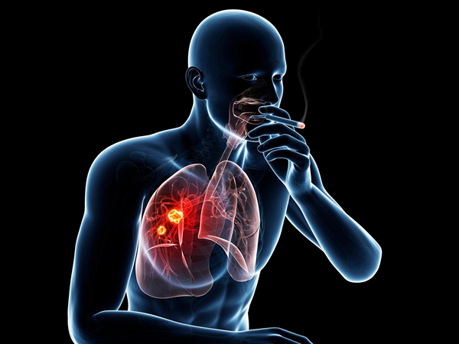
Reasons for the importance of this project
Lung cancer is the 2nd most common cancer worldwide. It is the most common cancer in men and the 2nd most common cancer in women.
Lung cancer is the biggest cancer killer in Europe, accounting for approximately 20% of total cancer deaths
According to the latest WHO data published in 2020 Lung Cancers Deaths in France reached 35,657 or 7.46% of total deaths. The ranks of France is 19 in the world
Diagnosis:
Chest CT Scan and Chest X-rays
A CT scan is more likely to show lung tumors than routine chest x-rays. It can also show the size, shape, and position of any lung tumors
Early diagnosis of cancer provide the best chance for successful treatment
Notes:
Why this project is important?
Therefore, having an application that can easily and quickly diagnose a tumor will really important
Early diagnosis of cancer provide the best chance for successful treatment

Slide 3
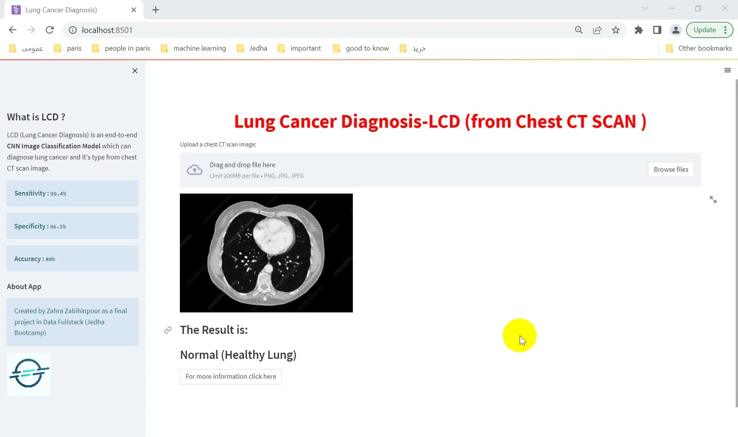
Deployment
with Streamlit
Notes:
Before I go any further, I want to show you how this app is like
this application works really easily and quick
we just need to upload an image to the app and the program determines whether the lung tissue is healthy or there is tumor cancer,
It can also with a high accuracy diagnose the type of cancer as you see

Slide 4
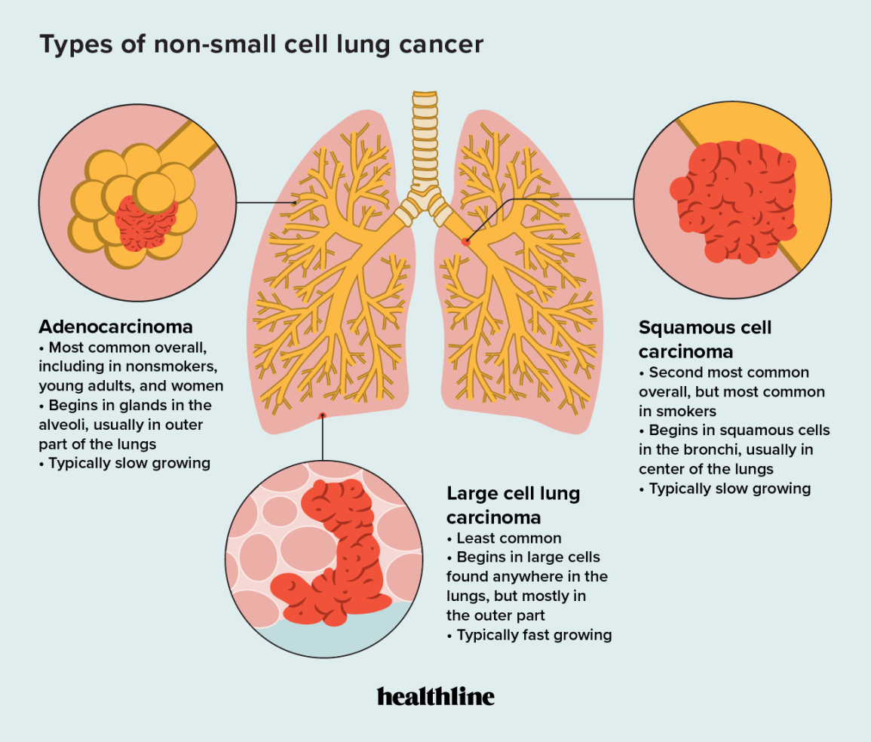
What is this project about?
Type of Data and the Source?
What is the Goal?
Lung Cancer
15%
Small Cell Lung Cancer
85%
Non-Small Cell Lung Cancer
Adenocarcinoma
Squamous Cell Carcinoma
Large Cell Carcinoma.
Data set come from Kaggle website and the data are collected by MOHAMED HANY
Notes:
There are two main types of lung cancer that are treated very differently
non-small cell lung cancer are more common
It has3 sub types which are adenocarcinoma, squamous cell carcinoma, and large cell carcinoma
The Data set come from Kaggle website and the data are collected by MOHAMED HANY
The data are radiography images in the format jpg or png

Slide 5
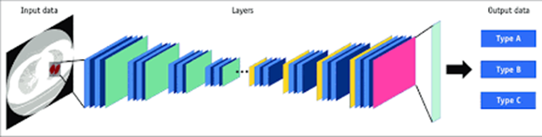
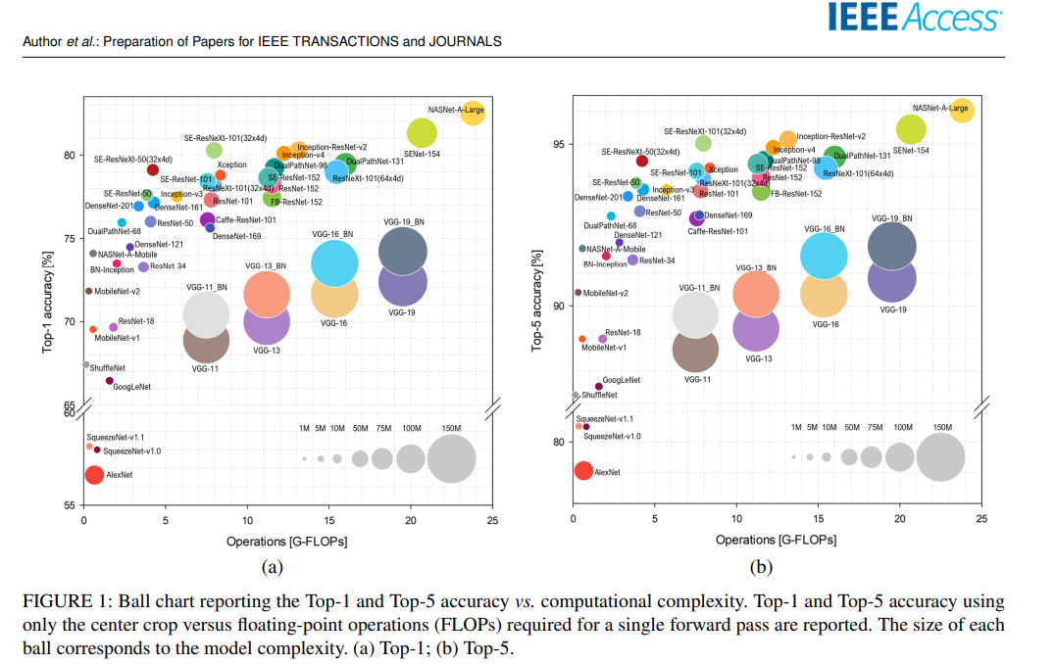
Data Collection
Select the base line model
Train the model and evaluate
Tune the hyper parameters
Build the Web App
Notes:
we have an image classification problem and In general convolutional neural network is suitable model for that
But the problem is we have about 600 labeled images in training folder which is not enough to train a good model with CNN
) but thanks to transfer learnings , we can train our dataset perfectly.
Transfer learning allows us to use an existing model by modifying it to a new case.
so
First of all we should do some preprocessing (like Image Data Augmentation and Rescaling )
Select the base model of transfer learning and re define the final layer according to our problem , compile the model and finally do fine tuning
But the first question is
there are very different model, how can we choose some of them?
A model with high accuracy , low operation and low complexity is optimum
The intuition behind transfer learning for image classification is that if a model is trained on a large and general enough dataset, this model will effectively serve as a generic model of the visual world.

Slide 6
Model Evaluation:
Sensitivity :99.4%
Specificity :96.3%
Accuracy :80%
Base model: Inception Optimizer: RMSprop |  | Real
 |  | Adenocarcinoma | Squamous Cell Carcinoma | Normal | Large Cell Carcinoma.
Predict | Adenocarcinoma | 88 | 1 | 13 | 18
 | Squamous Cell Carcinoma | 11 | 35 | 0 | 5
 | Normal | 1 | 1 | 52 | 0
 | Large Cell Carcinoma. | 9 | 5 | 0 | 86
Notes:
. By looking at confusion matrix I found out that
Actually all the model could diagnose cancer lung from healthy lung very well
But These changes in results and accuracy are more about diagnosing the type of cancer
I also did some search in the literature to find which base model has a better performance for radiography image classification
Here I try 3 different base model resnet, inception and xception
Then I try to find best score by changing the hyperparametrs like optimization method , number of epoch and the effect of using class weight for training
And after all of calculations , I find out that using Inception as base model and RMSprop optimizer leading a really good performance

Slide 7
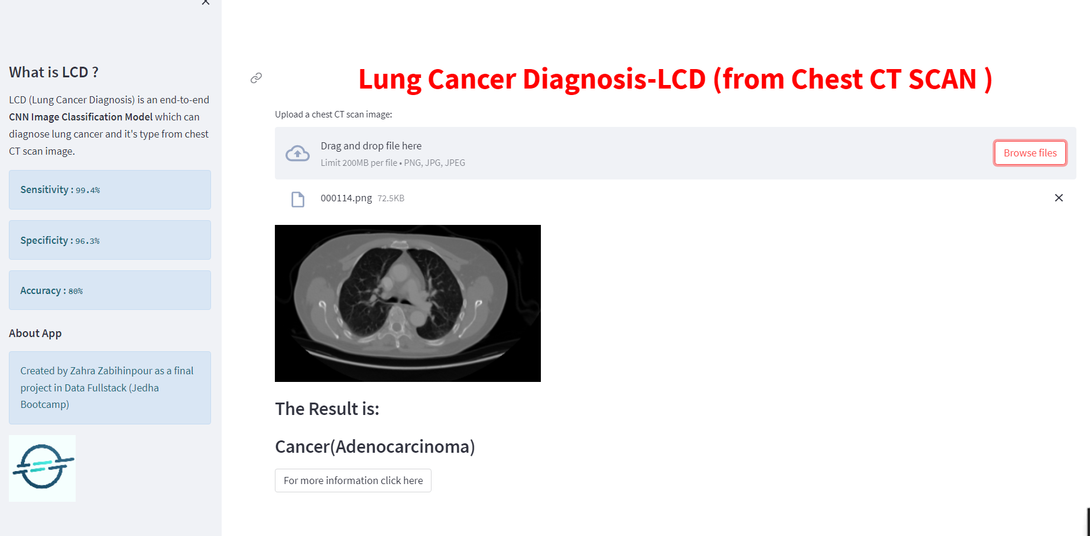
This data set does not contain the CT scan images for the small lung cancer.
More hyper parameter can be try to find the better result
What is Next Steps?
Notes:
This data set does not contain the ct scan images for the small lung cancer. If they add to this data, we will have a full app for detecting lung cancer
The more hyper parameter can be try to find the better result.

Slide 8


Special Thanks to Jedha

