Slide 1

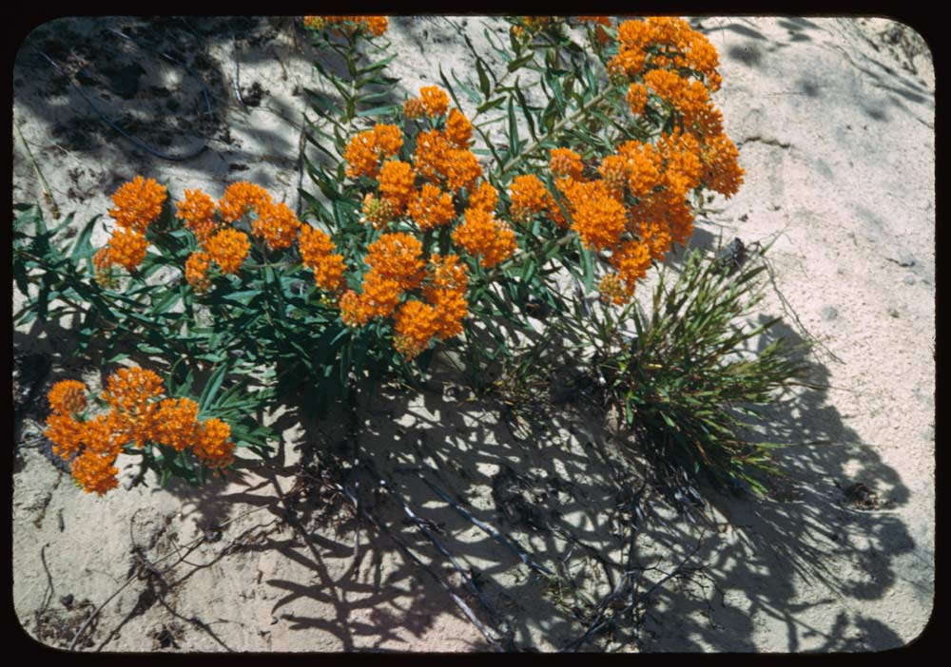
Beverly Shores, Indiana
Carla Beard

Slide 2
One of my descriptive words was floral.
Synonyms for floral include these:
blooming
blossoming
flower-patterned
sylvan
verdant

Slide 3
I chose verdant, which means
green in tint or color <verdant grass>
green with growing plants <verdant fields>

Slide 4
Model Sentence #1
  Drab in winter, then suddenly sodden with alpine runoff, the region turns dazzlingly verdant in spring.
  -- Patricia Albers, Shadows, Fire, Snow

Slide 5
Model Sentence #2
Do you know that charming part of our country which has been called the garden of France - that spot where, amid verdant plains watered by wide streams, one inhales the purest air of heaven?
-- Alfred de Vigny

Slide 6
My Sentence
Even a sandy dune can be verdant with wildflowers.

Slide 7
Sources Used
Charles W. Cushman Photograph Collection, http://webapp1.dlib.indiana.edu/cushman/
Thesaurus.com, http://thesaurus.reference.com/browse/verdant
Merriam-Webster.com, http://m-w.com/dictionary/verdant
Dictionary.com Word of the Day, http://dictionary.reference.com/wordoftheday/archive/2003/03/17.html
Brainy Quote.com, http://www.brainyquote.com/quotes/quotes/a/alfreddevi317458.html

