Slide 1
Automated Build, Flash & Test
A CLI- and logic-analyzer-driven workflow on the PIC16F13145 Curiosity Nano
Martin Ruppert | Microchip
2026-06-14

Slide 2
What We Built
Firmware — a UART console controlling two hardware PWM channels
PIC16F13145 Curiosity Nano, PWM1->RC0, PWM2->RC1 (Timer2)
Commands: help / version / reset / pulse freq|duty|on|off|status
Line editor with cursor, mid-line edit and 10-command history
Build-timestamp banner identifies the running firmware
Tooling — the whole loop runs from the command line
build.bat (CMake+Ninja+XC8), flash.py (MPLAB MDB)
smoketest.py, freq_sweep.py, duty_sweep.py (Saleae-verified)

Slide 3
Manual vs. Automated
The same edit-build-flash-measure loop, by hand versus one command.
Manual (IDE + scope by eye)
Automated (CLI + logic analyzer)
• Click Build, click Program in the IDE
• Open a terminal, type commands by hand
• Read a scope, eyeball frequency and duty
• Slow, subjective, not repeatable, no record
• build.bat -> flash.py -> smoketest.py
• Host scripts drive the console over USB CDC
• Saleae measures the real pins; pass/fail in code
• Fast, objective, reproducible, CSV + plots archived
One scripted pipeline replaces a dozen manual clicks and a pair of eyes.

Slide 4
The Automated Pipeline
1. Build
2. Flash
3. Run
4. Verify
build.bat drives the CMake preset + Ninja with the XC8 toolchain.
flash.py drives the MPLAB MDB to program the HEX over ICSP.
The target boots and exposes its CLI over the virtual COM port.
Host scripts set PWM via the CLI and measure it with the Saleae.
Edit a line of C and one command later you have a pass/fail with plots.

Slide 5
1. Build from the CLI — build.bat
build.bat :: configure (if needed) + build
build.bat rebuild :: clean, then build
build.bat clean :: remove build tree + output
=== Build finished ===
Output: out\Loop\default.elf (+ default.hex)
Program space 76.0% Data space 75.7%
• Wraps the generated CMake preset and Ninja — no IDE needed.
• XC8 is referenced by absolute path, so it need not be on PATH.
• Returns a non-zero exit code on failure — CI-friendly.

Slide 6
2. Flash from the CLI — flash.py (MPLAB MDB)
python flash.py # program out\Loop\default.hex, then run
python flash.py --list # list detected debuggers
[LOOP] MDB << program "out\Loop\default.hex"
[LOOP] MDB >> Program succeeded.
[LOOP] SUCCESS: Device programmed; target running.
• Drives mdb.bat (Microchip Debugger Backend) as a subprocess.
• Auto-selects the on-board pkobnano debugger and programs over ICSP.
• Releases the target so it runs immediately — no IDE in the loop.

Slide 7
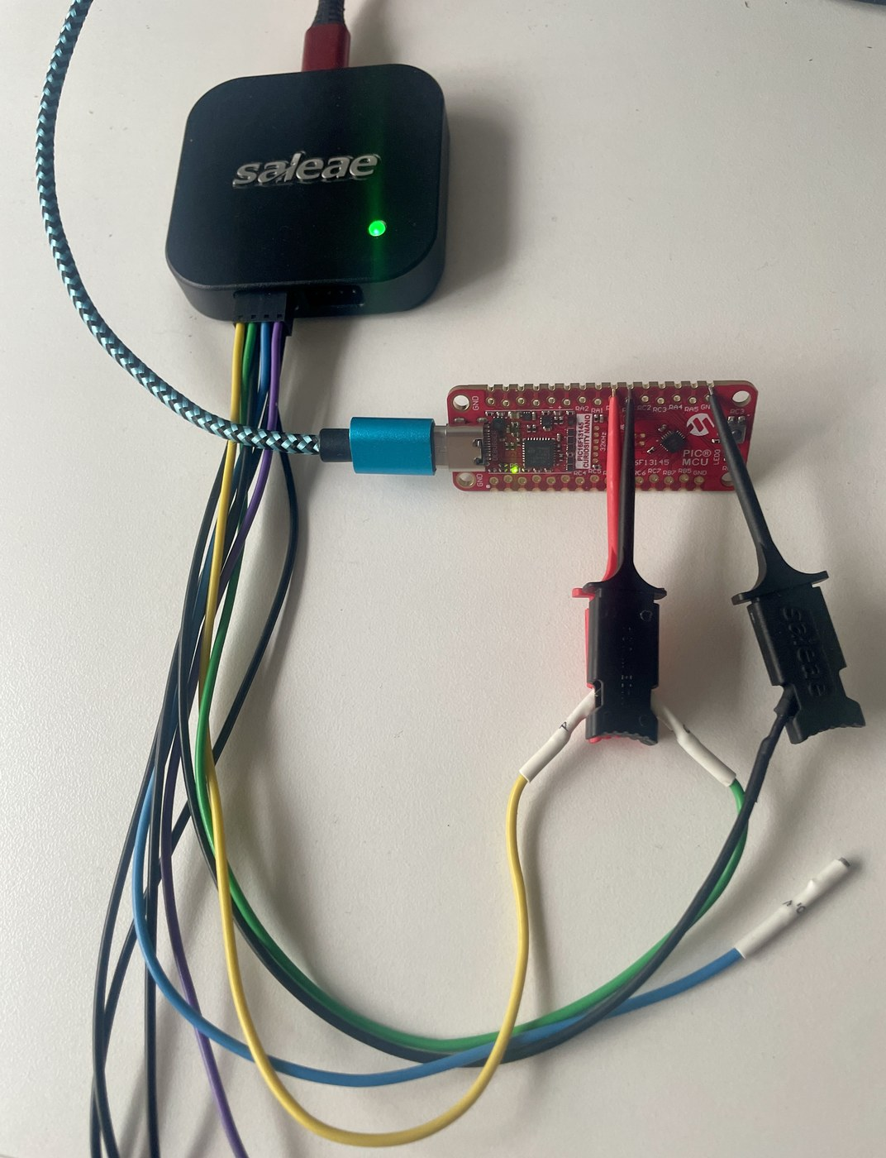
Hardware-in-the-Loop Test Setup
PIC16F13145 RC0 / RC1 PWM
Saleae Logic 8 ch0 / ch1
Logic 2 automation API
digital.csv raw export
Python edge analysis
PASS / FAIL + plot
• Measurement path: the PWM pins are sampled directly by the analyzer.
• Control path: commands go to the CLI over USB CDC (COM12).
• One host process orchestrates both the serial console and the capture.
Real HIL bench: Saleae Logic + PIC16F13145 Curiosity Nano

Slide 8
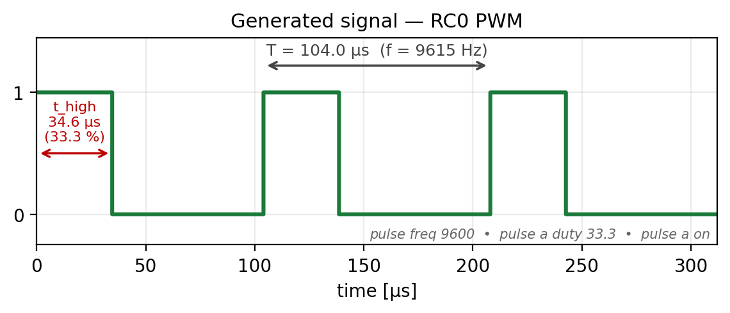
The CLI Under Test
COM12 - 115200 baud 8N1
– □ ×
> version
Loop firmware | build Jun 14 2026 00:13:01
> pulse freq 9600
Frequency -> 9615.384 Hz (requested 9600)
> pulse a duty 33.3
Duty A -> 33.293 % (requested 33.3)
> pulse a on
Signal A -> ON
> pulse status
Frequency = 9615.384 Hz (shared)
A (RC0): ON, duty 33.293 %
> █
• Floating-point input; the device echoes the quantised actual value.
• Scripts parse these replies as the expected reference for each test.

Slide 9
3. Verify — smoketest.py drives CLI + Saleae
console.cmd(f"pulse freq {f}") # set via the CLI
console.cmd(f"pulse a duty {da}")
console.cmd("pulse a on")
cap = manager.start_capture(...) # Saleae timed capture
cap.export_raw_data_csv(out_dir) # -> digital.csv
m = analyze_digital_csv("digital.csv", ch=0)
assert abs(m.freq - f) < f * 0.03 # 3% (HFINTOSC)
assert abs(m.duty - da) < 2.0 # 2 percentage points
• Frequency from the median of rising-edge intervals.
• Duty from high-time / period; a disabled channel must read low.

Slide 10
Smoke-Test Results
Test cases 4/4 PASS
Freq deviation < 0.5 %
Duty deviation < 0.05 pp
Verdict PASS
• Cases: 1 kHz, 5 kHz, 20 kHz at various duties + one disabled channel.
• Measured duty matched the firmware's quantised values exactly.
• Frequency offset is the internal HFINTOSC (+/-2%), well inside tolerance.

Slide 11
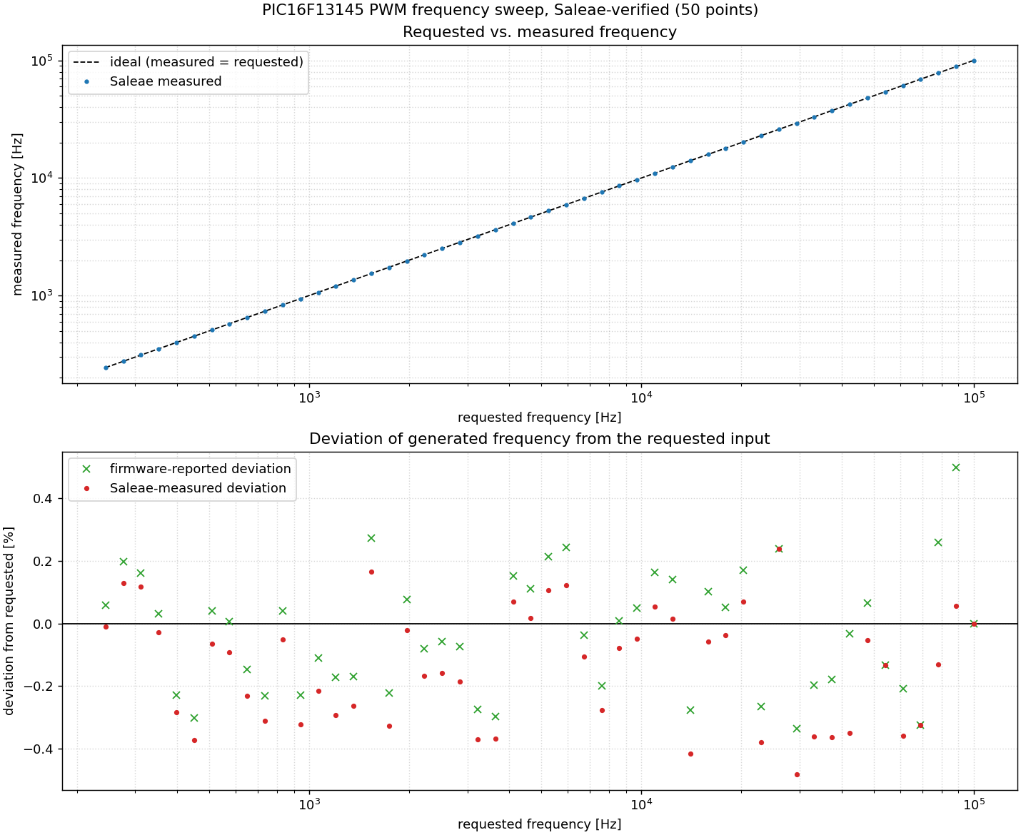
Frequency Sweep — Saleae-Verified
• Every requested frequency is set, captured and measured on RC0.
• Top: requested vs. measured (on the ideal line). Bottom: deviation.
• Deviation = quantisation of the integer Timer2 divider (< 0.5%).

Slide 12
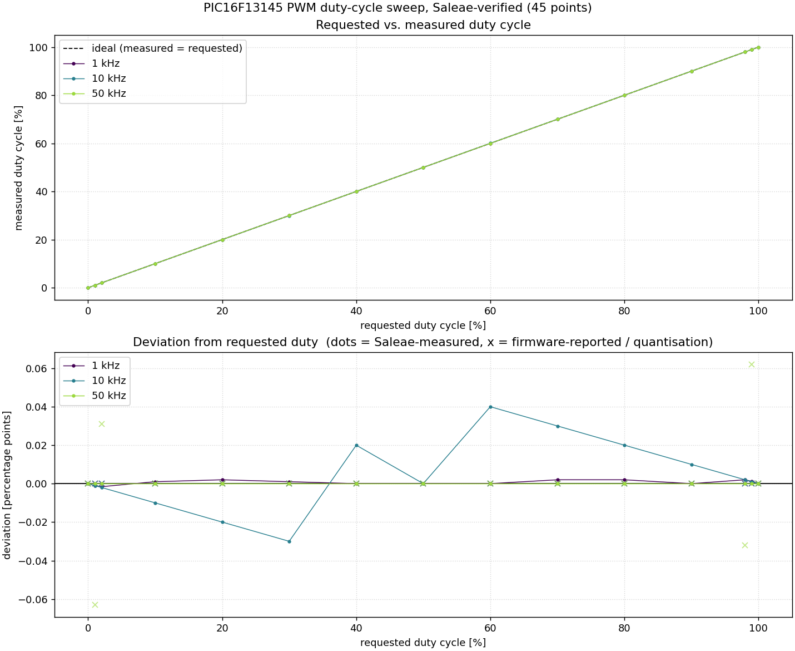
Duty-Cycle Sweep across Frequencies
• Duty 0..100% swept at 1 / 10 / 50 kHz, each point Saleae-measured.
• Resolution (4*N steps) gets coarser as the frequency rises.
• Dots = measured, x = firmware-reported quantisation.

Slide 13
Interpreting the Results — Quantisation vs. the Real World
Two deviations per point — firmware vs. requested = quantisation; measured vs. firmware = oscillator + measurement.
Frequency
Duty cycle
• Firmware vs. requested = integer-divider quantisation (15321 -> 15267 Hz)
• Measured vs. firmware = a consistent -0.1...-0.15 %
– That offset is the HFINTOSC running slightly slow (inside its +/-2 % spec)
• Saleae is accurate here: per-edge +/-100 ns averages over many cycles
• It only limits above ~100-200 kHz, as samples/period approach the rate
• Firmware quantises to 4N steps — at 50 kHz that is 0.156 pp/step
• Saleae duty resolution = frequency / sample_rate (one sample per period)
– 50 kHz @ 10 MS/s -> 0.5 pp, coarser than the firmware's step
• So measured != firmware at 1 % / 99 % is a measurement limit, not a fault
• Fix: raise --sample-rate to 25-50 MS/s -> >=1000 samples/period again
The only real analogue error is the HFINTOSC (~-0.1 %); the Saleae is the bottleneck only for duty at high frequency.

Slide 14
run_ci.py — One Command, One HTML Protocol
build.bat XC8
flash.py MDB / ICSP
regression.py serial
smoketest.py Saleae
report.html PASS / FAIL
• Serial regression (no instrument): input validation, line editor, RX-stress, reset.
• Saleae smoke: frequency + duty on the pins, plus duty-held-across-frequency.
• One self-contained report.html: overall verdict, every check, build memory, firmware stamp.
• Non-zero exit code on any failure -> drops straight into a CI job.
• The regression suite already caught a real bug (pulse freq overflow accepted 9 MHz).

Slide 15
Scaling to the CLB Half-Bridge
The same build -> flash -> verify pipeline now drives a second peripheral.
Goal: a complementary half-bridge on RC0 (HS) / RC1 (LS) with a runtime-adjustable dead-time.
The PIC16F13145 has no CWG -> built entirely from the on-chip fabric.
Same console, new commands:
clb on | off
clb dt <0-255> (dead-time, live)
clb freq <0|1> (125 / 62.5 kHz, live)
clb status
Probed on the analyzer: RC0->D0, RC1->D1, RC2->D2, RC3->D3.

Slide 16
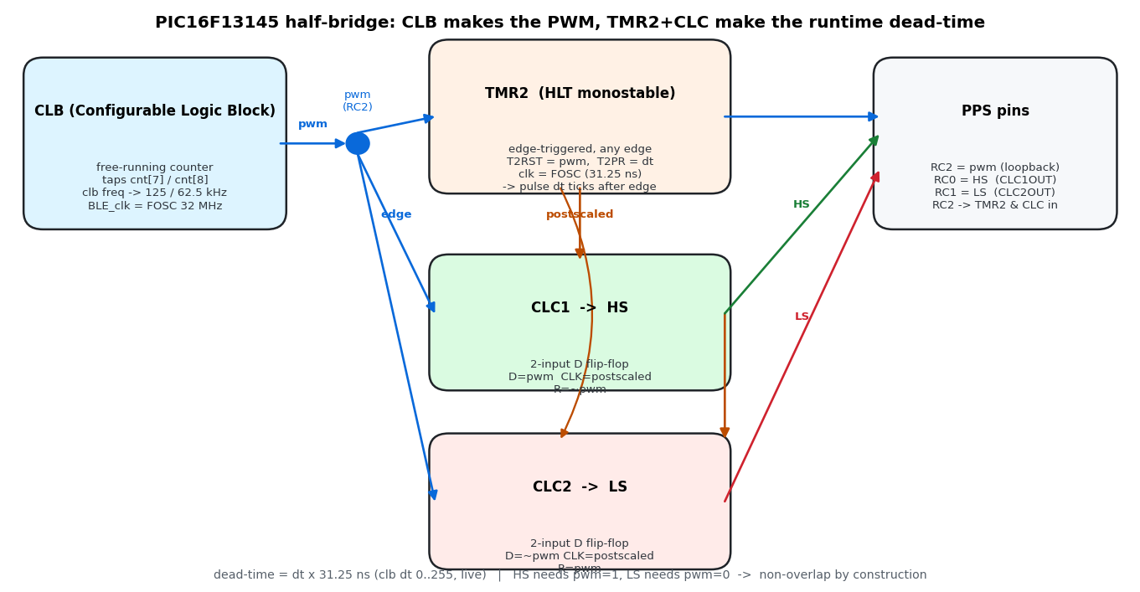
The CLB Half-Bridge - Design
CLB free-running counter -> PWM carrier (125 / 62.5 kHz).
TMR2-HLT monostable, retriggered by every PWM edge -> dead-time = dt x 31.25 ns.
Two CLC D-flip-flops build the complementary HS / LS.
HS only while PWM=1, LS only while PWM=0
-> non-overlap is guaranteed by construction (no shoot-through).
Frequency and dead-time are set independently and live.

Slide 17
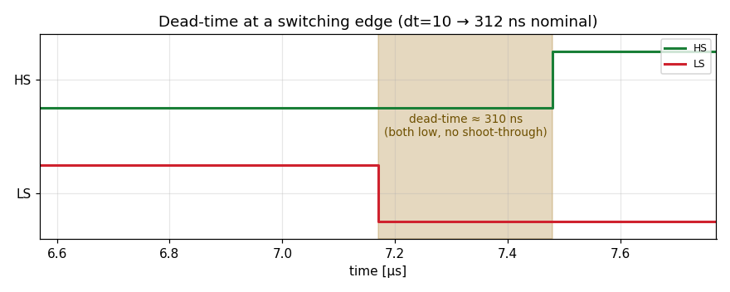
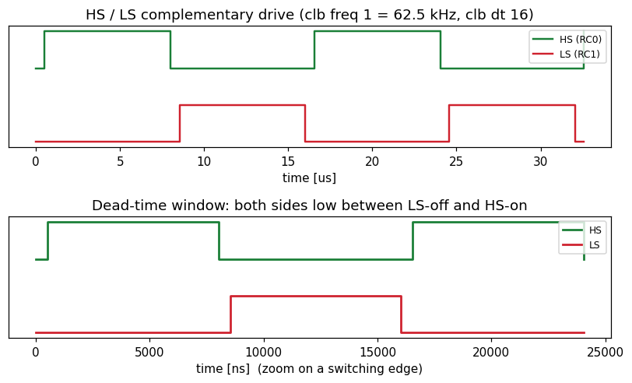
Half-Bridge - Measured (Hardware-in-the-Loop)
smoketest.py now sweeps 2 carriers x 6 dead-times, measured on the pins.
Dead-time tracks dt x 31.25 ns to within ~10 ns (one 100 MS/s sample).
Zero shoot-through (both-high = 0 ns) at every setting.
Carrier exact to the oscillator tolerance.
Results, accuracy verdicts and plots in smoketest_report.html.

Slide 18
What the CLB Can / Can't Do - Capability Map
A two-gate suite (clb_analyze.py): synthesis (does it route?) + silicon (does it run?).
Reliable: a small free-running counter (<=2 output taps), clocked internally or from a pin.
CLBSWIN software inputs work - once the CLBCON.BUSY write-handshake is honoured.
Programmable dividers route, but P&R silently drops period bits -> only ~4 frequencies.
Lesson: keep the counter in the CLB; build gating / dead-time in CLC + TMR2.
Full 'extended datasheet + errata' for a future engineer/AI: clb_description.md.

Slide 19
Why an LLM Can Configure a Logic Peripheral
Register setup is documentation-driven pattern work
Datasheet register tables -> ordered SFR writes: CLBCON, CLBSWIN, PPS, TMR2/HLT
PIC / XC8 idioms + MCC-generated headers + existing project code as scaffold
Knowledge came from tools, not the model's memory alone
Datasheet looked up live (e.g. the CLBCON.BUSY handshake); MCC register defs reused
The hardware-in-the-loop did the heavy lifting
flash -> measure (Saleae) -> compare -> fix exposed the real bugs:
TMR2 prescaler (dead-time x32), missing BUSY handshake, PPS invert / off-by-one
Honest limit: the CLB logic fabric is NOT generated headlessly
Verilog is sent to pyclbsynthesizer (Microchip server); only a small counter routes reliably
"Configure the registers" is not the same as "synthesize the logic fabric"

Slide 20
Takeaways
The full edit -> build -> flash -> verify loop is one scripted pipeline
A serial CLI makes the firmware controllable and observable from a host
A logic analyzer turns 'looks right' into a measured pass/fail
Logic 2 automation + CSV export = repeatable, archivable evidence
Everything is CI-ready: exit codes, CSV data and plots per run
Same pattern scales to any peripheral with an observable output

