Slide 1
OLED1 Integration
Martin Ruppert

Slide 2
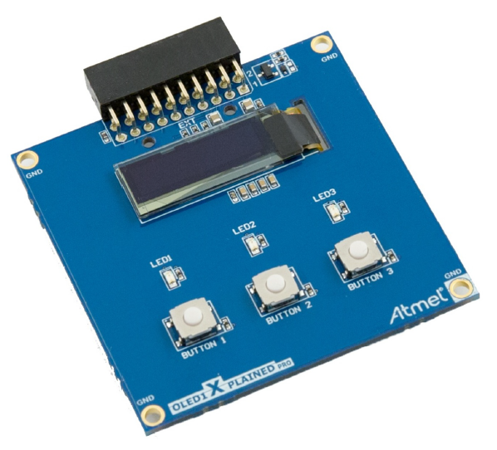
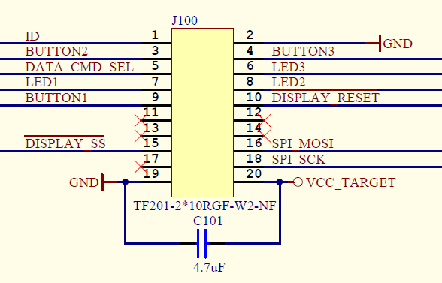
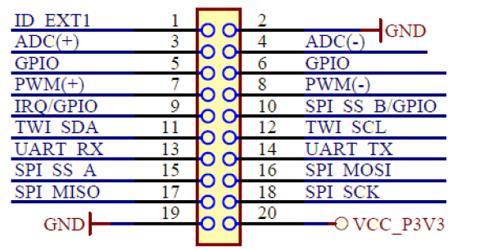
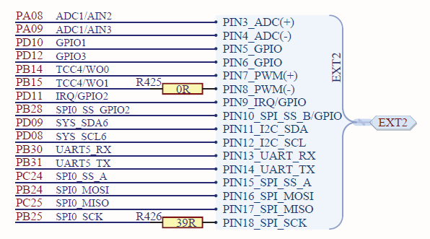
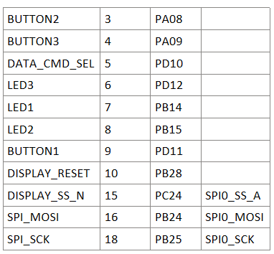
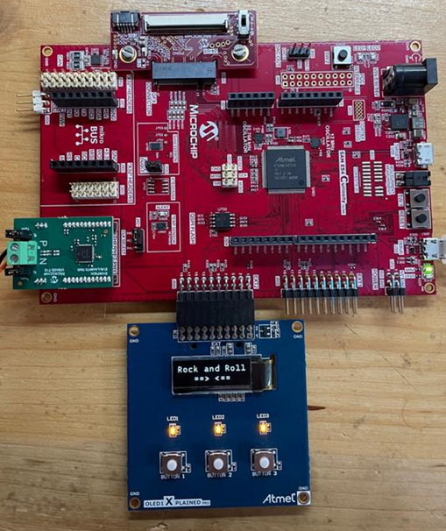
OLED1 Xplained Pro - SSD1306

Slide 3
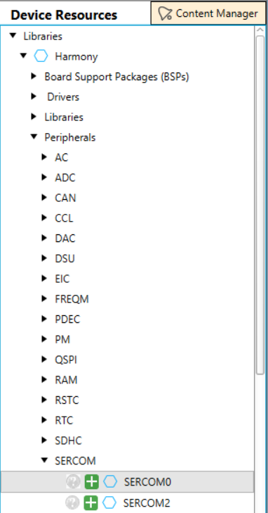
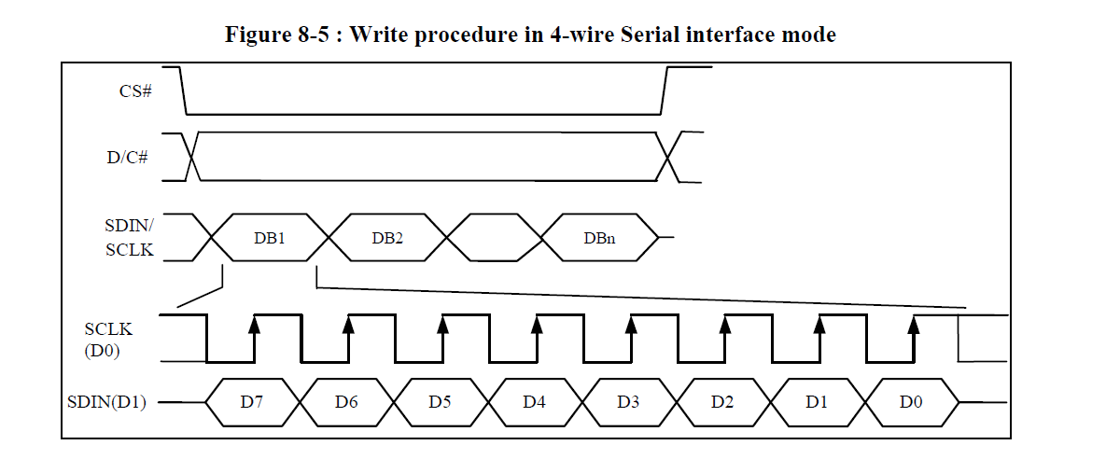
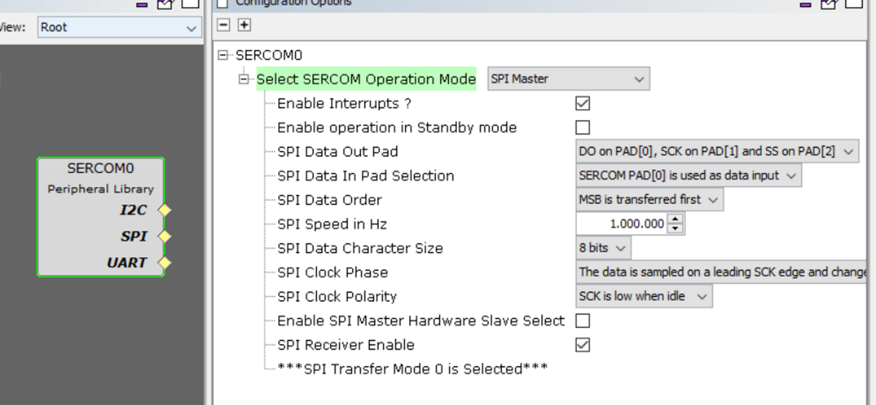
Configure the SERCOM0 with MCC

Slide 4
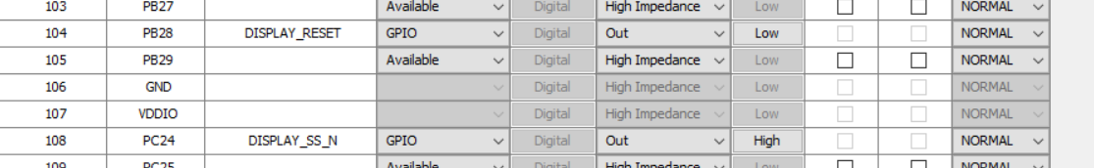
Configure Pins

Slide 5
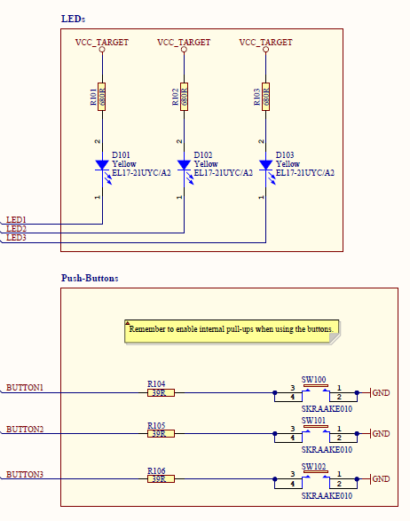
LED‘s and Buttons

Slide 6
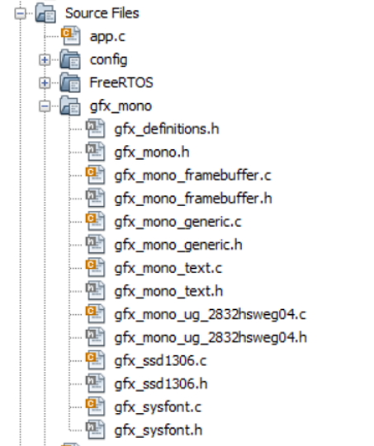
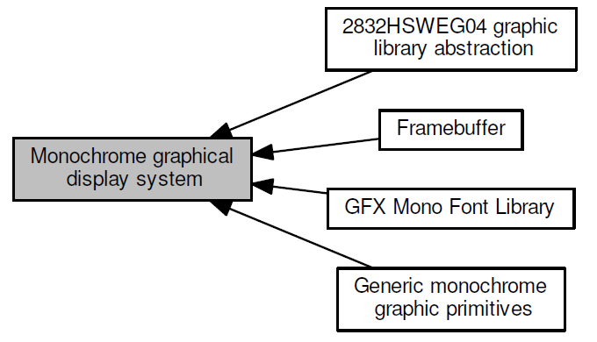
GFX Mono Library

Slide 7
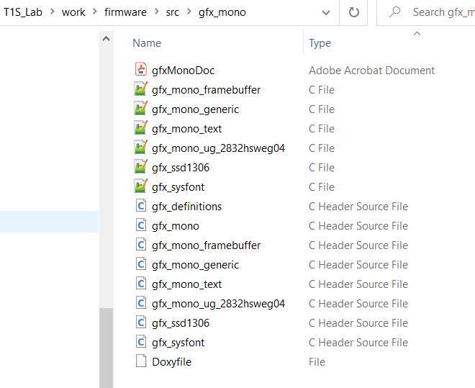
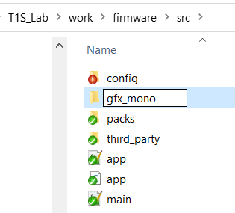
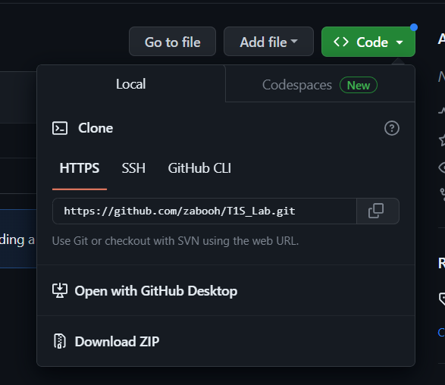
Copy over Files with Windows Explorer
Step 1: goto github (see link below)
Step 2: clone or download Repo
Step 3: and with using Windows File Explorer
Create Subfolder in project
/src named gfx_mono
Step 4: Copy GFX Mono Files from
\T1S_Lab-main.zip\T1S_Lab-main\firmware\src\gfx_mono
Into the folder you created
https://github.com/zabooh/T1S_Lab.git
=> firmware/src/gfx_mono

Slide 8
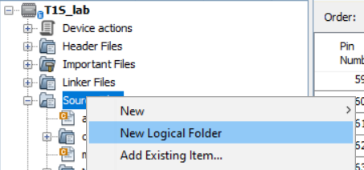
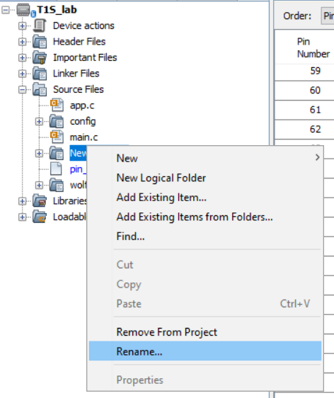
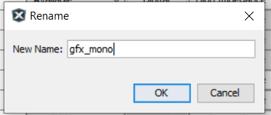
Create Logical Folder in MPLABX

Slide 9
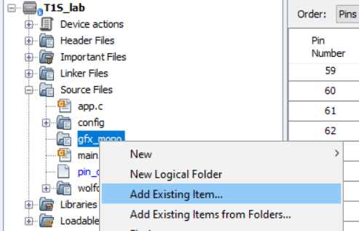
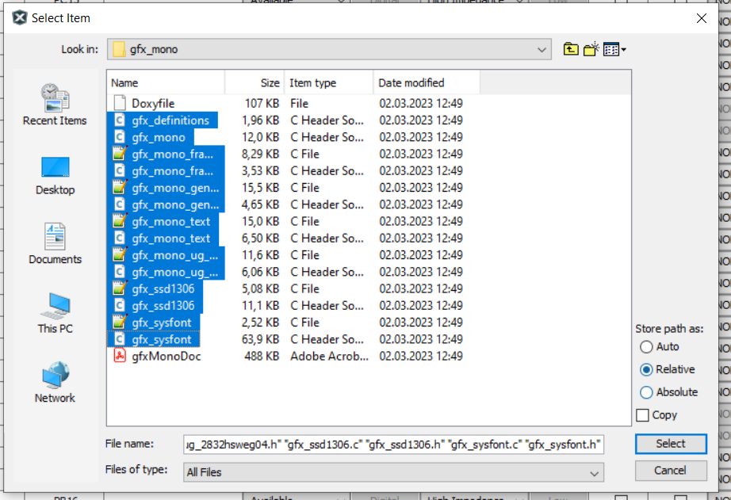
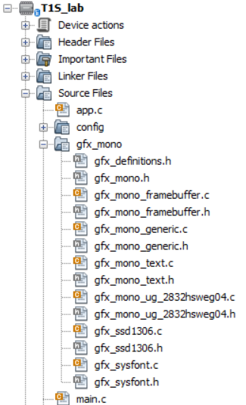
Add Files to the Project

Slide 10
Explanation of the gxf_mono Glue
\src\gfx_mono\gfx_definitions.h
#include "../peripheral/port/plib_port.h"
#include "../peripheral/sercom/spi_master/plib_sercom0_spi_master.h"
#include "../system/time/sys_time.h"
#define GFX_DELAY_FUNCTION(x) \
{ \
SYS_TIME_HANDLE tm_hdl; \
SYS_TIME_DelayMS ( x, &tm_hdl ); \
while(SYS_TIME_DelayIsComplete(tm_hdl) == false); \
}
#define GFX_SPI_WRITE_FUNCTION(x,y) SERCOM0_SPI_Write(x,y)
#define GFX_SPI_IS_BUSY() SERCOM0_SPI_IsBusy()
#define GFX_DISPLAY_RESET_CLEAR() DISPLAY_RESET_Clear()
#define GFX_DISPLAY_RESET_SET() DISPLAY_RESET_Set()
#define GFX_DISPLAY_SS_N_CLEAR() DISPLAY_SS_N_Clear()
#define GFX_DISPLAY_SS_N_SET() DISPLAY_SS_N_Set()
#define GFX_DATA_CMD_SEL_CLEAR() DATA_CMD_SEL_Clear()
#define GFX_DATA_CMD_SEL_SET() DATA_CMD_SEL_Set()

Slide 11
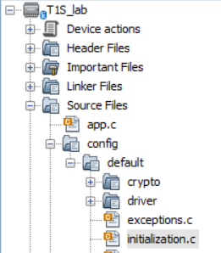
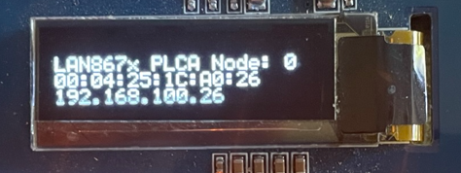
Add the Code for the gfx_mono Initialization
In initialization.c add includes add the top
#include "peripheral/port/plib_port.h"
#include "../../gfx_mono/gfx_definitions.h"
In initialization.c add code and the end of SYS_Initialize()
void SYS_Initialize ( void* data )
{
...
init system functions
...
APP_Initialize();
NVIC_Initialize();
gfx_mono_ssd1306_init();
gfx_mono_print_scroll("LAN867x PLCA Node: %d",DRV_ETHPHY_PLCA_LOCAL_NODE_ID);
gfx_mono_print_scroll("%s",TCPIP_NETWORK_DEFAULT_MAC_ADDR_IDX0);
gfx_mono_print_scroll("%s",TCPIP_NETWORK_DEFAULT_IP_ADDRESS_IDX0);
}

Slide 12
Add „virtual“ UART Receive Function
send terminal commands from firmware „to myself“
Add function in
\peripheral\sercom\usart\plib_sercom1_usart.c
void SERCOM1_USART_Virtual_Receive(char *str) {
while (*str!=0) {
if (SERCOM1_USART_RxPushByte(*str) == true) {
SERCOM1_USART_ReadNotificationSend();
}
str++;
}
}
Add function prototype in
peripheral\sercom\usart\plib_sercom1_usart.h
void SERCOM1_USART_Virtual_Receive(char *str);
Usage in application
SERCOM1_USART_Virtual_Receive("iperf -s\n");

Slide 13
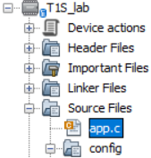
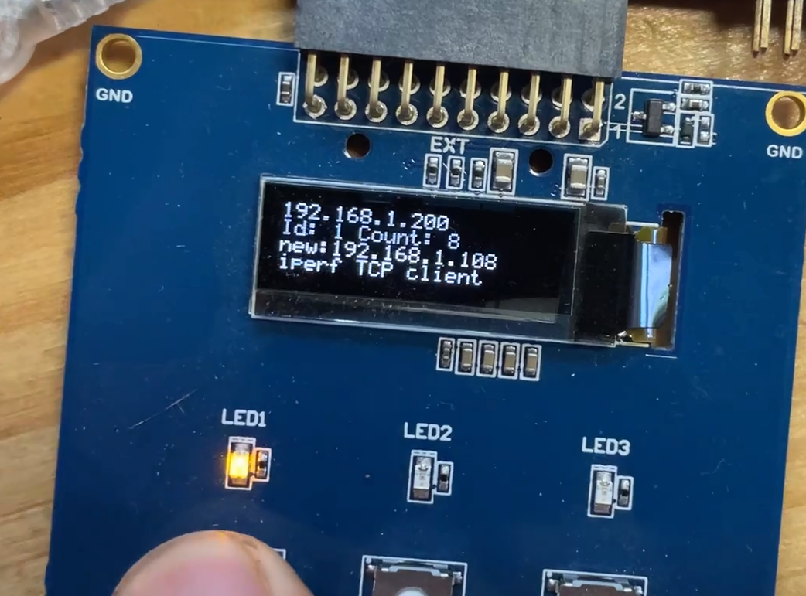
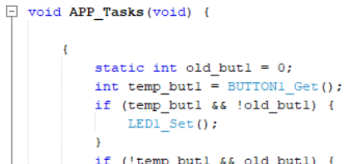
Add Button Polling and Action
#include "config/default/peripheral/port/plib_port.h"
#include "config/default/peripheral/sercom/usart/plib_sercom1_usart.h"
#include "gfx_mono/gfx_definitions.h"
{
static int old_but1 = 0;
int temp_but1 = BUTTON1_Get();
if (temp_but1 && !old_but1) {
LED1_Set();
}
if (!temp_but1 && old_but1) {
LED1_Clear();
SERCOM1_USART_Virtual_Receive("iperf -s\n");
gfx_mono_print_scroll("iperf TCP server");
}
old_but1 = temp_but1;
static int old_but2 = 0;
int temp_but2 = BUTTON2_Get();
if (temp_but2 && !old_but2) {
LED2_Set();
}
if (!temp_but2 && old_but2) {
LED2_Clear();
SERCOM1_USART_Virtual_Receive("iperf -s -u\n");
gfx_mono_print_scroll("iperf UDP server");
}
old_but2 = temp_but2;
static int old_but3 = 0;
int temp_but3 = BUTTON3_Get();
if (temp_but3 && !old_but3) {
LED3_Set();
}
if (!temp_but3 && old_but3) {
LED3_Clear();
SERCOM1_USART_Virtual_Receive("iperfk\n");
gfx_mono_print_scroll("iperf kill server");
}
old_but3 = temp_but3;
}
Step 1: copy include at the top of app.c
Step 2: copy code at begin of APP_Tasks()
SERCOM1_USART_Virtual_Receive("iperf –c 192.168.100.20\n");
Start iperf Client
Start iperf Server

Slide 14
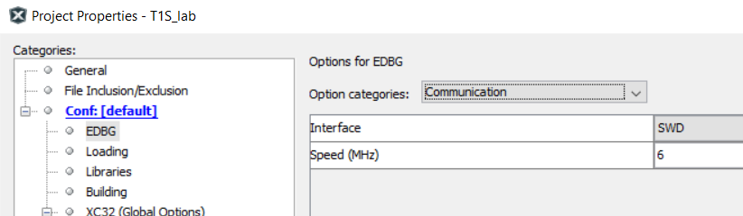
Tips&Tricks: Set Programming Speed Up

Slide 15
Tips&Tricks: Toggle LED every Second
SYS_TIME_HANDLE tm_hdl;
Blocking Version:
while(1){
SYS_TIME_DelayMS ( 1000, &tm_hdl );
while(SYS_TIME_DelayIsComplete(tm_hdl)==false);
LED3_Toggle();
}
Unblocking Version:
SYS_TIME_DelayMS ( 1000, &tm_hdl );
while(1){
if(SYS_TIME_DelayIsComplete(tm_hdl)==true){
LED3_Toggle();
SYS_TIME_DelayMS ( 1000, &tm_hdl );
}
}

