Slide 1
OLED1 Integration
Martin Ruppert

Slide 2
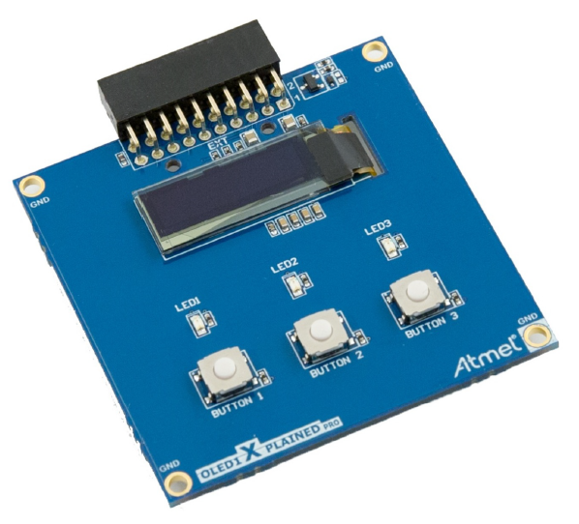
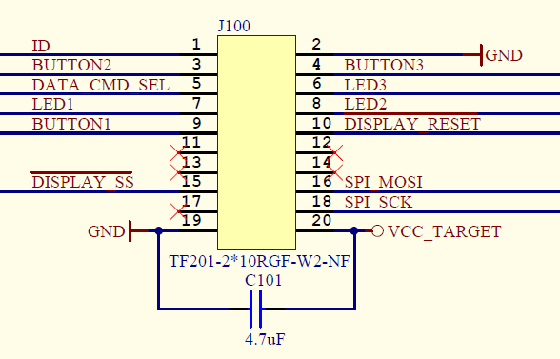
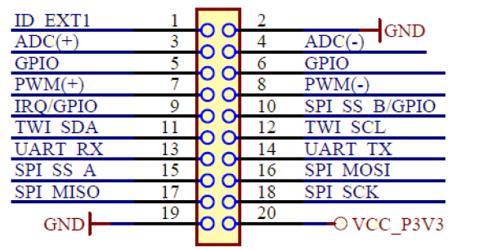
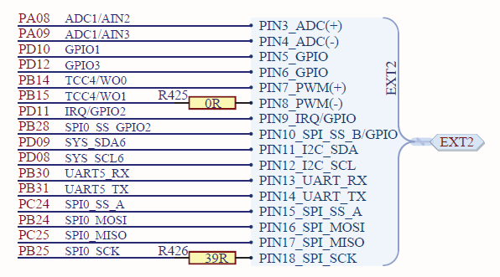
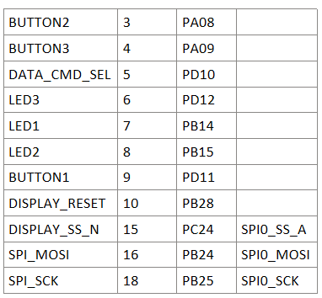
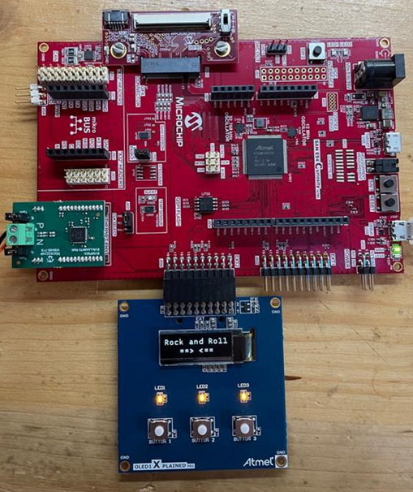
OLED1 Xplained Pro - SSD1306

Slide 3
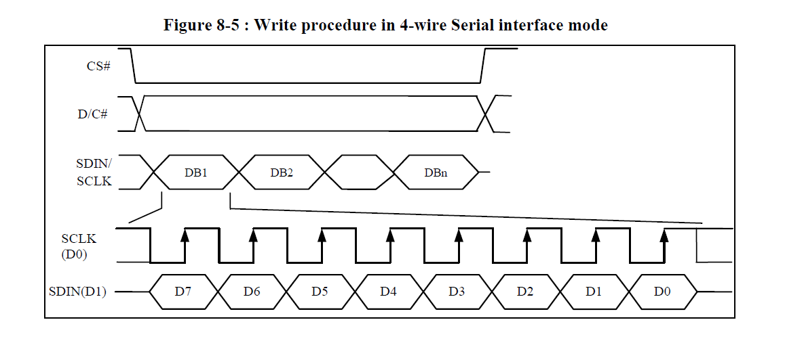
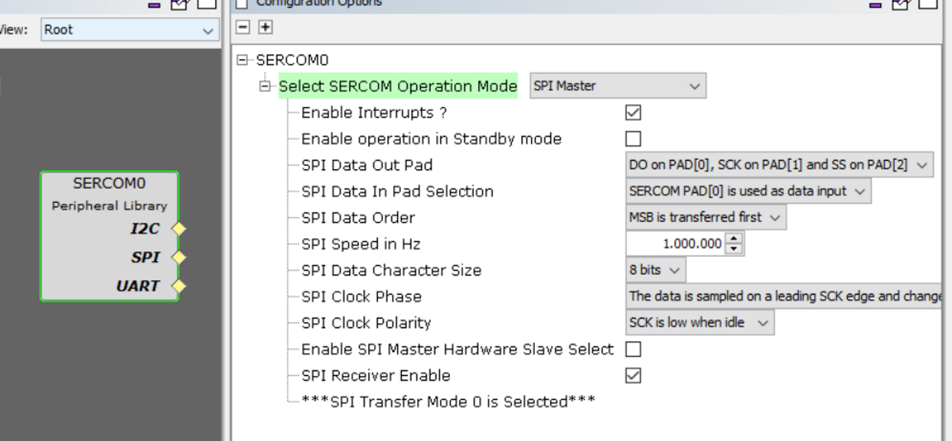
Configure the SERCOM0 with MCC

Slide 4
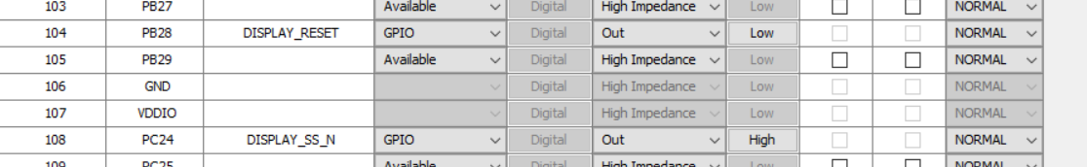
Configure Pins

Slide 5
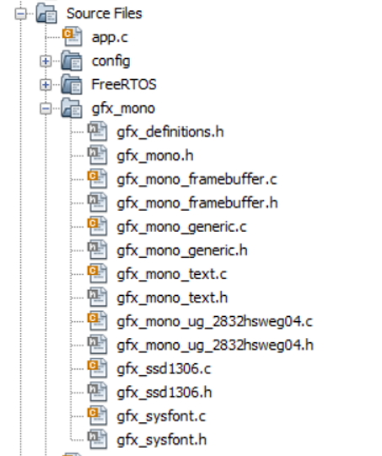
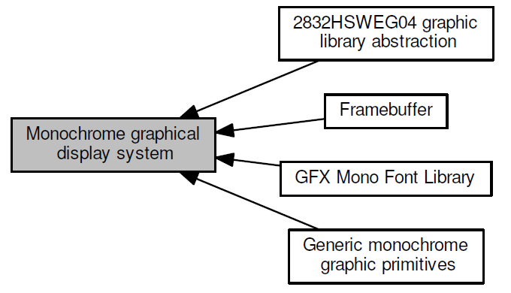
GFX Mono Library

Slide 6
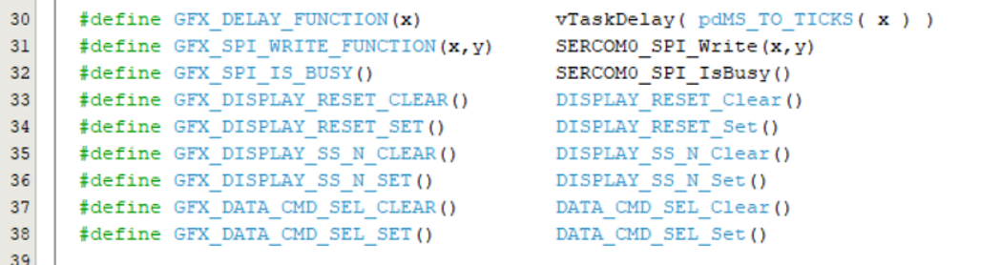
In \apps\tcpip_iperf_10base_t1s\firmware\src\gfx_mono\gfx_definitions.h are the Wrappers defined

Slide 7
Initialization
Init the Ports and the SERCOM0 with PORT_Initialize()and SERCOM0_SPI_Initialize()
Init the Interrupts (because the SPI handling is based on interrupts)
The display can be initialized with gfx_mono_ssd1306_init()
Init the display with gfx_mono_ssd1306_init()
The gfx_mono graphic library offer a lot of generic functions also for circles, lines, etc. see documentation “gfxMonoDoc.pdf”
We have added and use only a “Line Print Function with automatic scroll” in this project:
Example usage: gfx_mono_print_scroll("LAN867x PLCA");

