Slide 1
LAN8670/1/2 PHY
Wolfgang Wittmer
December 2023

Slide 2

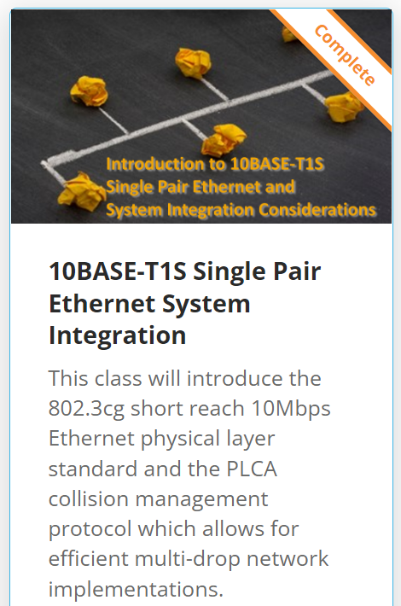
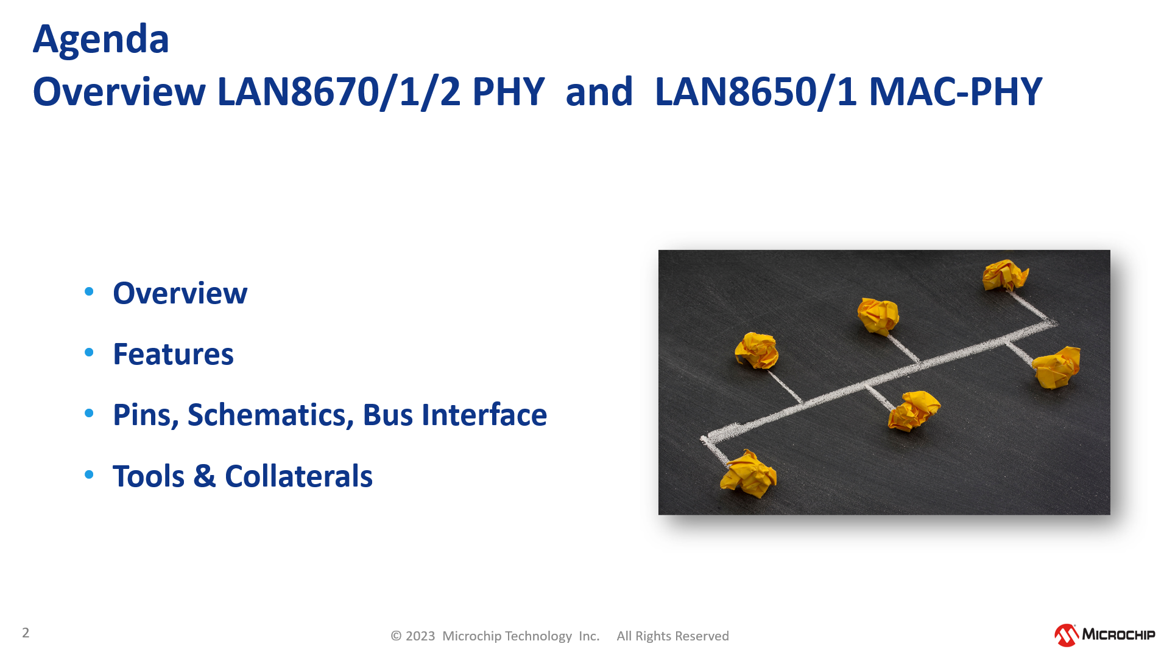
Recommended Previous Knowledge for this Training
Trainingpresentation
&
10base-t1s-single-pair-ethernet-system-integration
~1 hour
10BASE-T1S,
PLCA,
Live Demo using MCHP Eval Boards,
Analysis of Network Bandwidth

Slide 3
Agenda LAN8670/1/2 PHY

Slide 4
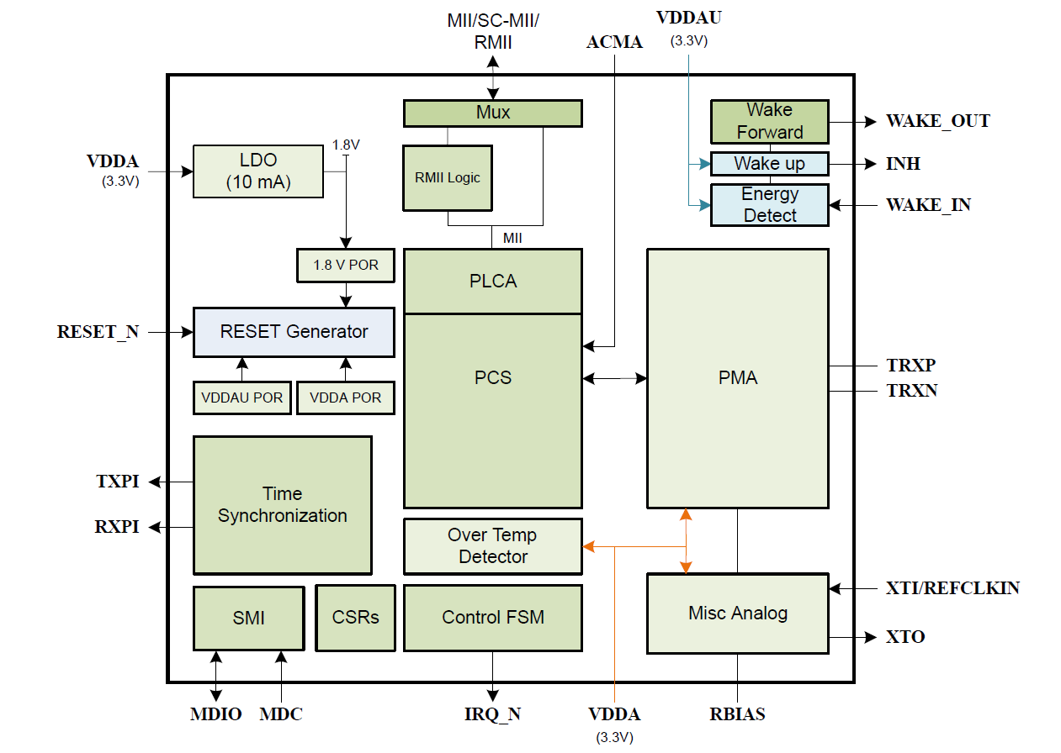
Internal
Block Diagram LAN8670/1/2
Notes:
The Microchip LAN8670/1/2 is a compact, low power, and cost-effective single-port 10BASE-T1S Ethernet PHY designed according to the IEEE Std 802.3cg-2019 specification. The device provides 10 Mbit/s half‑duplex transmit and receive capability over a single balanced pair of conductors such as Unshielded Twisted Pair (UTP) cable. The LAN8670/1/2 is designed for use in applications requiring an extended temperature range (-40°C to +125°C ambient) and is optimized for AEC-Q100 automotive Grade 1 use cases. The device is also compliant to automotive and industrial EMC and EMI requirements. The single power supply and simple bus interface network simplifies its integration into small form factor applications.
The LAN8670/1/2 allows for the creation of both half‑duplex multidrop and point-to-point network topologies. Point-to-point link segments of up to at least 15m in length are supported. The multidrop mode supports up to at least 8 PHYs connected to a common mixing segment of up to at least 25m in length. The ability to connect multiple PHYs to a common mixing segment reduces weight and implementation costs by requiring fewer connectors, individual cables and switch ports.
Access to the physical medium is managed by CSMA/CD and optionally supplemented by Physical Layer Collision Avoidance (PLCA) as per IEEE Std 802.3cg-2019. In addition to the single transmit opportunity per bus cycle in this standard, the LAN8670/1/2 has the ability to be configured with up to 8 additional transmit opportunities in each bus cycle. As an alternative to PLCA, the Application Controlled Media Access (ACMA) pin can be used to implement time-division multiple access (TDMA) to the physical medium.
The LAN8670/1/2 interfaces with an Ethernet MAC via standard MII/RMII, or via the Single Clock Media Independent Interface (SC-MII) which is similar to the MII but with fewer pins. An integrated serial management interface (SMI) provides rapid register access and configuration at up to 4 MHz.
Microchip’s LAN8670/1/2 EtherGREEN energy efficient technology provides low power 10BASE-T1S PHY operation along with an ultra-low power sleep mode with flexible wake options.
In addition, the LAN8670/1/2 can be used to implement high-precision clock synchronization. This enables implementation of the IEEE Std 802.1AS profile, among others, of IEEE Std 1588 for applications utilizing AVB or other Time Sensitive Networking (TSN) standards. This feature can be used to provide a Timing Synchronization Service Interface (TSSI) as specified in IEEE Std 802.3™ Clause 90 as part of a TSN implementation.
Advanced PHY diagnostics are provided, which enable troubleshooting and monitoring capabilities such as cable defect detection of shorts or opens, a receiver Signal Quality Indicator (SQI), PLCA diagnostics, over-temperature, under-voltage detection, comprehensive status interrupt support, and various loopback and test modes.

Slide 5
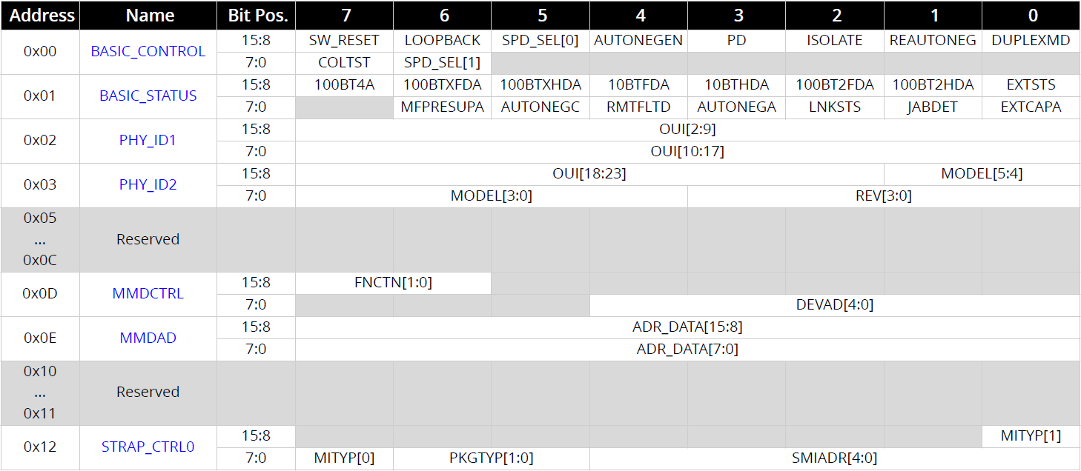
Register Overview LAN8670/1/2
Direct RW access to standardized Clause 22 registers
SMI Basic Control and Status Registers (Clause 22)
SMI Basic Control and Status Registers
PMA/PMD Registers
PCS Registers
Misc. Registers
Indirect access to Clause 45 registers via Clause 22 MMDCTRL and MMDAD
Notes:
Through the SMI interface the MCU has direct access to the registers defined in Clause 22 of IEEE Std 802.3.
Registers mapped into IEEE Std 802.3 Clause 45 are accessed indirectly through
the MMD Access Control (MMDCTRL) register 0D
and MMD Access Data (MMDAD) register 0E.

Slide 6
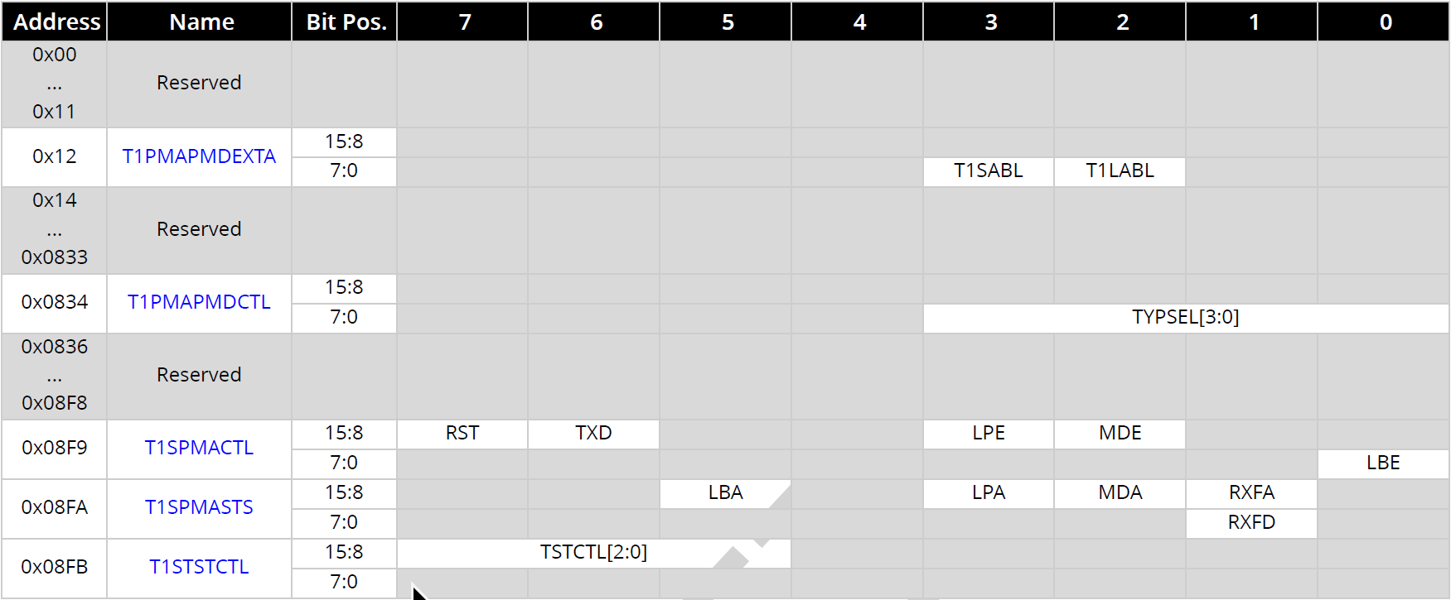
Register Overview LAN8670/1/2
Basic chip configuration
PMA/PMD Registers (MMD 1)
Reset the device
SMI Basic Control and Status Registers
PMA/PMD Registers
PCS Registers
Misc. Registers
Transmit disable
Select test mode
Low power enable
PMA loopback enable

Slide 7
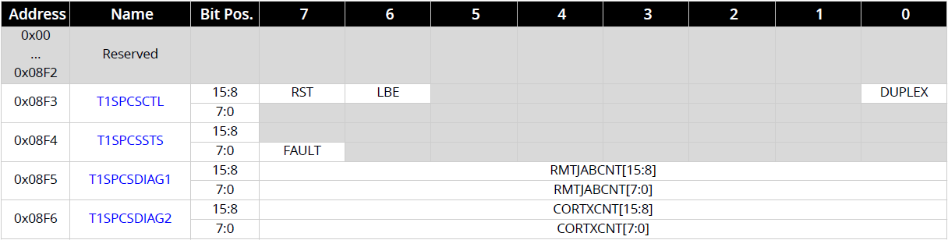
Register Overview LAN8670/1/2
Remote Jabber Count
ESDJAB events received since the last read
PCS Registers (MMD 3)
SMI Basic Control and Status Registers
PMA/PMD Registers
PCS Registers
Misc. Registers
Corrupted Transmit Count
Transmission resulted in a corrupted signal at MDI, typically because of collision.

Slide 8
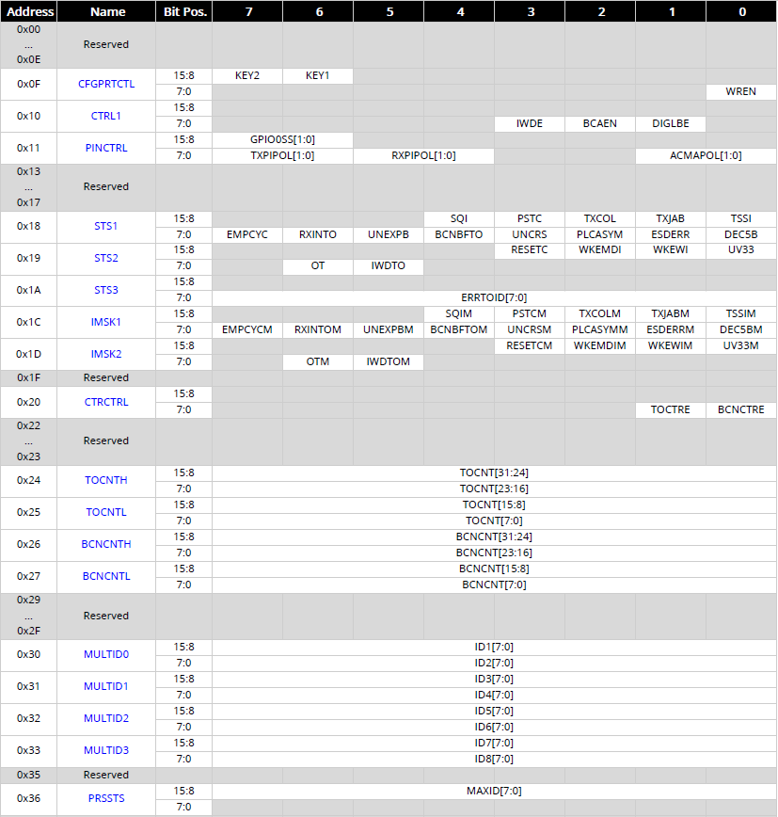
Register Overview LAN8670/1/2
Miscellaneous Registers (MMD 31)
Configuration protection
Pin configuration
GPIO, ACMA, polarities
Status and errors of
PLCA, SQI, time sync
Status of
reset, wake-up, under-voltage, overtemp, watchdog
Enable monitoring counters
SMI Basic Control and Status Registers
PMA/PMD Registers
PCS Registers
Misc. Registers
TO counter
Beacon counter
Additional Node IDs
for Multi TOs

Slide 9
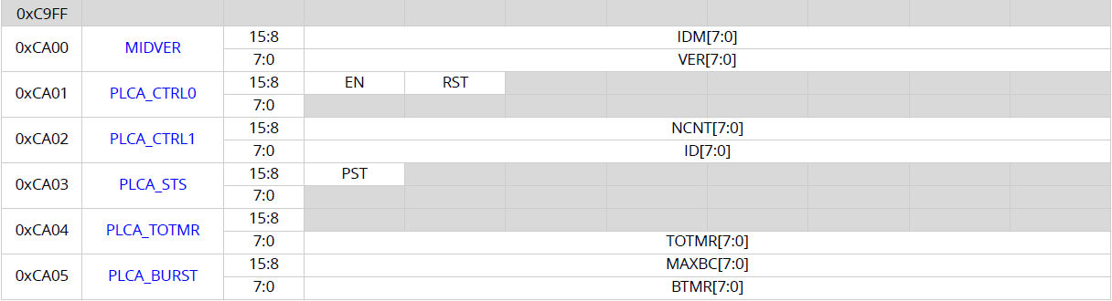
Register Overview LAN8670/1/2
Configure PLCA
Enable and reset
PLCA
Miscellaneous Registers (MMD 31) cont...
Node Count
= number of TOs in one bus cycle
Node ID
Transmit opportunity
timer
= 32 bit default
SMI Basic Control and Status Registers
PMA/PMD Registers
PCS Registers
Misc. Registers
PLCA status
indicates if PLCA is active, (Beacons transmitted)
Burst timer
= max time between two frames of the burst
Max burst count
= number of add. frames per TO

Slide 10
PLCA - Status 1 Register (MMD 31)
Bit 11 – PSTC PLCA Status Changed This bit is set to indicate that the PLCA Status (PST) bit has changed within the PLCA Status (PLCA_STS) register.
Bit 10 – TXCOL Transmit Collision Status Physical collision on the network detected. This does not include logical collisions due to normal operation of PLCA.
Bit 9 – TXJAB Transmit Jabber Status A transmit jabber condition occurs when the PHY detects that PCS has remained in transmit state longer than 2 ms. In this case the transmitter is disabled for 16 ms.
Bit 2 – PLCASYM PLCA Symbols Detected This bit indicates the detection of PLCA BEACON symbols when PLCA is not enabled. This condition may indicate the local node is operating with PLCA disabled on a segment with PLCA enabled nodes.
Bit 1 – ESDERR End-of-Stream Delimiter Error
Bit 0 – DEC5B 5B Decode Error
PLCA-related errors
can be signaled via interrupt
PLCA-related status

Slide 11
PLCA - Status 1 Register (MMD 31) - continued
Bit 7 – EMPCYC PLCA Empty Cycle Status indicates an empty PLCA bus cycle, which occurs when the node detects no transmissions in any of the possible transmit opportunities between two successive BEACONs.
Bit 6 – RXINTO Receive in Transmit Opportunity indicates another node transmitting in this node’s assigned TO. This could indicate multiple nodes being assigned the same Local ID.
Bit 5 – UNEXPB Unexpected BEACON Received When configured as the PLCA coordinator in charge of transmitting the periodic BEACONs, this bit indicates the detection of an unexpected BEACON on the segment, coming from another or multiple PLCA coordinators on the segment.
Bit 4 – BCNBFTO BEACON Received Before Transmit Opportunity indicates the detection of a BEACON before the local node’s assigned transmit opportunity. Either multiple PLCA coordinators on the segment, or NodeCount (NCNT) in the PLCA coordinator is less or equal to local ID, i.e. PLCA cycle is “too small”
Bit 3 – UNCRS Unexpected Carrier Sense When operating in ACMA mode, this bit will indicate carrier sense during this PHY’s transmit slot when ACMA is asserted
PLCA-related
monitoring
Changes can be signaled via interrupt

Slide 12
Agenda LAN8670/1/2 PHY

Slide 13
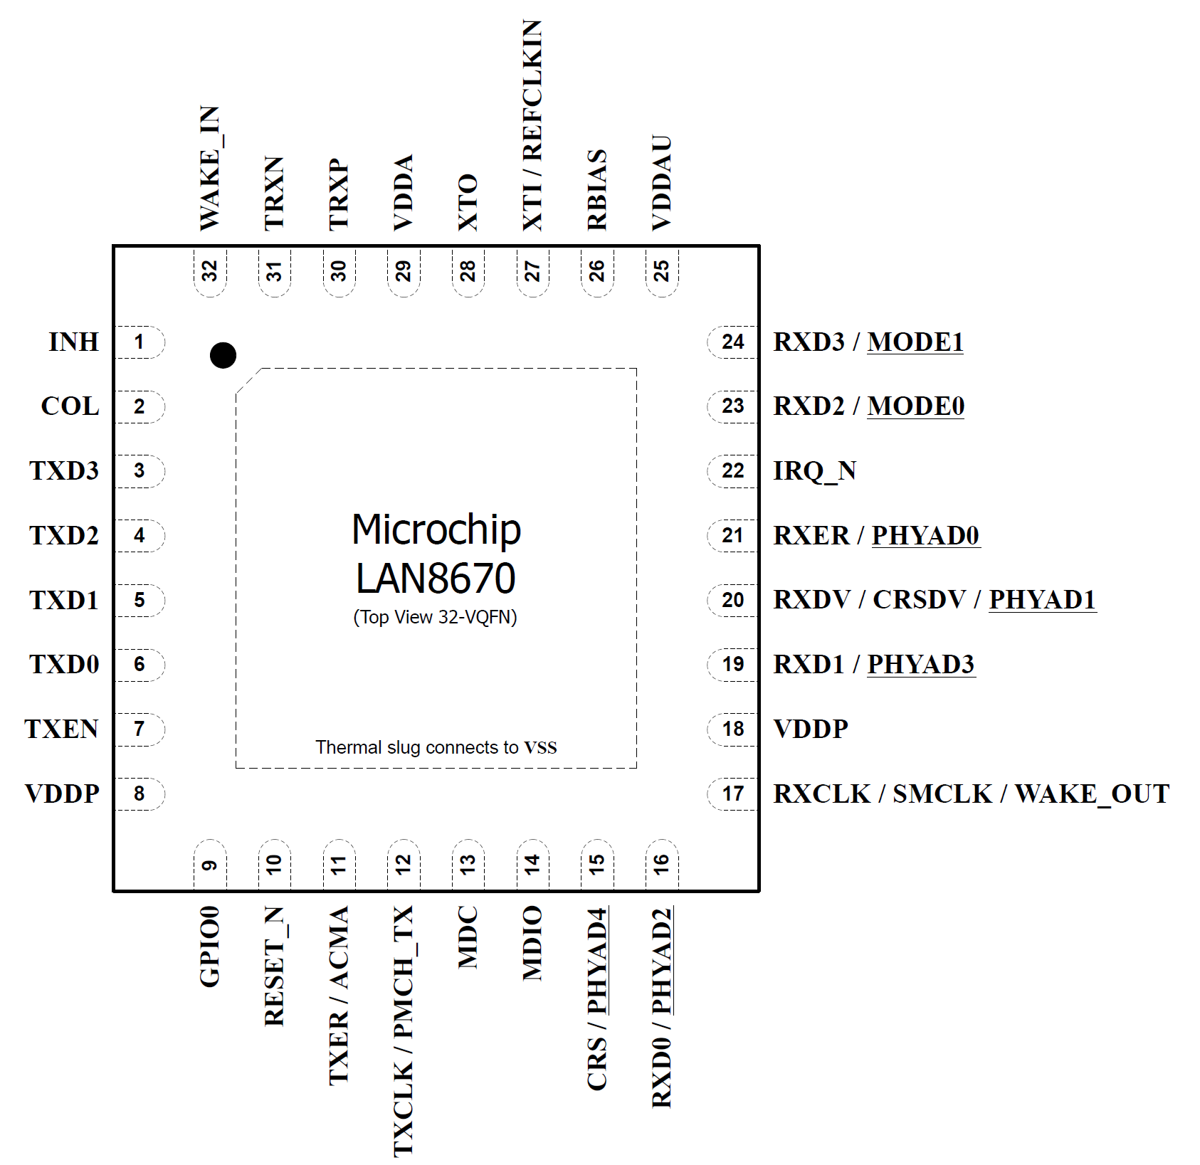
MDIO (Management Data Input/Output)
SMI (Serial Management Interface)
MIIM (Media Independent Interface Management)
--> All the same…
Connect
a PHY
to an MCU
Read & Write
Status & Control
2-wire serial bus
MDC (Clock)
MDIO (Data)
Notes:
There are several terms used for the configuration interface of the LAN8670/1/2:
Management Data Input/Output - or MDIO
Serial Management Interface - or SMI
Media Independent Interface Management - or MIIM
However, they basically all mean the same 2-wire serial bus interface which is used to read and write the control and status registers of the PHY.

Slide 14
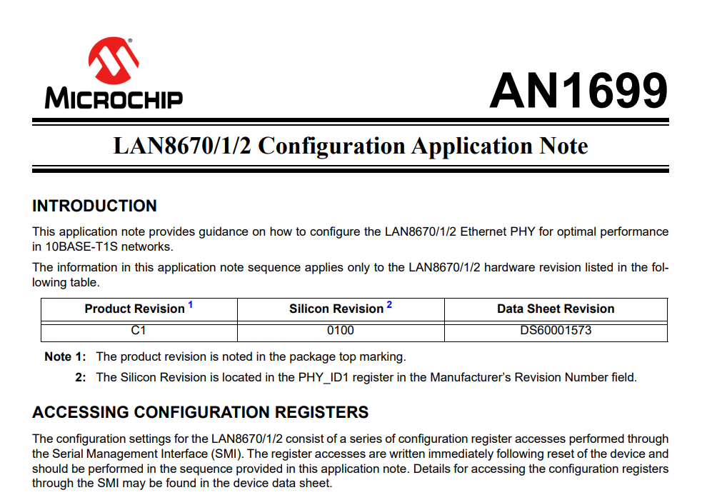
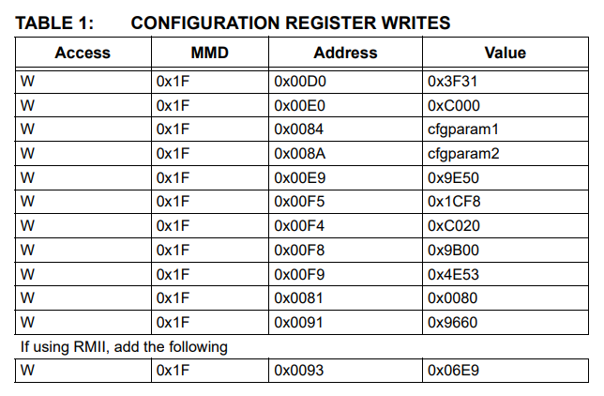
AppNote AN1699 describes how to configure LAN8670/1/2
Initial Configuration of LAN8670/1/2 (AN1699)
Sequence of register values written to LAN8670/1/2
after reset by
Linux driver
Windows driver
Harmony Example
Customer needs to integrate this configuration sequence
in his own application
Notes:
A certain sequence of register accesses is needed for initial configuration of the LAN8670/1/2.
Microchip’s Linux driver, the Windows driver and the Harmony Example will write this sequence to the LAN8670/1/2 immediately after reset.
Customers who develop their own application need to integrate this sequence.
The latest sequence for the initial configuration is available as an AppNote AN1699 on the product page of the LAN8670/1/2.

Slide 15
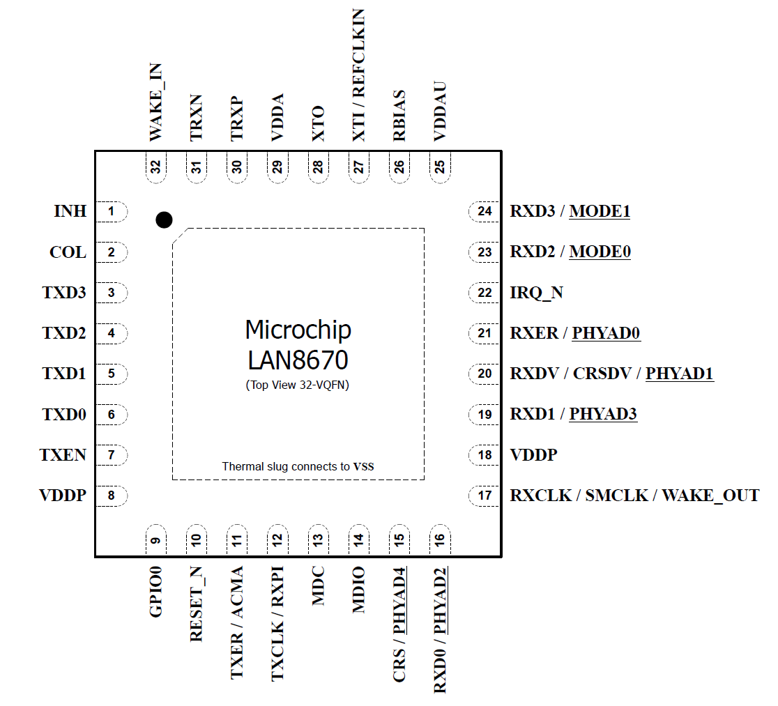
Configuration Straps MODE[1:0]
Are latched on Power-On Reset (POR) or pin reset (RESET_N).
Determine the interface to the MAC: MII, RMII, or SC-MII
Must use pull-up or pull-down resistors
Device Mode determines
MAC Interface
LAN8670/1/2 Family
MODE[1:0] | Description | LAN8670 | LAN8671 | LAN8672
00b | Undefined
01b | MII with 25 MHz crystal | X |  | X
10b | RMII with 50 MHz REFCLKIN oscillator | X | X
11b | SC-MII (Single Clock MII) with 25 MHz crystal | X
Notes:
Device Mode (MODE[1:0])
The MODE[1:0] configuration straps determine whether the interface to the MAC is MII, RMII, or
SC-MII, as shown in Table 3-12 below. The value can be read in the STRAP_CTRL0 register, if needed.
Note: As the LAN8672 only supports operation in MII mode, the MODE[1:0] configuration straps
must be set to 01b.
Configuration straps are latched on Power-On Reset (POR) and pin reset (RESET_N). At the completion of the reset, that is when all power supplies are above the thresholds and the RESET_N pin is no longer asserted, the associated register bit values are loaded.

Slide 16
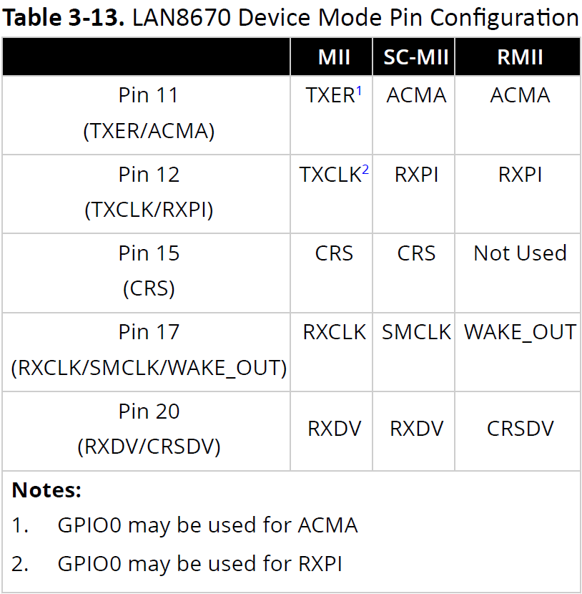
Device Mode
(Config Straps)
Determines...
Pin Configurations
LAN8670/1/2 Family
MAC Interface
(MII, RMII, SC-MII)
Determines...
Pin Configuration
(ACMA, 1588, etc)
GPIO –
General Purpose
In Out
RXPI –
Receive Packet
Indication
CRSDV –
Carrier Sense
Data Valid
ACMA –
Appl Controlled Media Access
Notes:
The Device Mode determines the interface to the MAC, that is whether the communication between the LAN867x is using the MII, RMII or SC-MII interface.
Setting the MAC interface results in a specific Pin configuration. Some pins of the LAN8670/1/2 may take on multiple functions depending on the device and mode.

Slide 17
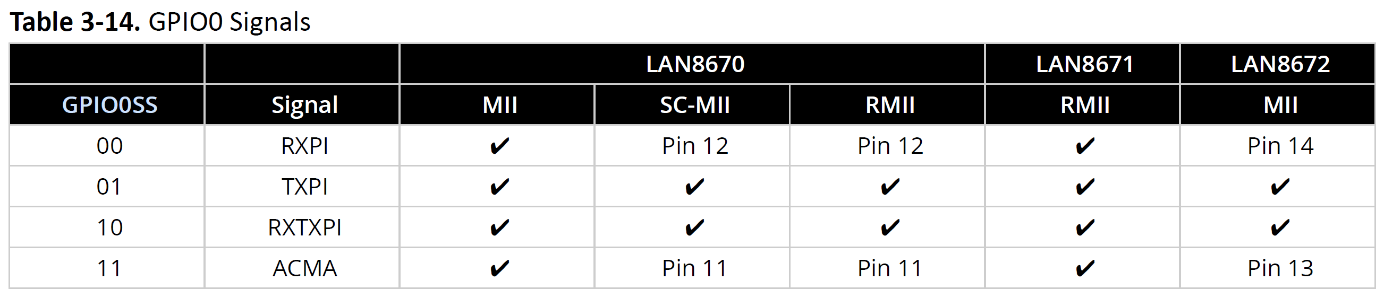
GPIO Pin – Multipurpose Pin
Device Mode
(Config Straps Mode0/1)
determines
GPIO Configuration
LAN8670/1/2 Family
LAN8670 in MII mode
Pin 9 = GPIO needs to be used for RXPI, TXPI, RXTXPI or RXTXPI,
In case the corresponding function
is enabled
MAC Interface
(MII, RMII, SC-MII)
determines
LAN8670 in RMII mode
Pin 11 must be used for ACMA
Pin 12 must be used for RXPI
Pin 9 = GPIO can be used for TXPI or RXTXPI
In case the corresponding function
is enabled
Pin Configuration
(ACMA, 1588)
Notes:
The GPIO0 pin is a multipurpose pin that can be configured as desired for multiple uses.
The GPIO0 pin functionality is configured by writing to the GPIO0 Signal Select (GPIO0SS) field of
the Pin Control (PINCTRL) register. The GPIO0 Signal Select should be configured prior to configuring
and enabling the underlying Packet Pattern Matching or Application Controlled Media Access blocks.
Valid configurations for the GPIO0 pin depend on the device in use and its operating mode. When
a dedicated pin is available, it must be used rather than the GPIO0 pin. Table 3-14 below shows the
valid configurations for the GPIO0 pin. When a pin number is shown, this is an invalid configuration
for the GPIO0 Signal Select and the designated dedicated pin must be used instead.

Slide 18
Agenda LAN8670/1/2 PHY

Slide 19
Wake / Sleep
Enables Wake/Sleep on small MCUs without external components according to OPEN Alliance TC10
Sleep mode
Ultra low power consumption (<= 140 μW)
Just constant 3.3V power supply during sleep, but no switched power
Go to sleep via command from host, or via internal watchdog timeout
Wake from...
Remote network activity (MDI)
Local event (WAKE_IN), e.g. user input
Activate switched power
INH pin output to enable/disable power supply
Forward wake signal
Via MDI (network) to wake remote nodes
Via WAKE_OUT to wake other local devices
Via WAKE_OUT to inform MCU that network re-assumed operation
MCU
V_{Batt}
WAKE_IN
Switched power
PHY
INH
WAKE_OUT
MDI
Remote network activity
10BASE-T1S
Note: MDI wake detection does not meet the OPEN Alliance 10BASE-T1S Sleep/Wake-up Specification, version 1.0.
Notes:
Note: In the LAN8670/1/2 and LAN8650/1 MDI wake detection was not designed to meet the OPEN Alliance
10BASE-T1S Sleep/Wake-up Specification, version 1.0. Received energy that is of sufficient length
that is detected either from other nodes transmitting onto the segment or from noise will trigger the
device to wake when MDI wake-up is enabled.

Slide 20
Simple System without Sleep Mode
VDDA = power supply voltage for analog parts of the chip
VDDP = power supply voltage for digital parts of the chip
VDDAU = uninterruptible analog supply voltage
VSS = common ground exposed pad must be connected to the ground plane with a via array.
VDDA, VDDP, VDDAU
all connected to same
3.3V power supply
VDDAU only needed for wake detection in sleep mode
If Wake-forwarding not used:
WAKE_OUT: no connect
If Sleep mode not used:
INH: no connect
WAKE_IN: connect to VSS

Slide 21
System with Sleep Mode and Advanced Features
VDDA, VDDP disabled in sleep mode VDDAU for wake-up detection
After sleep mode starts, INH will be deasserted, which disables the voltage regulator for VDDA/VDDP
Wake-up is initiated by
the host via WAKE_IN,
network activity via MDI
Wake-up might be forwarded via WAKE_OUT to local devices via MDI to wake remote nodes
Wake-up can be forwarded via
WAKE_OUT to local devices
MDI to wake remote nodes
Notes:
This slide shows an example of how power should be supplied in a system that will use the low-power sleep mode of the LAN8670/1/2 and LAN865/1. In this diagram, VDDAU is provided by a constant supply, so that it is always enabled, even during sleep mode. On system power-up, once this supply is active, the INH pin will be asserted so that its active high output can drive the enable pins of the external switchable supplies for VDDA and VDDP.
After the device enters sleep mode, the INH pin will enter a high-impedance state. The external resistor will pull the signal down to ground, which will then disable any voltage sources controlled by INH. This can be used to disable power to additional devices, including, when needed, the station controller.
The sleep/wake module is powered by the externally protected continuous VDDAU supply and detects a wake condition when the device is in the SLEEP state. This module monitors activity energy on the MDI interface and/or wake pulses on the WAKE_IN pin to determine if the device has received wake-up signaling. Once wake-up signaling has been received and validated, this module will drive the INH pin high to the VDDAU supply to enable the external switched power supplies.
If wake from the WAKE_IN pin is enabled (WKIEN=1), the WAKE_IN pin must be deasserted before the Sleep Inhibit Delay timer will be started.
Wake from MDI is enabled by writing a ’1’ to the MDI Wake Enable (MDIWKEN) bit in the Sleep
Control 0 (SLPCTL0) register prior to entering the SLEEP state.
The device may be configured to generate activity signaling on the MDI upon wake from SLEEP due to a wake pulse on WAKE_IN. The wake signaling consists of a 1 ms transmission of differential Manchester encoded pseudo-random binary data. The device will not listen for activity on the network prior to transmitting the wake signaling.
Enabling of MDI wake activity forwarding is accomplished by setting the MDI Forward Enable
(MDIFWDEN) bit of the Sleep Control 1 (SLPCTL1) register.
The WAKE_OUT pin may be configured to assert for 90 μs upon wake from SLEEP due to MDI activity or a wake pulse on WAKE_IN. Enabling of WAKE_OUT pin forwarding is accomplished by setting the WAKE_OUT Forward Enable (WKOFWDEN) bit of the Sleep Control 1 (SLPCTL1) register prior to entering the SLEEP state.

Slide 22
Host Configures Each Time before Going to SLEEP...
Time from init SLEEP to INH release (leading to power off):
SLPINHDLY (Sleep Inhibit Delay)
Select wake-modes for next wake-up:
MDIWKEN (MDI Wakeup Enable)
WKINEN (WAKE_IN Enable)
Should other network nodes / local devices also be woken up by...
MDIFWDEN (MDI Forward Enable)
WKOFWDEN (WAKE_OUT Forward Enable)
Notes:
Before entering SLEEP mode, the desired wake configuration must be
configured in the LAN8670/1/2 and LAN8650/1. It is recommended that this mode is configured
immediately after a reset.
Some systems may require a delay between the trigger for the start of sleep mode and disable
of the local power supplies, for example, to allow for other nodes on the mixing segment to go
quiet. Delay timing is configured with the Sleep Inhibit Delay (SLPINHDLY) field of the Sleep Control
0 (SLPCTL0) register.

Slide 23
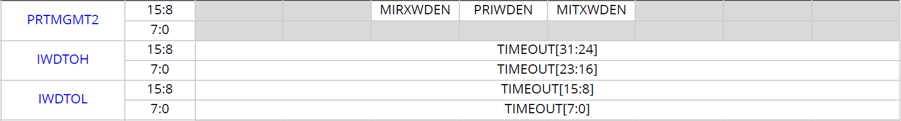
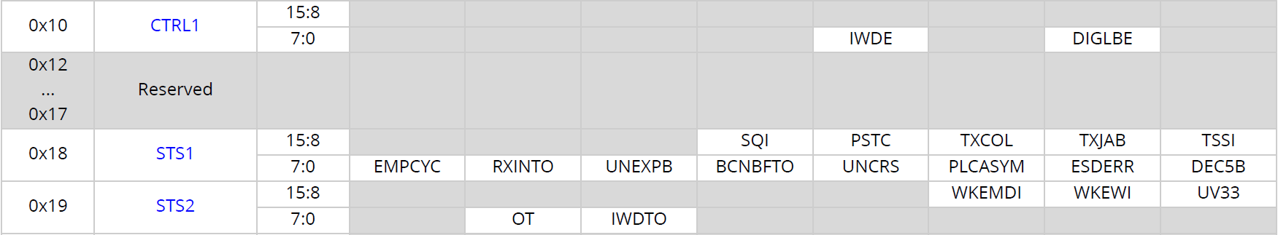
Going to SLEEP – Two Ways
LAN865x or LAN867x automatically goes to SLEEP
when Watchdog timeout occurs
Host must configure 1...3 inactivity WD sources
No RX from network: MIRXWDEN (Media Interface Receive Watchdog Enable)
No TX to network: MITXWDEN (Media Interface Transmit Watchdog Enable)
No SMI access: PRIWDEN (PHY Register Inactivity Watchdog Enable )
Host actively sets
SLPEN (Sleep Enable) = 1
ACTIVE
LAN865x or LAN867x waits for SLPINHDLY
(Sleep Inhibit Delay)
LAN865x or LAN867x releases INH pin
configure IWDTOH / IWDTOL (Inact. WD Timeout)
unmask IRQ_N: IWDTOM = 0
set IWDE = 1 (Inactivity WD Enable)
SLEEP
In case of any timeout LAN865x or LAN867x
sets IWDTO = 1 (Inactivity WD Timeout Status)
waits for SLPINHDLY, and releases INH pin
Notes:
After wake-up has been configured, the device may at any time be commanded to enter the SLEEP
state. This may be done in one of two ways. The station controller may initiate a transition to SLEEP
by writing a ‘1’ to the Sleep Enable (SLPEN) bit in the Sleep Control 0 (SLPCTL0) register. Alternatively,
the device may be configured to enter SLEEP automatically upon expiration of an inactivity watchdog.
The inactivity watchdog can be configured to trigger on inactivity of three sources: no receive
packets from the network, no transmit packets from the MAC, and no SMI access by the controller.
Each of these three inactivity sources may be enabled separately or together in any combination.
Once enabled, the watchdog timer will be reset upon detected activity on any of the selected
watchdog sources. When the watchdog expires, the Inactivity Watchdog Timeout (IWDTO) bit in
the Status 2 (STS2) register will be set commanding the transition to the SLEEP state and initiating
the Sleep Inhibit Delay timer.

Slide 24
Wake – Sleep Cycle
Check if WAKEIND (Wake Indication) = 1,
in case of a wake event:
check WKEWI (wake over Wake IN),
check WKEMDI (wake over MDI)
VDDA/P/U = ON,
INH = 1
Inactivity watchdog timeout or
app sets SLPEN (Sleep Enable) = 1
Wait for SLPINHDLY (Sleep Inhibit Delay)
Then release INH pin
if WAKEIND (Wake Indication) = 1,
set CLRWKI (clear wake indication) = 1
to activate wake-detection for the next wake-up
ACTIVE
SLEEP
Device in SLEEP
VDDAU = ON,
INH = 0
Wake event occurred,
Drive INH = 1
VDDA/P/U = ON

Slide 25
Agenda LAN8670/1/2 PHY

Slide 26
ACMA – Application Controlled Media Access
Alternative to PLCA or CSMA/CD access
Node can only send when app asserts ACMA-signal
Custom scheduled access to the medium, e.g. TDMA
ACMA – how is it done?
When ACMA-signal is asserted LAN865x and LAN867x releases CRSDV/CRS, signaling to the MAC that network is idle and MAC can start sending.
Packets are sent completely
When ACMA-slot is large enough several packets can be sent
ACMA
LAN8670/1/2 Family
ACMA enables
TDMA in small MCUs

Slide 27
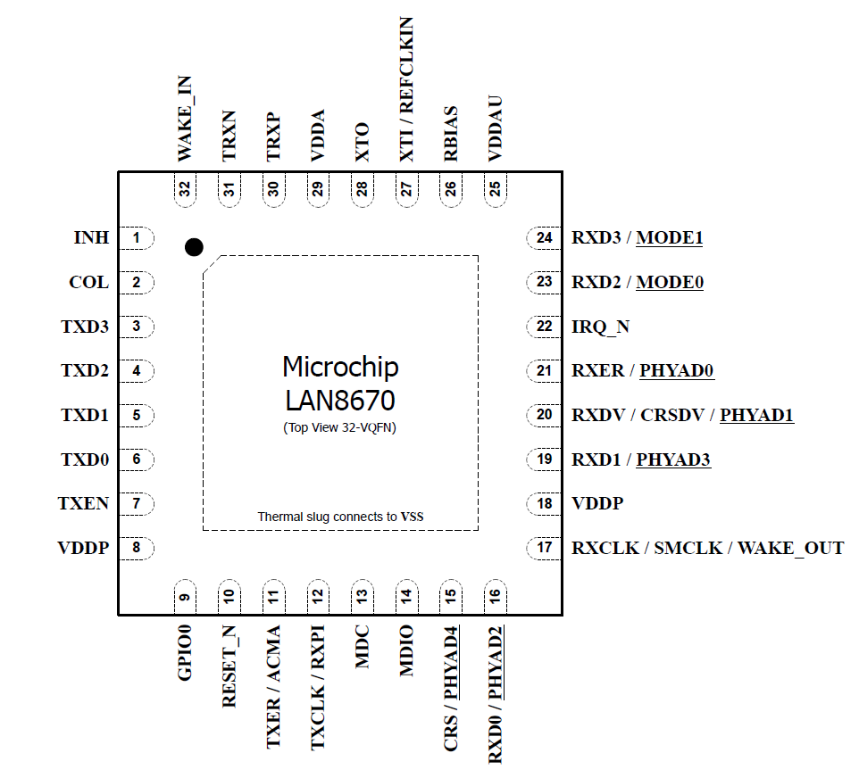
Available Pins on LAN8670 in RMII Mode
Configuration Example for ACMA
LAN8670/1/2 Family
RMII Interface
Dedicated ACMA pin available
in RMII / SC-MII mode, if enabled
ACMA pin available
in each chip, in each mode
Sometimes via GPIO0
Notes:
The LAN8670 supports a dedicated ACMA pin in SC-MII mode and in RMII mode.

Slide 28
Application configures and enables ACMA
after reset
Application can monitor media access and detect errors
Configure & Monitor ACMA
LAN8670/1/2 Family
ACMAPOL =1 (ACMA Polarity)
in PINCTRL (Pin Control Register)
ACMAEN =1 (ACMA Enable)
in ACMACTL (ACMA Control Register)
UNCRS (Unexpected Carrier Sense)
in STS1 (Status1 Register)
signaled via interrupt

Slide 29
Agenda LAN8670/1/2 PHY

Slide 30
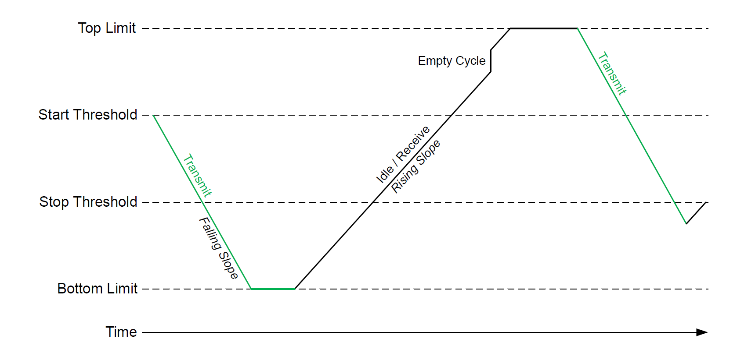
CBS – Credit Based Traffic Shaping
Provides a node a certain bandwidth based on credits
Prevents a “best-effort-node” from flooding the network
Bandwidth distribution independent of Ethernet frame length
HW-based: Application only needs to configure
Works on top of PLCA or CSMA/CD
Do not mix with PLCA Burst Mode or Cycle Skipping
Credit Based Traffic Shaping
LAN8670/1/2
&
LAN8650/1
Enables
traffic shaping in small MCUs
Credits decrease while TX
Node can only send a packet if it has enough credits
Credits increase while RX or idle
Notes:
The LAN8670/1/2 and LAN8650/1 implements a hardware credit based traffic shaper (CBS) to control the station’s transmit bandwidth. A hardware credit counter is used to enable and disable the ability to transmit packets onto the medium. The PHY decrements the credit counter during transmit and increments the counter when the PHY is receiving data or the medium is idle. When the credit counter is below the stop threshold, the PHY does not have enough credits to transmit. The PHY will then hold the MAC off from transmitting by asserting the MII CRS or RMII CRSDV pin. When the PHY is not transmitting, it will accumulate credits. Once the credit counter exceeds the start threshold, CRS/CRSDV will operate normally.

Slide 31
No more increment when
credits > TOPLIMIT
prevents bursts of packets
RISESLP (Rising Slope)
30 Bytes RX or 800 ms idle => +1 Credit
ECCRDS (empty Cycle Credits)
1 empty PLCA cycle
=> +30 Credits
Credit Based Traffic Shaping
LAN8670/1/2
&
LAN8650/1
PHY starts TX only if
credits > STARTTHR
PHY stops TX when
credits < STOPTHR
Packet sent completely,
even when
credits < STOPTHR
FALLSLP (Falling Slope)
2 Bytes TX
=> -1 Credit
No more decrement when
credits < BOTLIMIT
prevents waiting for too long
Notes:
The PHY can only start transmitting when its credits are higher than the start threshold. Once the PHY allows the MAC to begin transmitting a packet, the entire packet will be transmitted even if the credit counter decrements below the stop threshold while it is transmitting.
The Falling Slope (FALLSLP) field of the Credit Based Shaper Slope Control (CBSSLPCTL) register configures the rate at which the credit counter loses credits when transmitting. Similarly, the Rising Slope (RISESLP) field configures the rate at which the credit counter will accumulate credits when the medium is idle or the PHY is receiving data.
When PLCA is enabled, credits may additionally be accumulated at an accelerated rate when no transmission is detected within each PLCA bus cycle. The rate at which credits are accumulated for each empty PLCA bus cycle is configured by the Empty Cycle Credits (ECCRDS) field.
The credit counter will saturate and stop accumulating credits when the limit set by the Top Limit (TOPLIMIT) field in the Credit Based Shaper Top Limit High/Low (CBSTPLMTH/CBSTPLMTL) registers is reached. Likewise, the credit counter will saturate and stop losing credits at the limit set by the Bottom Limit (BOTLIMIT) field. This prevents the credit counter from incrementing or decrementing into an overflow condition. The saturation of the credit counter also prevents the PHY from delaying transmission of a packet too long or transmitting a burst of packets. For example, the PHY may lose a significant number of credits by transmitting a maximal size packet. If the credit counter were not limited by a lower bound, it may take a significant amount of time for the PHY to accumulate enough credits to transmit another packet. Similarly, if the PHY has not transmitted in a long time, it may accumulate too many credits allowing it to transmit multiple frames if the credit counter were not limited by an upper bound. By controlling the top and bottom limits of the credit counter, the credit based shaper may be configured to transmit at the desired rate.

Slide 32
CBS – Credit Based Traffic Shaping
Switched on by CBSEN (CBS Enable) =1
CREDITCTR (Credit Counter) for monitoring and debugging
Less bandwidth available for certain nodes:
Start/stop threshold can be configured differently in each node
Higher start threshold => node needs to wait longer for TX
Higher stop threshold => node needs to stop earlier when TX
Credit Based Traffic Shaping
LAN8670/1/2
&
LAN8650/1

Slide 33
Agenda LAN8670/1/2 PHY

Slide 34

Usecases & Standards
Input sensor data needs timestamping for processing and analysis
Motor and brake controls must be synchronized to control machines
Chimes and lights are coordinated for better user experience in the car
Time Sensitive Networking
LAN8670/1/2
&
LAN8650/1
IEEE1588 (PTPv2)
Precision Time Protocol
IEEE 802.1Qbv (Traffic scheduling)
IEEE 802.1Qcc (Stream Reservation)
... many other PTP-profiles ...
IEEE 802.1AS (Time Synchronization - gPTP)
SYNC
FOLLOW_UP
PDELAY_REQ
PDELAY_RES

Slide 35
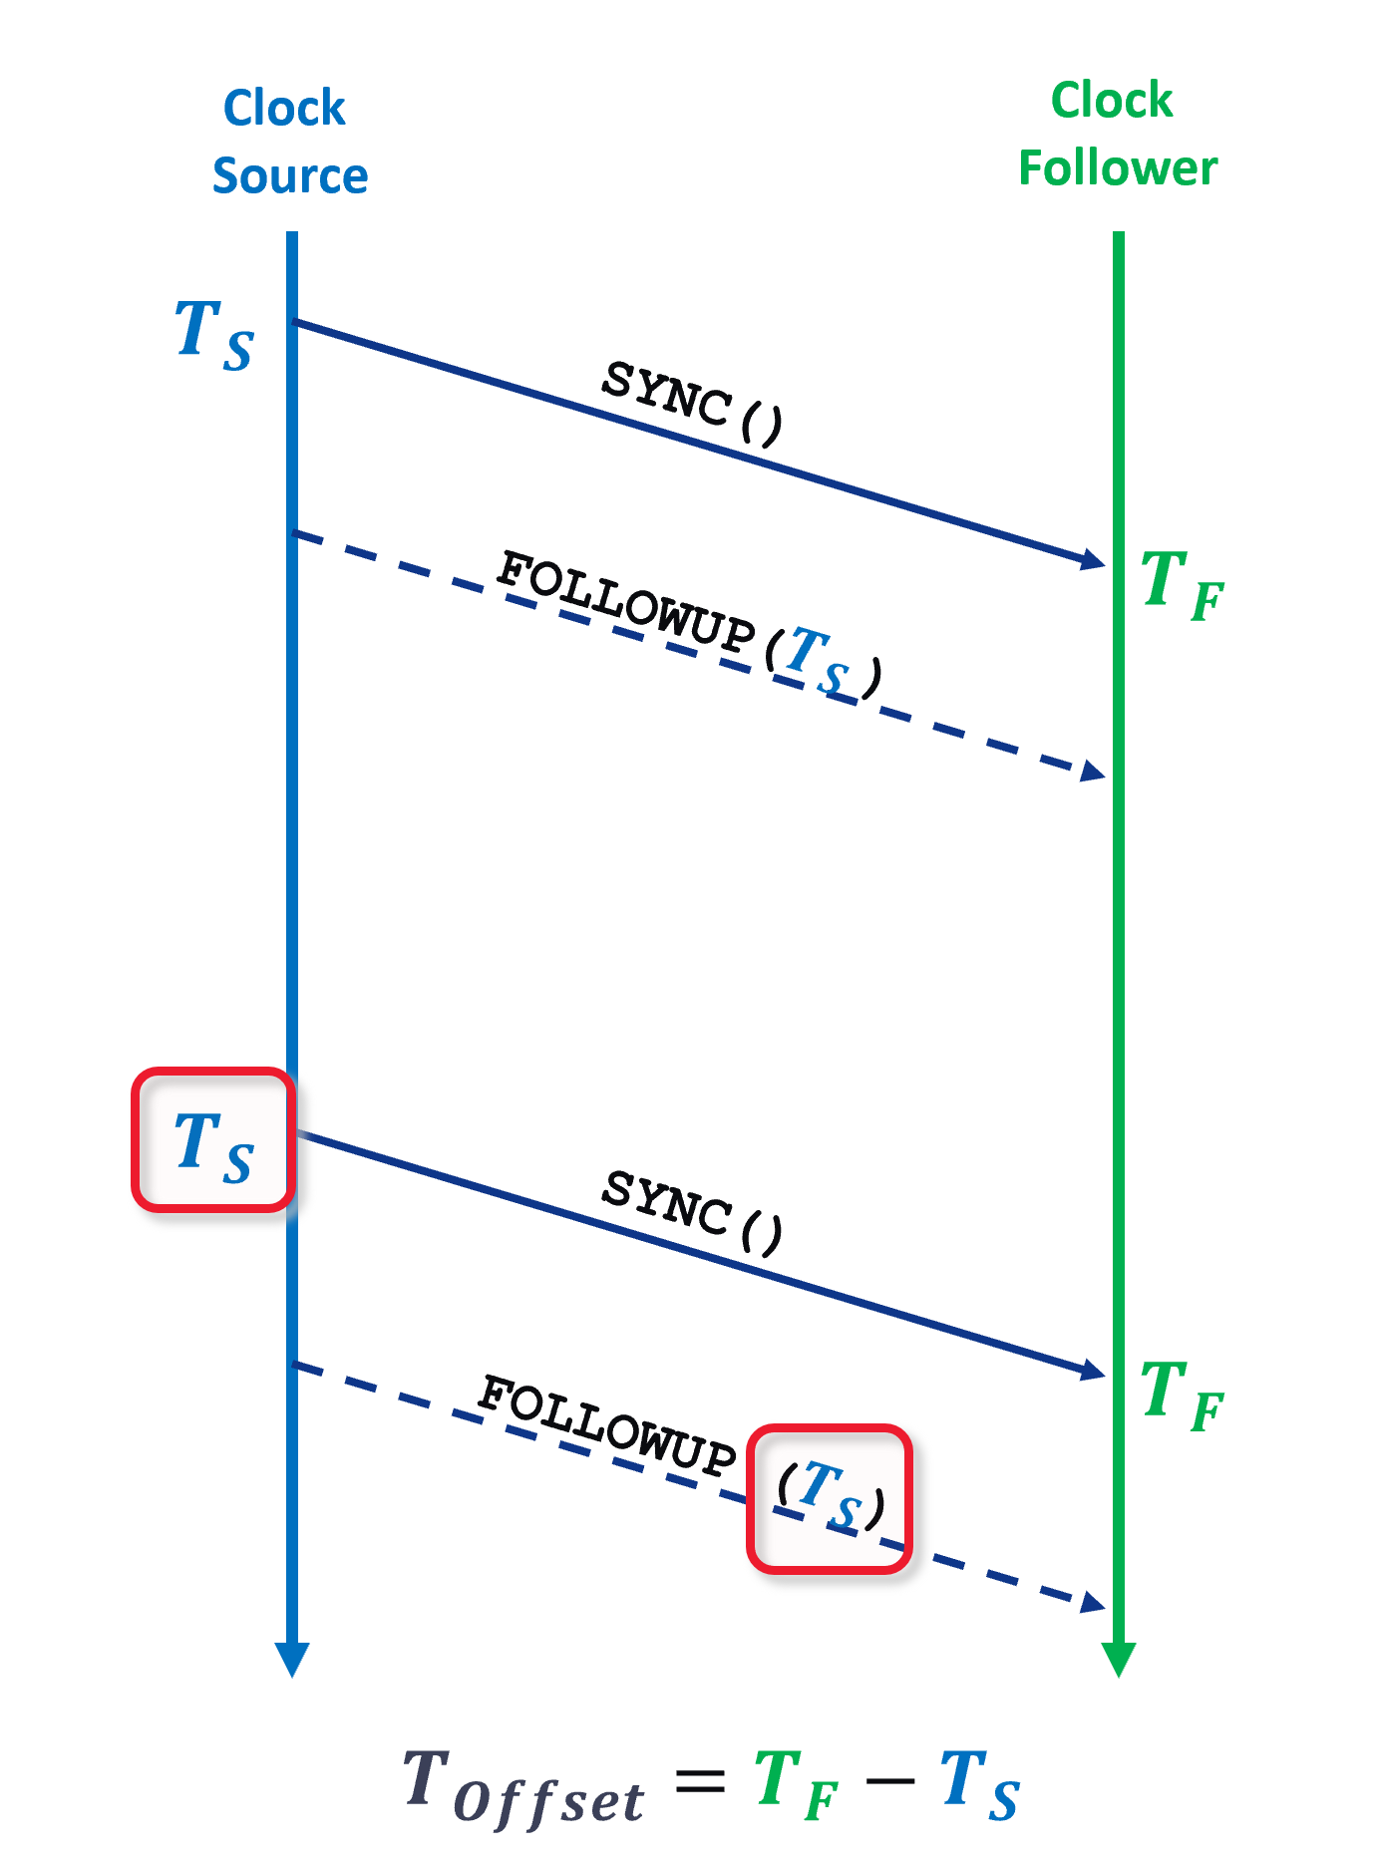
IEEE 802.1AS Support
Pattern Matcher (Comparator)
Identifies gPTP messages
Enables precise ingress/egress timestamping by MAC/MCU
LAN8670/1/2 & LAN8650/1 “Transmit Match Enable” Pattern Matcher can assert GPIO to inform MCU/MAC on ingress/egress
LAN8670/1/2 MAC “MAC Transmit Timestamp Enable” Pattern Matcher can trigger PLCA-aware transmission of gPTP messages, bypassing the PLCA buffer, having very low and constant PHY-delay
Enables time sensitive networking according to IEEE 802.1AS
IEEE 802.1AS Support
LAN8670/1/2
&
LAN8650/1
Notes:
The LAN8670/1/2 and LAN8650/1 support the IEEE 802.1AS standard, and enable high-precision clock recovery with ultra-low jitter.
In the operation mode, activated by the TXME-bit (Transmit Match Enable), the pattern matcher can assert a GPIO pin to inform the MCU/MAC on any ingress or egress packets.
The LAN8670/1/2 supports a second mode, activated by setting the MACTXTSE-bit (MAC Transmit Timestamp Enable). In this mode the pattern matcher triggers a PLCA-aware transmission of gPTP messages, where the message directly passes the PHY without any delay by the PLCA buffer, just having a very low and constant PHY-delay.

Slide 36
IEEE 802.1AS Support – Packet Timestamping
PTP relies on exact timestamps (Ts) broadcasted regularly (e.g. every 125 ms) in SYNC or FOLLOWUP messages by the Clock Source. All Clock Followers use this exact timestamp Ts to calculate the offset to their own time Ts.
Sending a SYNC message over a PLCA-based network adds a variable delay of 0-40 µs caused by the PLCA sending buffer when waiting for the own transmit opportunity and leads to an outdated timestamp Ts.
Receiving a SYNC message (or any frame) is done without PLCA buffer, adding only internal fixed delays of PHY, MAC and stacks.
LAN8670/1/2 has two operational modes to solve this problem:
MCU
Transmit Match Enable
PHY recognizes an ingress/egress SYNC at its MDI
PHY informs MCU via GPIO
MCU can now compensate any delay in its time stamps due to PLCA or internal reasons (e.g. By using FOLLOW-UP messages)
MCU/
MAC
MAC Transmit Time Stamp Enable
PHY signals a logical collision to the MAC when it starts sending a SYNC.
MAC will backoff and retry the SYNC with an updated timestamp Ts.
This retry will pass the PHY without PLCA buffer, i.e. having an exact timestamp.
MAC
MII
GPIO
PHY
PLCA
PHY
PLCA Buffer
Timestamp at MDI
MII
PCS
PMA
SYNC
FOLLOWUP(Ts)
10BASE-T1S

Slide 37
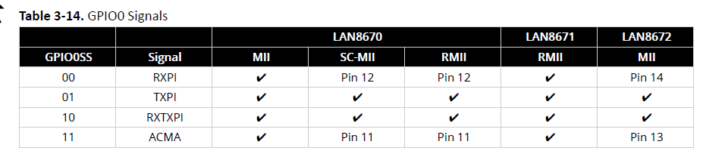
Pin Configuration – RMII Example
LAN8670/1/2 started in
RMII Device Mode
GPIO0SS field = 01
(GPIO Signal Select)
in PINCTRL (Pin Control)
When RX-SYNC() detected
=> Pin 12 asserted
RMII example configuration has dedicated pins for:
RXPI (RX Packet Indication)
TXPI (TX Packet Indication)
ACMA (Application Controlled Media Access)
Dedicated ACMA input pin available on Pin 11
When TX-SYNC() detected
=> Pin 9 (GPIO0 ) asserted
Notes:
Some pins of the LAN8670/1/2 may take on multiple functions depending on the device and mode.
The GPIO0 pin functionality is configured by writing to the GPIO0 Signal Select (GPIO0SS) field of
the Pin Control (PINCTRL) register. The GPIO0 Signal Select should be configured prior to configuring
and enabling the underlying Packet Pattern Matching or Application Controlled Media Access blocks.
Valid configurations for the GPIO0 pin depend on the device in use and its operating mode. When
a dedicated pin is available, it must be used rather than the GPIO0 pin. Table 3-14 shows the
valid configurations for the GPIO0 pin. When a pin number is shown, this is an invalid configuration
for the GPIO0 Signal Select and the designated dedicated pin must be used instead.

Slide 38
Pattern Matcher – PTP SYNC Example
Arbitrary RX/TX Ethernet frame
Pattern Matcher can
check 3 Bytes
in RT/TX Ethernet frame
Pattern for SYNC:
0x 88 F7 10
In case of a match
either RXPI, TXPI or RXTXPI pin is asserted
according to pin configuration
Configured in TXMPATH
(TX Match Pattern High)
Configured in TXMPATL
(TX Match Pattern Low)
Notes:
The LAN86xx supports the implementation of PTP over Ethernet within the station controller by
being able to detect the exact time of transmission and reception of PTP messages. This is done by
examining the bytes of a packet that contain the EtherType and the first 2 bytes of the PTP header, and signaling when the correct pattern is detected.
To configure the desired pattern on transmitted packets, the most significant byte of the desired
value is written into the Transmit Match Pattern High (TXMPATH) register and the lower two octets of
the match value is written into the Transmit Match Pattern Low (TXMPATL) register. As an example,
to match on a SYNC message, the EtherType value of 0x88F7 and PTP header value of 0x10 creates
a 24-bit match value of 0x88F710. The value 0x88 is written into TXMPATH and the value 0xF710 is
written into TXMPATL.
Configuring the receive pattern matcher is done in a similar manner but using Receive Match Pattern High (RXMPATH) register and Receive Match Pattern Low (RXMPATL) register.
Pattern match output pins can be used on both transmitted and received packets.

Slide 39

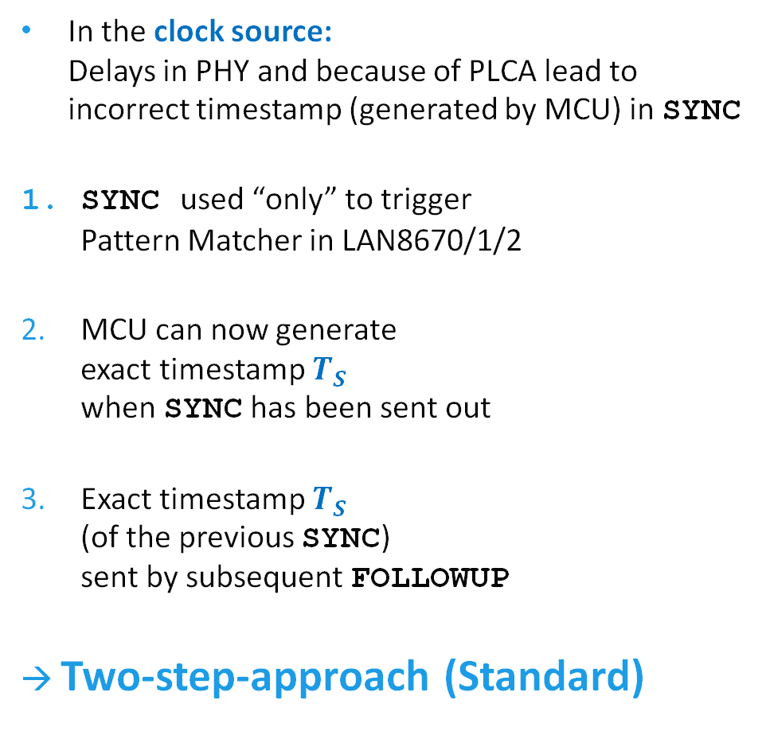






IEEE 802.1AS – Clock Synchronization (Standard)
Clock
Source
Clock
Follower
In the clock source: Delays in PHY and because of PLCA lead to incorrect timestamp (generated by MCU) in SYNC
SYNC used “only” to trigger Pattern Matcher in LAN8670/1/2
MCU can now generate exact timestamp $T_{S }$ when SYNC has been sent out
Exact timestamp $T_{S }$ (of the previous SYNC) sent by subsequent FOLLOWUP
→ Two-step-approach (Standard)
$$T_{S }$$
SYNC()
$$T_{F }$$
FOLLOWUP($T_{S }$)
1a.TXPI
2.
MCU
Pattern Matcher
PLCA
$$T_{S}$$
1.SYNC
SYNC()
3.FOLLOW-UP
$$T_{F}$$
FOLLOWUP ($T_{S}$)
$$T_{Offset}=T_{F}−T_{S}$$

Slide 40
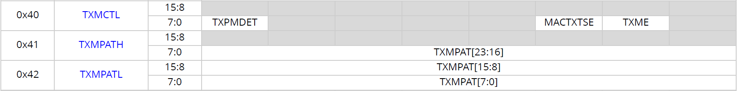
IEEE 802.1AS – LAN8670/1/2 Configuration for Standard Clocksynchronization
“Two-step-approach” (Standard)
Configure Pattern Matcher to detect TX SYNC packets (or other PTP message)
TXME = 1 (Transmit Packet Match Enable)
in TXMCTL (Transmit Match Control Register)
MACTXTSE and TXME cannot be set at the same time.
Functionalities mutually exclude each other.
In case of a match, the TXPI pin will be asserted to inform MCU.
MCU sends a FOLLOWUP, with previous TS

Slide 41
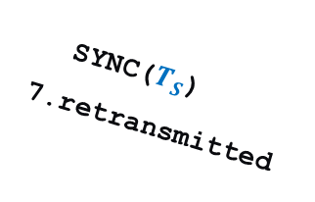





IEEE 802.1AS – Clock Synchronization (MAC Timestamping)
In the clock source:
Some MACs can compensate constant TX-delay through PHY
However, TX PHY delay is variable (0...39,6 µs) because of PLCA buffer => cannot be compensated
LAN8670/1/2 can be configured for MAC Timestamping
Patern Matcher detects TX-SYNC and triggers PLCA module
PLCA emulates collision to MAC
MAC terminates TX-SYNC sends JAM, backs off
PLCA asserts Carrier Sense to keep MAC waiting until its next TO arrives
PLCA sends COMMITS to hold its TO
PLCA releases Carrier Sense
MAC retransmits SYNC (updated, correct TS) which bypasses PLCA buffer (no delay)
Clock Source
Clock Follower
$$T_{S }$$
SYNC()
previous
$$T_{F }$$
MAC
PLCA
Pattern Matcher
1.SYNC()
Buffer
SYNC()
3.aborted
2.COL
trigger
4.CRS
5.COMMIT
6.release
7.SYNC
(updated Ts)
$$T_{S}$$
SYNC($T_{S}$)
7.retransmitted
$$T_{F}$$
→ One-step-approach
$$T_{Offset}=T_{F}−T_{S}$$

Slide 42
IEEE 802.1AS – LAN8670/1/2 Configuration for MAC Timestamping
“One-step-approach”
In case of a match, the PLCA module will be triggered to
signal a logical collision to the MAC,
CRS is asserted until the next TO arrives,
and retransmitted SYNC can bypass the PLCA buffer.
Configure Pattern Matcher
to detect TX SYNC packets
(or other PTP message)
MACTXTSE =1
(MAC TX Time Stamp Enable)

Slide 43
Agenda LAN8670/1/2 PHY

Slide 44
SQI - Signal Quality Index
LAN867x and LAN865x can accumulate statistics on RX-data.
Signal quality of the RX-signal rated in one of 8 levels from 0 (worst) to 7 (best).
MCU can monitor the SQI and take corrective action.
Without PLCA: SQI determined from RX-data from all nodes on the bus.
PLCA enabled: SQI determined from RX-data from a single node (Transmit Opportunity)
SQI
LAN8670/1/2
&
LAN8650/1
Compatible with OPEN Alliance TC14
Advanced diagnostic features for automotive Ethernet PHYs.
Data
Remote Node ID 1
Local Node
Calculates SQI
…
B
0
TO-1
TO-2
TO-3
TO-4
TO-5
B
…
Notes:
The channel Signal Quality Indication (SQI) provides an indication of channel quality between nodes
on the network segment. In the LAN8670/1/2 and LAN8650/1, the SQI implementation is designed to be compatible
with the OPEN Alliance specification for advanced diagnostic features for automotive Ethernet PHYs.
The SQI is determined by accumulating statistics on received data. When PLCA is used, a single node
is selected by using its Transmit Opportunity ID (TOID) in the SQI Configuration;
the SQI is then computed from the data received only during that transmit opportunity. When PLCA
is not enabled, this field should be set to request that the SQI will be computed over all received
data. Statistics are calculated on the selected data and the resulting quality index is stored in the SQI
Value (SQIVAL) in eight levels (between ‘000’ = worst value and ‘111’ = best value).

Slide 45
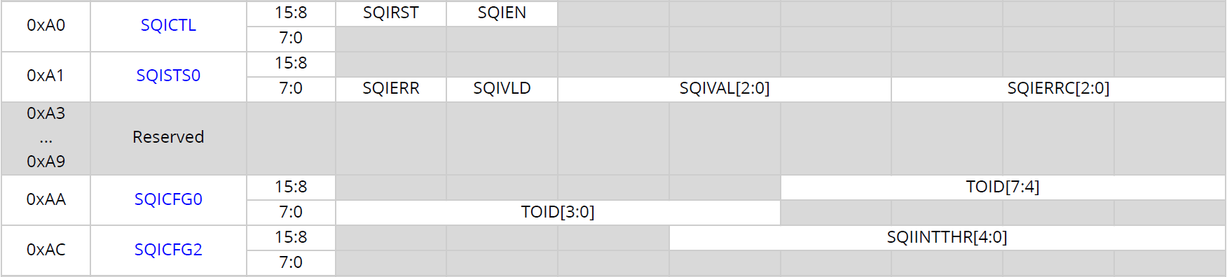
SQI – Polling Mode Single measurement used to compare SQI of different channels
SQI
LAN8670/1/2
&
LAN8650/1
Read the result SQIVAL (SQI Value) When SQIVLD = 1 (SQI Valid) in SQISTS0 (SQI Status 0) Recommended SQI polling rate ~ 1 sec
Start measurement SQIEN = 1 (SQI Enable) in SQICTL (SQI Control)
Configure SQIINTTHR = “11111b” (SQI Interrupt Threshold) in SQICFG2 (SQI Config 2)
Configure TOID = n (n = TO of interest) in SQICFG0 (SQI Config 0)
Notes:
Programming Model - Polling
In polling mode, the station controller polls the device to identify when a new SQI estimation is
available. Polling mode is selected by setting the SQI Interrupt Threshold (SQIINTTHR) field of the
SQI Configuration 2 (SQICFG2) to 11111b, which disables interrupts.

Slide 46
SQI – Threshold Alert Mode SQI measured continuously, MCU alerted via interrupt when SQI <= threshold
SQI
LAN8670/1/2
&
LAN8650/1
Read the result SQIVAL (SQI Value) when Interrupt asserted because SQI = 1 changed in STS1 register
Start measurement SQIEN = 1 (SQI Enable) in SQICTL (SQI Control)
Configure TOID = n (n=TO of interest) in SQICFG0 (SQI Config 0)
Configure SQIINTTHR = 1...7 (SQI Interrupt Threshold) in SQICFG2 (SQI Config 2)
Notes:
Programming Model - Threshold Alert Mode
In threshold alert mode, the device is configured to continually estimate the SQI and alert the station
controller via an interrupt when the measured SQI falls below a specified threshold. When the SQI
Interrupt Threshold is set to a value from 1 to 7, the device will assert the SQI status bit in the Status
1 (STS1) register any time the measured SQI is equal to or below the configured threshold. If the
SQI Interrupt Mask (SQIM) bit is ‘0’ in the Interrupt Mask 1 (IMSK1) register, the assertion of the SQI
status bit will additionally generate an assertion on the IRQ_N pin.

Slide 47

Thank You!

