Slide 1
PTP over 10BASE-T1S
Martin Ruppert | Microchip WNET | 2026-04-21
Theory · PHY Context · LAN8651 Specifics · Measurement Results

Slide 2
What the Demo Shows
Board A ATSAME54 + LAN8651
Board B ATSAME54 + LAN8651
single-pair Ethernet (10BASE-T1S)
↕ Shared notion of time (PTP, IEEE 1588) ↕
Without synchronisation
With PTP synchronisation
Pulses on the two boards slowly drift apart.
Pulses on both boards line up on the wire — within a few microseconds.
Goal: two independent microcontrollers that agree on time well enough to act together.

Slide 3
How We Achieved It
1. Hardware timestamping
2. PTP protocol (IEEE 1588)
3. Software wall-clock
4. Cyclic Fire demo
LAN8651 latches the exact moment a packet crosses the wire.
Boards exchange timestamps and compute offset + path delay.
A shared nanosecond clock runs on every board.
Each board toggles a GPIO at scheduled clock values.
Result: a cross-board edge delta of ~10 µs median — inside the 100 µs product window.

Slide 4
Standalone Button-LED Demo — How It Works
Self-contained: two boards, a T1S cable, two buttons (SW1 / SW2), two LEDs (LED1 / LED2) — no PC, no CLI.
1. Boot — Unsynchronised
2. Role Selection via Buttons
3. Synchronised — Lock-Step
• Both boards boot with PTP OFF.
• LED1 blinks at 1 Hz on each board (500 ms on / 500 ms off).
• LED2 is off.
• Because the two crystals differ by ~100 ppm, the two LED1 blinks visibly drift apart.
• PD10 mirrors LED1 — a scope can watch the drift quantitatively.
• One board: press SW1 → becomes PTP Follower.
• Other board: press SW2 → becomes PTP Master.
• On each board, LED2 starts blinking fast (4 Hz) to signal 'syncing'.
• The Follower's servo runs until it reaches FINE lock.
• The Master waits ~2 s (visual symmetry with the Follower).
• Master: LED2 solid ON (full brightness).
• Follower: LED2 noticeably dimmer (~6 % PWM @ 250 Hz, no flicker).
• → The darker LED2 is the 'this is the follower' marker — visible from across the room.
• LED1 on both boards now blinks in lock-step at 1 Hz — drift is gone.
• PD10 on a scope shows the two 1 Hz edges co-aligned within microseconds.
SW1 = PD00 SW2 = PD01 LED1 = PC21 (1 Hz blink) LED2 = PA16 (status) PD10 = LED1 mirror (scope)
Source: apps/tcpip_iperf_lan865x/firmware/src/standalone_demo.c (branch: ptp-standlone-demo)

Slide 5
Standalone Demo — Why the LEDs Blink in Sync
PTP software wall-clock
cyclic_fire callback every 250 µs
Decimator ÷ 2000
LED1 toggles every 500 ms (= 1 Hz blink)
4 kHz callback → ÷ 2000 → 1 Hz visible blink. Every step is derived from the same PTP wall-clock.
Without PTP lock (drifting)
With PTP lock (synchronised)
• Each board's callback is driven only by its own TC0 crystal.
• Two crystals differ by ~100 ppm → the 4 kHz callback instants drift.
• The ÷ 2000 divider faithfully inherits that drift.
• LED1 on the two boards therefore blinks a little slower / faster.
• Over 10 s the LED1 edges separate by tens of ms — clearly visible.
• Both boards' PTP_CLOCK anchors are pinned to the same wall-clock.
• cyclic_fire schedules each callback at an absolute PTP-ns time.
• The 4 kHz callback fires at the identical PTP instant on both boards.
• The ÷ 2000 divider converts that into a common 1 Hz LED edge.
• LED1 on both boards toggles together — the human eye sees one blink.
Key idea: decimating a fast, PTP-anchored callback is what turns sub-µs network time into a slow, human-visible LED blink.

Slide 6
Standalone Demo — Live Flow & Auto-Recovery
Role indicator — LED2 brightness tells master from follower at a glance
Master board
Follower board
LED2 = solid ON (full brightness)
LED2 = ~6 % PWM @ 250 Hz (dimmed, no flicker)
SW2 is a master on/off toggle — lets you live-demonstrate sync-loss and recovery
• Press SW2 on the master again → master stops sending Sync, returns to FREE.
• Follower notices no Sync for > 1000 ms → enters DEMO_LOST → LED2 turns OFF.
• Press SW2 on the master once more → master re-arms → follower auto-recovers → LED2 dimmed again.
• SW1 stays one-shot: the follower self-recovers, no manual off-switch needed.
Three recovery mechanisms cover the failure modes seen on the bench
1. Stale sync-sequence-id → PTP_FOL_Reset() on DEMO_LOST entry so the first fresh Sync is accepted.
2. PTP_CLOCK backward-jump at restart → cyclic_fire watchdog samples cycle count every 500 ms and re-arms with a fresh 'now+period' anchor if the chain stalls.
3. Grandmaster liveness → PTP_FOL_GetLastSyncTick() latched at the top of processSync() — even rejected Syncs count as 'heard from GM'.
Companion: standalone_demo_test.py walks the operator through the run + gates the result with a Saleae capture.

Slide 7
Standalone Demo — iperf Payload over Synchronised Link
After PTP lock, the opposite-role button launches iperf over the T1S link — real TCP traffic, no PC needed.
Master board 192.168.0.10/24 iperf TCP server :5001
10BASE-T1S shared pair rate-capped 4 Mbps
Follower board 192.168.0.20/24 iperf TCP client → .10:5001
Button usage after role selection (primary button already stayed the way it was)
• Master (SW2 was pressed first): SW1 → start iperf server. SW1 again → stop server.
• Follower (SW1 was pressed first): SW2 → start iperf client (streams 4 Mbps to .10:5001). SW2 again → stop client.
• Pressing the primary button to leave the role also stops any iperf session that role owned.
• 4 Mbps cap: keeps the client inside the observed 4–6 Mbps sustainable T1S goodput and avoids PLCA back-pressure / TCPIPStack_Assert warnings.
• iperf banner and bandwidth reports are routed to the same UART as the PTP logs — one console for everything, no second serial window.
• Proves the sync is not cosmetic: the two boards exchange real, timed TCP payload on the very link PTP disciplined.
Source: src/iperf_control.{c,h} + src/standalone_demo.c (branch: iperf-payload-test, commit e360177)

Slide 8
Reproducing the Project — Prerequisites
Hardware
2 × ATSAME54 Curiosity Ultra + 2 × LAN865x click board — connected pair-to-pair over 10BASE-T1S
USB (EDBG) cables from each board to the PC for flashing and for the serial console (115200 8N1).
Software on the PC
• MPLAB XC32 v4.60 or v5.x (default path C:\Program Files\Microchip\xc32\)
• MPLAB X IDE / MDB (used by flash.py to program the boards)
• CMake ≥ 4.1 + Ninja (both on PATH)
• Python 3.9+ with pip install pyserial (plus python-pptx only if you rebuild this deck)
• Two terminal windows — one per board — e.g. PuTTY or Tera Term (115200 8N1)
Clone
git clone https://github.com/zabooh/net_10base_t1s.git
cd net_10base_t1s\apps\tcpip_iperf_lan865x\firmware\tcpip_iperf_lan865x.X

Slide 9
Reproducing the Project — Setup, Build, Run
Quick path — no build required (just run the demo)
After git clone and python setup_flasher.py, simply run:
python flash.py
flash.py finds the newest pre-built HEX under out/…/image/*.hex (checked into the repo) and programmes it onto both boards — no XC32 / CMake / build step needed.
Full rebuild — 1. One-time tool setup (run once per machine)
python setup_compiler.py # pick the installed XC32 version
python setup_flasher.py # assign Board 1 (GM) and Board 2 (FOL) to their EDBG debuggers
python setup_debug.py # fix SAME54_DFP tool-pack (needed for VS Code debugging)
2. Build and flash both boards
build.bat # incremental build (build.bat rebuild for a clean build)
python flash.py # flash Board 1 and Board 2 in sequence
3. Run the Cyclic Fire demo
Open two terminals (115200 8N1). Wait for PTP state = FINE. On each:
cyclic_start_marker 5000 <anchor_ns> # or: python cyclic_fire_hw_test.py --marker --period-us 5000

Slide 10
Live CLI Test — GM + Follower over Two Terminals
After flashing, open two serial terminals (115200 8N1, no flow control) — one per board — and type the role command. No scripts needed; firmware does the rest.
Terminal 1 — Board 1 (GM) e.g. COM8
Terminal 2 — Board 2 (FOL) e.g. COM10
> ptp_mode master v
> ptp_mode follower v
• Immediately prints 'PTP master STARTED (via CLI)'.
• Board begins sending Sync + Follow_Up ≈ every 125 ms.
• Verbose flag 'v' → one '[GM] #N t1=hh:mm:ss.nnnnnnnnn' line per Sync.
• Stays master until 'ptp_mode off' or reset.
• Servo steps: UNINIT → MATCHFREQ → HARDSYNC → COARSE → FINE.
• FINE typically reached in 2-3 s after the master is up.
• Then prints one '[FOL] FINE t1=… off=±N ns' line per Sync.
• 'ptp_status' at any time → current servo state + last offset.
Expected Follower console output
> ptp_mode follower v
PTP follower STARTED (via CLI)
PTP UNINIT->MATCHFREQ scheduling TI=40 TISUBN=0x3A00000D
[00:00:02.332 PTP ] MATCHFREQ->HARDSYNC offset=-13497830
Hard sync completed
PTP COARSE offset=-2034
PTP FINE offset=-23
[FOL] FINE t1=00:00:05.123456789 t2=00:00:05.123514600 off= +57 ns
[FOL] FINE t1=00:00:05.248334810 t2=00:00:05.248392100 off= +55 ns
Initial lock offsets are typically ±200 ns, steady-state under ±1 µs. Sustained 'FINE' lines = two boards share one nanosecond clock, ready for cyclic_fire, iperf, SW-NTP, or any PTP_CLOCK_GetTime_ns() application.

Slide 11
Agenda
Part 0 — Overview & standalone button-LED demo
Part 1 — Reproduce the demo on your own machine
Part 2 — PTP theory (IEEE 1588)
Clock model, message exchange, timestamp accuracy, error sources
Part 3 — 10BASE-T1S context
Single-pair multidrop PHY, PLCA, implications for PTP
Part 4 — LAN8651 specifics
SPI MAC-PHY, timestamp engine, SFD-to-IRQ latency
Part 5 — Cyclic Fire application
Concept, use cases, API and patterns
Part 6 — PTP_CLOCK for firmware event logging
API, usage pattern, cross-board correlation
Part 7 — Measurement results, open issues & outlook

Slide 12
PTP — Purpose & Clock Model
Goal: distribute a common notion of time across networked nodes
Target accuracy: sub-microsecond on a LAN — not reachable with NTP
Roles within a PTP domain:
Grandmaster (GM) — reference clock, source of truth
Ordinary / Boundary clock — follower, steers local clock to GM
Transparent clock — forwards and corrects for residence time
Best Master Clock Algorithm (BMCA) elects the GM automatically
Local clock corrected in two dimensions:
Phase — absolute offset to GM (ns)
Rate — frequency ratio between local and GM oscillator (ppb)

Slide 13
PTP — Message Exchange
Grandmaster
Follower
t1
Sync (t1 on TX, t2 on RX)
t2
Follow_Up (carries t1)
t3
t4
Delay_Req (t3 on TX, t4 on RX)
Delay_Resp (carries t4)
mean_path_delay = ((t2 − t1) + (t4 − t3)) / 2 offset_from_master = (t2 − t1) − mean_path_delay

Slide 14
PTP — Hardware Timestamping
Where the timestamp is taken dictates the achievable accuracy
Software timestamping (at socket layer):
Jitter from kernel scheduling, stack queues, cache effects
Typical accuracy: tens of microseconds to low milliseconds
Hardware timestamping (at PHY/MAC Start-of-Frame):
Timestamp latched on the SFD bit — ideal reference point
Removes OS/driver jitter from the measurement
Typical accuracy: tens of nanoseconds, limited by counter resolution
IEEE 1588 assumes path symmetry — PTP cannot measure asymmetry directly
Any TX/RX pipeline asymmetry becomes a constant offset → must be calibrated

Slide 15
PTP — Error Sources
Oscillator rate offset and wander (short- and long-term)
Quantisation of hardware timestamps (timestamp counter tick period)
Asymmetric TX vs RX datapath latency — not observable by PTP math
Link-layer residence time variance (queuing, media access)
Especially relevant on shared media such as 10BASE-T1S PLCA
Temperature drift of crystals → rate changes slowly over minutes/hours
Servo dynamics:
Fast servo → tracks wander, amplifies measurement noise
Slow servo → quiet but sluggish against temperature transients

Slide 16
10BASE-T1S — PHY Overview
10 Mbit/s full-duplex-equivalent over a single unshielded twisted pair
Two physical topologies supported:
Point-to-point — two nodes sharing one pair
Multidrop — many nodes on one shared segment (up to 8+ specified)
Targets automotive in-vehicle networking and industrial sensor aggregation
Cable reach up to ~25 m on a shared segment, low EMI, low cost wiring
Media access arbitration via PLCA (Physical Layer Collision Avoidance):
Time-slotted, deterministic round-robin transmit opportunities
No CSMA/CD backoff → bounded worst-case access latency

Slide 17
10BASE-T1S — PTP Implications
PTP works over 10BASE-T1S the same way as over ordinary Ethernet
Favourable properties:
PLCA bounds media-access jitter — residence time is predictable
Physical medium is symmetric by construction (same pair, same direction)
Challenges:
10 Mbit/s → one byte takes 800 ns, lower timestamp resolution than 1 GbE
PLCA slot wait adds variable queuing before TX
→ hardware SFD timestamping removes this from the PTP measurement
MAC-PHY vendor implementations vary — must characterise the specific chip

Slide 18
LAN8651 — Device Overview
Microchip 10BASE-T1S MAC-PHY with SPI host interface
Integrated MAC + PHY in a single package
MCU needs no on-chip Ethernet MAC
OPEN Alliance TC6 SPI protocol — data chunks over SPI
Supports PLCA for multidrop topologies
Hardware timestamp engine latches TX-SFD and RX-SFD events
Raw material for PTP — accuracy depends on SFD latch point
Interrupt-driven host signalling via nIRQ
Pin-count and BOM optimised for automotive and industrial edge nodes

Slide 19
LAN8651 — Timestamping Signal Path
T1S wire SFD bit
LAN8651 PHY SFD detect
LAN8651 MAC timestamp latch
nIRQ to MCU
ISR: SW-TS + signal TC6
SPI readout
• MAC latches the hardware timestamp on the SFD bit — that is the 'ground truth' moment.
• LAN8651 then asserts nIRQ to the MCU.
• In the nIRQ ISR the driver captures the internal SW timestamp (SYS_TIME tick) — pairs SFD with MCU time, semi-deterministic.
• The ISR then signals the TC6 driver layer, which later performs the SPI transfer that carries the frame and the HW timestamp to the host.
• RX bias: ~10 ms from SFD-on-wire to the RX-nIRQ assertion on the LAN8651 — compensated outside PTP (PTP_FOL_ANCHOR_OFFSET_NS).
• TX bias: ~800 µs from SFD-on-wire to TX-timestamp nIRQ — compensated via PTP_GM_ANCHOR_OFFSET_NS.

Slide 20
LAN8651 — Calibrating the Biases
Project design: ISR-captured anchor pair (wall-clock_ns, TC0_tick)
Anchor offsets shift the wall-clock timestamp forward to the ISR moment:
PTP_GM_ANCHOR_OFFSET_NS = 800 000 ns (TX pipeline)
PTP_FOL_ANCHOR_OFFSET_NS = 10 000 000 ns (RX pipeline)
Calibration is empirical:
Measure cross-board edge delta D with cyclic_fire_hw_test.py
new_offset = old_offset + D (positive D means FOL lags GM)
Effect of the 10 ms compensation (commit deb2773):
Cross-board median delta: +10 005 µs → +10 µs

Slide 21
Project Integration — Firmware Map
ptp_gm_task.c Grandmaster state machine
ptp_fol_task.c Follower PI servo
ptp_clock.c Nanosecond software clock
drv_lan865x_api.c — SPI MAC-PHY driver + TX/RX timestamp capture
Harmony 3 TCP/IP stack (net_10base_t1s v1.4.3)
ATSAME54P20A — TC0 @ 60 MHz timestamp counter, SPI master
Grandmaster and Follower run identical firmware — role is configuration, not code.

Slide 22
Cyclic Fire — What Is It?
A firmware module that fires a periodic GPIO pulse train on PD10
Pin sits on the EXT1 Xplained-Pro header — directly scope-clippable
Each pulse edge is scheduled against the PTP software clock, not a local timer
Implemented with tfuture — single-shot timer re-armed from its own callback
The scheduling time is given in absolute PTP wall-clock nanoseconds
cyclic_fire_start(period_us, phase_anchor_ns)
phase_anchor_ns = the PTP moment at which the very first edge should fire
Identical firmware, identical API call on both boards
→ a shared anchor_ns produces wire-level coincident edges across boards
A CPU-cheap, direct-from-wire way to observe whether two PTP clocks really agree

Slide 23
Cyclic Fire — What You Can Achieve
Sync quality measurement: cross-board rising-edge delta quantifies PTP accuracy
Median → static bias (calibration target)
MAD / extrema → short-term wander, filter behaviour
Calibration feedback loop: run test → read D → update anchor offset → rerun
PTP regression test: a single gated CI metric (|median| + MAD ≤ 100 µs)
Sub-µs demonstration target: visible proof that two independent MCUs tick together
Distributed actuation reference: template for real coordinated outputs
Sensor sampling on N nodes at the same nanosecond
Time-slotted TX windows (TDMA over T1S)
Synchronised ADC trigger / actuator pulse
Failure detection: PLCA starvation, MAC wedge, clock drift all show up as edge drift

Slide 24
Cyclic Fire — API & Output Patterns
bool cyclic_fire_start(uint32_t period_us, uint64_t phase_anchor_ns);
bool cyclic_fire_start_ex(uint32_t period_us, uint64_t phase_anchor_ns, cyclic_fire_pattern_t pattern);
void cyclic_fire_stop(void);
bool cyclic_fire_is_running(void);
uint64_t cyclic_fire_get_cycle_count(void);
uint64_t cyclic_fire_get_missed_count(void);
PATTERN_SQUARE — 50/50 rectangle (default)
PATTERN_MARKER — 1-high + 4-low isolated pulse
• period_us is the FULL rectangle period — callback fires every period_us/2
• Default 1000 µs → 1 kHz square wave
• Periods below ~400 µs not recommended (half-period ≈ tfuture spin threshold)
• MARKER pattern isolates the rising edge — makes 'which board fires first?' unambiguous
• CLI wrappers: cyclic_start, cyclic_start_marker, cyclic_start_free, cyclic_stop, cyclic_status

Slide 25
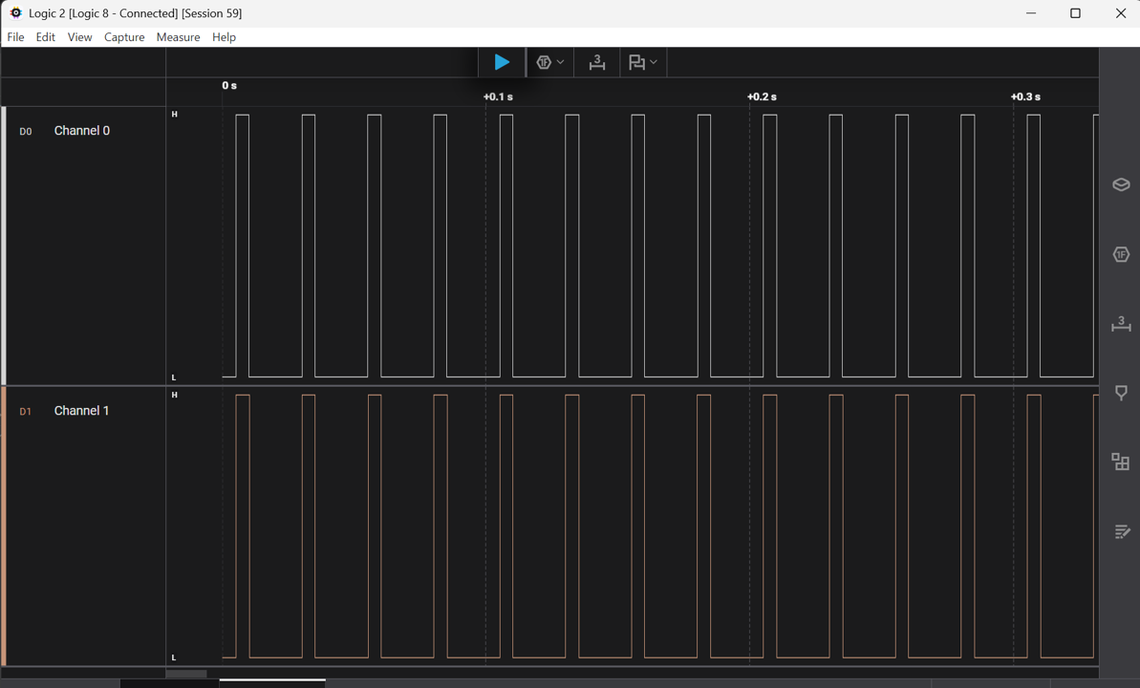
Cyclic Fire — Wire-Level View
Saleae Logic 2 capture — Ch0 (top) = Grandmaster PD10, Ch1 (bottom) = Follower PD10.
MARKER pattern: 1 high half-period + 9 low half-periods → one isolated rising edge every 5 full periods.
Both channels fire coincident edges over 0.3 s — visible evidence that the two boards share a single PTP time base.

Slide 26
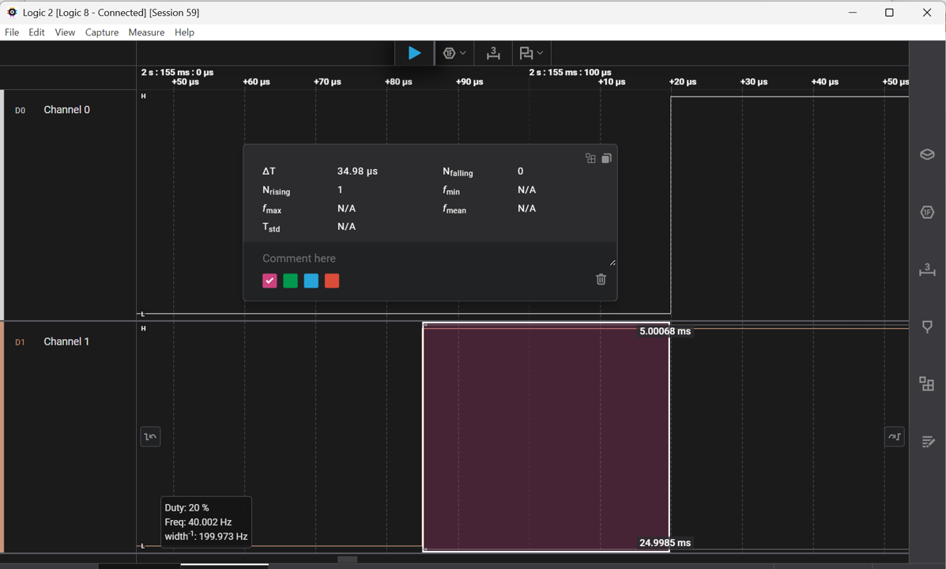
Cyclic Fire — Zoom-In: Cross-Board Edge Delta
Zoomed Logic 2 view of a single MARKER pulse pair (period_us = 5000 → 20 % duty, 40 Hz).
Cursor tool ΔT = 34.98 µs — time between the Grandmaster rising edge (Ch0) and the Follower rising edge (Ch1).
Well inside the 100 µs product window — this single wire-level frame corroborates the automated 10 µs median statistic.

Slide 27
PTP_CLOCK — Application API for PTP Time
uint64_t PTP_CLOCK_GetTime_ns(void); // current wall-clock, interpolated
bool PTP_CLOCK_IsValid(void); // true once first anchor was set
int32_t PTP_CLOCK_GetDriftPPB(void); // measured MCU vs PTP rate offset
void PTP_CLOCK_ForceSet(uint64_t ns); // standalone set (no PTP sync)
• Any context — no SPI, no mutex, no blocking. Safe from ISR and main loop.
• Interpolates between anchors via TC0 (60 MHz) + drift IIR filter.
• One anchor is refreshed on every PTP Sync (≈ 8 Hz).
• Returns 0 until the first anchor has been set — always check PTP_CLOCK_IsValid() first.
• GM and Follower expose the same API — application code is role-agnostic.
• Resolution ≈ 16.7 ns (TC0 tick); short-term jitter dominated by filter wander.

Slide 28
PTP_CLOCK — Logging Firmware Events
#include "ptp_clock.h"
static void on_frame_received(void) {
uint64_t t_ns = PTP_CLOCK_GetTime_ns(); // synchronised wall-clock
SYS_CONSOLE_PRINT("RX %llu.%09llu seq=%u\r\n",
t_ns / 1000000000ull,
t_ns % 1000000000ull,
rx_seq);
}
void actuator_fire(uint64_t at_ns) {
while (PTP_CLOCK_GetTime_ns() < at_ns) { /* tight spin */ }
GPIO_PinSet(ACT_PIN);
}
• Pattern: call PTP_CLOCK_GetTime_ns() at the moment of interest, store alongside the event.
• Log to console, ring buffer, or CLI — the timestamp is portable across boards.
• For event correlation across nodes: compare two logs directly; no relative-time conversion.
• For scheduled actions: give the target time to the action, spin or sleep until reached.
• Always guard with PTP_CLOCK_IsValid() during startup to avoid 0-timestamps.

Slide 29
PTP_CLOCK — Cross-Board Correlation
Every event stamped with PTP_CLOCK_GetTime_ns() lives on a common timeline
Typical workflows the API enables:
Distributed trace — collect logs from N nodes, sort by PTP timestamp
Race analysis — precise order of events on nodes A, B, C
Latency measurement — PTP_CLOCK_ns at TX on A vs RX on B
Scheduled output — compute target ns, hand to application, pin fires synchronously
Drift surveillance — log PTP_CLOCK_GetDriftPPB() over long runs
Accuracy envelope (current firmware):
Static bias between boards: ~10 µs after calibration
Short-term wander: ~40 µs RMS within a 0.7 s window
Long-term rate agreement: 1.2 ppm over 60 s
Cyclic Fire is the canonical consumer of this API — any feature using PTP time follows the same pattern

Slide 30
Results — Methodology
Saleae Logic 8 — Ch0 = GM board PD10, Ch1 = Follower board PD10
cyclic_fire_hw_test.py orchestrates the full run:
Reset both boards → wait for FINE PTP state
Issue cyclic_start with a shared future anchor_ns
Capture ~0.7 s via the Logic 2 scripting socket
Extract rising edges, pair cross-board edges, compute delta distribution
Reported statistics: median, MAD, extrema, per-edge CSV dump
Pass gate: |median| ≤ 50 µs AND MAD ≤ 50 µs → sum ≤ 100 µs window
Spot-check: Logic 2 cursor measurements cross-validated the script output

Slide 31
Results — Measurement Summary
Median +10 µs
MAD 38 µs
Verdict PASS
• Before RX-IRQ compensation: median +10 005 µs → FAIL
• After the fix: median +10 µs → inside the 100 µs product window
• Long-term (60 s) cross-board rate residual: 1.2 ppm
• MAD dominated by short-term drift-filter wander, not stack asymmetry
• Drift IIR raised from N=32 to N=128 → halved filter stddev

Slide 32
Open Issues & Outlook
Short-term wander within 0.7 s capture windows: 50…200 µs/s drift bursts
Drift filter random-walks (lag-1 autocorrelation > 0.9)
Paths forward:
Longer averaging window (N = 256) — trades response speed for variance
Median-of-N filter instead of IIR for outlier resilience
Hardware-scheduled GPIO anchored to the LAN8651 1PPS / MAC timer
→ bypasses software PTP_CLOCK, opens the sub-microsecond regime
Known failure mode: LAN8651 MAC occasionally wedges after long runs
Soft reset insufficient; USB power-cycle required
References in-tree: README_PTP §§4.3, 11, 12 and README_NTP §8

