Slide 1
T1S 100BASE-T Bridge
Layer 2 Bridge Firmware for ATSAME54P20A
Microchip Technology
2026-08

Slide 2
Part 1: Architecture & Hardware

Slide 3
Hardware Platform Overview
Microcontroller — SAM E54P20A
Network Interfaces
• Cortex-M4 core, 120 MHz
• 256 KB SRAM (heap + stack)
• Integrated Ethernet MAC (GMAC)
• SPI interface (CS=PC15, INT=PC14)
• UART via EDBG probe for CLI
• Emulated EEPROM for persistent config
• eth0: LAN8651 PHY (10BASE-T1S)
– Single-pair Ethernet (point-to-point)
– PLCA collision avoidance built-in
• eth1: LAN8740A PHY (100BASE-T)
– Multi-pair Ethernet (standard)
– L2 Bridge: transparent frame forwarding

Slide 4
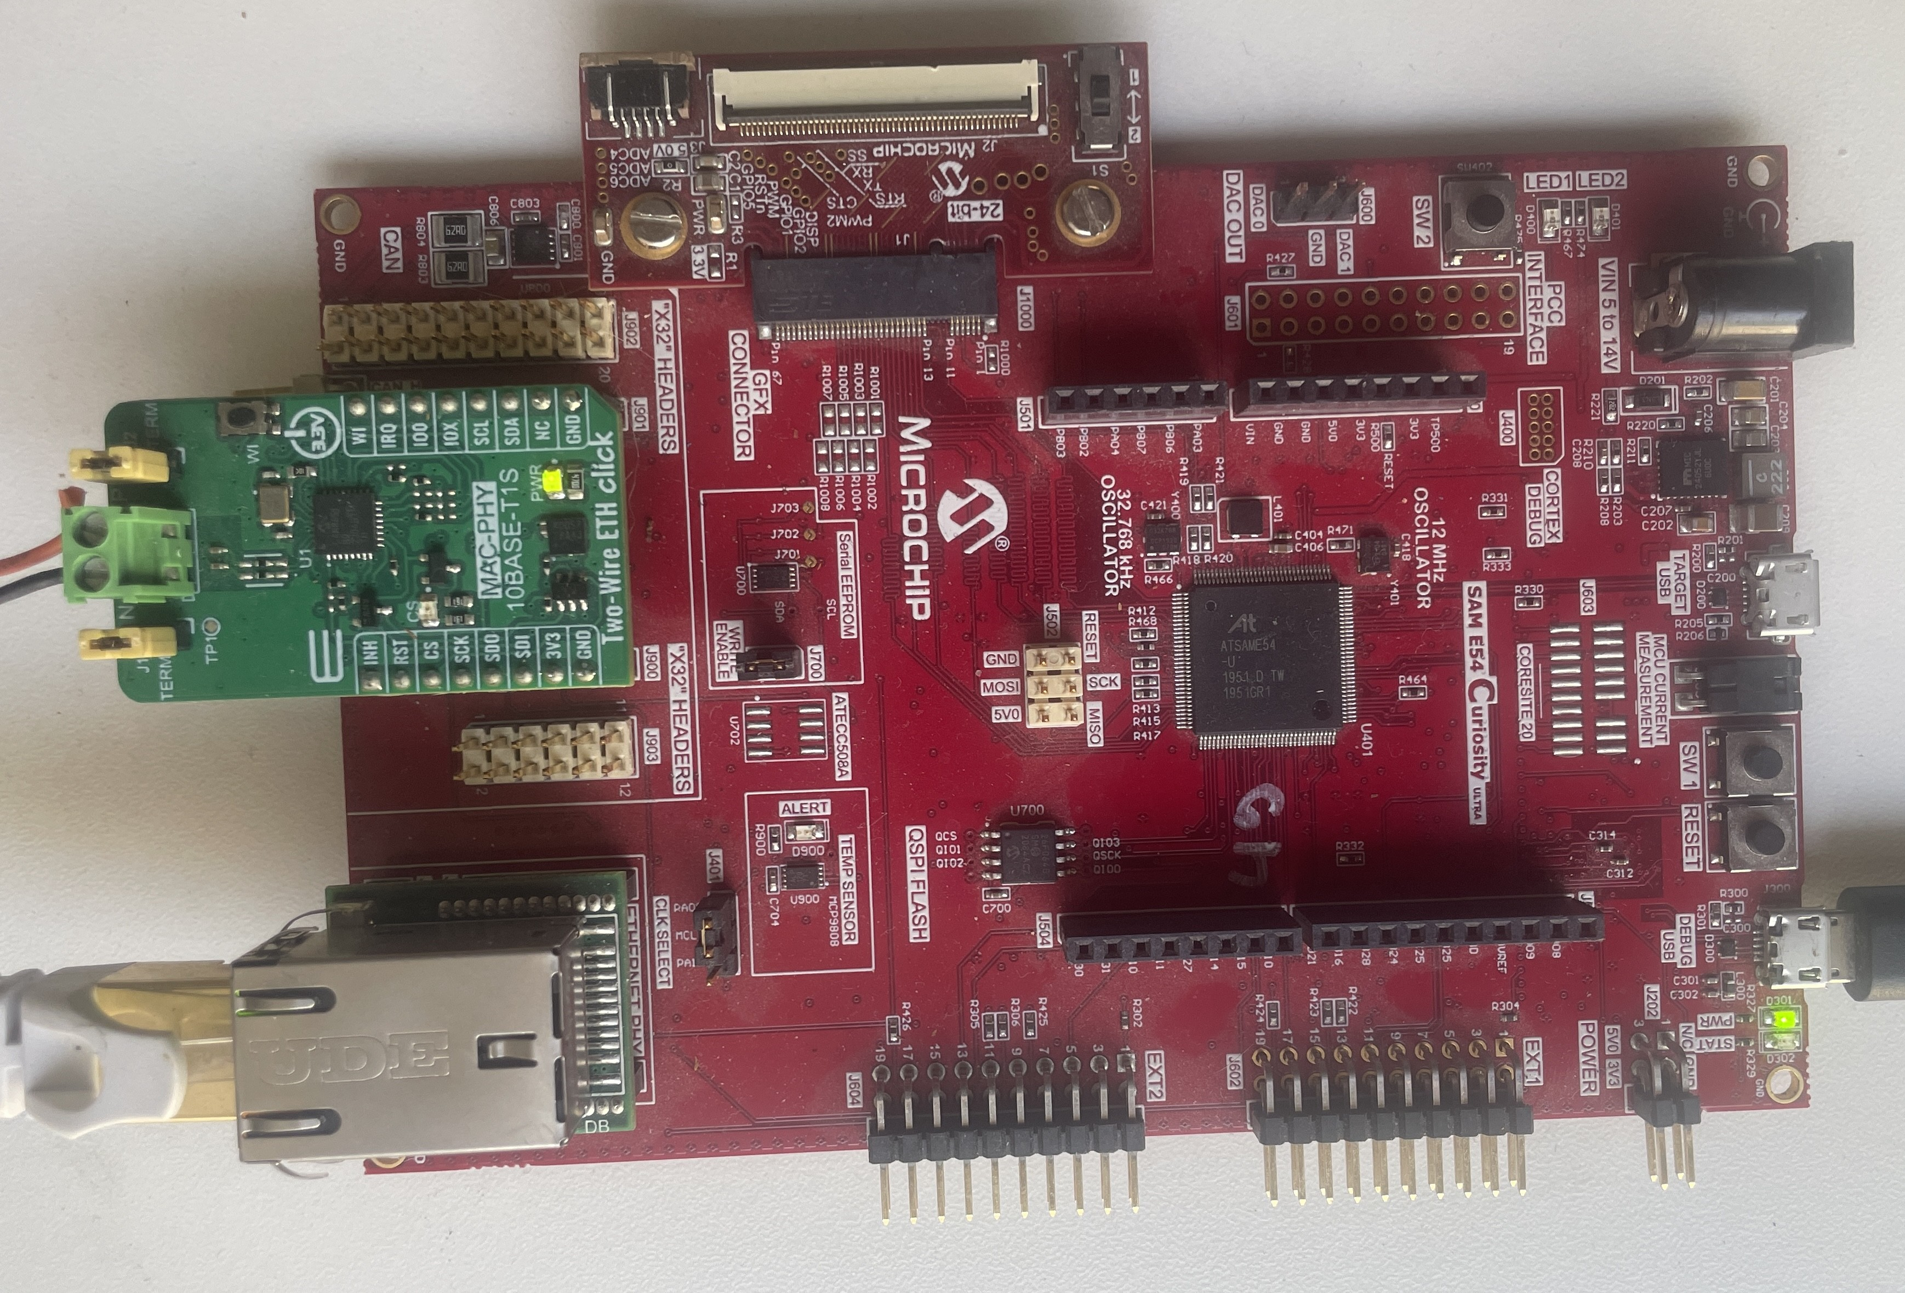
Hardware Assembly
• SAM E54 Curiosity Ultra (red board) + LAN8651 Two-Wire ETH Click (green, eth0) + LAN8740A PHY Daughter Board (bottom left, eth1)

Slide 5
Physical Layout & Connectors
SAM E54 Curiosity Ultra Development Board (red in photo)
EDBG on-board debugger (UART debug console)
GMAC connector for eth1 (100BASE-T to LAN8740A PHY)
Mikrobus socket for SPI peripheral expansion
LAN8651 Two-Wire ETH Click (green in photo, MIKROE-5543)
Mounts in Mikrobus socket of SAM E54 board
SPI master (DIN=MOSI, DOUT=MISO, CLK=SCK, CS=PC15)
Interrupt pin nIRQ on PC14
LAN8740A PHY Daughter Board (bottom-left in photo, AC320004-3)
Connects to GMAC interface of SAM E54
Four twisted-pair Ethernet port (standard RJ45)
Single 10BASE-T1S Cable (Point-to-Point)
Connects all nodes on the T1S network segment
Two wires (TX+, TX-) carry all PLCA-coordinated traffic

Slide 6
Signal Path & Data Flow
T1S Network (point-to-point)
LAN8651 PHY (Receive)
SPI/TC6 Interface
SAM E54 MAC (GMAC)
L2 Bridge Logic
100BASE-T Network
• Frames arrive on eth0 via 10BASE-T1S
• LAN8651 buffers & signals via SPI interrupt (PC14)
• SAM E54 reads frame, learns MAC, forwards to eth1
• GMAC transmits on 100BASE-T; return path mirrors back to T1S

Slide 7
Key Component Roles
LAN8651 — 10BASE-T1S PHY with PLCA
Hardware timestamping on RX/TX for PTP (future)
PLCA slots (contention-free scheduling)
IEEE test modes (voltage, droop, spectrum, high-Z)
LAN8740A — Standard 100BASE-T PHY
Multi-pair (four twisted pairs per connection)
No PLCA — legacy Multi-Master-Slave scheduling
MPLAB Harmony v3 — TCP/IP Stack with L2 Bridge Patches
Dual-PHY MAC learning & forwarding logic
Port mirroring (SPAN) support
Raw frame injection (EtherType bypass)

Slide 8
Part 2: PLCA — Physical Layer Collision Avoidance

Slide 9
PLCA Concept — Deterministic Access
Traditional Ethernet (CSMA/CD)
PLCA (IEEE 802.3-2022 Clause 171)
• Carriers sense & listen before transmit
• Collision on multi-drop bus → backoff retry
• Latency unpredictable, varies with load
• Throughput degrades as node count grows
• Coordinator grants time slots to nodes
• Each node waits its turn — zero collisions
• Latency bounded, deterministic
• Ideal for industrial & automotive real-time

Slide 10
PLCA Parameters & Configuration
Node ID — 0..255
0 = Coordinator (grants slots, sends beacons)
1–255 = Regular nodes (wait for slot)
Node Count (CNT) — 1..255
Number of active nodes on the segment
Slot Time — microseconds per PLCA slot
Default varies with media (10BASE-T1S: ~40 µs/slot)
Enabled via setenv plca_id <N>; saveenv (persistent)

Slide 11
Part 3: Functional Features & CLI

Slide 12
L2 Bridging vs. Port Mirroring — Two Different Functions
Why do we need 'mirror on' if the bridge already forwards traffic?
L2 Bridge (Normal Operation)
Port Mirror (SPAN — Debugging Only)
• Forwards traffic between eth0 ↔ eth1
– Data frames flow through transparently
– eth0 frames go to eth1 (and vice versa)
– Each frame delivered ONCE to destination
• T1S nodes talk to 100BASE-T network — bridge is invisible
– Use case: normal bridge operation (production)
• COPIES eth0 frames to eth1 for monitoring
– eth0 traffic is duplicated (not moved)
– Original bridge forwarding still happens
– Extra copy sent to Wireshark on the PC
• Analyzer sees T1S bus without physical probe
– Use case: debugging, compliance testing, bus analysis

Slide 13
Why Mirror Is Essential for Debugging
The 100BASE-T side (eth1) cannot natively see T1S traffic
Two different physical media with different PHYs
Wireshark on the PC plugged into eth1 sees only 100BASE-T frames
To see T1S frames on your PC, the bridge must copy them to eth1
mirror 1 enables SPAN — copy eth0 → eth1
mirror 0 disables SPAN — back to normal bridging
Mirror does NOT interfere with the bridge forwarding
Data flows normally AND gets copied for analysis
Perfect for seeing T1S bus traffic without stopping the bridge

Slide 14
Core Bridge Functions
Three independent, complementary capabilities
L2 Forwarding
Port Mirroring (SPAN)
Raw Frame Testing
• Transparent MAC learning
• eth0 ↔ eth1 bidirectional
• PLCA-aware scheduling
• FDB aging (default 5 min)
• Copy eth0 → eth1 (SPAN)
• Duplicate, not redirect
• Wireshark capture capable
• Toggleable: mirror 1/0
• EtherType 0x88B5 bypass
• TCP/IP stack agnostic
• Reproducible timing tests
• noip_send / noip_stat cmds

Slide 15
Essential CLI Commands — Configuration
# Environment (Persistent in EEPROM)
showenv # Show IP, MAC, PLCA settings
setenv ipaddr 192.168.0.200 # Set eth0 IP (default)
setenv hwaddr 00:1A:2B:3C:4D:5E # Set MAC address
setenv plca_id 0 # Set Node ID (0=Coordinator)
setenv plca_cnt 8 # Set Node Count
saveenv # Persist to EEPROM
readenv # Read from EEPROM (verify)
resetenv # Restore factory defaults

Slide 16
Essential CLI Commands — Diagnostics
# Bridging & Diagnostics
stats # Real-time counters (RX/TX packets)
meminfo # Heap usage, free memory, watermark
dump 0x20000000 64 # Hex memory dump (64 bytes)
mirror 1 # Enable Port Mirroring
mirror 0 # Disable Port Mirroring
# PHY & Register Access
lan_read 0x000308FB # Read LAN8651 register
lan_write 0x000308FB 0x2000 # Write register value
lan_rmw 0x000308FB 0x7000 0x2000 # Read-Modify-Write

Slide 17
IEEE Test Modes & PLCA
# Test Modes (IEEE 802.3-2022 §147.5.2)
testmode # Show current mode (0=Normal)
testmode 1 # Test Mode 1 (voltage/jitter)
testmode 1 30 # Mode 1 + auto-revert after 30 s
testmode 2 # Test Mode 2 (droop)
testmode 3 # Test Mode 3 (spectrum)
testmode 4 # Test Mode 4 (high-Z/open circuit)
testmode 0 # Return to normal operation
# PLCA Runtime Control (volatile, lost on reboot)
plca_node # Show current Node ID
plca_node 0 # Become Coordinator
plca_node 7 # Join as regular node #7

Slide 18
Raw Frame Testing & Network Perf
# Raw Frame Testing (No IP stack)
noip_send 10 2 # Send 10 frames, 2 ms apart (EtherType 0x88B5)
noip_stat # Show frame counters (RX/TX/loss)
# Performance Testing (requires iperf client)
iperf # Start iperf server (default 5001)
iperfk # Stop iperf gracefully
# Help & Discovery
help # List all commands
lanhelp # LAN865x register commands
• noip_send bypasses TCP/IP stack — pure Ethernet measurements
• Useful for latency-sensitive protocols (SOME/IP-SD, CANopen over Ethernet)

Slide 19
Register Addressing — Memory Map Selector (MMS)
MMS Ranges & Banks
Address Encoding & Examples
• 0x00: OA Standard (config, status)
• 0x01: MAC (Wall Clock, TX-TS)
• 0x02: PHY PCS (link control)
• 0x03: PHY PMA/PMD (test modes, loopback)
• 0x04: PHY Vendor (PLCA, SQI, CFD)
• 0x0A: Misc (1PPS, PADCTRL, DEVID)
• Full = (MMS << 16) | Offset
– PLCA_CTRL1 = 0x0004CA02
– MMS 0x04 (Vendor), Offset 0xCA02
– T1STSTCTL (test modes) = 0x000308FB
– MMS 0x03 (PMA/PMD), Offset 0x08FB
• ALWAYS verify with lan_read after writes!

Slide 20
Part 4: Test Modes in Detail

Slide 21
IEEE 802.3 Test Modes — What & Why
Test Mode 1 (T1STSTCTL = 0x2000)
Measures: Output voltage, timing jitter, frequency accuracy
Instrument: Oscilloscope with rise/fall edge detection
Test Mode 2 (0x4000)
Measures: Output droop (voltage sag under load)
Instrument: Oscilloscope (zoom on falling edge)
Test Mode 3 (0x6000)
Measures: PSD spectrum (EMI/RFI compliance)
Instrument: Spectrum analyzer (1 MHz–1 GHz)
Test Mode 4 (0x8000)
Transmitter goes high-impedance (open circuit)
Measures: Bus impedance, cable termination

Slide 22
Verification & Safety
Always read back after every mode change
lan_read 0x000308FB verifies the write
testmode command auto-verifies ([VERIFY] PASS/FAIL)
Safety: T1S link is DOWN during test modes
Bridge cannot forward traffic during measurement
Auto-revert prevents accidental lockout (testmode 1 30)
Test modes are transient — revert to 0x0000 when done

Slide 23
Part 5: Build, Deployment & Troubleshooting

Slide 24
Build & Flash Workflow
Clone repo → build.bat (generates makefiles + compiles)
No manual MPLAB-X steps required
nbproject/Makefile-*.mk auto-generated from .xml
build.bat rebuild for clean rebuild
flash.bat deploys via pyOCD + EDBG probe
Artifact: firmware/T1S_100BaseT_Bridge.X/dist/…/…hex
Console: EDBG COM port, 115200 8N1 (auto on plug)
python cli.py --port COM8 --read 1 '<cmd>' to send commands

Slide 25
Network Setup — IP Addressing Strategy
Bridge Interface IPs (Fixed)
Host PC Configuration
• eth0 (LAN8651): 192.168.0.200
• eth1 (GMAC): 192.168.0.210
• Both in same /24 subnet (no routing)
• Codified in configuration.h (static, DHCP off)
• Persistent over reboot — no re-negotiation
• eth1 adapter → static 192.168.0.100
– Netmask 255.255.255.0
• Verify with ipconfig or netsh
• Ping tests:
– ping 192.168.0.200 → eth0 reachable
– ping 192.168.0.210 → eth1 reachable & forwarding works

Slide 26
Common Troubleshooting Checklist
Bridge not forwarding frames
Check: mirror 0 (disable mirroring, test core logic)
Check: stats (count RX/TX, look for drops)
Check: test_mirror.py (automated bidirectional test)
PLCA nodes not synchronizing
Verify: plca_node 0 on one board (Coordinator)
Verify: plca_node 1–7 on other boards
Check: test_lan8651.py (auto-verifies PLCA frames flow)
Addresses show (Duplicate) in Windows
Conflict with 192.168.0.200 or .210 — use .100 on host

Slide 27
Part 6: Automation & Testing

Slide 28
Automated Test Suite
test_lan8651.py
Verifies all four IEEE test modes (Readback, traffic-stops, traffic-resumes)
Requires: PLCA Coordinator (Node ID 0), python3, pyserial
Exit code 0 = all modes pass; ≠ 0 = failure (easy CI integration)
test_mirror.py
Checks Port Mirror bidirectionality (eth0→eth1, eth1→eth0)
Catches silent failure if DRV_LAN865X_PacketTx hook is missing
cli.py
Python tool — send CLI commands from scripts, parse responses
Enables: iperf automation, register sweeps, log collection

Slide 29
Part 7: Reference & Resources

Slide 30
Documentation Hierarchy
README.md — Full architecture, setup, iperf examples, FAQs
Best starting point for new users
LAN8651_TEST_MODES.md — Test mode deep dive
Measurement setup, example plots, troubleshooting
CLAUDE.md — Firmware implementation notes & fallstricke
Register quirks, callback pitfalls, PLCA addressing
CLI_COMMANDS.md — Command reference (auto-generated)

Slide 31
Key Tools & Scripts
build.bat — Compile & link (auto makefiles)
flash.bat — Deploy via pyOCD
cli.py — Send commands over UART, capture responses
test_lan8651.py — IEEE test mode verification
test_mirror.py — Port Mirror bidirectional check
build_summary.py — Flash/RAM usage & interrupt summary

Slide 32
External Resources
IEEE 802.3-2022 Clause 171 — PLCA specification
IEEE 802.3-2022 Clause 147.5.2 — 10BASE-T1S test modes
LAN8651 Datasheet — PHY register definitions, timing
SAM E54 DS — Memory map, GMAC, SPI, EEPROM
MPLAB Harmony v3 TCP/IP Stack Documentation

Slide 33
Part 8: Use Cases & Next Steps

Slide 34
Typical Deployment Scenarios
Industrial Automation — Extend 100BASE-T to single-pair (long cable runs)
Cost reduction: 4 twisted pairs → 1 pair (cable & connector savings)
Deterministic PLCA scheduling for motion control
Automotive In-Vehicle Networking — T1S backbone with 100BASE-T gateways
Mixed-media bridge for legacy & next-gen nodes
Building Automation — T1S branch (energy efficient) to Ethernet backbone
Low power sensors on T1S; aggregation on 100BASE-T

Slide 35
Future Enhancements (Out of Scope)
PTP 1588 — IEEE time synchronization (10 µs median tested)
Cyclic Fire — scheduled actions at synchronized timestamps
VLAN support — multiple virtual bridges
QoS — priority queuing per PLCA node
Remote management — SNMP, syslog

Slide 36
Questions & Next Steps
T1S 100BASE-T Bridge Training — Complete
Microchip Field Application Engineering
2026-08

