Slide 1
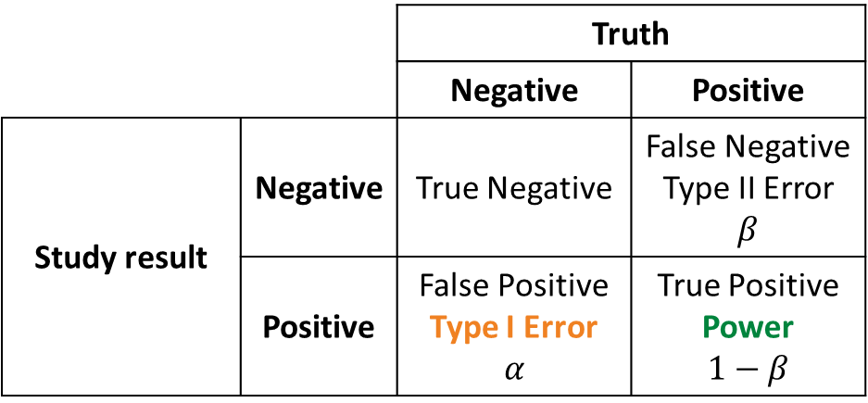
 |  | Truth
 |  | Negative | Positive
Study result | Negative | True Negative | False Negative Type II Error $$β$$
 | Positive | False Positive Type I Error $$α$$ | True Positive Power $$1−β$$

