Slide 1
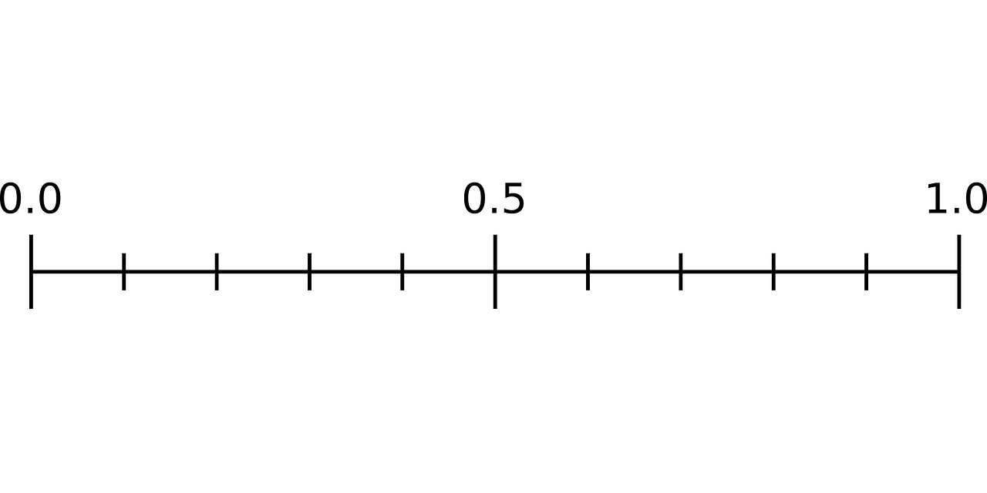
Less frequent stopping for futility
More frequent stopping for futility
Predictive probability threshold

