Slide 1
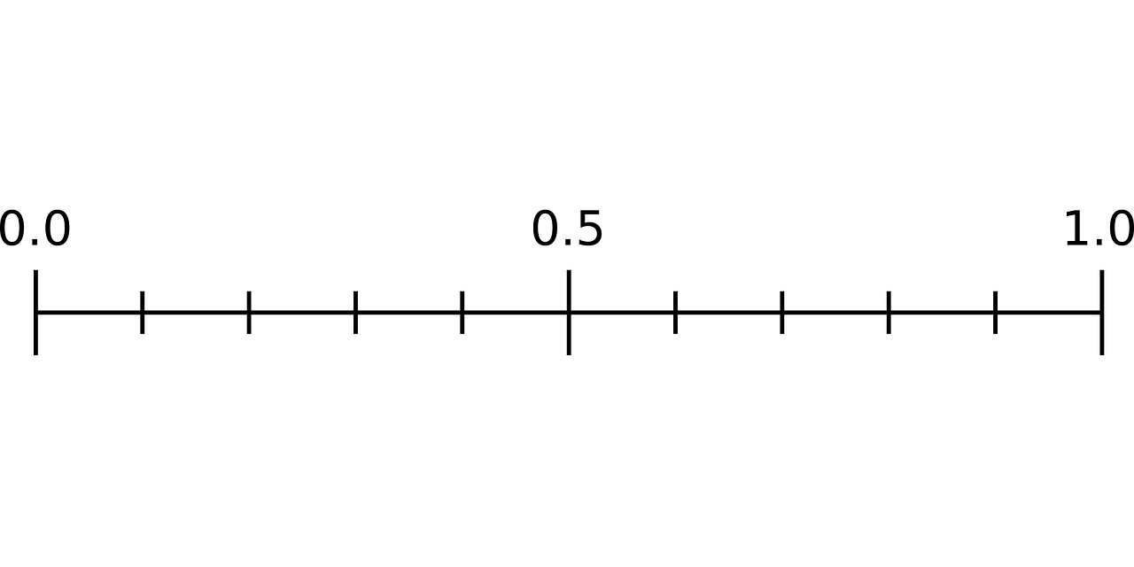
Less frequent stopping for futility
More frequent stopping for futility
Posterior predictive probability

